Slide 1
MICRO SERVICES – SPRING BOOT
Module-2 – Version -2

Slide 2
SPRING ACTUATOR

Slide 3
Spring Boot Actuator
Exposes REST endpoints that can be consumed to manage and monitor application.
Monitor application health, application bean details, version details, thread dumps, logger details etc
Can restrict these endpoints to be consumed by authorized users only and Spring provides easy way to secure your REST endpoints.

Slide 4
actuator End Point
actuator
  It provides a hypermedia-based discovery page for the other endpoints.
  It is required to have Spring HATEOS on the classpath to enable it.
  By default it is sensitive and hence requires username/password for access or may be disabled if web security is not enabled.
Beans
  It displays complete beans configured in the app.
Configprops
  It displays a collated list of all @ConfigurationProperties.

Slide 5
actuator End Point
Health
    It shows application health information
  management.endpoint.health.show-details:=always
Info
  It displays arbitrary application info.
Loggers
  It shows and modifies the configuration of loggers in the application.
metrics:
  It shows metrics information for the current application.
Mappings
  It displays a collated list of all @RequestMapping paths.

Slide 6
Actuator Endpoints
health and info can be accessed
  Other endpoints are disabled by default
management.endpoints.web.exposure.include=*.
  Will enable all of them
  Can also list endpoints which should be enabled
To expose all enabled endpoints except one (for example /loggers), we use:
  management.endpoints.web.exposure.include=*
  management.endpoints.web.exposure.exclude=loggers
  management.security.enabled=false

Slide 7
Info and Health Endpoint
  info:
  app:
  name:@project.name@
  version:@project.version@
  encoding:@project.build.sourceEncoding@
  java:
  version:@java.version@
  management:
  endpoint:
  health:
  show-details: always

Slide 8
Logger Endpoint
http://localhost:8787/actuator/metrics
http://localhost:8787/actuator/loggers
To Change the Log level make a post request
  http://localhost:8787/actuator/loggers/org.springframework.boot.SpringApplication
  { "configuredLevel": "trace“ }
To reset the logging level back to the original value
  { "configuredLevel": null }

Slide 9
Auditing Event End Point
Provides information about the application’s audit events.
Accessed with a GET request to /actuator/auditevents
Can also access the details of a particular principal
  http://localhost:6060/actuator/auditevents?principal=nepal
Enabled with the following entries in application.yml
  Jmx.exposure.include=*
Need To register the AuditEventRepository Bean
  @Bean
  public AuditEventRepository repo() {
  return new InMemoryAuditEventRepository();
  }

Slide 10
Custom End Points
Created by Adding one of the following annotations
  @EndPoint
  @WebEndPoint
  @JmxEndPoint
Can Add Methods for Read ,Write and Delete Operations with following annotations
  @ReadOperation
  @WriteOperation
  @DeleteOperation

Slide 11
Custom End Points
  @Component
  @WebEndpoint(id="notes")
  public class ReleaseNoteEndPoint {
  String version10 = new StringBuffer().append("Version 10.0 ").append("\n").append("Add Tour Agent Added").toString();
  @ReadOperation
  public String releaseInfo() {
  return version10;
  }

Slide 12
Custom End Points
  @WriteOperation
  public String addToReleaseInfo(String message) {
  this.version10 = this.version10+"\n"+ message;
  return this.version10;
  }
  }
  By Calling the Post Method with
  http://localhost:6060/actuator/notes
  Need to add Json data to the body request as raw-json

Slide 13
@RestControllerEndpoint
REST endpoint that is only exposed over Spring MVC or Spring WebFlux.
Mapped methods must be annotated with @GetMapping, @PostMapping, @DeleteMapping, etc
  Instead of @ReadOperation, @WriteOperation, @DeleteOperation.
This annotation can be used when deeper Spring integration is required, but at theexpense of portability.
Prefer the @Endpoint or @WebEndpoint annotations whenever possible.

Slide 14
Spring Boot Actuator
Spring Boot Actuator has started using Micrometer as metrics facade.
Simplifies and standardizes application metrics
Can export metrics to Elasticsearch
  <dependency>
  <groupId>io.micrometer</groupId>
  <artifactId>micrometer-registry-elastic</artifactId>
  </dependency>
  management.metrics.export.elastic.host=
  http://<elastic-host>:<elastic-port>

Slide 15
FEIGN CLIENT

Slide 16
Feign
Feign is a declarative web service client.
  A Netflix open-source software library
Declarative client easier than the “RestTemplate”
  Clients are created by defining one or more Java interfaces
  Interfaces, will have method signatures for the rest call
  Interface to be annotated @FeignClient and the actual service to call

Slide 17
@FeignClient
At run time, Feign will automatically provide implementations of the interfaces that are defined with @FeignClient
  Annotation takes the base URL of the service to be called.
For application which are Eureka client
  Will resolve the service in the Eureka service registry.
  @FeignClient(name="SHOW-CUSTOMER-DETAILS")
  @FeignClient(url =http://localhost:6060/api/v1/tours)

Slide 18
@EnableFeignClients
Need to add the starter with artifact id
  spring-cloud-starter-openfeign.
@EnableFeignClients
  When the application starts up, the Feign libraries provide runtime implementations
  @SpringBootApplication
  @EnableDiscoveryClient
  @EnableFeignClients
  public class FeignclientApplication {
  }

Slide 19
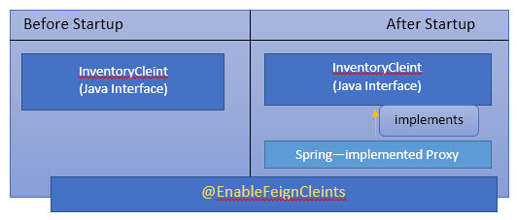
Working of Feign Client

Slide 20
RestTemplate vs FeignClient
Using RestTemplate would require unit testing.
Can Eliminate with Feign because no code to do unit test
In Feign Clients Ribbon is automatically enabled.
  It will automatically load balance between the clients
Eureka
  handles the configuration of the servers that are calling
Ribbon
  handles the load balancing
Feign
  handles the actual code.
  Hystrix
  Handles the Fault Tolerence

Slide 21
Configuring Feign Client
  @FeignClient(name="SHOW-CUSTOMER-DETAILS“ fallback= HystrixClientFallback )
  public interface MyClient {
  @RequestMapping(method = RequestMethod.GET, value = "/customer")
  List<LoanCustomer> findAll();
  }

Slide 22
Controller
  @RestController
  public class FeignController {
  @Autowired
  private MyClient loadBalancer;
  @GetMapping(value = "/client")
  public List<LoanCustomer> getCustomers() {
  return this.loadBalancer.findAll ();
  }
  }

Slide 23
SPRING CLOUD GATEWAY

Slide 24
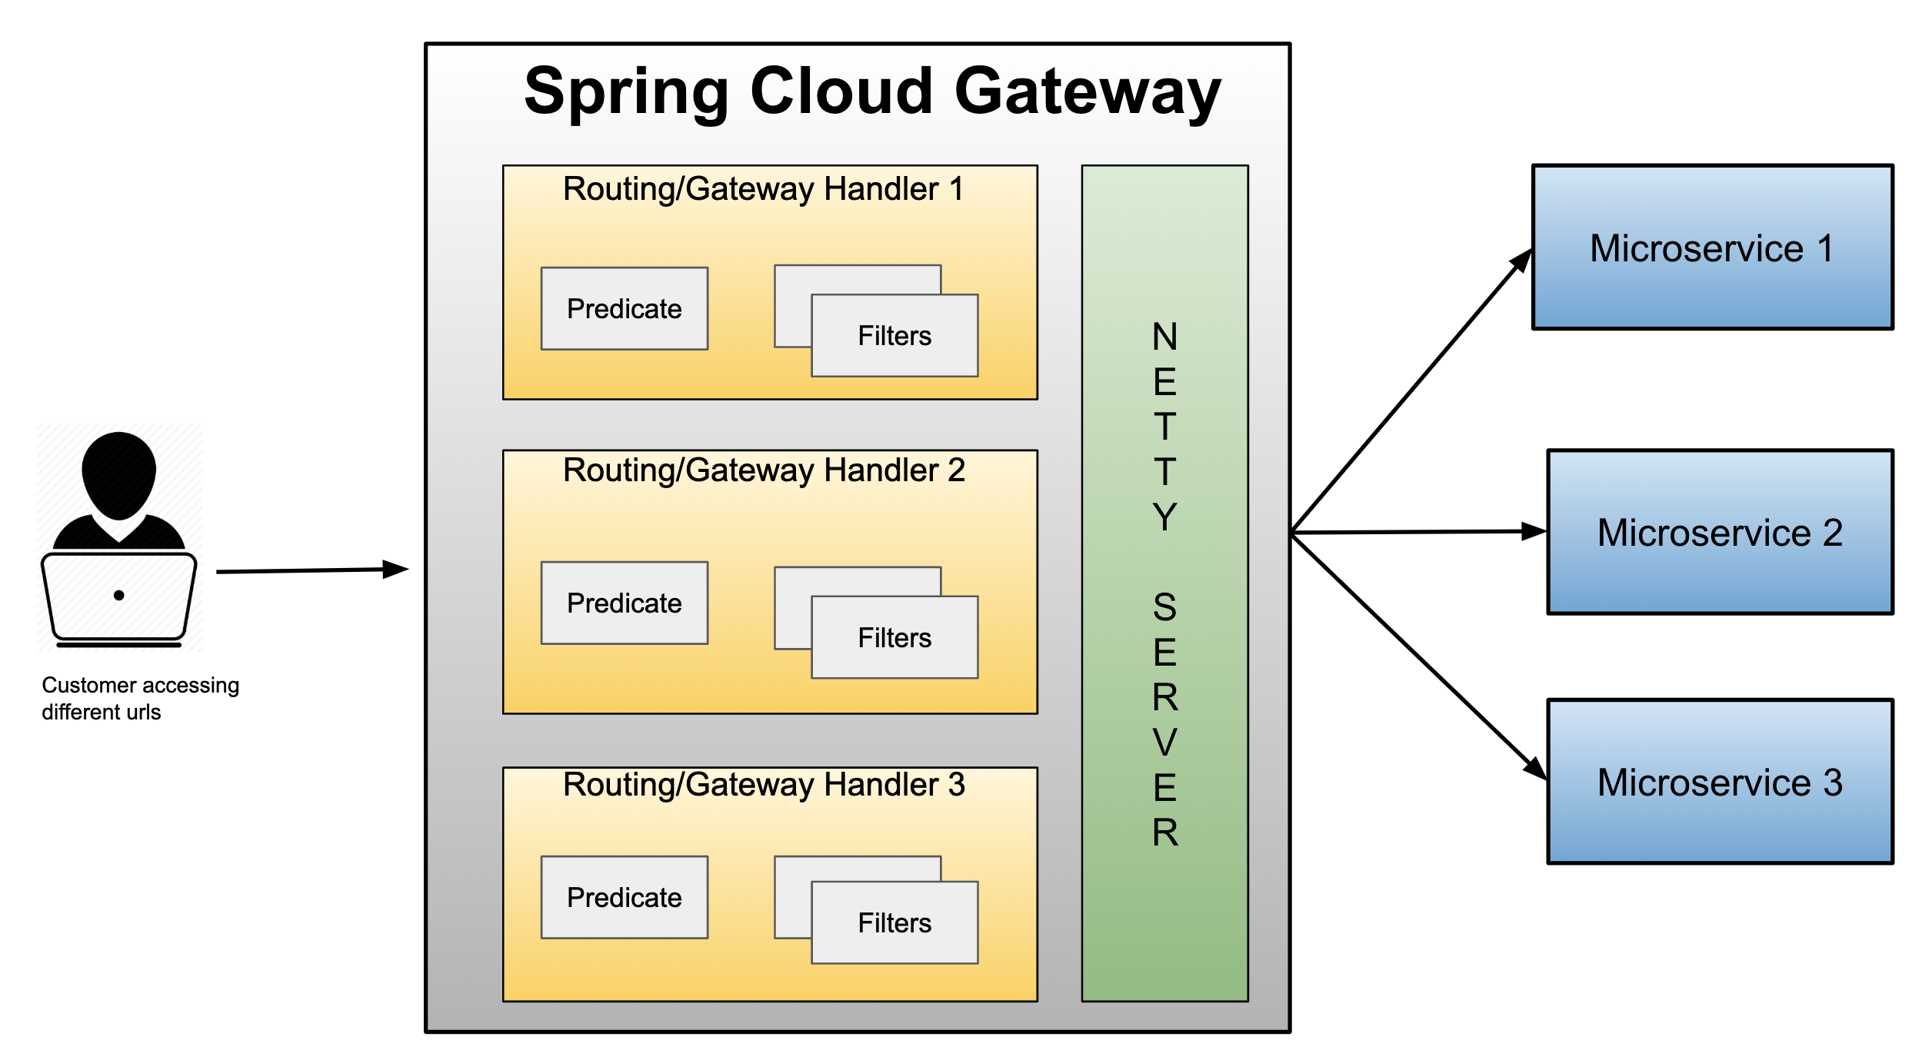
Spring cloud gateway

Slide 25
Gateway
Micro Services require a unified interface to the consumers.
  Services are split into small composable apps
  It shouldn’t be visible to users
  Should have less development effort.
Gateway handles requests to multiple backing services.
  It provides a unified “front door”
  Browser, Mobile Application or other user interface can consume services from multiple hosts
  Can mange the cross-origin resource sharing and authentication

Slide 26
Cloud Gateway
Gateway is an intermediate layer between the users and services.
  Eureka server solved the problem of giving names to services instead of hard coding their IP addresses.
It Maps between a prefix path and a service or more than one service running on different ports
Can Use Eureka server to route the requested service.
Load balances instances
Can filter requests, add authentication, etc.

Slide 27
Reverse Proxy
If any service/application need to access any of the microservices deployed It must come through the Gateway proxy.
It will hide the identities of the server applications behind the proxy and serve the client applications exposing its identity on behalf of backend servers and sever applications.
Therefore it is identified as a Reverse Proxy.
Difference between Proxy (forward Proxy) and Reverse Proxy.
One is for protecting/hiding clients and other one is for protecting/hiding servers.

Slide 28
Spring Cloud Gateway
Provides a simple and effective way to route incoming requests to the appropriate destination using Gateway Handler Mapping.
Uses Netty server to provide non-blocking asynchronous request processing.
Route configuration
Programmatically
  Using Spring RouteLocator.
Properties
  application.yml

Slide 29
Enable Discovery Locator
Can configure routes to the services registered with eureka
Can skip creating API Gateway routes manually.
  spring:
  application:
  name: api-gateway
  cloud:
  gateway:
  discovery:
  locator:
  enabled: true
  lower-case-service-id: true
To access a service with “serviceId” PRODUCT_SERVICE
  http://localhost:8080/product-service/api/v1/items

Slide 30
Gateway Routing
Has Three Main parts
Route:
  The Destination of a particular request.
  It will have destination URI
  It has a condition to be satisfied
  It has one or more filters.
Predicate
  A condition to match like an “if” condition.
  Java 8 Function Predicate
Filter:
  Instances of Spring Framework WebFilter.
  Can modify request or response.
  Spring Provides many WebFilters

Slide 31
Routing With Properties
id
  Unique id of any route.
uri
  uri where microservice is running.
Predicates
  The condition to check before routing to uri
Path
  Predicate factories
Filters
  Spring Cloud Gateway Provides many filters
  Filter Can be configured Both globally and locally

Slide 32
application.yml
  spring:
  cloud:
  gateway:
  routes:
  - id: product-module
  uri: lb://PRODUCT-SERVICE
  predicates:
  - Path=/api/v1/items/**
  - id : customer-module
  uri: lb://CUSTOMER-SERVICE
  predicates:
  - Path=/customers/**
  Invoke the service :
  http://localhost:8080/api/v1/reviews

Slide 33
Actuator Endpoints
Base Path :
  /actuator/gateway
/actuator/gateway/routefilters
  Displays the list of global filters applied to the routes.
/actuator/gateway/routes
  Displays the list of routes defined in the gateway.
/actuator/gateway/routes/{id}
  Displays information about a particular route.

Slide 34
Route Locator Builder
RouteLocatorBuilder
  To add predicates and filters
  Provides a Static Method Builder()
    Builder() method is used to construct routes and return a RouteLocator
RouteLocator
  An Interface with a method getRoutes()
  There are many implementation of this interface
    CachingRouteLocator
    CompositeRouteLocator
    RouteDefinitionRouteLocator

Slide 35
Configuring Route Locator
  @Configuration
  public class MyRouteConfig {
  @Bean
  public RouteLocator gatewayRoutes(RouteLocatorBuilder builder) {
  return builder.routes()
  .route(p -> p
  .path("/api/v1/items/**")
  .filters(f -> f.addRequestHeader("Hello", "World"))
  .uri("lb://PRODUCT-SERVICE"))
  .build();
  }
  }

Slide 36
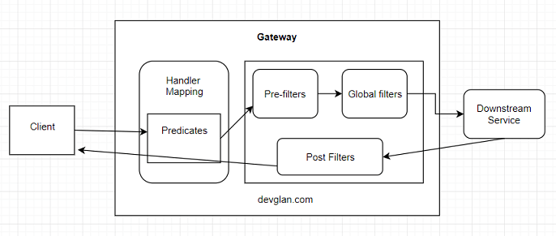
Cloud Gateway Filters

Slide 37
Global Filters
Spring Provides an Interface Global Filter with one Method filter()
public Mono<Void> filter(ServerWebExchange exchange, GatewayFilterChain chain)
ServerWebExchange
  Contract for an HTTP request-response interaction.
  Provides access to the HTTP request and response
  Exposes Properties for server-side processing
GatewauFilterChain
  An inteface that allows a WebFilter to delegate to the next in the chain.

Slide 38
Global Filters- Pre Filter
  @Component
  public class MyGlobalFilter implements GlobalFilter {
  @Override
  public Mono<Void> filter(ServerWebExchange exchange, GatewayFilterChain chain) {
  String requestPath = exchange.getRequest().getPath().toString();
  System.out.println("Request path = " + requestPath);
  HttpHeaders headers = exchange.getRequest().getHeaders();
  Set<String> headerNames = headers.keySet();
  headerNames.forEach((header) -> {
  System.out.println(header + " " + headers.get(header));
  });
  return chain.filter(exchange);
  }
  }

Slide 39
Global Filter – Post Filter
@Bean
public GlobalFilter postGlobalFilter() {
return (exchange, chain) -> {
return chain.filter(exchange)
.then(Mono.fromRunnable(() -> {
log.info("Global Post Filter executed");
}));
};

Slide 40
CORS Filter
  spring:
  cloud:
  gateway:
  globalcors:
  corsConfigurations:
  '[/**]':
  allowedOrigins: "http:/localhost:7070"
  allowedHeaders:
  - content-type
  allowedMethods:
  - GET
  - POST

Slide 41
SPRING CLOUD CIRCUIT BREAKER

Slide 42
Circuit Breaker
circuit breaker
Used to stop the communication to the application may slow down or fail
  It interrupts the current flow after a fault is detected
  When it is is reset (manually or automatically), it can resume its normal operation.
Services will fail fast and have some fallback functionality.
It prevents the failure from cascading and giving the failing service time to recover.

Slide 43
Spring Cloud Circuit Breaker
Spring Cloud Circuit Breaker
  An abstraction API for adding circuit breakers to your application.
  There are few supported implementations:
Resilience4J
Resilience4J Reactive
Spring Retry

Slide 44
Resilience4j
Fault tolerance library designed for Java 8 and functional programming.
It is lightweight, modular and fast.
  resilience4j-circuitbreaker
  resilience4j-ratelimiter
  resilience4j-bulkhead
  resilience4j-retry
  resilience4j-cache
Fault Tolerance
  The ability of a system to operate properly in case of the failure of some of its components.
  Done at all levels and also in subsystems as a part of the design.

Slide 45
Error Handling
Error/Failure Detection
  Errors are often ignored and incorrectly detected;
Error Propagation
  This class of problems arises in layered systems where error detection and error handling code are located on different layers and there is propagation problem across layers;
Error Handling
  Sometimes it's not clear how to handle rare corner-cases, and the lack of such specifications leads to error-prone code.

Slide 46
Dependency
  <dependency>
  <groupId>org.springframework.cloud</groupId>
  <artifactId>spring-cloud-starter-circuitbreaker- resilience4j</artifactId>
  </dependency>
  <dependency>
  <groupId>org.springframework.cloud</groupId>
  <artifactId>spring-cloud-starter-circuitbreaker- reactor-resilience4j</artifactId>
  </dependency>

Slide 47
Item Controller
  @RestController
  public class ItemController {
  @GetMapping(path = "/item")
  public String getItem() {
  return new String("{'id':101,'name':'tv')");
  }
  }

Slide 48
Circuit Breaker
  @RestController
  public class OrderController {
  private static final String ORDER_SERVICE = "orderService";
  @Autowired
  private RestTemplate restTemplate;
  @Bean
  public RestTemplate getRestTemplate() {
  return new RestTemplate();
  }

Slide 49
Circuit Breaker
  @GetMapping("/order")
  @ResponseStatus(HttpStatus.OK)
  @CircuitBreaker(name=ORDER_SERVICE, fallbackMethod = "orderFallback")
  public ResponseEntity<String> createOrder(){
  String response = restTemplate.getForObject("http://localhost:8081/item", String.class);
  return new ResponseEntity<String>(response, HttpStatus.OK);
  }
  public ResponseEntity<String> orderFallback(Exception e){
  return new ResponseEntity<String>("Item service is down", HttpStatus.OK);
  }
  }

Slide 50
circuitbreaker
  resilience4j:
  circuitbreaker:
  instances:
  orderService:
  registerHealthIndicator: true

Slide 51
RETRY
Retry pattern
  Used When Services doesn’t receive a response from downstream within
  Used When specific time window or replies with an error
  Used When service is overloaded, and it’s momentarily unable to process new requests.
Starting an immediate sequence of retry attempts is not recommended
  Add some delay between retry attempts
  Allows the service downstream some time to recover, without being flooded with requests.

Slide 52
Configure Retry
@Retry (name=“”, fallBackMethod=“”)
Added to a particular operation.
name
  parameter has to be the same as the instance name defined in the configuration.
fallbackMethod.
  The name of a method to be called
  Either Exception will be throws or fall back method is executed;

Slide 53
Retry
maxAttempts
  Default value 3
  The maximum number of attempts (including the initial call as the first attempt)
waitDuration
  Default value 500ms
  A fixed wait duration between retry attempts
  resilience4j.retry:
  instances:
  orderService:
  maxAttempts: 3
  waitDuration: 10000

Slide 54
Retry
  @RestController
  @Slf4j
  public class OrderController {
  private static final String ORDERSERVICE ="orderService" ;
  @Autowired
  private RestTemplate restTemplate;
  private int attempts=1;
  @Bean
  public RestTemplate getRestTemplate() {
  return new RestTemplate();
  }

Slide 55
Retry
  @GetMapping("/order")
  @Retry(name = ORDERSERVICE,fallbackMethod = "fallback_retry")
  public ResponseEntity<String> createOrder(){
  log.info("item service call attempted:::"+ attempts++);
  String response = restTemplate.getForObject("http://localhost:8081/item", String.class);
  log.info("item service called");
  return new ResponseEntity<String>(response, HttpStatus.OK);
  }
  public ResponseEntity<String> fallback_retry(Exception e){
  attempts=1;
  return new ResponseEntity<String>("Item service is down", HttpStatus.INTERNAL_SERVER_ERROR);
  }
  }

Slide 56
Configure Retry
Retries are a useful tool in case of temporarily unavailable services,
Should be attempted if the operation throws any exception.
But not for 404 response don’t have to keep retrying the request.
Can configure the Retry by defining which exceptions should trigger a retry and which ones should be ignored.
Retrying a GET request is Recommended

Slide 57
REACTIVE CIRCUIT BREAKER

Slide 58
Working of Circuit Breaker
Should wrap a method call in a circuit breaker
Spring Cloud Circuit Breaker watches for failing calls to that method, and if failures build up to a threshold, Spring Cloud Circuit Breaker opens the circuit so that subsequent calls automatically fail.
While the circuit is open, Spring Cloud Circuit Breaker redirects calls to the method, and they’re passed on to our specified fallback method.

Slide 59
Customer Service
  public class CustomerService {
  @Autowired
  private WebClient client;
  public Mono<String> getCustomerList(int id) {
  return client.get().uri("lb://CUSTOMER-SERVICE/customers/"+id).retrieve().bodyToMono(String.class);
  }

Slide 60
Controller
  @RestController
  public class ClientController {
  @Autowired
  private CustomerService service;
  ReactiveCircuitBreaker rcb;
  public ClientController(ReactiveCircuitBreakerFactory rcbf) {
  this.rcb = rcbf.create("cust");
  }
  }

Slide 61
Controller
  @GetMapping(path = "/cbcustomers/{id}")
  public Mono<String> getCustomers(@PathVariable("id") int id) {
  Mono<String> results=this.service.getCustomerList(id);
  return this.rcb.run(results,new Function<Throwable, Mono<String>>() {
  public Mono<String> apply(Throwable throwable){
  return Mono.just("default customer");
  }
  });
  }

