Slide 1
SPRING SECURITY

Slide 2
Spring Security
Highly customizable authentication and access-control framework.
Focuses on providing both authentication and authorization
“Authentication”
  The process of establishing a user, device or some other system which can perform an action in the application
“Authorization”
  The process of deciding whether a principal is allowed to perform an action within the application.
  authorization is done after authentication process.
  Once the user is authenticated they may have one or more “roles”

Slide 3
@EnableWebSecurity
Should be always added to the application .
Can also be used to disable the default security configuration.
  Allows to customize by adding external properties
  A Bean of type WebSecurityConfigurerAdapter is created
  Spring finds bean with @Configuration and automatically apply Security

Slide 4
Spring Security Modules
  <dependency>
    <groupId>org.springframework.boot</groupId>
    <artifactId>spring-boot-starter-security</artifactId>
  </dependency>
  <dependency>
    <groupId>org.springframework.security</groupId>
    <artifactId>spring-security-test</artifactId>
    <scope>test</scope>
  </dependency>

Slide 5
Disabling the Auto-Configuration
Can discard the security auto-configuration and add custom Configuration
  @SpringBootApplication(exclude = { SecurityAutoConfiguration.class })
  public class SpringBootSecurityApplication {
  public static void main(String[] args) {
  SpringApplication.run(SpringBootSecurityApplication.class, args);
  }
  }

Slide 6
WebSecurityConfigurerAdapter
A base class for creating a WebSecurityConfigurer instance.
Can do customization by overriding methods
configure(HttpSecurity)
  Defines the mapping of secured URLs or path that will determine if the user can access specific pages.
configure(AuthenticationManagerBuilder).
  Defines how the security will handle the retrieval of user information commonly in the database.

Slide 7
HTTP Security
authorizeRequests()
  Provided by HttpSecurity
  To Define custom requirements for URLs
  Can add multiple children to this method.
  The matchers are considered in the order they were declared.
  http.authorizeRequests()
  .anyRequest().authenticated()
  .and().httpBasic();

Slide 8
AuthenticationManagerBuilder
AuthenticationManagerBuilder
  Used to create an Authentication Manager
Authentication Manager
  Used to authenticate the passed Authentication object,
  Allows building in memory authentication
  Can also use LDAP authentication
  Can also use JDBC based authentication,

Slide 9
Form Login
  @Configuration
  public class SecurityConfig extends WebSecurityConfigurerAdapter {
  @Override
  protected void configure(HttpSecurity http) throws Exception {
  http.authorizeRequests().antMatchers("/first").authenticated().and().formLogin();
  }
  @Override
  protected void configure(AuthenticationManagerBuilder auth) throws Exception {
  auth.inMemoryAuthentication().withUser("ramesh").password("{noop}ramesh").roles("USER");
  }

Slide 10
Controller
  @RestController
  public class ProjectController {
  @GetMapping("/first")
  public String getSecuredMessage(Principal user) {
  return "Welcome to Secured Page"+user.getName();
  }
  @GetMapping("/second")
  public String getUnSecuredMessage() {
  return "Welcome to UN-Secured Page";
  }
  }

Slide 11
CSRF
  Its a web security vulnerability that allows an attacker to induce users to perform actions that they do not intend to perform.
  It allows an attacker to partly circumvent the same origin policy, which is designed to prevent different websites from interfering with each other.
Should be used for protecting any request that could be processed by a browser by normal users.
If a service is used by non-browser clients, CSRF protection can be disabled

Slide 12
Sample Security Config
  http.authorizeRequests()
  .antMatchers("/","/*.html","/h2/**")
  .permitAll().
  antMatchers("/first")
  .authenticated().and()
  .httpBasic().and()
  .csrf().
  disable();

Slide 13
Sample Security Configurations
  http.authorizeRequests()
  .antMatchers("/","/*.html","/h2/**")
  .permitAll().
  antMatchers("/first")
  .authenticated().and()
  .formLogin().and().logout().logoutSuccessUrl("/first")
  .invalidateHttpSession(true)
  .deleteCookies("JSESSIONID").and().csrf().
  disable();

Slide 14
Method Level Security
Spring Security supports authorization semantics at the method level.
Service layer can be secured by which roles are able to execute a particular method – and test it using dedicated method-level security test support.

Slide 15
Method Level Security
  @Configuration
  @EnableGlobalMethodSecurity( securedEnabled = true,)
  public class SecurityConfig extends WebSecurityConfigurerAdapter {
  protected void configure(HttpSecurity http) throws Exception {
  // required configurations
  }
  protected void configure(AuthenticationManagerBuilder auth) throws Exception {
  // required configurations
  }
  }

Slide 16
@Secured
Used to specify a list of roles on a method.
  User with only role can access that method
  @GetMapping(“/srch")
  @Secured("ROLE_ADMIN")
  public String message() {
  return "Hello, World!";
  }
  }

Slide 17
Example
  @RestController
  @RequestMapping("book")
  public class BookController {
  @GetMapping("anonymous")
  @Secured("ROLE_ANONYMOUS")
  public String anonymously() { return "Hello, World!"; }

Slide 18
Method Security
@RolesAllowed
  is a standard annotation
  @Secured
  is spring security only.
  @PermitAll
  public String anonymously() {
  return "Hello, World!"; }
  @RolesAllowed({"ROLE_ADMIN"})
  public String hasRole() {
  return "Hello, World!";
  }

Slide 19
Using Rest Template-With Security
  @Bean
  public RestTemplate template() {
  RestTemplate template = new RestTemplate();
  template.getInterceptors().add(interceptor());
  return template;
  }
  @Bean
  public BasicAuthenticationInterceptor interceptor() {
  return new BasicAuthenticationInterceptor("india", "india");
  }

Slide 20
Using Rest Template-With Security
  @Bean
  public HttpHeaders headers() {
  HttpHeaders headers = new HttpHeaders();
  headers.setAccept(Arrays.asList(MediaType.APPLICATION_JSON));
  return headers;
  }
  @Bean
  public HttpEntity entity() {
  HttpEntity <String> entity = new HttpEntity<String>(headers());
  return entity;
  }

Slide 21
Using Rest Template-With Security
  @Bean
  public MedicalServiceClient client() {
  return new MedicalServiceClient();
  }
  @Bean
  public Medicine medicine() {
  return new Medicine(899L,"Glycomet",45.00,35);
  }
  }

Slide 22
Using Rest Template-With Security
  public class MedicalServiceClient {
  @Autowired
  private RestTemplate template;
  @Autowired
  private HttpEntity entity;
  @Autowired
  private Medicine medicine;
  private final String url = "http://localhost:8080/medicines";

Slide 23
Using Rest Template-With Security
  public String useGetAll() {
  return this.template.exchange(url,HttpMethod.GET,entity,String.class).getBody();
  }
  public Medicine usePostMethod() {
  return this.template.postForEntity(url,medicine,Medicine.class).getBody();
  }

Slide 24
SECURITY USING JDBC

Slide 25
Sql Statements
  CREATE TABLE users( `username` varchar(50) NOT NULL, `password` varchar(200) NOT NULL, `enabled` tinyint(1) NOT NULL, PRIMARY KEY (`username`))
  CREATE TABLE authorities ( `username` varchar(50) NOT NULL, `authority` varchar(50) NOT NULL, KEY `fk_authorities_users` (`username`), CONSTRAINT `fk_authorities_users` FOREIGN KEY (`username`) REFERENCES `users` (`username`))

Slide 26
SQL Statements
  insert into users (username, password,enabled) values ('india','$2a$10$P.9MaemE6x38wnZer4qauO8Dl9pixQEZ27.yEQglTtyjdmJBRtTFS',true);
  insert into authorities (username, authority) values ('india', 'ROLE_USER');
  insert into test.users (username, password, enabled) values ('nepal','$2a10$t4kkrerTgJlcvTj7QresWuBqAsnxVxMxaJ6UzlXCaP/HSdDraO5QC',true);
  insert into authorities (username, authority) values ('nepal', 'ROLE_ADMIN');

Slide 27
Application.properties
  spring.datasource.url=jdbc:mysql://localhost:3306/test
  spring.datasource.username=root
  spring.datasource.password=srivatsan
  spring.datasource.driver-class-name=com.mysql.cj.jdbc.Driver

Slide 28
Pass Word Encoder
  public static void main(String[] args) {
  BCryptPasswordEncoder encoder = new BCryptPasswordEncoder();
  String encoded = encoder.encode("india");
  System.out.println(encoded);
  encoded = encoder.encode("nepal");
  System.out.println(encoded);
  }

Slide 29
Rest Controller
  @RestController
  public class ProjectController {
  @GetMapping("/first")
  public String getSecuredMessage(Principal user) {
  return "Welcome to Secured Page"+user.getName();
  }
  }
  }

Slide 30
Security Config
  @Configuration
  public class SecurityConfiguration extends WebSecurityConfigurerAdapter {
  @Autowired
  private DataSource dataSource;
  @Bean
  public BCryptPasswordEncoder encoder() {
  return new BCryptPasswordEncoder();
  }

Slide 31
Security Config
  @Override
  public void configure(AuthenticationManagerBuilder auth) throws Exception{
  auth.jdbcAuthentication()
  .dataSource(dataSource)
  .usersByUsernameQuery(
  "SELECT username, password, enabled from users where username = ?")
  .authoritiesByUsernameQuery(
  "SELECT u.username, a.authority " +
  "FROM authorities a, users u " +
  "WHERE u.username = ? " +
  "AND u.username = a.username"
  )
  .passwordEncoder(new BCryptPasswordEncoder());
  }

Slide 32
Security Configuration
  @Override
  protected void configure(HttpSecurity http) throws Exception {
  http.authorizeRequests()
  .antMatchers("/api/v1/hospital/**")
  .authenticated().and().httpBasic().and().csrf().disable();
  }

Slide 33
SECURITY OAUTH2

Slide 34
OAuth
OAuth is a secure authorization protocol
  Provides authorization flows for web ,desktop and mobile applications.
  Used for authorization of third party application to access the user data without exposing their password.

Slide 35
OAuth2 Roles
Client
  A Third-Party Application
  An application making protected resource requests on behalf of the Resource Owner and with its authorization
Resource Server
  Component that manages users resources.
  To allow a client to access the resources, the Resource Server requires a valid access token.
  Client uses the access token to call resources in this server by adding it in the HTTP request headers.

Slide 36
OAuth2 Roles
The Authorization Server
  The server that presents the interface where the user approves or denies the request.
  May be the same server as the API server, but often built as a separate component.
Resource Owner
  Is the User
  Is the Resource Owner
  Person who is giving access to some portion of their account.

Slide 37
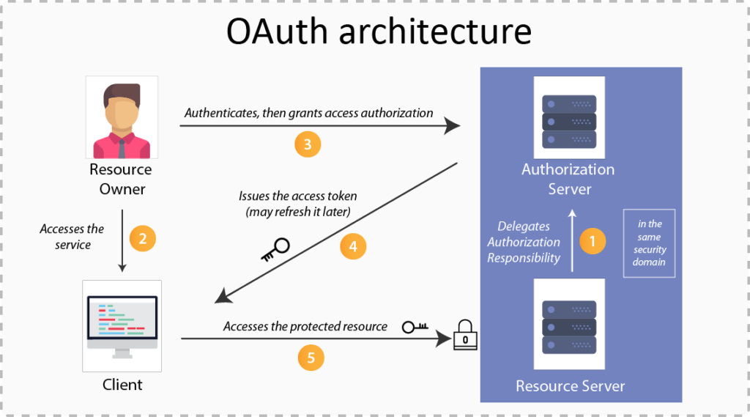
OAuth Roles

Slide 38
OAuth2 Grant Types
There are many different grant type flows defined and described to perform authorizations tasks.
Authorization Code
  used with server-side Applications
  Used by confidential and public clients to exchange an authorization code for an access token.
  After the user returns to the client via the redirect URL
  The application will get the authorization code from the URL
  Will use it to request an access token.

Slide 39
Client Credentials Grant Types
Apps that can request an access token and access resources on its own.
  These apps often use services that call APIs without users.
Application:
  A client that makes protected requests using the authorization of the resource owner.
Authorization Server:
  The server that issues access tokens to client apps after successfully authenticating the resource owner.
Resource Server:
  The server that hosts protected resources and accepts and responds to protected resource requests using access tokens.
  Apps access the server through APIs.

Slide 40
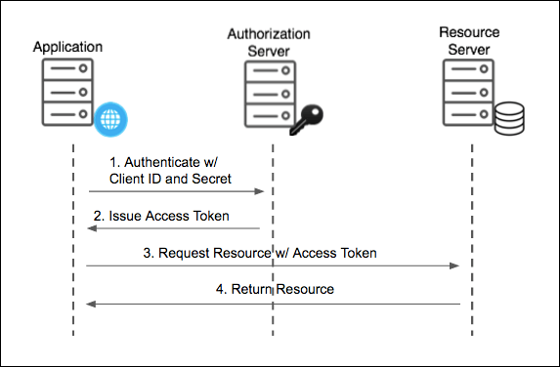
Client Credentials Grant Types

Slide 41
Resource Owner Password Grant Type
Used For Native Mobile and Desktop apps
  Used for highly trusted apps where resource owners share their credentials directly with the app.

Slide 42
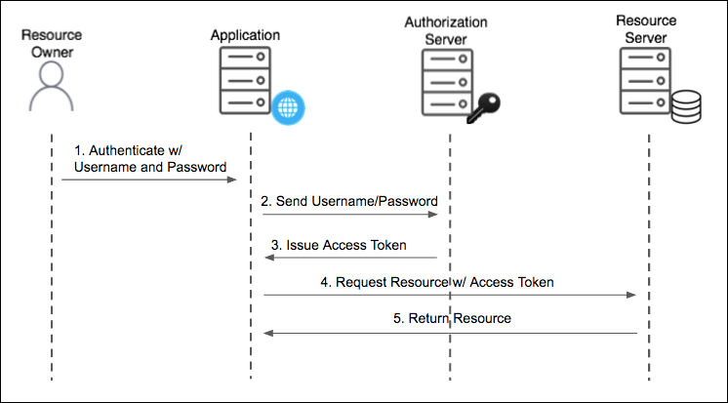
PassWord Grant Type

Slide 43
Password Grant
Simplest OAuth grants
The application presents a traditional username and password login form to collect the user’s credentials
Uses that data and makes a POST request to the server and gets an access token.
The Post request has following parameters
  Grant-type
  userName
  Password
  Client Id
  Client Secret
  Scope

Slide 44
Password Grant Request Parameters
grant_type=password
  To denote the usage of Password grant type
Username
  The user’s username that they entered in the application
Password
  The user’s password that they entered in the application
client_id
  Public identifier of the application that the developer obtained during registration
client_secret (optional)
  If the application is a “confidential client” (not a mobile or JavaScript app), then the secret is included as well.
scope (optional)
  If the application is requesting a token with limited scope

Slide 45
OAuth2 Tokens
Tokens are implementation specific random strings, generated by the authorization server.
Access Token
  Sent with each request, usually valid for about an hour only.
Refresh Token
  It is used to get new access token, not sent with each request, usually lives longer than access token.
  Allows clients to continue to have a valid access token without further interaction with the user.

Slide 46
Access Token
Access token in the same format for all grant types.
  {
  "access_token": "MTQ0NjOkZmQ5OTM5NDE9ZTZjNGZmZjI3",
  "token_type": "bearer",
  "expires_in": 3600,
  "scope": "create"
  }

Slide 47
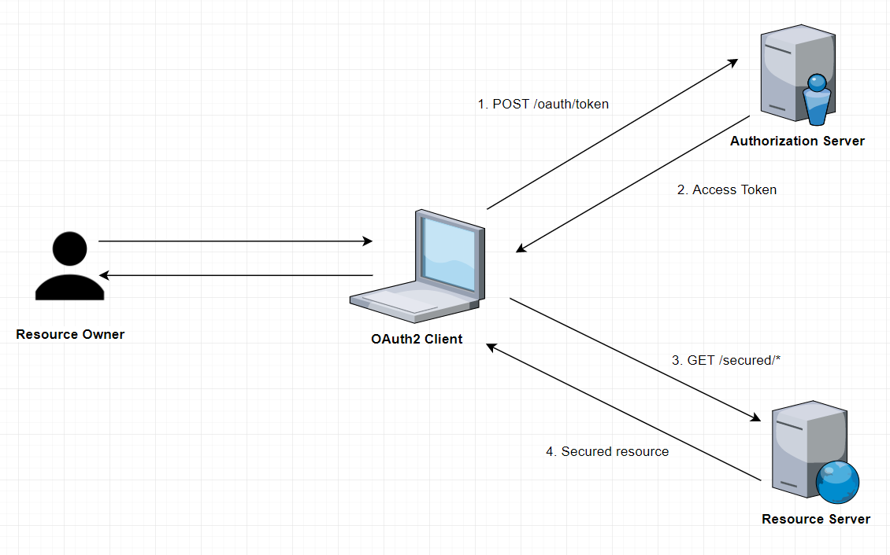
How it Works

Slide 48
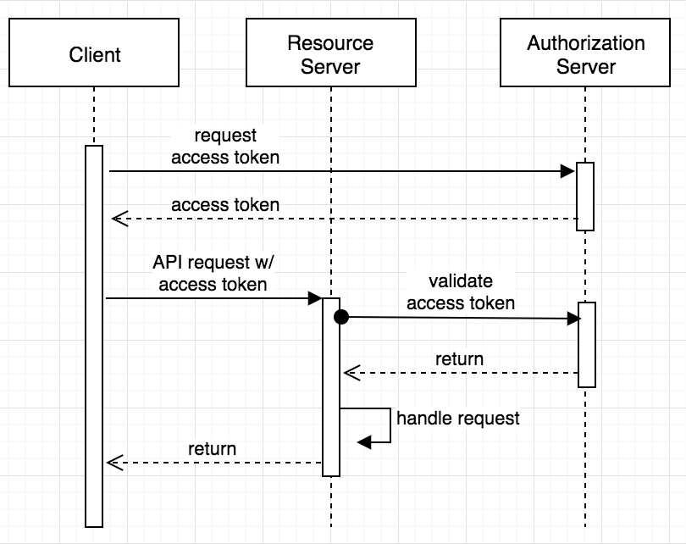
Sequence Diagram

Slide 49
Resource
    @RestController
    public class HospitalController {
    @GetMapping(path = "/hospital")
    public String getDetails() {
    return "Malar Hospitals";
    }
    }

Slide 50
@EnableResourceServer
Enables application to behave as a Resource Server by configuring an OAuth2AuthenticationProcessingFilter and required components.
The annotation creates a WebSecurityConfigurerAdapter with predefined configuration and order 3, it also takes care of the following
    Access rules
    Paths that are protected by OAuth2 security.
It enables a Spring Security filter that authenticates requests via an incoming OAuth2 token

Slide 51
Resource Server - Secured
  @SpringBootApplication
  @EnableResourceServer
  public class FlowerHospitalServicePasswordGrantApplication {
  public static void main(String[] args) {
  SpringApplication.run(FlowerHospitalServicePasswordGrantApplication.class, args);
  }
  }

Slide 52
Authentication
AuthenticationManager
  An interface with authenticate() method
Authenticate method does one of the following :
  Return an Authentication with authenticated=true if valid principal.
  Throw an AuthenticationException if there is a invalid principal.
  Return null if it cannot decide.
AuthenticationManagerBuilder
  A helpers to set up authentication
  Can be configured to work with in-memory, JDBC, or LDAP

Slide 53
Endpoints
/oauth/authorize
  The user is responsible for securing the Authorization Endpoint
  Spring Security features are used for this
/oauth/token
  The Token Endpoint will be automatically secured using HTTP Basic authentication on the client's credentials.

Slide 54
WebSecurityConfigurerAdapter
  @Configuration
  public class SecurityConfig extends WebSecurityConfigurerAdapter {
  @Autowired
  private PasswordEncoder encoder;
  @Override
  protected void configure(HttpSecurity http) throws Exception {
  http
  .authorizeRequests()
  .antMatchers("/login").permitAll()
  .antMatchers("/oauth/authorize")
  .authenticated();
  }

Slide 55
WebSecurityConfigurerAdapter
  @Override
  protected void configure(AuthenticationManagerBuilder auth) throws Exception {
  auth.inMemoryAuthentication()
  .withUser("india").password(encoder.encode("india"))
  .roles("USER");
  }
  @Bean
  @Override
  public AuthenticationManager authenticationManagerBean() throws Exception {
  return super.authenticationManagerBean();
  }

Slide 56
Authorization Server
@EnableAuthorizationServer
  Used for enabling an Authorization Server
AuthorizationServerConfigurerAdapter
  Adapter class for AuthorizationServerEndpointsConfigurer
  Configure the properties and enhanced functionality of the Authorization Server endpoints
  @Configuration
  @EnableAuthorizationServer
  public class AuthServerConfiguration extends
  AuthorizationServerConfigurerAdapter {
  }

Slide 57
Checking Tokens
Spring Security OAuth exposes two endpoints for checking tokens
  These are not exposed by default- they are "denyAll()".
/oauth/check_token
/oauth/token_key
To Verify the tokens with this endpoint they are exposed with condition.
  security.tokenKeyAccess("isAuthenticated()")
  .checkTokenAccess("isAuthenticated()"

Slide 58
ClientDetailsServiceConfigurer
.withClient(“client”)
  consumes client_id from request body
.authorizedGrantTypes(grant_types)
  Sets specific grant types, by password(yourLegacyToken)
scopes(“read”)
secret(yourClientSecret)
  from your application.properties file
.autoApprove(true)
  To kill default radiobox approval page
  clients.inMemory().withClient("myclient")
  .authorizedGrantTypes("password")
  .secret(encoder().encode("pass123")).scopes("read","write").redirectUris("http://localhost:4046/flower/login/oauth2/code/myclient").autoApprove(false);

Slide 59
Redirect URI
The path in the application that the end-user's user-agent is redirected back to after they have authenticated
The default redirect URI template is
{baseUrl}/login/oauth2/code/{registrationId}.
  The registrationId is a unique identifier for the ClientRegistration.
autoApprove(true)
  To kill default radiobox approval page

Slide 60
Authorization Server
  @Configuration
  @EnableAuthorizationServer
  public class AuthServerConfiguration extends AuthorizationServerConfigurerAdapter {
  @Autowired
  private AuthenticationManager authenticationManager;
  @Override
  public void configure(AuthorizationServerSecurityConfigurer security) throws Exception {
  security.tokenKeyAccess("isAuthenticated()")
  .checkTokenAccess("isAuthenticated()") ;
  }

Slide 61
Authorization Server
  @Override
  public void configure(ClientDetailsServiceConfigurer clients) throws Exception {
  clients.inMemory()
  .withClient("myclient")
  .authorizedGrantTypes("password")
  .secret(encoder().encode("pass123"))
  .scopes("read","write")
  .redirectUris("http://localhost:4046/flower/login/oauth2/code/myclient")
  .autoApprove(false);
  }

Slide 62
Authorization Server
  @Override
  public void configure(AuthorizationServerEndpointsConfigurer endpoints) throws Exception {
  endpoints.authenticationManager(authenticationManager);
  }
  @Bean
  public BCryptPasswordEncoder encoder() {
  return new BCryptPasswordEncoder();
  }
    }

Slide 63
Testing with Postman
Make a post call to the url http://localhost:4040/oauth/token
Select Authorization , and basic authentication
  Add the UserName : my-trusted-client ( Refer Slide No :57)
  Add the password : secret ( Refer Slide No :57)
Select Body form-url-endcoded and key and values , the following keys with respective values
  grant_type : password
  Username : india
  Password : india
  Will get the JWT Token

Slide 64
Testing with Postman
  Access resource using uri
    Select params tab and add access_token as a parameter
  http://localhost:4040/api/customers/customer/1?access_token=37ec591b-bae9-46ac-8e5a-573e82cb0630

Slide 65
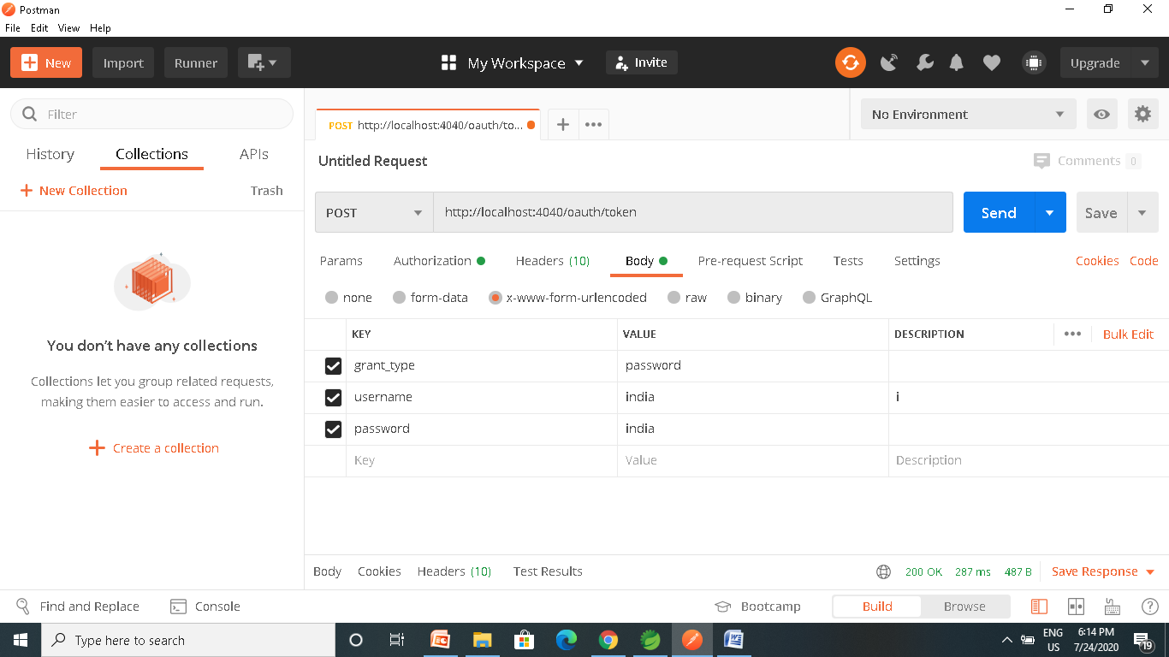
Testing with Postman

Slide 66
Testing with Postman

Slide 67
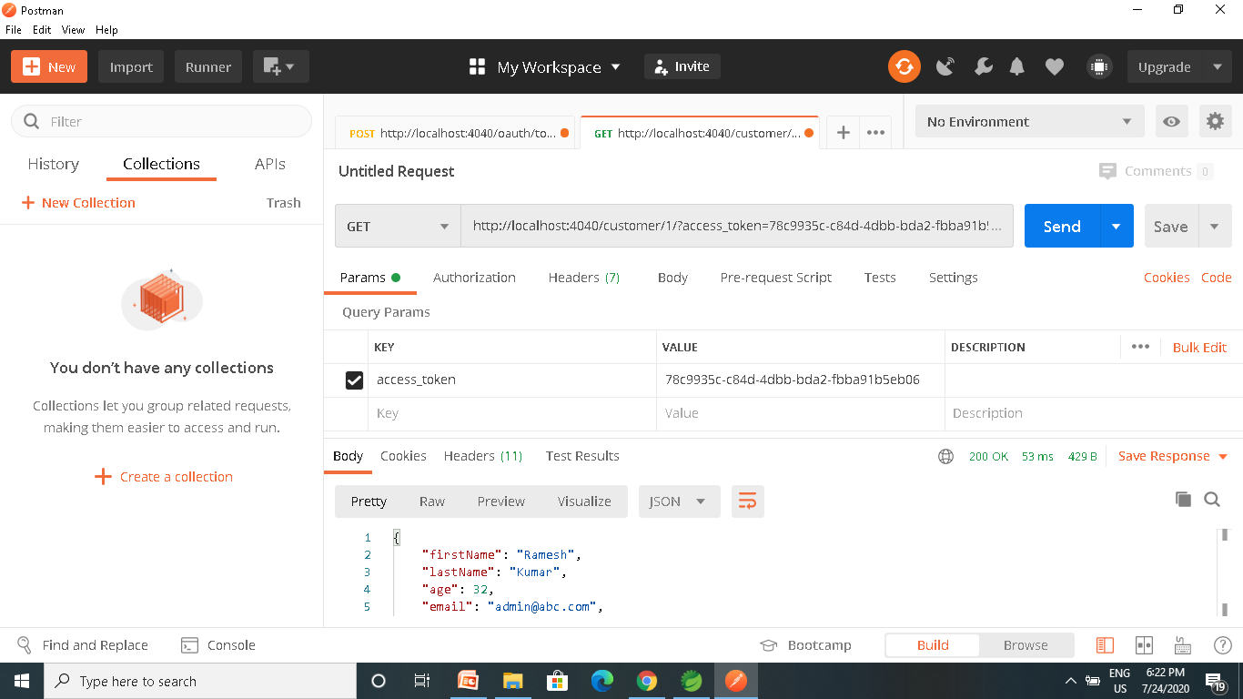

Slide 68
OAuth2RestTemplate
  @Bean
  public OAuth2RestTemplate template() {
  ResourceOwnerPasswordResourceDetails details = new ResourceOwnerPasswordResourceDetails();
  details.setAccessTokenUri("http://localhost:4040/oauth/token");
  details.setClientId("ourclient");
  details.setClientSecret("pass345");
  details.setUsername("india");
  details.setPassword("india");
  details.setGrantType("password");
  OAuth2RestTemplate template = new OAuth2RestTemplate(details);
  return template;
  }

Slide 69
OAuth2Template
  OAuth2RestTemplate template = ctx.getBean(OAuth2RestTemplate.class);
  String resp =
  template.getForObject("http://localhost:4040/api/v1/hospitals/2", String.class);
  System.out.println(resp)

Slide 70
CLIENT CREDENTIALS

Slide 71
Pom.xml
<dependency>
<groupId>org.springframework.boot</groupId>
<artifactId>spring-boot-starter-oauth2-resource-server</artifactId>
</dependency>
<dependency>
<groupId>org.springframework.boot</groupId>
<artifactId>spring-boot-starter-web</artifactId>
</dependency>
<dependency>
<groupId>org.springframework.cloud</groupId>
<artifactId>spring-cloud-starter-oauth2</artifactId>
</dependency>

Slide 72
Resource Server
  @SpringBootApplication
  @EnableResourceServer
  public class FlowerHospitalServiceApplication {
  public static void main(String[] args) {
  SpringApplication.run(FlowerHospitalServiceApplication.class, args);
  }

Slide 73
Rest Controller
  @RestController
  public class HospitalController {
  @GetMapping(path = "/hospitals")
  public String getDetails() {
  return "Hello Details From Hospitals";
  }
  }

Slide 74
AuthorizationServerConfigurerAdapter
  @Configuration
  @EnableAuthorizationServer
  public class AuthServerConfiguration extends AuthorizationServerConfigurerAdapter {
  @Autowired
  private AuthenticationManager authenticationManager;
  @Override
  public void configure(AuthorizationServerEndpointsConfigurer endpoints) throws Exception {
  endpoints.authenticationManager(authenticationManager);
  }
  @Bean
  public BCryptPasswordEncoder encoder() {
  return new BCryptPasswordEncoder();
  }

Slide 75
AuthorizationServerConfigurerAdapter
  @Override
  public void configure(ClientDetailsServiceConfigurer clients) throws Exception {
  clients.inMemory()
  .withClient("myclient")
  .authorizedGrantTypes("client_credentials")
  .secret(encoder().encode("pass123"))
  .scopes("read","write")
  .redirectUris("http://localhost:4043/login/oauth2/code/myclient")
  .autoApprove(false);
  }

Slide 76
Web Security ConfigurerAdapter
  @Configuration
  public class SecurityConfig extends WebSecurityConfigurerAdapter {
  @Override
  protected void configure(HttpSecurity http) throws Exception {
  http
  .authorizeRequests()
  .antMatchers("/login").permitAll()
  .antMatchers("/oauth/authorize")
  .authenticated();
  }

Slide 77
Web Security ConfigurerAdapter
  @Bean
  @Override
  public AuthenticationManager authenticationManagerBean() throws Exception {
  return super.authenticationManagerBean();
  }

Slide 78
OAuth2Template
  public OAuth2RestTemplate template2() {
  ClientCredentialsResourceDetails details = new ClientCredentialsResourceDetails();
  details.setAccessTokenUri("http://localhost:3030/oauth/token");
  details.setClientId("ourclient");
  details.setClientSecret("pass123");
  details.setGrantType("client_credentials");
  OAuth2RestTemplate template = new OAuth2RestTemplate(details);
  return template;
  }

Slide 79
SOCIAL LOGIN WITH GITHUB

Slide 80
Social Login
Social logins using Oauth2 have become an industry standard.
Facebook, LinkedIn and Github are OAuth2 login providers
It has revolutionized the way sites share data
Users can quickly access new applications without having to create a new set of credentials.

Slide 81
How Social Login Works
Authorization Server
  Client Application can use the authorization code grant to obtain an access token from GitHub
Resource Server
  It uses the access token to ask GitHub for permitted personal details like login ID and name.
  It Decodes the token checking if it gives the app permission to access the user’s details.
  Inserts the user details into the Spring Security context

Slide 82
Git Hub Social Login
Navigate to https://github.com/settings/developers
create a New OAuth app under the OAuth Apps left menu.
Fill in the Authorization callback URL field to include the redirect URI to your app: http://<your-domain>/login/oauth2/code/github
Click on Register Application
Copy the client ID and client secret to be used Later

Slide 83
OAuth2 Client
  <dependency>
  <groupId>org.springframework.boot</groupId>
  <artifactId>spring-boot-starter-oauth2-client</artifactId>
  <version>2.3.3.RELEASE</version>
  </dependency>

Slide 84
Controller
  @RestController
  public class AppController {
  @GetMapping("/")
  public String home() {
  return "home";
  }
  @GetMapping("/secured")
  public String classified() {
  return "Secured Resource";
  }
  }

Slide 85
Security Config
oauth2Login()
  similar to httpBasic() and formLogin()
  Will be used to display an auto-generated login page for login provider
  public class SecurityConfig extends WebSecurityConfigurerAdapter {
  protected void configure(HttpSecurity http) throws Exception {
  http.authorizeRequests()
  .antMatchers("/","/actuator")
  .permitAll().antMatchers("/secured").authenticated().anyRequest()
  .authenticated().and().oauth2Login();
  }
  }

Slide 86
Security Configuration
Client credentials to the application.properties file.
  Properties are prefixed with
    spring.security.oauth2.client.registration
  This is followed by the client name
    spring.security.oauth2.client.registration.github
  The name of the client property follows next
spring.security.oauth2.client.registration.github.client-id=c1c7fb187a46dea59fbe
spring.security.oauth2.client.registration.github.client-secret=53f1d9de1d00d4f00e9ab6bc276e5166c492f45c

Slide 87
SPRING ACTUATOR

Slide 88
Spring Boot Actuator
Exposes REST endpoints that can be consumed to manage and monitor application.
Monitor application health, application bean details, version details, thread dumps, logger details etc
Can restrict these endpoints to be consumed by authorized users only and Spring provides easy way to secure your REST endpoints.

Slide 89
actuator End Point
actuator
  It provides a hypermedia-based discovery page for the other endpoints.
  It is required to have Spring HATEOS on the classpath to enable it.
  By default it is sensitive and hence requires username/password for access or may be disabled if web security is not enabled.
Beans
  It displays complete beans configured in the app.
Configprops
  It displays a collated list of all @ConfigurationProperties.

Slide 90
actuator End Point
Health
    It shows application health information
  management.endpoint.health.show-details:=always
Info
  It displays arbitrary application info.
Loggers
  It shows and modifies the configuration of loggers in the application.
metrics:
  It shows metrics information for the current application.
Mappings
  It displays a collated list of all @RequestMapping paths.

Slide 91
Actuator Endpoints
health and info can be accessed
  Other endpoints are disabled by default
management.endpoints.web.exposure.include=*.
  Will enable all of them
  Can also list endpoints which should be enabled
To expose all enabled endpoints except one (for example /loggers), we use:
  management.endpoints.web.exposure.include=*
  management.endpoints.web.exposure.exclude=loggers
  management.security.enabled=false

Slide 92
Spring Boot Actuator
Spring Boot Actuator has started using Micrometer as metrics facade.
Simplifies and standardizes application metrics
Can exporting metrics to Elasticsearch
  <dependency>
  <groupId>io.micrometer</groupId>
  <artifactId>micrometer-registry-elastic</artifactId>
  </dependency>
  management.metrics.export.elastic.host=
  http://<elastic-host>:<elastic-port>

Slide 93
Info and Health Endpoint
  info:
  app:
  name:@project.name@
  version:@project.version@
  encoding:@project.build.sourceEncoding@
  java:
  version:@java.version@
  management:
  endpoint:
  health:
  show-details: always

Slide 94
Logger Endpoint
http://localhost:8787/actuator/metrics
http://localhost:8787/actuator/loggers
To Change the Log level make a post request
  http://localhost:8787/actuator/loggers/org.springframework.boot.SpringApplication
  { "configuredLevel": "trace“ }
To reset the logging level back to the original value
  { "configuredLevel": null }

Slide 95
Securing Actuator Endpoint
  @Bean
  public SecurityWebFilterChain securityWebFilterChain(
  ServerHttpSecurity http) {
  return http.authorizeExchange()
  .pathMatchers("/actuator/**").permitAll()
  .anyExchange().authenticated()
  .and().httpBasic().build();
  }

Slide 96
SPRING SLEUTH

Slide 97
Sleuth
Capable of enhancing logs
Spring Cloud Sleuth uses Brave as the tracing library
  Adds unique ids to each web request that enters the application.
  Has added support for sharing these ids across thread boundaries.
  Provides trace and span ids
    Can be used to pinpoint exactly when and where application processes a request.
    Making reading logs much easier.
Added through spring boot starter project.
Zipkin Cient Module is also added

Slide 98
Trace and Span
Trace
  A single request or job that is triggered in an application.
  All the various steps in that request, even across application and thread boundaries, will have the same traceId.
Spans
  As sections of a job or request.
  A single trace can be composed of multiple spans each correlating to a specific step or section of the request.

Slide 99
Log Format
This data follows the format
[application name, traceId, spanId, export]
Application name
  Name as set in the properties file
  Used to aggregate logs from multiple instances of the same application.
TraceId
  This is an id that is assigned to a single request, job, or action.
  Each unique user initiated web request will have its own traceId.

Slide 100
Log Format
SpanId
  Tracks a unit of work.
  A request may consists of multiple steps.
  Each step could have its own spanId and be tracked individually.
  By default, any application flow will start with same TraceId and SpanId.
Export
  A boolean property
  To indicate whether or not this log was exported to an aggregator like Zipkin.

Slide 101
Installing Zipkin
Download the latest Zipkin server from maven repository
  https://zipkin.io/pages/quickstart
  Under Java choose latest release
Run the executable jar file using below command.
  java -jar zipkin-server-1.30.3-exec.jar
Zipkin server starts with default configuration.
After Startup , the Web UI is at http://localhost:9411/zipkin/.

Slide 102
Zipkin
Has Four modules
Collector
  Once any component sends the trace data arrives to Zipkin collector daemon
  , it is validated, stored, and indexed for lookups by the Zipkin collector.
Storage
  store and index the lookup data in backend. Cassandra, ElasticSearch and MySQL are supported.
Search
  This module provides a simple JSON API for finding and retrieving traces stored in backend. The primary consumer of this API is the Web UI.
Web UI
  – A very nice UI interface for viewing traces.

Slide 103
Tracer
  @Autowired
  private Tracer tracer;
  public void usingSameSpan() {
  try {
  Thread.sleep(1000L);
  } catch (InterruptedException e) {
  e.printStackTrace();
  }
  log.info("Doing some work");
  }

Slide 104
Continue Span
  All Sleuth related annotations should be applied to an existing span instead of creating a new one.
  @ContinueSpan(log = "method2")
  public void usingSameSpanWithDifferentTag(@SpanTag("tag20") String param) {
  try {
  Thread.sleep(1500L);
  } catch (InterruptedException e) {
  e.printStackTrace();
  }
  log.info("Doing some More work");
  }

Slide 105
New Span
Creates a new span around a public method.
The new span will be either a child of an existing span if a trace is already in progress or a new span will be created if there was no previous trace.
  @NewSpan(name = "secondspan")
  public void createNewSpan() throws InterruptedException {
  log.info("I'm in the original span");
  log.info("I'm in the original span");
  }

Slide 106
ELK

Slide 107
Why Log Analysis
In cloud-based environment infrastructures, performance, and isolation is very important.
The performance of virtual machines in the cloud may vary based on the specific loads, environments, and number of active users in the system.
Reliability and node failure can become a significant issue.
Log management helps DevOps engineers, system admin to make better business decisions.
Log analysis via Elastic Stack or similar tools is important.

Slide 108
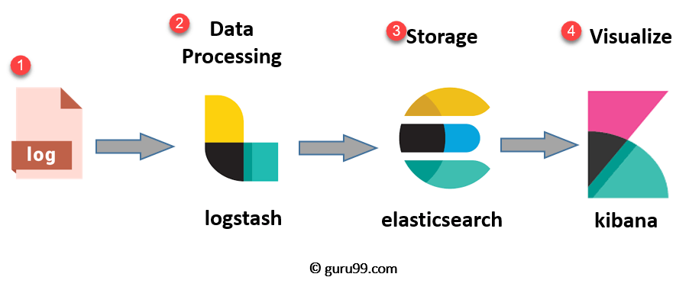
ELK Stack Architecture
Netflix, LinkedIn, Tripware, Medium all are using ELK stack for their business
Used when logs from various Apps of an enterprise converge into a single ELK instance

Slide 109
ELK
Logstash
  Collect logs and events data.
  Parses and transforms data
ElasticSearch
  The transformed data from Logstash is Stored, Search, and indexed.
Kibana
  Uses Elasticsearch DB to Explore, Visualize, and Share
Beats.
  Component for Data collection
This led Elastic to rename ELK as the Elastic Stack.

Slide 110
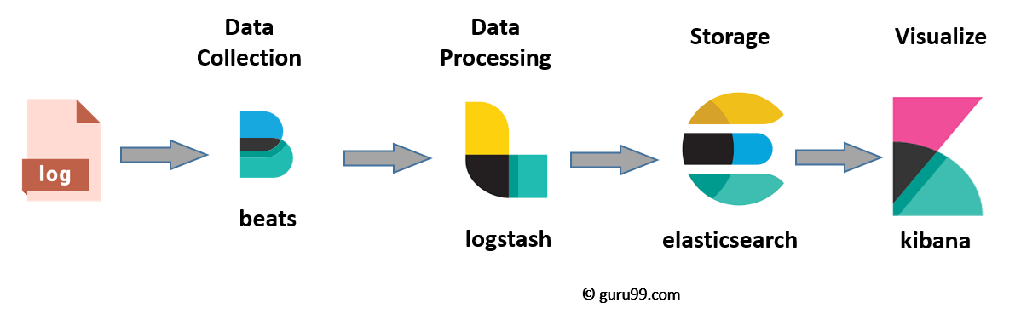
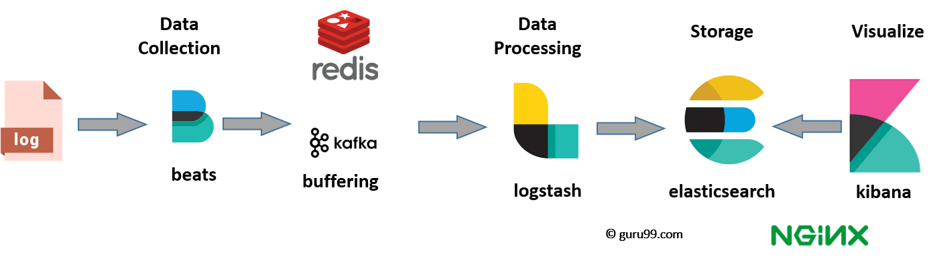
ELK stack el e

Slide 111
Elasticsearch
A NoSQL database.
Based on Lucene search engine
Has built in RESTful APIS.
Simple deployment, maximum reliability, and easy management.
Can do advanced queries and perform detail analysis
Stores all the data centrally.
It is helpful for executing a quick search of the documents.

Slide 112
Features of Elastic search:
Open source search server is written using Java
Used to index any kind of heterogeneous data
Full-Text Search
Sharded, replicated searchable, JSON document store
  Sharding is database partitioning
  Separates very large databases the into smaller, faster, more easily managed parts called data shards
Multi-language & Geolocation support

Slide 113
Elastic Search
A cluster is a collection of nodes which together holds data and provides joined indexing and search capabilities.
Node
  A node is an elasticsearch Instance.
  It is created when an elasticsearch instance begins.

Slide 114
Elastic Search
Index
  An index is a collection of documents which has similar characteristics.
  e.g., customer data, product catalog.
  It is very useful while performing indexing, search, update, and delete operations.
  It allows you to define as many indexes in one single cluster.

Slide 115
Elastic Search
Document
  It is the basic unit of information which can be indexed. It is expressed in JSON (key: value) pair. '{"user": "nullcon"}'. Every single Document is associated with a type and a unique id.
Shard
  Every index can be split into several shards to be able to distribute data.
  The shard is the atomic part of an index, which can be distributed over the cluster if you want to add more nodes.

Slide 116
LOGSTASH

Slide 117
Logstash
  Logstash is the data collection pipeline tool.
  Collects data inputs and feeds into the Elasticsearch.
  Gathers all types of data from the different source and makes it available for further use.
  Used unify data from disparate sources and normalize the data into your desired destinations.
  It allows to cleanse and democratize all your data for analytics and visualization of use cases.

Slide 118
Components of Logstash
Input:
  passing logs to process them into machine understandable format
Filters
  It is a set of conditions to perform a particular action or event
Output
  : Decision maker for processed event or log

Slide 119
Features of Logstash
Events are passed through each phase using internal queues
Allows different inputs for logs
Filtering/parsing for your logs
Advantage of Logstash
  Offers centralize the data processing
  It analyzes a large variety of structured/unstructured data and events
  Offers plugins to connect with various types of input sources and platforms

Slide 120
Kibana
Data visualization which completes the ELK stack.
Can perform advanced data analysis and visualize data in a variety of tables, charts, and maps with Elasticsearch documents
Has dashboard which
  interactive diagrams
  geospatial data
  graphs to visualize complex queries

Slide 121
Search Types
Free text searches
  It is used for searching a specific string
Field-level searches
  It is used for searching for a string within a specific field
Logical statements
  It is used to combine searches into a logical statement.
Proximity searches
  It is used for searching terms within specific character proximity.

Slide 122
Executing KLK Stack
Run the elasticsearch.bat using the command prompt.
  Elasticsearch can then be accessed at localhost:9200
Modify the kibana.yml to point to the elasticsearch instance.
Uncomment the kibana.yml
  elasticsearch.url: "http://localhost:9200"
Run the kibana.bat using the command prompt.
  kibana UI can then be accessed at localhost:5601

Slide 123
Executing KLK Stack
Run logstash using the command
  logstash -f .\..\config\logstash.conf
http://localhost:9200/_cat/indices
GET /_cat/indices/<index>
GET /_cat/indices
http://localhost:9200/logstash-2020.12.19-000001?pretty
http://localhost:9200/logstash-2020.12.19-000001/_search?pretty

Slide 124
Configuring Logstash
Logstash Configuration file consists of three section: input, filter and output.
Each section contains plugins that do relevant part of the processing
  Should be saved into logstash.conf config file.
Once the config file is in place and Elasticsearch is running, can run Logstash

Slide 125
Logstash-conf file
  input {
  file {
  type => "java"
  path => "C:/elk/*.log"
  codec => multiline {
  pattern => "^%{YEAR}-%{MONTHNUM}-%{MONTHDAY} %{TIME}.*" negate => "true"
  what => "previous"
  }
  }
  }

Slide 126
Logstash-conf file
  output {
  stdout {
  codec => rubydebug
  }
  elasticsearch {
  hosts => ["localhost:9200"] } }
  Start logstash using the command prompt
  logstash -f logstash.conf

Slide 127
Zuul Route Configuration
  zuul:
  host:
  socket-timeout-millis: 2000000
  add-host-header: true
  add-proxy-headers: true
  ribbon:
  eager-load:
  enabled: true

Slide 128
To add a prefix to all mappings, set zuul.prefix to a value, such as /api. By default, the proxy prefix is stripped from the request before the request is forwarded by (you can switch this behavior off with zuul.stripPrefix=false). You can also switch off the stripping of the service-specific prefix from individual routes, as shown in the following example:
application.yml.
zuul: routes: users: path: /myusers/** stripPrefix: false
zuul.stripPrefix only applies to the prefix set in zuul.prefix. It does not have any effect on prefixes defined within a given route’s path.
In the preceding example, requests to /myusers/101 are forwarded to /myusers/101 on the users service.

Slide 129
Zuul Route Configurations
  api:
  path: /api/**
  service-id: resource
  sensitiveHeaders:
  strip-prefix: false
  url: http://localhost:5050/

Slide 130
Sensitive Headers
A blacklist, and the default is not empty.
To Make Zuul send all headers it should be set to the empty list.
  Can pass cookie or authorization headers to back end.

Slide 131
SPRING WEB FLUX

Slide 132
Spring Webflux
A reactive-stack web framework that is fully non-blocking, supports Reactive Streams back pressure, and runs on such servers as Netty, Undertow, and Servlet 3.1+ containers.
It was added in Spring 5.0.
Spring Webflux uses Project Reactor as a reactive library

Slide 133
Creating Spring Boot Project
spring-boot-starter-webflux dependency
spring-webflux framework and reactor-core
  <dependency>
  <groupId>org.springframework.boot</groupId>
  <artifactId>spring-boot-starter-webflux</artifactId>
  <version>2.1.6.RELEASE</version>
  </dependency>

Slide 134
Reactor
The reactor is a Reactive Streams library and, therefore, all of its operators support non-blocking back pressure.
Spring Webflux uses two Publishers:
  Mono
  Flux

Slide 135
Mono
A specialized Publisher that emits at most one item and then optionally terminates with an onComplete signal or an onError signal.
It returns 0 or 1 element.
  Mono noData = Mono.empty();
  Mono data = Mono.just(“ramesh”);

Slide 136
Flux
A standard Publisher
  Represents an asynchronous sequence of 0 to N emitted items
It can be terminated by either a completion signal or an error.
  Flux flux1 = Flux.just(“foo”, “bar”, “foobar”);
  Flux flux2 = Flux.fromIterable(Arrays.asList(“A”, “B”, “C”));
  Flux flux3 = Flux.range(5, 3);
Has three types of signals
  That translate to calls to a downstream subscriber’s
  onNext, onComplete, or onError methods.
  flux.subscribe();

Slide 137
Spring WebFlux
To define the classes for rest APIs.
Spring WebFlux comes in two flavors:
  functional
  annotation-based.

Slide 138
Annotation-Based
  @RestController
  public class UserRestController {
  @Autowired
  private UserRepository userRepository;
  @GetMapping("/users")
  public Flux getUsers() {
  return userRepository.findAll();
  }

Slide 139
Annotation-Based
  @GetMapping("/users/{id}")
  public Mono getUserById(@PathVariable String id) {
  return userRepository.findById(id);
  }
  @PostMapping("/users")
  public Mono addUser(@RequestBody User user) {
  return userRepository.save(user);
  }
  }

Slide 140
WEB CLIENT

Slide 141
Reactive Web Client
  Introduced in Spring 5
  It’s a non-blocking client with support for Reactive Streams.
  Used on the client side to retrieve data from endpoints
  WebClient client = WebClient.create("http://localhost:8080");

Slide 142
Retrieving a Single Resource
WebClient.create
  A factory method to retrieve single resource of type Mono from endpoint
  Mono<Employee> employeeMono =
  client.get()
  .uri("/employees/{id}", "1")
  .retrieve()
  .bodyToMono(Employee.class);
  employeeMono.subscribe(System.out::println);

Slide 143
Retrieving Collection Resource
  Flux<Employee> employeeFlux = client.get()
  .uri("/employees")
  .retrieve()
  .bodyToFlux(Employee.class);
  employeeFlux.subscribe(System.out::println);

