Slide 1

REACTIVE SPRING

Slide 2
Reactive Spring
Project Reactor
Reactive in Spring Boot
Reactive types – Flux and Mono
Subscribing to Reactive Streams
Transforming reactive sequences with operators
Handling reactive sequences and Elements
WebFlux Async Non-Blocking Communication
Purely functional web with WebFlux
Non-blocking cross-service communication with WebClient
Reactive template engines
Reactive Relational Database Connectivity
Using RDBC with Spring Data RDBC
Transforming a synchronous repository into reactive

Slide 3
Introduction
A programming paradigm that promotes
  asynchronous, non-blocking, event-driven approach to data processing.
“Reactive programming is about non-blocking applications that are asynchronous and event-driven and require a small number of threads to scale.
  The concept of backpressure which is a mechanism to ensure producers don’t overwhelm consumers.”

Slide 4
Advantages of Reactive Programming
Thread per request model to more requests with few number of threads
  Prevent threads from blocking while waiting for I/O operations to complete
Easy to do parallel calls
Support “back pressure”, giving the client a possibility to inform the server on how much load it can handle

Slide 5
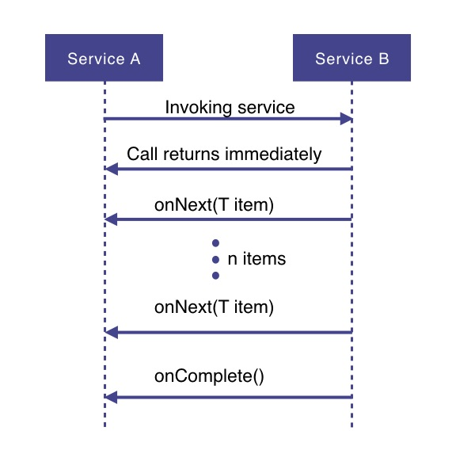
How Does it Work

Slide 6
How Does it Work
Service A wants to retrieve some data from service B.
Service A will make a request to service B which returns immediately
  Non-blocking and asynchronous.
Data requested will be made available to service A as a data stream,
  Service B will publish an onNext-event for each data item one by one.
When all the data has been published
  onComplete event is fired
In case of an error, an onError event would be published
  Items would not be emitted.

Slide 7
Event Stream
Reactive programming uses a functional style approach
  Like the Streams API
Possibility to perform different kinds of transformations on the streams.
A stream can be used as an input to another one.
Streams can be merged, mapped and filtered

Slide 8
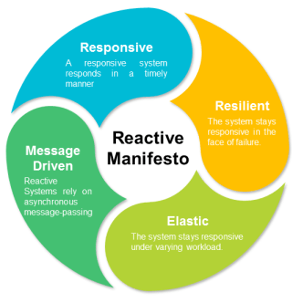
Reactive Manifesto

Slide 9
REACTIVEX
In 2011, Microsoft released the Reactive Extensions (ReactiveX or Rx) library for .NET, to provide an easy way to create asynchronous, event-driven programs.
In a few years time, Reactive Extensions was ported to several languages and platforms including Java, JavaScript, C++, Python and Swift.
ReactiveX quickly became a cross-language standard.
ReactiveX uses a mix of the Iterator pattern and the Observer pattern from Gang of Four.

Slide 10
Reactive Extensions
Reactive Extensions also called ReactiveX or Rx
  A cross-language standard
Implementations of Reactive Streams
  The Java implementations are RxJava 1.x ,2.x
    Published under the Apache 2.0 license.
    Povides Java API for asynchronous programming with observable streams.
  Project Reactor
  Vert.x
  Akka Streams

Slide 11
Reactive Stream Specification
Publisher
Subscriber
Subscription
Processor

Slide 12
Publisher
Represents the data source
  database, external service, etc.
  public interface Publisher<T> {
  public void subscribe(Subscriber<? super T> s);
  }

Slide 13
Subscriber
Represents the consumer of the stream data.
  public interface Subscriber<T> {
  public void onSubscribe(Subscription s);
  public void onNext(T t);
  public void onError(Throwable t);
  public void onComplete();
  }

Slide 14
Subscription
A subscription is required to be made by the subscriber against the publisher in order to fetch data.
  public interface Subscription {
  public void request(long n);
  public void cancel();
  }

Slide 15
Processor
A Processor represents a processing stage which is both a Subscriber and a Publisher.
If an entity shall transform incoming items and then pass it further to another Subscriber, an implementation of the Processor interface is needed.
This acts both as a Subscriber and as a Publisher.
  public interface Processor<T, R> extends Subscriber<T>, Publisher<R> {
  }

Slide 16
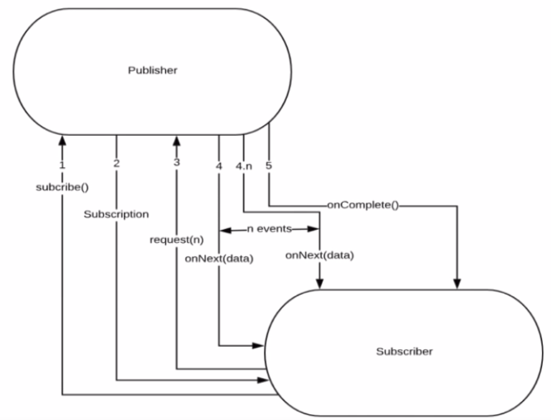
Flow Between Publisher and Subscriber

Slide 17
PROJECT REACTOR

Slide 18
PROJECT REACTOR
Spring Framework supports reactive programming since version 5.
  That support is build on top of Project Reactor.
WebFlux, Spring's reactive-stack web framework, requires Reactor as a core dependency.
Suited for Microservices Architecture
Offers backpressure-ready network engines for HTTP (including Websockets), TCP, and UDP.
Built and maintained by Pivotal
Recommended Library to work with Spring Boot
Runs on Java 8 and above.

Slide 19
Reactor Modules
Project Reactor consists of a set of modules
  The modules are embeddable and interoperable.
Reactor Core
  Holds the reactive types Flux and Mono
  Implementation of the Reactive Stream's Publisher interface and a set of operators that can be applied .
Reactor Test
  Utilities for testing reactive streams

Slide 20
Reactor Modules
Reactor Extra
  Additional Flux operators
Reactor Netty
  Non-blocking and backpressure-ready TCP, HTTP clients and servers
  Based on the Netty framework
Reactor Adapter
  Adapting to/from other reactive libraries such as RxJava2 and Akka Streams
Reactor Kafka
  Reactive API for Kafka

Slide 21
Setting up a Project
Spring Boot application using Spring Initializr.
  Add Spring Reactive Web as dependecy
The spring-boot-starter-webflux dependency is added
  It will bring in the reactor-core dependency.
  The reactor-test has been added as a dependency.
Spring Webflux
  A reactive-stack web framework
  Runs on Netty, and Servlet 3.1+ containers.

Slide 22
Setting up a Project
  <dependency>
  <groupId>org.springframework.boot</groupId>
  <artifactId>spring-boot-starter-webflux</artifactId>
  </dependency>
  <dependency>
  <groupId>org.springframework.boot</groupId>
  <artifactId>spring-boot-starter-test</artifactId>
  <scope>test</scope>
  </dependency>

Slide 23
Types of Publishers
Spring Webflux uses two Publishers
Mono
  To publish 0..1 element
  Mono is like the Optional type provided in Java 8.
  Mono to return a single object or VOid
Flux
  To publish 0..N element.
  Used to return lists.

Slide 24
Flux and Mono
They are both terminated either by a completion signal or an error
They call a downstream Subscriber's onNext, onComplete and onError methods.
Both provide a set of operators to support transformations, filtering, and error handling.

Slide 25
Flux
  Flux flux1 = Flux.just(“foo”, “bar”, “foobar”);
  Flux flux2 = Flux.fromIterable(Arrays.asList(“A”, “B”, “C”));
  Flux flux3 = Flux.range(5, 3);
Has three types of signals
  Signals that translate calls to a downstream subscriber’s
  onNext, onComplete, or onError methods.

Slide 26
Creating Flux
Just (T... data)
  Overloaded method
  Create a new Flux that will only emit a single element then onComplete.
  Returns a new Flux
Flux<String> fluxColors = Flux.just("red", "green", "blue");
fluxColors.subscribe(System.out::println);

Slide 27
Creating Flux
  @Component
  public class CreatingFlux {
  @Autowired
  private List<Book> bookList;
  public Flux<String> emptyFlux(){
  Flux<String> emptyFlux = Flux.empty();
  return emptyFlux;
  }
}

Slide 28
Creating Flux
  public Flux<String> fluxFromValue(){
  Flux<String> fluxFromValue = Flux.just("India","Nepal","Srilanka","Bhutan");
  return fluxFromValue;
  }
  public Flux<String> fluxFromArray(){
  String[] names = {"India","Nepal","Srilanka","Bhutan"};
  Flux<String> fluxFromArray = Flux.fromArray(names);
  return fluxFromArray;
  }

Slide 29
Creating Flux
  public Flux<Book> fluxFromList(){
  Flux<Book> fluxFromList = Flux.fromIterable(this.bookList);
  return fluxFromList;
  }

Slide 30
Creating Flux
  public void fluxWithCallBacks(){
  Flux<Book> fluxFromList1 = Flux.fromIterable(this.bookList);
  fluxFromList1.subscribe(
  System.out::println,
  e-> System.out.println(e),
  ()-> System.out.println("complete")
  );

Slide 31
Creating Flux
  Flux<Book> fluxFromList2 = fluxFromList1
  .doOnNext(value -> System.out.println(
  "[doOnNext] " + Thread.currentThread().getName() + " value: " + value))
  .doOnSubscribe(sub -> System.out.println(
  "[doOnSubscribe] " + Thread.currentThread().getName()));
  fluxFromList2.subscribe();
  }

Slide 32
Application
  public static void testFlux(Flux<?> fluxRef) {
  fluxRef.subscribe(System.out::println);
  }
  CreatingFlux fluxAppRef = ctx.getBean(CreatingFlux.class);
  testFlux(fluxAppRef.emptyFlux());
  testFlux(fluxAppRef.fluxFromList());

Slide 33
Mono
Emits at most one item and then optionally terminates with an onComplete signal or an onError signal.
  Mono noData = Mono.empty();
  Mono data = Mono.just(“ramesh”);

Slide 34
Mono and Flux
  public Mono<Book> bestBook(){
  Mono<Book> bestBook = Mono.just(bookList.get(1));
  return bestBook;
  }
  public Mono<Book> betterBook(){
  Mono<Book> betterBook = Mono.just(bookList.get(0));
  return betterBook;
  }
  public Flux<Book> fluxFromMono(){
  return Flux.concat(bestBook(),betterBook());
  }

Slide 35
OPERATORS

Slide 36
Operators
Operators adds behavior to a Publisher
Wraps the previous step’s Publisher into a new instance.
Methods in the API return a Flux or a Mono
  Helps in chaining operators
  Data originates from the first Publisher and moves down the chain, transformed by each link.
Eventually, a Subscriber finishes the process.
  Nothing happens until a Subscriber subscribes to a Publisher.

Slide 37
Operators
Creating a new sequence
  just, fromArray, fromIterable, fromStream
Transforming an existing sequence
  map, flatMap, startWith, concatWith
Peeking into a sequence
  doOnNext, doOnComplete, doOnError, doOnCancel
Filtering a sequence
  filter, ignoreElements, distinct, elementAt, takeLast
Handling errors
  onErrorReturn, onErrorResume, retry

Slide 38
Operators
Working with time
  elapsed, interval, timestamp, timeout
Splitting a Flux
  buffer, groupBy, window
Going back to the synchronous world
  block, blockFirst, blockLast, toIterable, toStream
Multicasting a Flux to several Subscribers
  publish, cache, replay

Slide 39
Log() operator
Operator provides logging of all Reactive Streams signals taking place behind the scenes.
  fluxColors.log().subscribe(System.out::println);

Slide 40
Map Operator
There are many reactive operators. We will be discussing about map, flatMap, concat, merge and zip.
Map
Map transforms the elements emitted by a Flux to other value by applying a synchronous function to each item.
Flux.just(1, 5, 10) .map(num -> num * 10) .subscribe(System.out :: println);
  Map transforms the elements emitted by a Flux to other value by applying a synchronous function to each item.
  Flux.just(1, 5, 10)
  .map(num -> num * 10)
  .subscribe(System.out :: println);
  Flux<String> fluxColors = Flux.just("red", "green", "blue");
  fluxColors.map(color -> color.charAt(0)).subscribe(System.out::println);

Slide 41
FlatMap
Transform the elements emitted by the Flux asynchronously into Publishers
  Then flatten these inner publishers into a single Flux through merging.
Flux.just(1, 5, 10)
.flatMap(num -> Flux.just(num * 10))
.subscribe(System.out :: println);

Slide 42
Concat and Merge
  Flux<Integer> flux1 = Flux.just(1, 5, 10)
  .delayElements(Duration.ofMillis(200));
  Flux<Integer> flux2 = Flux.just(15, 20, 25)
  .delayElements(Duration.ofMillis(400));
  Mono<Integer> mono1 = Mono.just(1);
  /*flux1.concat(flux2).concat(mono1)
  .subscribe(System.out :: println);*/
  flux1.concatWith(flux2).concatWith(mono1)
  .subscribe(System.out :: println);
  Thread.sleep(4000);

Slide 43
Concat and Merge
Flux.concat(mono1, mono2, mono3)
  Static function for concatenation
flux1.concatWith(flux2)
  Instance method for concatenation.
merge ()
  merge data from a Flux and a Publisher into an interleaved merged sequence
  concat merge adds with no interleave.

Slide 44
Concat and Merge
  Flux<Catalog> mergeFluxWithInterleave(Flux<Catalog> flux1, Flux<Catalog> flux2) {
  return flux1.mergeWith(flux2);
  }
Merge flux1 and flux2 values with no interleave (flux1 values and then flux2 values)
  Flux<Catalog> mergeFluxWithNoInterleave(Flux<Catalog> flux1, Flux<Catalog> flux2) {
  return flux1.concatWith(flux2);
  }

Slide 45
Zip
It zips given Flux with another Publisher source,
It waits for both to emit one element and combine these elements once into a Tuple
Flux<String> fluxFruits = Flux.just("apple", "pear", "plum");
Flux<String> fluxColors = Flux.just("red", "green", "blue");
Flux<Integer> fluxAmounts = Flux.just(10, 20, 30);
Flux.zip(fluxFruits, fluxColors, fluxAmounts).subscribe(System.out::println);

Slide 46
Zip
  Flux<String> bookNames = Flux.just("Java","Python","Spring","Angular");
  Flux<String> authorNames = Flux.just("Ramesh","Suresh","Magesh","Vignest");
  Flux<Integer> ids = Flux.just(1,2,3,4);
  Flux<Double> priceList = Flux.just(
  Flux<Book> zippedList =
  Flux.zip(ids,bookNames,authorNames,priceList)
  .map(tuple -> new Book(tuple.getT1(),tuple.getT2(),tuple.getT3(),tuple.getT4()));

Slide 47
EXCEPTION HANDLING

Slide 48
Exception Handling
In Reactive Streams Exceptions are terminal events.
  It stops the whole sequence and the error gets propagated to the Subscriber's onError method
  onError should always be defined.
  If not defined, throws an UnsupportedOperationException.
  Flux<String> fluxCalc = Flux.just(-1, 0, 1)
  .map(i -> "10 / " + i + " = " + (10 / i));
  fluxCalc.subscribe(value -> System.out.println("Next: " + value),
  error -> System.err.println("Error: " + error));
Third value will not be emitted

Slide 49
onErrorResume
Method will emit a fallback value when an error of the specified type is observed.
  Similar to catching an Exception and returning a static fallback value in imperative programming.
  testFlux(fluxAppRef.errorFlux().onErrorResume(e -> Flux.just(new Book(0, "dummy", "guest", 0))));
  testFlux(fluxAppRef.errorFlux());

Slide 50
Debugging
Debugging reactive code could become a challenge because of its functional, declarative style
Java stack trace that is generated from a Reactor application will not include any references to the assembly code
  Hard to identify what was the actual root cause of a propagated error.
Hooks.onOperatorDebug()
  To get a more meaningful stack trace
  Added to the application.
Not recommended in a production environment
  because it involves a heavy-weight stack walking and would hurt performance.

Slide 51
Reactor-tools
To Use Debugging in production,
A Java Agent that instruments code and adds debugging info
  without paying the cost of capturing the stacktrace on every operator call.
Need to add the reactor-tools artifact to your dependencies
ReactorDebugAgent.init();

Slide 52
Example
  public class StackTest {
  public static void main(String[] args) {
  Mono<Long> totalTxtSize = Flux
  .just("/tmp", "/home", "/404")
  .map(File::new)
  .concatMap(file -> Flux.just(file.listFiles()))
  .filter(File::isFile)
  .filter(file -> file.getName().endsWith(".txt"))
  .map(File::length)
  .reduce(0L, Math::addExact);
  totalTxtSize.subscribe(System.out::println);
  }

Slide 53
BACK PRESSURE

Slide 54
Back Pressure Processing
Need for Back-pressured Processing
  Communicate workload levels so that data passing never faces bottlenecks on either side.
  Manage the rate of the operations of the source and sink.
  Make sure the data producer doesn’t overwhelm the data consumer and potentially bring down the entire system.

Slide 55
Back Pressure Processing
  Consider a scenario where there is a fast publisher publishing at a speed of 100 ops/sec and a slow subscriber subscribing at the speed of 1 ops/sec.
  The subscriber usually has some kind of buffer to manage incoming messages but that also has a limited space which keeps on filling as the publisher is much faster than the subscriber.
  As the buffer keeps on filling, at one time the buffer will surely overflow as the publisher is continuously sending data to the subscriber via the flow.

Slide 56
Back Pressure Processing
Option 1: Increase Buffer Size :
  One option is to increase the buffer size of subscribers.
  This is possible, but not always realistic.
  As the memory is limited, we will eventually run out of memory.
Option 2: Bounded Buffer + Drop Messages
  Another option is to simply drop elements.
  Working in stream processing gives us some flexibility for dropping what can’t be handled, but it’s not always appropriate.
  This would highly increase the load on Publisher.

Slide 57
Back Pressure Processing
Optimal Solution:
  What we need is a bi-directional flow of data — elements emitted downstream from publisher to the subscriber, and a signal for demand emitted upstream from subscriber to publisher.
  If the subscriber is placed in charge of signaling demand, the publisher is free to safely push up to the number of elements demanded.
  This also prevents wasting resources because demand is signaled asynchronously, a subscriber can send many requests for more work before actually receiving any.

Slide 58
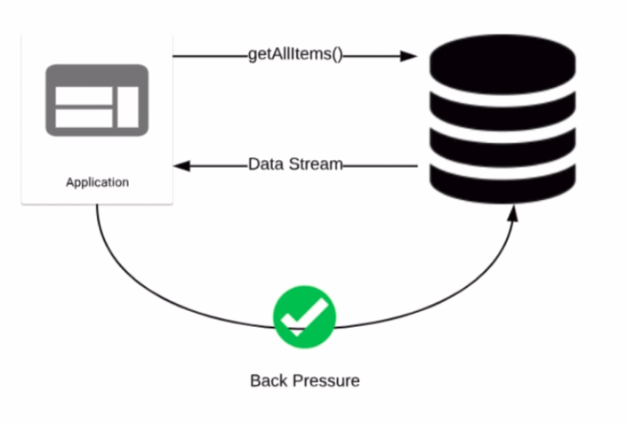
Back Pressure

Slide 59
Back Pressure Example
  Flux.range(1,5)
  .subscribe(new Subscriber<Integer>() {
  private Subscription s;
  int counter;
  @Override
  public void onSubscribe(Subscription s) {
  System.out.println("onSubscribe");
  this.s = s;
  System.out.println("Requesting 2 emissions");
  s.request(2);
  }

Slide 60
Back Pressure Example
  @Override
  public void onNext(Integer i) {
  System.out.println("onNext " + i);
  counter++;
  if (counter % 2 == 0) {
  System.out.println("Requesting 2 emissions");
  s.request(2);
  } }
  @Override
  public void onError(Throwable t) {
  System.err.println("onError");
  }
  public void onComplete() {
  System.out.println("onComplete");
  } });
  }

Slide 61
The push and pull model:
As soon as a subscription is made to a publisher, it starts emitting data (pushing the data).
But, with the concept of backpressure, we also know, that a subscriber can also take control of how many items need to be pulled or when a subscription needs to be canceled.
So, here we can say, Reactive streams follow the push and pull model.
This transforms the push model into a push-pull hybrid, where the downstream can pull n elements from upstream if they are readily available.
But if the elements are not ready, they get pushed by the upstream whenever they are produced.

Slide 62
Cancelling a subscribe() with Its Disposable
Lambda-based variants of subscribe() have a Disposable return type.
Disposable interface represents the subscription can be cancelled,
  Has a dispose() method.
Cancellation is a signal that the source should stop producing elements.
  However, it is NOT guaranteed to be immediate:
  Some sources might produce elements so fast that they could complete even before receiving the cancel instruction.

Slide 63
Disposable
List<String> lists = Lists.newArrayList("abc", "def", "ghi");
Disposable disposable = Flux.fromIterable(lists)
.delayElements(Duration.ofSeconds(3))
.map(String::toLowerCase)
.subscribe(System.out::println);
Thread.sleep(5000); //Sleeping so that some elements in the flux gets printed
disposable.dispose();
Thread.sleep(10000); // Sleeping so that we can prove even waiting for some time nothing gets printed after cancelling the flux

Slide 64
Disposable in a Functional Style
List<String> lists = Lists.newArrayList("abc", "def", "End", "ghi");
Flux.fromIterable(lists).takeUntil(s -> s.equalsIgnoreCase("End"))
.delayElements(Duration.ofSeconds(3))
.map(String::toLowerCase)
.subscribe(System.out::println);
List<String> lists = Lists.newArrayList("abc", "def", "ghi");
Flux.fromIterable(lists).take(2)
.delayElements(Duration.ofSeconds(2))
.map(String::toLowerCase)
.subscribe(System.out::println);

Slide 65
Comparing with Java 8 Streams
How they different form Java 8 Streams:
The core difference is that Reactive is a push model, whereas the Java 8 Streams are a pull model. In reactive approach. events are pushed to the subscribers as they come in.
The next thing to notice is a Streams terminal operator is just that, terminal, pulling all the data and returning a result. With Reactive we could have an infinite stream coming in from an external resource, with multiple subscribers attached and removed on an ad hoc basis. We can also do things like combine streams, throttle streams and apply backpressure.

Slide 66
Spring 5 Reactive Building blocks :
1) WebFlux
2) Spring Data reactive library
3) Reactive IO
4) Nonblocking Servlet container (Netty, Tomcat 8+,Jetty,Undertow etc.)
5) Spring security reactive API.

Slide 67
@GetMapping("/banking/account/{accountId}")
public Mono<ResponseEntity<Account>> getAccountById(@PathVariable ("accountId") String accounId)
{
return repo.findById(accounId).map(savedAccount
->ResponseEntity.ok(savedAccount)).log()
.defaultIfEmpty(ResponseEntity.notFound().build());
}
@GetMapping(value="banking/stream/accounts",produces=org.springframework.http.MediaType.TEXT_EVENT_STREAM_VALUE)
public Flux<Account> getAccountByStream()
{
return repo.findAll().publishOn(Schedulers.parallel()).log().delayElements(Duration.ofMillis(100));
view raw

Slide 68
Functional Controller:
Spring WebFlux has introduced another way to write rest endpoints using Router function.
@Component
public class RouterConfig {
@Bean
RouterFunction<?> routes(AccountRepository repo) {
return nest(path("/banking"),route(GET("/account/{accoutId}"),request -> ok().body(repo.findById(request.pathVariable("id")), Account.class))
.and(route(GET("/accounts"), request ok().body(repo.findAll(), Account.class)))
.and(route(POST("/account/add"),request -> request.body(BodyExtractors.toMono(Account.class))
.doOnNext(repo::save).doOnSuccess(System.out::println).then(ok().build()))));
}

Slide 69
Apache Kafka and Reactive Spring Boot:
Dependencies:

Slide 70
Functional Controller:
Spring WebFlux has introduced another way to write rest endpoints using Router function.

