Slide 1
SPRING CLOUD STREAM

Slide 2
Spring Cloud Stream
A framework for building message-driven microservice applications.
Without specifying the implementation details of the underlying messaging system.
  Just by specifying the required binding dependencies
Cloud Stream will integrate the messaging systems to Spring Boot Application.
Kafka & Rabbit are currently supported

Slide 3
Cloud Stream
Transparent content-type negotiation and argument resolution
Ability to connect microservices to external systems
  Kafka
  Rabbit MQ
  JMS
  Etc. . .
Provides flexible programming model
  Built on familiar Spring idioms - Spring Messaging
  Supports pub/sub semantics, consumer groups, stateful partitions and other messaging paradigms
  Message centric
  Supports Imperative and Declarative programming models

Slide 4
Programming model
Spring Cloud Stream - Spring Boot app
Flexible configuration (i.e., Annotation, XML, hybrid)
Binders
  Streaming
    Kstream
  Channel-based
    Kafka
    Rabbit
Seamless integration with the rest of the Spring Cloud stack
  Metrics
  Sleuth
  Config
  Circuit Braker
  Etc.

Slide 5
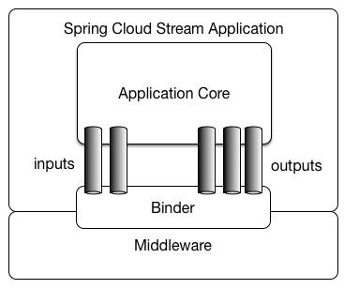
Cloud Stream

Slide 6
Binders and Channel
Binder
  Represents the underlying message broker middleware
Channel
  A virtual connection inside a connection
  Publishing or consuming a message from queue will happen over a channel
Publisher application publishes message to the message broker through Output channel
Consumer application receives messages from message broker through Input channel.

Slide 7
RabbitMQ
RabbitMQ is open source message broker software
The RabbitMQ server is written in the Erlang programming language
Built on the Open Telecom Platform framework for clustering and failover.
Need to install Erlang before installing RabiitMQ

Slide 8
Binder Detection
Serial peripheral interface (SPI)
  An interface that enables the serial exchange of data between two Applications,service,devices
  Operates on the Duplex Mode
Spring Cloud Stream relies on implementations of the Binder SPI
  To connect channels to message brokers.
  Each Binder implementation connects to one type of messaging system.
  Has out of the box binders for Kafka, RabbitMQ and Redis.

Slide 9
Class Path Detection
Spring Cloud Stream relies on Spring Boot’s auto-configuration to configure the binding process.
If a single binder implementation is found on the classpath, Spring Cloud Stream will use it automatically.
To bind only to RabbitMQ
  <dependency>
  <groupId>org.springframework.cloud</groupId>
  <artifactId>spring-cloud-stream-binder-rabbit</artifactId>
  </dependency>

Slide 10
Multiple Binders
When multiple binders are present on the classpath
Can use the property to configure the Binder
  org.springframework.cloud.stream.binder.Binder.
Can also be done globally ,
  spring.cloud.stream.defaultBinder=rabbit
Can be done individually on each channel binding.
  spring.cloud.stream.bindings.input.binder=kafka,
  spring.cloud.stream.bindings.output.binder=rabbit.

Slide 11
@EnableBinding
  To get immediate connectivity to a message broker
  Takes one or more interfaces as parameters
Adding this to a Configuration class makes an application Cloud Stream application
It triggers the configuration of Spring Cloud Stream infrastructure
Can be parameterized with one or more interface classes,
  The methods represent bindable components
  They are the message channels.

Slide 12
@StreamListener
@StreamListener
  annotation is modeled after other Spring Messaging annotations
  @MessageMapping, @JmsListener, @RabbitListener, etc.)
  Difference is it adds content type management and type coercion features.

Slide 13
Sink
@Input
  Identifies an input channel, through which received messages enter the application.
@Output
  Identifies an output channel, through which published messages leave the application.
Both take a channel name as a parameter and creates the channels
If a name is not provided, the name of the annotated method is used.

Slide 14
Sink
An Interface provided Spring Cloud Stream
Interface has one method which return a channel
Used like a Consumer to consume messages
  public interface Sink {
  String INPUT = "input";
  @Input(Sink.INPUT)
  SubscribableChannel input();
  }

Slide 15
Custom Sink
  Can also create Custom Interface to act as a Sink
  Can add more than one to channel to subscribe
  public interface HelloBinding {
  String GREETING = "greetingChannel";
  @Input(GREETING)
  SubscribableChannel greeting();
  }

Slide 16
Source
  public interface Source {
  String OUTPUT = "output";
  @Output(Source.OUTPUT)
  MessageChannel output();
  }

Slide 17
Custom Source
  public interface HelloBinding {
  @Output("greetingChannel")
  MessageChannel greeting();
  }

Slide 18
Binding properties
spring.cloud.stream.rabbit.binder.addresses
  A comma-separated list of RabbitMQ server addresses used only for clustering
  Default empty.
spring.rabbitmq.host=localhost
spring.rabbitmq.port=5672

Slide 19
Binding Properties
Supplied using the following format
spring.cloud.stream.bindings.<channelName>.<property>=
<channelName>
  represents the name of the channel being configured,
Binding properties may be available for both input and output
Bindings must be prefixed accordingly
  spring.cloud.stream.bindings.greetingChannel.destination = greetings

Slide 20
Setting Up Application
spring.cloud.stream.bindings.<channel-name>.group :-
  This will represent the queue that is responsible for storing the messages.
  The queue will be created when the consumer application is up and it will be subscribed to the exchange for getting messages.
  The consumer application will listen to the queue for receiving incoming messages.

Slide 21
Rabbit MQ Config Property
  server.port = 8081
  #RabbitMQ connection details
  spring.rabbitmq.host=localhost
  spring.rabbitmq.port=5672
  spring.rabbitmq.username=test
  spring.rabbitmq.password=test
  #this is the name of the exchange
  spring.cloud.stream.bindings.output.destination=orders-exchange

Slide 22
Model
  @Data
  public class Order implements Serializable {
  @JsonProperty("order_name")
  private String orderName;
  private Float amount;
  private String status;
  }

Slide 23
Rabbit MQ Config Property
  server.port=7070
  spring.rabbitmq.host=localhost
  spring.rabbitmq.port=5672
  spring.rabbitmq.username=guest
  spring.rabbitmq.password=guest
  spring.cloud.stream.bindings.employeeRegistrationChannel.destination=employeeRegistrations

Slide 24
Application
  @SpringBootApplication
  @EnableBinding(Sink.class)
  public class CloudStreamWithRabbitApplication {
  public static void main(String[] args) {
  SpringApplication.run(CloudStreamWithRabbitApplication.class, args);
  }
  @StreamListener(target = Sink.INPUT)
  public void processRegisterEmployees(String employee) {
  System.out.println("Employees Registered by Client " + employee);
  } }

Slide 25
Message Channel
  public interface EmployeeRegistrationSource {
  @Output("employeeRegistrationChannel")
  MessageChannel employeeRegistration();
  }

Slide 26
Controller
  @RestController
  @EnableBinding(EmployeeRegistrationSource.class)
  public class EmployeeRegistrationController {
  @Autowired
  EmployeeRegistrationSource employeeRegistrationSource;
  @PostMapping("/register")
  public String employeeRegistry(@RequestBody Employee employee) {
  employeeRegistrationSource.employeeRegistration().
  send(MessageBuilder.withPayload(employee).build());
  System.out.println(employee.toString());
  return "Employee Registered";
  }
  }

Slide 27
Stream Consumer
server.port=8090
spring.rabbitmq.host=localhost
spring.rabbitmq.port=5672
spring.rabbitmq.username=guest
spring.rabbitmq.password=guest
spring.cloud.stream.bindings.input.group=employeeRegistrationQueue

Slide 28
Consume Message
    @EnableBinding(Sink.class)
    @SpringBootApplication
    public class EmployeeRegistrationProcessingApplication {
    public static void main(String[] args) {
    SpringApplication.run(EmployeeRegistrationProcessingApplication.class, args);
    }
    @StreamListener(target = Sink.INPUT)
    public void processRegisterEmployees(String employee) {
    System.out.println("Employees Registered by Client " + employee); }
    }

Slide 29
Domain Driven Design
An introduction to core Domain Driven Design concepts
  What is a Domain?
  Ubiquitous Language
  Decomposing the domain
  Bounded Context
  Aggregates and AggregateRoot

Slide 30
DOMAIN DRIVEN DESIGN

Slide 31
Domain Driven Design
DDD is a software development approach that uses and builds upon OOADprinciples and ideas
Common definition of domain
  “A sphere of knowledge or activity.”
In Application development, the domain
  “sphere of knowledge and activity around which the application logic revolves.”

Slide 32
Domain-Driven Design
DDD focuses on three core principles:
  Focus on the core domain and domain logic.
  Base complex designs on models of the domain.
  Constantly collaborate with domain experts, in order to improve the application model and resolve any emerging domain-related issues.

Slide 33
DDD Practices
Context
  The setting in which a word or statement appears
  It determines its meaning.
  Statements about a model can only be understood in a context.
Model
  A system of abstractions that describes selected aspects of a domain and can be used to solve problems related to that domain.

Slide 34
DDD Practices
Ubiquitous Language
  A language structured around the domain model
  Used by all team members to connect all the activities of the team with the software.
Bounded Context
  A description of a boundary
  A subsystem, or the work of a specific team within which a particular model is defined and applicable.

Slide 35
Building Blocks
DDD has high-level concepts that can be used in conjunction with one another to create and modify domain models:
Entity
  An object that is identified by its consistent thread of continuity, as opposed to traditional objects, which are defined by their attributes.
Value Object
  An immutable (unchangeable) object that has attributes, but no distinct identity.

Slide 36
Building Blocks
Domain Event
  An object that is used to record a discrete event related to model activity within the system.
  A domain event is only created for event types which the domain experts care about.
Aggregate
  A cluster of entities and value objects with defined boundaries around the group.
AggegateRoot
  Instead of allowing every single entity or value object to perform all actions on its own
  The collective aggregate Root is assigned
  This will be directly accessed by External objects

Slide 37
Building Blocks
Service
  Service is an operation or form of business logic that doesn’t naturally fit within the realm of objects.
  If some functionality must exist, but it cannot be related to an entity or value object, it’s probably a service.
Factories
  DDD suggests the use of a factory, which encapsulates the logic of creating complex objects and aggregates,
  Ensures that the client has no knowledge of the inner-workings of object manipulation

Slide 38
Building Blocks
Repositories
  DDD meaning of a repository is a service that uses a global interface
  Provides provide access to all entities and value objects that are within a particular aggregate collection.
  Methods should be defined to allow for creation, modification, and deletion of objects within the aggregate.
  Remove data query capabilities from within the business logic of object models.

Slide 39
CQRS AND EVENTSOURCING

Slide 40
CQRS
Command Query Responsibility Segregation
A pattern to separate the Read and Write operations.
CQRS distinguishes the operations as:
CQRS separates the responsibilities
  A component that covers CUD operations without the Reading
  A component will ensure the Read operation.

Slide 41
Query
Query
  is a Read operation
  Does not update any the state of the application.
  Handled by the Reading Components
  They will interact with the DB, parses the DB response, creates a Data Transfer Object that will be returned to the User.

Slide 42
Command
Command
  Business Action that the Application’s user want to do
    RegisterStudent, MakeDeposit
  Every Command has a Handling Layer that knows how to apply the Business Action.
  Commands are inserted in a Queue to be processed asynchronously
  Command Handler is invoked by a Queue Listener..

Slide 43
Command and Queries
Feature Command Query
Create a new account Yes No
Credit an amount from account Yes No
Debit an amount from account Yes No
Get Account information No Yes
Commands
  CreateAccountCommand
  CreditMoneyCommand
  DebitMoneyCommand
Queries
  FindAccountQuery

Slide 44
Event Sourcing
Event Sourcing aims to persist the state of a business entity as a sequence of state-changing events.
Every action performed on a business entity should be persisted.
The application reconstructs an entity’s current state by replaying the events.
Applications persist events in a database of events called event store.
  The store has an API for adding and retrieving an entity’s events.
  The event store also behaves like a message broker.
  It provides an API that enables services to subscribe to events.
  When a service saves an event in the event store, it is delivered to all interested subscribers.

Slide 45
Event Sourcing
Event Sourcing stores a record of every action in a dedicated database.
An event handler reads these changes in order, applies them appropriately and marks them as complete once the transaction is complete.
This event handler does not need to be complex — it can be as simple as an API endpoint.
Once the event handler creates an event record, a central service messaging system can push notifications every time it discovers about a new event.

Slide 46
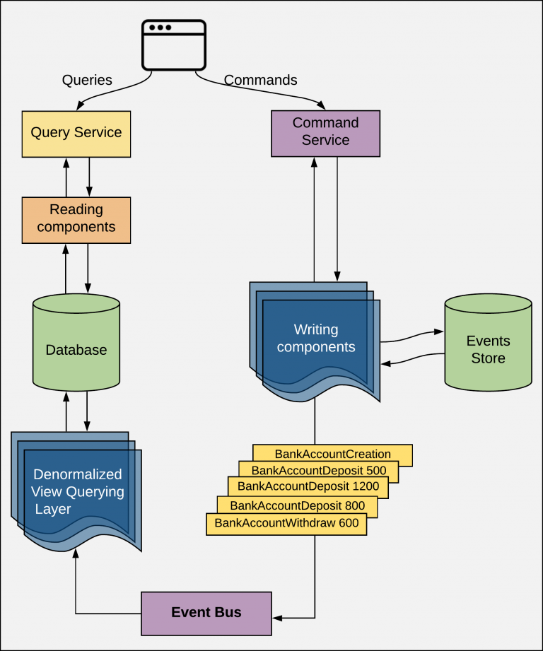
CQRS and Event Sourcing

Slide 47
AXON
Axon provides a unified, productive way of developing Java applications that can evolve without significant refactoring from a monolith to Event-Driven microservices.
Axon includes both a programming model as well as specialized infrastructure
  scaling and distributing mission critical business applications.
The programming model is provided by the popular Axon Framework
Axon Server is the infrastructure part of Axon, all open sourced.

Slide 48
Application
Application will have these features:
Create a new account for a given Owner with a given Initial Balance
Credit an amount on a given account
Debit an amount from a given account
Read information about a given account

Slide 49
AXON -CQRS
Aggregate
  Will have a Command Handler and EventSourcing Handler
  Has a @AggregateIdentifier
Command
  A class - CreateAccount,CreditAccount,DebitAccount
  With a Property with a @TargetAggregateIdentifier
Command Handler
  A Method annotated with a @CommandHandler
  Takes Command as argument
Also contains Repository,DTO and Controllers

Slide 50
AXON -CQRS
Entity
  A Class annotated with Entity
Event
  Can be immutable Class with @Value annotation
  Command is formed by an Action + Command suffix
  Event is PastAction + Event suffix
Projector
  A dedicated class that will match the DB operations for every received event
  Has Event Handler and Query Handler
Services
  Which has Command and Query Gateway
  To send command and Query

Slide 51
Rest API
REST API and the Spring Service will be receiving the HTTP Requests and dispatching the Commands to the Axon Engine.
Axon provides a component CommandGateway
  Convenient interface towards the command dispatching mechanism
EventStore
  provides access to both the global event stream comprised of all domain and application events.
Axon Server UI will be reachable on http://localhost:8024/

Slide 52
APACHE KAFKA

Slide 53
Apache Kafka
Open-source stream processing platform
  A distributed publish-subscribe messaging system with a unique design.
  Written in Scala and Java.
  Distributed, partitioned, replicated
  Can handle hundreds of thousands to millions of messages per second on a small cluster
    ActiveMQ can only handle 1000 messages per second.

Slide 54
ZooKeeper
Kafka is a Messaging System with distributed features
  It uses Zookeeper to track status of its cluster nodes, topics, partitions etc.
Zookeeper
  Distributed, open-source, configuration, synchronization service
    Also naming registry for distributed applications
Kafka need to have Zookeeper installed.

Slide 55
ZooKeeper
Zookeeper can be downloaded from its official site
  https://zookeeper.apache.org/releases.html
Extract and execute zookeeper-server-start.bat
  zookeeper-server-start ../../config/zookeeper.properties
It will be automatically started as a daemon, and by default will be listening on port 2181
Check the connection by telnet localhost 25
  If the connection succeeds, a blank screen will show up,

Slide 56
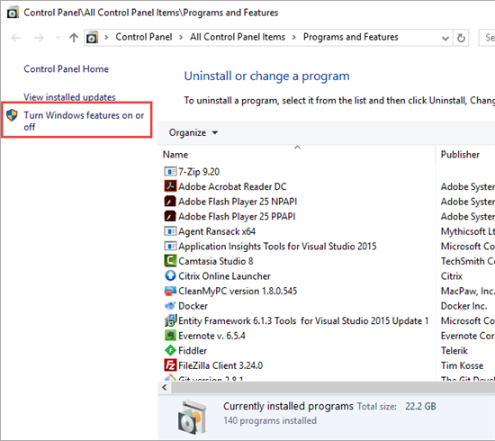
Telnet
Open “Control Panel“.
Open “Programs“.
Select the “Turn Windows features on or off ” option.
Check the “Telnet Client” box.

Slide 57
Kafka
Download the latest Kafka
  https://kafka.apache.org/downloads
Configure the Kafka Server
  Update server.properties file.
  By adding delete.topic.enable at the end of the file.
delete.topic.enable = true

Slide 58
Start.bat
kafka_2.12-2.3.0\bin \start.bat
  cd windows
  start zookeeper-server-start ../../config/zookeeper.properties
  start kafka-server-start ../../config/server.properties

Slide 59
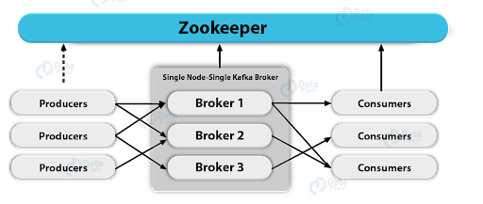
ZooKeeper

Slide 60
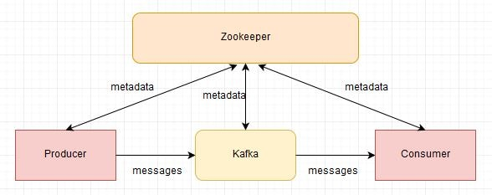
Apache Kafka
.

Slide 61
Apache Kafka
Used to build real-time streaming data pipelines
  Reliably passing a stream of records from one application to another
  Processing and transferring the records to the target applications.
  publishing and subscribing to a stream of records
  storing the records in a fault tolerant way

Slide 62
Advantages of Kafka
High Throughput
  Can process messages at very fast speed.
  Processing rates can exceed beyond 100k/seconds.
  The data is processed in a partitioned and ordered fashion.
Scalability
  Achieved at various levels.
  Multiple producers can write to the same topic.
  Topics can be partitioned.
  Consumers can be grouped to consume individual partitions.
Durability
  Offers data durability as well, message written in Kafka can be persisted.
  The persistence can be configured.
  This ensures re-processing, if required, can be performed.

Slide 63
Advantages of Kafka
Fault Tolerance
  Kafka has several nodes running together to serve the cluster.
  Topics inside Kafka are replicated.
  Users can choose the number of replicas for each topic to be safe in case of a node failure.
  Node failure in cluster won’t impact.
  Integration with Zookeeper provides producers and consumers accurate information about the cluster.
  Internally each topic has its own leader which takes care of the writes.
    Failure of node ensures new leader election.

Slide 64
Producers
Application that produces or streams data to a topic
  Can also assign the partition to which the data should be published
The stream of records is published to the topics by the producers.
Data is sent in a round robin way
Can also implement a priority system
  Sending to certain partitions based on the priority of the record.

Slide 65
Consumers
Consumer groups
  A group of consumers acting as a single unit.
  Used for scaling the application.
Consumer
  An application that receives the messages sent by the producer
  Based on the consumer-group,
The record which is published to the topic is only delivered to one instance of the consumer from one consumer-group.
Each instance of the consumer will get hold of the particular partition such that within a consumer-group, the records can be processed parallel by each consumer.

Slide 66
Topics
Kafka is run as a cluster in one or more servers
  Clusters stores/retrieves the records in Topics.
  topic is a name for a data stream.
Each record in the topic is stored with a key, value, and timestamp.
The topics can have zero, one, or multiple consumers, who will subscribe to the data written to that topic.
Each consumer will listen to a particular topic and whenever there is data in that topic, the consumer will receive it.

Slide 67
Partition
Cluster
  A cluster is a group of something, it is a group of computers
  Each executing one instance of Kafka broker.
The data in each topic may be broken into partitions
  They are distributed to different brokers across the clusters.
The records are always appended at the end of the partitions.
“Offset
  It is a sequence number assigned to each message arriving into the Kafka server.
  Offsets are not globally assigned, rather it is assigned locally in partitions.

Slide 68
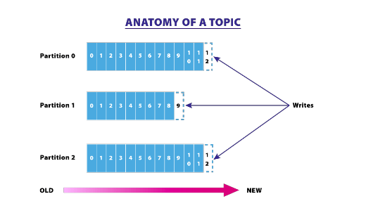
Partitions
The Kafka cluster uses a partitioned log for each topic.

Slide 69
Kafka Broker
It’s a Name for Kafka server.
The producer and consumer use Kafka broker as an agent
  Allows consumers to fetch messages by topic, partition and offset.
They can create a Kafka cluster by sharing information between each other directly or indirectly using Zookeeper.
A cluster has exactly one broker that acts as the Controller.

Slide 70
Kafka – pom.xml
  <dependency>
  <groupId>org.springframework.kafka</groupId>
  <artifactId>spring-kafka</artifactId>
  </dependency>

Slide 71


