Slide 1


Slide 2

K.Srivatsan - vatsank@gmail.com
IT Trainer Since 1991
Conducting Java Training Since 2004
About 60+ Corporate Clients

Slide 3
MICRO SERVICES – SPRING BOOT
Module-1 – Version -2

Slide 4
Course Outline
Introduction to Microservices
Spring Cloud Eureka
Spring Cloud Config Server and Client Configuration
Introduction Project Reactor and Reactive Spring
Client Side Load-Balancing with Spring Cloud Load Balancer
Spring Cloud circuit breaker and resilience4j
Request Routing With Spring cloud gateway

Slide 5
INTRODUCTION TO MICRO SERVICES

Slide 6
Micro Services
Problems with Monolithic Application
What is Microservices
Advantages and disadvantages
When not to use Microservice
Use case for MicroServices

Slide 7
Monolith Application
A monolithic application is a single-tiered software application
  Has user interface and data access code combined into a single program from a single platform.
Its characteristics
  Doesn’t have Module but Modularized using object-based approach to be distributed across multiple computers
  Deployed together as a single deployment unit- EAR or WAR.
  Long Release Cycles
  Large Teams

Slide 8
Challenges to Monolith
  Large codebases become mess over the time
  Multiple teams working on single codebase become tedious
  Difficulty in Adapting to Device Explosion
  Scaling up certain parts of the application
  Technology updates/rewrites become complex and expensive tasks

Slide 9
Micro Services
An engineering approach focused on decomposing applications with well-defined interfaces - service contracts such as a JSON schema or WSDL
  Deployed independently as services and operated by small teams who own the entire lifecycle of the service.
  Each service handles a specific business domain (logging, auth, orders, customers)
  Each Service provides the implementation for user interface, business logic, and connection to database.
  Each Service can be scaled up Individually

Slide 10
Micro Service
  class UserApp() {
  User getUser() {
  // 1. auth user
  // 2. get user data
  // 3. log user actions
  }
  }
  class UserApp() {
  void authUser(User user) { ... }
  User getUserData() { ... }
  void logUserActions() { ... }
  }

Slide 11
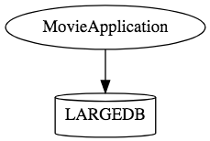
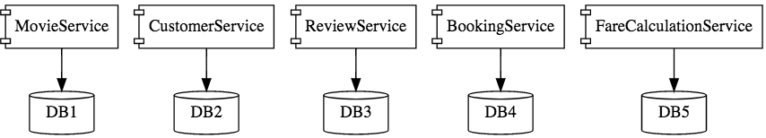
Micro Services

Slide 12
Characteristics of Micro Service
Single-function
  Each and every service has a specific function, or responsibility.
  A service can do many tasks, but all of them are relevant to a single function.
Well-defined interfaces
  Services must provide an interface that defines to communicate with it.
  Defines a list of methods, and their inputs and outputs.
  JSON Schema or WSDL files

Slide 13
Characteristics of Micro Service
Independent
  Services doesn’t know about each other implementation.
  They can get tested, deployed, and maintained independently.
  Services may be implemented using different language stacks, and communicate with different databases.
    They can work together to complete a required operation.

Slide 14
Characteristics of Micro Service
Small Teams
  Split the work up and team across the services.
  Each team focuses on a specific service, they don’t need to know about internal workings of other teams.
  Teams can work efficiently, communicate easily,
  Each service can be deployed rapidly as soon as it’s ready.
Entire Lifecycle
  The team is responsible for the entire lifecycle of the service; from coding, testing, staging, deploying, debugging, maintaining.
  No separate team for coding, deployment. Etc

Slide 15
Characteristics of Micro Service
Minimizing Communication
  Only essential cross-team communication should be through the interface that each service provides.
  They all need to agree on the external interface, so that communication between services is clearly defined.
Cloud Enabled
  Dynamic Scaling

Slide 16
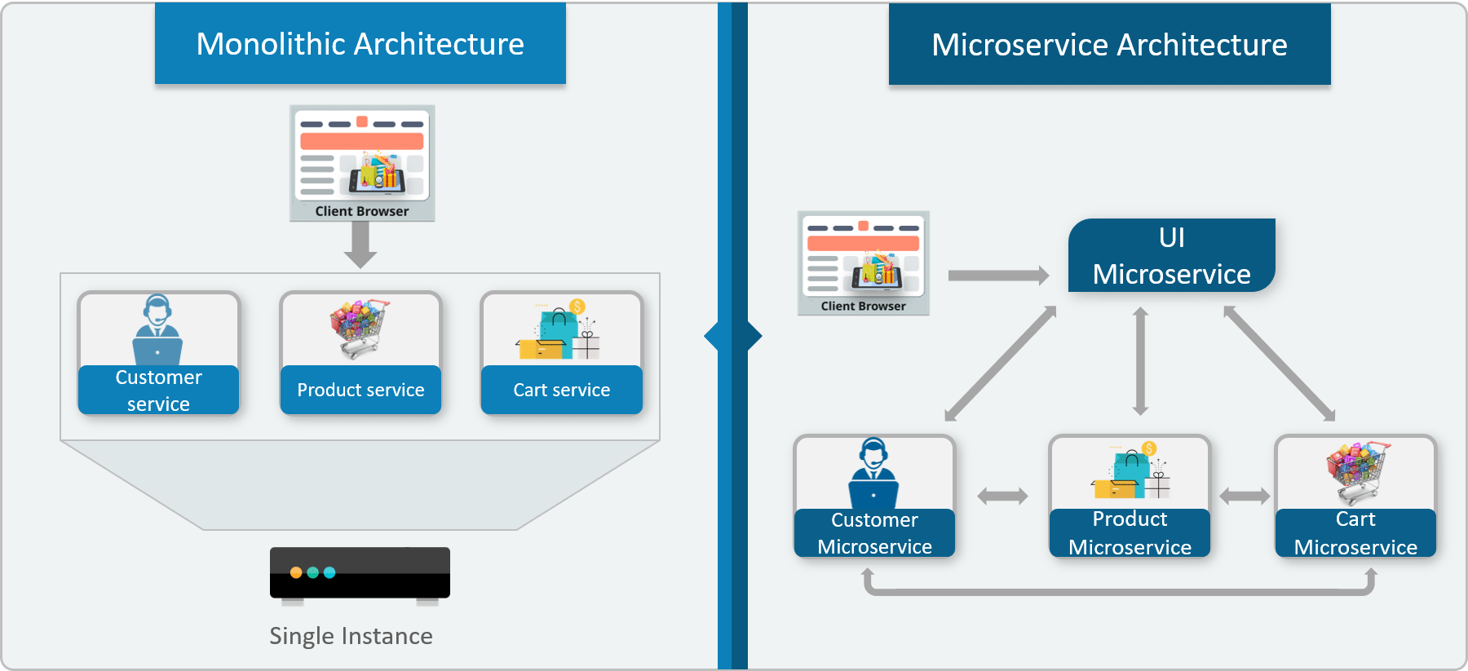

Monolithic vs Micro Service

Slide 17
When Not to use Micro Services
Complexity is a key factor
  "...don't even consider microservices unless you have a system that's too complex to manage as a monolith...“ –Martin Fowler
If complexity isn't problem, microservices aren't the solution.
Micro service architecture also brings with it significant overhead
  Design
  Interoperability of services
  Management
  Use of system resources.

Slide 18
Challenges with Micro service
Development has some inherent complexities
Quick Setup needed
  Should be able to create micro services quickly.
Automation
  Smaller component build ,deployment, monitoring etc should automated
Visibility :
  Should be able to monitor and identify problems automatically.
  Need great visibility around all the components.
Debugging
  Centralized Logging and Dashboards are essential to debug problems.

Slide 19
Challenges with Micro service
Configuration Management
  Need to maintain configurations for hundreds of components across environments.
  Should Have Configuration Management solution
Dynamic Scale Up and Scale Down
  Applications should be easily scaled up and down
Pack of Cards :
  If a Service at the bottom of the call chain fails, it can have knock on effects on all other services.
  Services should be fault tolerant by Design.
Consistency
  Should have some decentralized governance around the languages, platforms, technology and tools used for implementing/deploying/monitoring

Slide 20
Solutions to Challenges
Spring Boot
  Enable building production ready applications quickly
  Provide non-functional features
  embedded servers (easy deployment with containers)
  metrics (monitoring)
  health checks (monitoring)
  externalized configuration

Slide 21
Solutions to Challenges
Spring Cloud
  Cloud solutions open sourced by Netflix
Dynamic Scale Up and Down.
  Using a combination of Naming Server (Eureka)
  Ribbon (Client Side Load Balancing)
  Feign (Easier REST Clients)
Visibility and Monitoring
  Zipkin Distributed Tracing
  Netflix API Gateway
Configuration Management
  Spring Cloud Config Server
Fault Tolerance
  Hystrix

Slide 22
SPRING CLOUD EUREKA

Slide 23
Service Register and Discovery
Applications may consist of many number of microservices.
  Each deployed in different servers and different ports.
Services may need to communicate with each other to execute some tasks
  Using ip address and port number has many limitations on invoking the services

Slide 24
Service Register and Discovery
Services should register themselves in the centralized location with an identifier and server details.
  This is known as “Service Registration“.
Each microservice should be able to look up the list of registered services in the centralized location and it is known as “Service Discovery”
Following are the implementations of Service Registration and Discovery Server
  Netflix Eureka
  Consul
  Zookeeper

Slide 25
Netflix Eureka Server
An implementation for the “Service Registration and Discovery” pattern.
Keeps a track of registered micro sevices
  Hence known as registry of micro services
Micro services should register with Eureka server by providing their details
  host name, ip address, port, and health indicators etc…
  Service will be registered with unique identifier known as serviceId.
  Other services can use this serviceId to access the particular service.

Slide 26
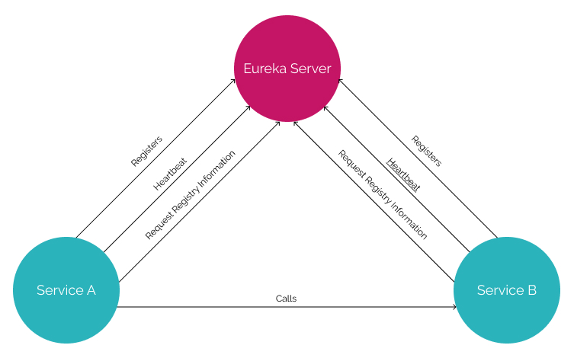
Service Registry

Slide 27
Service Registry
Eureka does not handle communication between the two servers, only the registration.
This means that a service uses Eureka only to find out the address of the other service.
After that the communication is done directly between the two services, without Eureka.
If Eureka is down, the client uses a cached copy of the remote service's address, which is good for resilience and temporary network failures.
If Eureka is down it doesn't mean that the remote service is also down or that it's physical address has changed.

Slide 28
Netflix Eureka Server
Represented by EurekaServerConfigBean
    It mplements com.netflix.eureka.EurekaServerConfig.
  Its properties are prefixed by eureka.server.
Server maintains a registry of up and running micro services.
Services registers itself with Eureka, and pings Eureka server to notify that it’s alive.

Slide 29
@EnableEurekaServer
Eureka instance
  Represented by EurekaInstanceConfigBean
    It indirectly implements com.netflix.appinfo.EurekaInstanceConfig.
  All properties are prefixed by eureka.instance.
@EnableEurekaServer
  Added to the main Spring Boot Application configuration class
  Used to Notify the Spring Container that this application is a registration service by Netflix technology
  It also activates Eureka Server related configurations

Slide 30
Enable Eureka Server
  @EnableEurekaServer
  @SpringBootApplication
  public class EurekaServerApplication {
  public static void main(String[] args) {
  SpringApplication.run(EurekaServerApplication.class, args);
  }
  }

Slide 31
Server Config Properties
  server:
  port: 8761
  spring:
  application:
  name: eureka-server-registry
  eureka:
  client:
  fetch-registry: false
  register-with-eureka: false
  service-url:
  defaultZone: http://localhost:8761/eureka

Slide 32
Configuration Properties
fetch-registry=false (default: true)
  Does not register itself in the service registry
  The client fetches the Eureka server registry at startup and caches it locally.
    Afterwards it only fetches the delta
eureka.client.registryFetchIntervalSeconds=60
  Registry fetching is an asynchronous task scheduled every 30s
  It can be Configured with the above property

Slide 33
Configuration Properties
eureka.client.register-with-eureka=false (default: true)
  Should this server register itself as a client;
  Eureka server is also acting as a client so that it can sync the registry.
  The value being false means it prevents itself from acting as a client.
  An instance registers with a Eureka server using a given URL

Slide 34
Configuration Properties
eureka.client.serviceUrl.defaultZone
  In standalone mode, used to switch off the client side behavior
    Does not keep trying and failing to reach its peers.
  To consult with other Eureka servers to sync the service registry.
  In a standalone mode points to the local server address.
  The port in which the server will be bound.

Slide 35
Configuration Properties
eureka.instance.leaseRenewalIntervalInSeconds.
  Client sends heartbeats every 30s
  If the server doesn’t receive a heartbeat, it waits for 90seconds
  After 90 seconds the instance is removed and there by disallowing traffic to that instance.
    Configued with the property
      eureka.instance.leaseExpirationDurationInSeconds

Slide 36
EUREKA DISCOVERY CLIENT

Slide 37
Discovery From Eureka Server
Eureka client
  Represented by EurekaClientConfigBean
    Implements com.netflix.discovery.EurekaClientConfig.
  All properties are prefixed by eureka.client.
Micro services can register themselves as Discovery clients
  The Server will allow the discover clients to look up the other registered services and fetch their information.
  Discover client can fetch the information of the targeted service
  Services can communicate without IP addresses and port numbers manually.

Slide 38
Discovery Clients
Need to register the applications in the Eureka server as a Eureka Discoverable Client.
@EnableDiscoveryClient
  To be added in the main spring boot configuration class to make the service as a Discoverable client.
  Can work with any Discovery Client implementations like Eureka, Consul, Zookeeper
@EnableEurekaClient
  Works only with Eureka Discovery Client implementation.

Slide 39
Registering a Service With Eureka
Create a Eureka Server Service
  Add spring-boot-starter-web and cloud-starter-Netflix-eureka-server module
Check its running on the configured port
  http://localhost:8761
  Eureka dash board will be shown on the browser
Create a Spring Boot Project to register with eureka
  Add spring-boot-starter-web
  cloud-starter-Netflix-eureka-client module
  Lombok
  Spring-Data-Jpa
  MySql Driver – or other database Drivers

Slide 40
Entity
  @Data
  @AllArgsConstructor
  @NoArgsConstructor
  @FieldDefaults(level = AccessLevel.PRIVATE)
  @Entity
  @Table(name = "ecomm_product")
  public class Item {
  @Id
  long id;
  String name;
  int quantity;
  double price;
  }

Slide 41
Data Repository
  public interface ItemRepository extends JpaRepository<Item, Long> {
  public List<Item> findByName(String name);
  }

Slide 42
Service
  @Service
  public class ItemService {
  @Autowired
  private ItemRepository repo;
  public List<Item> getAll(){
  return this.repo.findAll();
  }

Slide 43
Controller
  @RestController
  @RequestMapping(path = "/api/v1/")
  public class ItemController {
  @Autowired
  private ItemService service;
  @GetMapping(path = "/items" , produces = "application/json")
  public List<Item> findAll(){
  return this.service.getAll();
}

Slide 44
Discovery Client Service
  @SpringBootApplication
  @EnableEurekaClient
  public class BloodDonarServiceApplication {
  public static void main(String[] args) {
  SpringApplication.run(BloodDonarServiceApplication.class, args);
  }
  }

Slide 45
application.yml
  spring:
  application:
  name: product-service
  server:
  port: 5454
  eureka:
  client:
  service-url:
  defaultZone: http://localhost:8761/eureka

Slide 46
REACTIVE SPRING

Slide 47
Introduction
A programming paradigm that promotes
  asynchronous, non-blocking, event-driven approach to data processing.
Thread per request model to more requests with few number of threads
  Prevent threads from blocking while waiting for I/O operations to complete
Easy to do parallel calls

Slide 48
Event Stream
Reactive programming uses a functional style approach
  Like the Streams API
Possibility to perform different kinds of transformations on the streams.
A stream can be used as an input to another one.
Streams can be merged, mapped and filtered

Slide 49
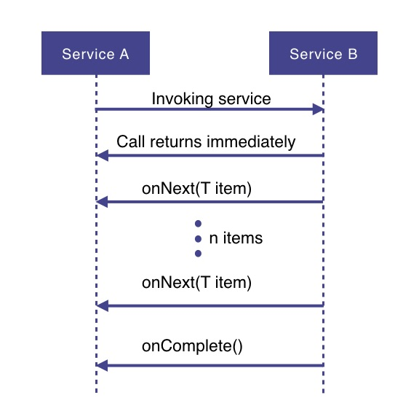
How Does it Work

Slide 50
How Does it Work
Service A wants to retrieve some data from service B.
Service A will make a request to service B which returns immediately
  Non-blocking and asynchronous.
Data requested will be made available to service A as a data stream,
  Service B will publish an onNext-event for each data item one by one.
When all the data has been published
  onComplete event is fired
In case of an error, an onError event would be published
  Items would not be emitted.

Slide 51
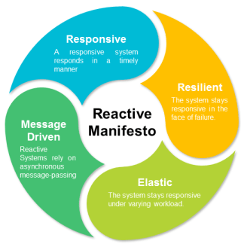
Reactive Manifesto

Slide 52
Reactive Extensions
Reactive Extensions also called ReactiveX or Rx
  A cross-language standard
Implementations of Reactive Streams
  The Java implementations are RxJava 1.x ,2.x
    Published under the Apache 2.0 license.
    Povides Java API for asynchronous programming with observable streams.
  Project Reactor
  Vert.x
  Akka Streams

Slide 53
Reactive Stream Specification
Publisher
Subscriber
Subscription
Processor

Slide 54
Publisher
Represents the data source
  database, external service, etc.
  public interface Publisher<T> {
  public void subscribe(Subscriber<? super T> s);
  }

Slide 55
Subscriber
Represents the consumer of the stream data.
  public interface Subscriber<T> {
  public void onSubscribe(Subscription s);
  public void onNext(T t);
  public void onError(Throwable t);
  public void onComplete();
  }

Slide 56
Subscription
A subscription is required to be made by the subscriber against the publisher in order to fetch data.
  public interface Subscription {
  public void request(long n);
  public void cancel();
  }

Slide 57
Processor
A Processor represents a processing stage which is both a Subscriber and a Publisher.
If an entity shall transform incoming items and then pass it further to another Subscriber, an implementation of the Processor interface is needed.
This acts both as a Subscriber and as a Publisher.
  public interface Processor<T, R> extends Subscriber<T>, Publisher<R> {
  }

Slide 58
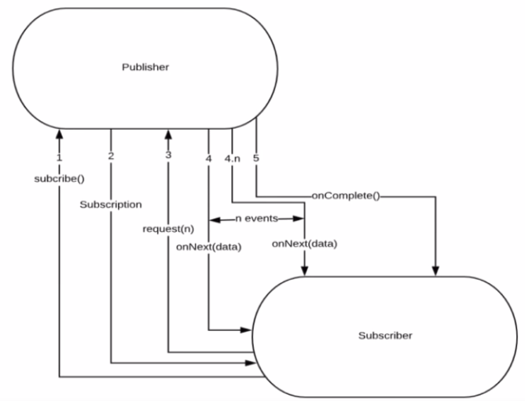
Flow Between Publisher and Subscriber

Slide 59
PROJECT REACTOR

Slide 60
PROJECT REACTOR
Spring Framework supports reactive programming since version 5.
  That support is build on top of Project Reactor.
WebFlux, Spring's reactive-stack web framework, requires Reactor as a core dependency.
Suited for Microservices Architecture
Offers backpressure-ready network engines for HTTP (including Websockets), TCP, and UDP.
Built and maintained by Pivotal
Recommended Library to work with Spring Boot
Runs on Java 8 and above.

Slide 61
Reactor Modules
Project Reactor consists of a set of modules
  The modules are embeddable and interoperable.
Reactor Core
  Holds the reactive types Flux and Mono
  Implementation of the Reactive Stream's Publisher interface and a set of operators that can be applied .
Reactor Test
  Utilities for testing reactive streams

Slide 62
Reactor Modules
Reactor Extra
  Additional Flux operators
Reactor Netty
  Non-blocking and backpressure-ready TCP, HTTP clients and servers
  Based on the Netty framework
Reactor Adapter
  Adapting to/from other reactive libraries such as RxJava2 and Akka Streams
Reactor Kafka
  Reactive API for Kafka

Slide 63
Setting up a Project
Spring Boot application using Spring Initializr.
  Add Spring Reactive Web as dependecy
The spring-boot-starter-webflux dependency is added
  It will bring in the reactor-core dependency.
  The reactor-test has been added as a dependency.
Spring Webflux
  A reactive-stack web framework
  Runs on Netty, and Servlet 3.1+ containers.

Slide 64
Setting up a Project
  <dependency>
  <groupId>org.springframework.boot</groupId>
  <artifactId>spring-boot-starter-webflux</artifactId>
  </dependency>
  <dependency>
  <groupId>org.springframework.boot</groupId>
  <artifactId>spring-boot-starter-test</artifactId>
  <scope>test</scope>
  </dependency>

Slide 65
Types of Publishers
Spring Webflux uses two Publishers
Mono
  To publish 0..1 element
  Mono is like the Optional type provided in Java 8.
  Mono to return a single object or VOid
Flux
  To publish 0..N element.
  Used to return lists.

Slide 66
Flux and Mono
They are both terminated either by a completion signal or an error
They call a downstream Subscriber's onNext, onComplete and onError methods.
Both provide a set of operators to support transformations, filtering, and error handling.

Slide 67
Flux
  Flux flux1 = Flux.just(“foo”, “bar”, “foobar”);
  Flux flux2 = Flux.fromIterable(Arrays.asList(“A”, “B”, “C”));
  Flux flux3 = Flux.range(5, 3);
Has three types of signals
  Signals that translate calls to a downstream subscriber’s
  onNext, onComplete, or onError methods.

Slide 68
Creating Flux
Just (T... data)
  Overloaded method
  Create a new Flux that will only emit a single element then onComplete.
  Returns a new Flux
Flux<String> fluxColors = Flux.just("red", "green", "blue");
fluxColors.subscribe(System.out::println);

Slide 69
Creating Flux
  @Component
  public class CreatingFlux {
  @Autowired
  private List<Book> bookList;
  public Flux<String> emptyFlux(){
  Flux<String> emptyFlux = Flux.empty();
  return emptyFlux;
  }
}

Slide 70
Creating Flux
  public Flux<String> fluxFromValue(){
  Flux<String> fluxFromValue = Flux.just("India","Nepal","Srilanka","Bhutan");
  return fluxFromValue;
  }
  public Flux<String> fluxFromArray(){
  String[] names = {"India","Nepal","Srilanka","Bhutan"};
  Flux<String> fluxFromArray = Flux.fromArray(names);
  return fluxFromArray;
  }

Slide 71
Creating Flux
  public Flux<Book> fluxFromList(){
  Flux<Book> fluxFromList = Flux.fromIterable(this.bookList);
  return fluxFromList;
  }

Slide 72
Creating Flux
  public void fluxWithCallBacks(){
  Flux<Book> fluxFromList1 = Flux.fromIterable(this.bookList);
  fluxFromList1.subscribe(
  System.out::println,
  e-> System.out.println(e),
  ()-> System.out.println("complete")
  );

Slide 73
Creating Flux
  Flux<Book> fluxFromList2 = fluxFromList1
  .doOnNext(value -> System.out.println(
  "[doOnNext] " + Thread.currentThread().getName() + " value: " + value))
  .doOnSubscribe(sub -> System.out.println(
  "[doOnSubscribe] " + Thread.currentThread().getName()));
  fluxFromList2.subscribe();
  }

Slide 74
Application
  public static void testFlux(Flux<?> fluxRef) {
  fluxRef.subscribe(System.out::println);
  }
  CreatingFlux fluxAppRef = ctx.getBean(CreatingFlux.class);
  testFlux(fluxAppRef.emptyFlux());
  testFlux(fluxAppRef.fluxFromList());

Slide 75
Mono
Emits at most one item and then optionally terminates with an onComplete signal or an onError signal.
  Mono noData = Mono.empty();
  Mono data = Mono.just(“ramesh”);

Slide 76
Mono and Flux
  public Mono<Book> bestBook(){
  Mono<Book> bestBook = Mono.just(bookList.get(1));
  return bestBook;
  }
  public Mono<Book> betterBook(){
  Mono<Book> betterBook = Mono.just(bookList.get(0));
  return betterBook;
  }
  public Flux<Book> fluxFromMono(){
  return Flux.concat(bestBook(),betterBook());
  }

Slide 77
OPERATORS

Slide 78
Operators
Operators adds behavior to a Publisher
Wraps the previous step’s Publisher into a new instance.
Methods in the API return a Flux or a Mono
  Helps in chaining operators
  Data originates from the first Publisher and moves down the chain, transformed by each link.
Eventually, a Subscriber finishes the process.
  Nothing happens until a Subscriber subscribes to a Publisher.

Slide 79
Operators
Creating a new sequence
  just, fromArray, fromIterable, fromStream
Transforming an existing sequence
  map, flatMap, startWith, concatWith
Peeking into a sequence
  doOnNext, doOnComplete, doOnError, doOnCancel
Filtering a sequence
  filter, ignoreElements, distinct, elementAt, takeLast
Handling errors
  onErrorReturn, onErrorResume, retry

Slide 80
Operators
Working with time
  elapsed, interval, timestamp, timeout
Splitting a Flux
  buffer, groupBy, window
Going back to the synchronous world
  block, blockFirst, blockLast, toIterable, toStream
Multicasting a Flux to several Subscribers
  publish, cache, replay

Slide 81
Log() operator
Operator provides logging of all Reactive Streams signals taking place behind the scenes.
  fluxColors.log().subscribe(System.out::println);

Slide 82
Map Operator
There are many reactive operators. We will be discussing about map, flatMap, concat, merge and zip.
Map
Map transforms the elements emitted by a Flux to other value by applying a synchronous function to each item.
Flux.just(1, 5, 10) .map(num -> num * 10) .subscribe(System.out :: println);
  Map transforms the elements emitted by a Flux to other value by applying a synchronous function to each item.
  Flux.just(1, 5, 10)
  .map(num -> num * 10)
  .subscribe(System.out :: println);
  Flux<String> fluxColors = Flux.just("red", "green", "blue");
  fluxColors.map(color -> color.charAt(0)).subscribe(System.out::println);

Slide 83
FlatMap
Transform the elements emitted by the Flux asynchronously into Publishers
  Then flatten these inner publishers into a single Flux through merging.
Flux.just(1, 5, 10)
.flatMap(num -> Flux.just(num * 10))
.subscribe(System.out :: println);

Slide 84
Concat and Merge
  Flux<Integer> flux1 = Flux.just(1, 5, 10)
  .delayElements(Duration.ofMillis(200));
  Flux<Integer> flux2 = Flux.just(15, 20, 25)
  .delayElements(Duration.ofMillis(400));
  Mono<Integer> mono1 = Mono.just(1);
  flux1.concatWith(flux2).concatWith(mono1)
  .subscribe(System.out :: println);

Slide 85
Concat and Merge
Flux.concat(mono1, mono2, mono3)
  Static function for concatenation
flux1.concatWith(flux2)
  Instance method for concatenation.
merge ()
  merge data from a Flux and a Publisher into an interleaved merged sequence
  concat merge adds with no interleave.

Slide 86
Concat and Merge
  Flux<Catalog> mergeFluxWithInterleave(Flux<Catalog> flux1, Flux<Catalog> flux2) {
  return flux1.mergeWith(flux2);
  }
Merge flux1 and flux2 values with no interleave (flux1 values and then flux2 values)
  Flux<Catalog> mergeFluxWithNoInterleave(Flux<Catalog> flux1, Flux<Catalog> flux2) {
  return flux1.concatWith(flux2);
  }

Slide 87
Zip
It zips given Flux with another Publisher source,
It waits for both to emit one element and combine these elements once into a Tuple
Flux<String> fluxFruits = Flux.just("apple", "pear", "plum");
Flux<String> fluxColors = Flux.just("red", "green", "blue");
Flux<Integer> fluxAmounts = Flux.just(10, 20, 30);
Flux.zip(fluxFruits, fluxColors, fluxAmounts).subscribe(System.out::println);

Slide 88
Zip
  Flux<String> bookNames = Flux.just("Java","Python","Spring","Angular");
  Flux<String> authorNames = Flux.just("Ramesh","Suresh","Magesh","Vignest");
  Flux<Integer> ids = Flux.just(1,2,3,4);
  Flux<Double> priceList = Flux.just(
  Flux<Book> zippedList =
  Flux.zip(ids,bookNames,authorNames,priceList)
  .map(tuple -> new Book(tuple.getT1(),tuple.getT2(),tuple.getT3(),tuple.getT4()));

Slide 89
Exception Handling
In Reactive Streams Exceptions are terminal events.
  It stops the whole sequence and the error gets propagated to the Subscriber's onError method
  onError should always be defined.
  If not defined, throws an UnsupportedOperationException.
  Flux<String> fluxCalc = Flux.just(-1, 0, 1)
  .map(i -> "10 / " + i + " = " + (10 / i));
  fluxCalc.subscribe(value -> System.out.println("Next: " + value),
  error -> System.err.println("Error: " + error));
Third value will not be emitted

Slide 90
SPRING WEBCLIENT

Slide 91
WebClient
Introduced from Spring 5
  Its a non-blocking client with support for Reactive Streams.
  It’s a replacement for RestTemplate .
  Its more functional and is fully reactive.
  It's included in the spring-boot-starter-weblux dependency

Slide 92
Load Balancing
A distributed system may consist of many services running on different computers.
When the number of users is large, a service is created multiple replicas.
Each replica runs on a different computer.
A Load Balancer” helps to distribute incoming traffic equally among servers.

Slide 93
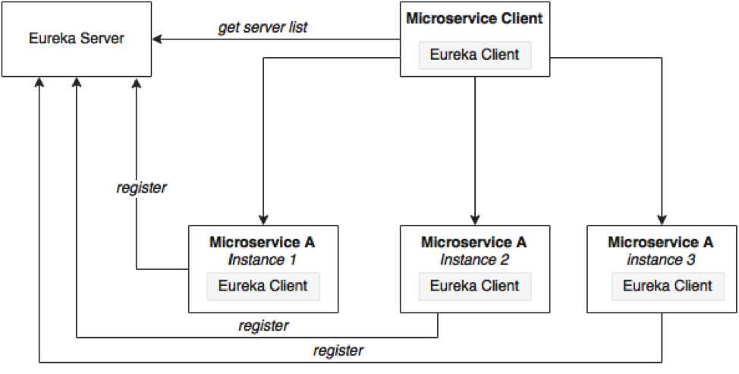
Load Balancing

Slide 94
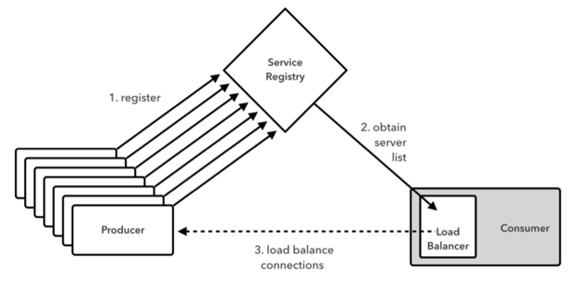
Working of Load Balancer

Slide 95
Load Balancing on Server Side
Load Balancers are components placed at the Server Side.
When the requests come from the Client, they will go to the load balancer, and the load balancer will designate a Server for the request.
It may use algorithm like random designation.
Most load balancers are hardware, integrated with software to control load balancing.
Need a separate server to host the load balancer instance which has the impact on cost and maintenance.

Slide 96
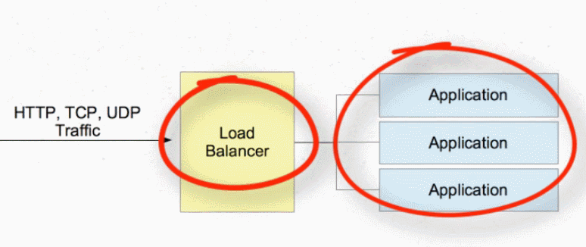
Load Balancer On Server Side

Slide 97
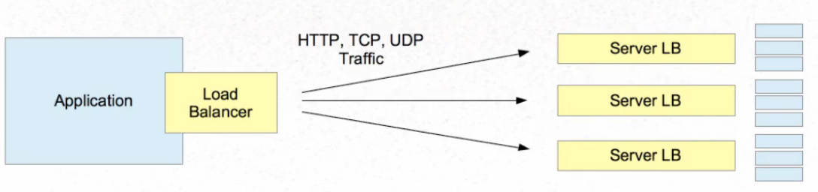
Load Balancer on Client Side

Slide 98
Load Balancing with Web Client
Add spring-cloud-starter-load balancer dependencies
Web Client can be configured to work with Load Balancer client
WebClient.Builder
  Used to create a load-balanced WebClient
  Add the @Bean annotation

Slide 99
Load Balancing with Web Client
  @Bean
  @LoadBalanced
  WebClient.Builder builder() {
  return WebClient.builder();
  }
  @Bean
  WebClient webClient(WebClient.Builder builder) {
  return builder.build();
  }

Slide 100
Reactive Load Balancer
ReactiveLoadBalancer
  The Implementation of the interface uses a Round-Robin
  It gets instance from reactive ServiceInstanceListSupplier
  It retrieves available instances from Service Discovery using a Discovery Client available in the classpath.
@LoadBalanced
  Need to have a load balancer implementation in the classpath.
  If the Spring Cloud LoadBalancer is in the class path Then, ReactiveLoadBalancer is used
    Helps to use "logical identifiers" for the URLs passed

Slide 101
Http Methods
get()
  indicates that we are making a GET request.
  We know that the response will be a single object, so we're using a Mono as explained before.
  client.get()
  Client.post()

Slide 102
WebClient
URI
Takes a service name
Cloud LoadBalancer is used to create a full physical address.
If the URL has a scheme of lb (such as lb://myservice), it uses the Spring Cloud LoadBalancerClient to resolve the name (myservice in this case) to an actual host and port and replaces the URI in the same attribute.
  client.get().uri("lb://PRODUCT-SERVICE/api/v1/items")

Slide 103
Retrieving a Single Resource
  Mono<Employee> employeeMono =
  client.get()
  .uri("/employees/{id}", "1")
  .retrieve()
  .bodyToMono(Employee.class);
  employeeMono.subscribe(System.out::println);

Slide 104
Retrieving Collection Resource
  Flux<Employee> employeeFlux = client.get()
  .uri("/employees")
  .retrieve()
  .bodyToFlux(Employee.class);
  employeeFlux.subscribe(System.out::println);

Slide 105
Rest Client - Application
  @SpringBootApplication
  @EnableDiscoveryClient
  public class CloudLoadBalancerApplication {
  public static void main(String[] args) {
  SpringApplication.run(CloudLoadBalancerApplication.class, args);
  }
  }

Slide 106
Rest Client - Controller
  @RestController
  public class ClientController {
  @Autowired
  private WebClient client;
  private String message;
  @GetMapping(path = "/client/items")
  public String getInfo() {
  }
  }

Slide 107
Rest Client - Controller
  @GetMapping(path = "/client/items")
  public String getInfo() {
  Mono<String> bodyMono = client.get()
  .uri("lb://PRODUCT-SERVICE/api/v1/items")
  .accept(MediaType.APPLICATION_JSON)
  .retrieve()
  .bodyToMono(String.class);
  bodyMono.subscribe( s -> this.message = s);
  return this.message;
  }

Slide 108
Rest Client –yml File
  spring:
  application:
  name: product-service-client
  server:
  port: 6060
  eureka:
  client:
  service-url:
  default-zone: http://localhost:8761/eureka

Slide 109
SUMMARY

Slide 110
Working of Eureka
Eureka server:
  When the Eureka client is bootstrapped, it tries to talk with the Eureka server in the same Zone.
    If it is not available, then it fails over to another Zone.
  Target is determined using the eureka.client.serviceUrl.defaultZone property
  Need to give a URL of the same Zone's Eureka server.
  If its failing over to another Zone, the Eureka server should be peer connected.

Slide 111
Working of Eureka
Register:
  Eureka client/microservices share the instance information with the Eureka server and registers themselves with the {service-id } (spring.application.name).
Heartbeat:
  Eureka client sends a heartbeat to the Eureka server to renew its leases.
  Sends heartbeat to the eureka server every 30 seconds
  If after 90 seconds the Eureka server does not get any heartbeat from the Eureka client,
    Unregisters the Eureka client instance from the service registry
    Sends the updated registry to all peers and Eureka clients.

Slide 112
Working of Eureka
Fetching service registry:
  Eureka clients fetch the service registry from the Eureka server
    Can discover other services and communicate with them.
  Service registry information gets updated after every 30 seconds
    Done by receiving delta updates from the Eureka server.
  Eureka server also caches the delta updates every 3 minutes
    Eureka client can receive the same delta instances multiple times.
  After receiving delta updates, it again tries to compare its local registry with the server registry to check that delta is successfully applied.
    If there are any mismatches, it pulls all the registries again.

Slide 113
Working of Eureka
Unregister:
  When the client instances are going to shut down
  They send a cancel signal to the Eureka client so the Eureka server unregisters it from its registry.
Synchronization:
  There may be some time lag as the Eureka server and client manage the cache.

Slide 114
Eureka Zones
  eureka:
  client:
  service-url:
  zone1: http://localhost:8761/eureka/
  fetch-registry: false
  register-with-eureka: false

Slide 115
Eureka Zones
  eureka:
  client:
  register-with-eureka: true
  fetch-registry: true
  service-url:
  zone1: http://localhost:8761/eureka

Slide 116
CLUSTERING EUREKA

Slide 117
Eureka High Availability
Eureka achieves high availability Using Server Cluster
  Eureka can be deployed as a cluster of servers.
    When one of these Eureka servers crash,
  clients can still connect to the remaining Eureka servers and discover other services
Peer Awareness
  Individual servers of the cluster are called peers.
  When the peers start up, they register with each other
  Helps in synchronizing registrations among themselves.

Slide 118
High Availability
  It is the ability of a system or system component to be continuously operational for a desirably long length of time
  A client is provided with a list of Eureka servers through configuration
    Either to DNS or /etc/hosts
  Client attempts to connect to server1; where server2 is sitting idle.
  In case server1 is unavailable, the client tries the next one from the list.
  When server1 comes back online, client goes back to using server1.
  server1 and server2 can be ran in peer-aware mode, and their registries replicated.

Slide 119
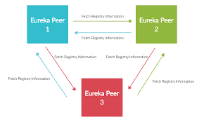
Peer Awareness

Slide 120
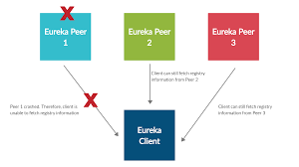
Peer Awareness

Slide 121
Service Registry
  @SpringBootApplication
  @EnableEurekaServer
  public class ServiceRegistryApplication {
  public static void main(String[] args) {
  SpringApplication.run(ServiceRegistryApplication.class, args);
  }
  }

Slide 122
Application.yml
  spring:
  profiles: default
  eureka:
  instance:
  hostname: default-eureka-server.com
  appname: eureka-cluster
  client:
  serviceUrl:
  defaultZone: http://localhost:8761/eureka/
  register-with-eureka: false
  fetch-registry: false
  server:
  port: 8761
  - - - : YAML supports multiple documents , New YAML document.

Slide 123
Application.yml
  spring:
  profiles: peer-1
  application:
  name: eureka-server-clustered
  eureka:
  instance:
  hostname: eureka-peer1
  appname: eureka-server-clustered
  client:
  serviceUrl:
  defaultZone: http://eureka-peer2:8770/eureka/
  server:
  port: 8765

Slide 124
Application.yml
  - - - ( Three Hypens)
  spring:
  profiles: peer-2
  application:
  name: eureka-server-clustered
  eureka:
  instance:
  hostname: eureka-peer2
  appname: eureka-server-clustered
  client:
  serviceUrl:
  defaultZone: http://eureka-peer1:8765/eureka/
  server:
  port: 8770

Slide 125
application.yml
eureka.instance.instanceId
  An instance is identified in Eureka by its Id
  Defaults to CLIENT IP:PORT
  If set ,it must be unique within the scope of the appName
eureka.instance.hostname:
  The hostname eureka advertises

Slide 126
application.yml
eureka.instance.appName
  Eureka instances find each other using appName
  Its defaulted to spring.application.name
    If Not defined declared as UNKNOWN
  Used when registering multiple Instances
  Applications with the same name are clustered together in Eureka server.

Slide 127
Client
  @SpringBootApplication
  @EnableDiscoveryClient
  public class ServiceRegistryClientApplication {
  public static void main(String[] args) {
  SpringApplication.run(ServiceRegistryClientApplication.class, args);
  }
  }

Slide 128
Client - Controller
  @RestController
  public class WelcomeController {
  @GetMapping(path = "/info")
  public String showMessage() {
  return "Hello from Client";
  }
  }

Slide 129
Client – application.yml
  spring:
  application:
  name: cluster-client
  server:
  port: 6060
  eureka:
  client:
  service-url:
  defaultZone: http://eureka-peer1:8765/eureka,http://eureka-peer2:8770/eureka
  instance:
  appname: cluster-client

Slide 130
Setting Cluster in Local Machine
Each of the server peers will run on separate hosts and ports.
Additional configurations are required to start this entire cluster in local machine
Need to edit the hosts file found in C:\Windows\System32\drivers\etc\hosts file
  Need to open with administrator privilege
  127.0.0.1 eureka-peer1
  127.0.0.1 eureka-peer2
java -jar -Dspring.profiles.active= eureka-peer1 eureka-server-1.0.0-
SNAPSHOT.jar

Slide 131
SPRING CLOUD CONFIG SERVER

Slide 132
Move configuration away from application
Cloud Applications requires a way to maintain and distribute the Configuration data to all services
Auditing changes:
  Look at the history of what changes were done by whom and when they were applied.
Approval of changes:
  Lot of issues are caused by the wrong configuration.
  Changes should be approved by some one
Resiliency:
  Issues related to configuration tool being not available
Synchronization:
  Way to know that there is a change in the configuration

Slide 133
Spring-cloud-config-server
Pulls configuration for remote clients from various sources.
  It adds a PropertySourceLocator, which will use one or more EnvironmentRepository that talk to different systems.
  Repositories can resolve the Environment that applies for a specific application, profile, and label.
  There are different implementations of EnvironmentRepository that can connect to Git, SVN, or Vault.

Slide 134
Spring Cloud Config Client
The client which will connect to the server through HTTP.
It adds a PropertySourceLocator that will call the server to load up the applicable configuration.

Slide 135
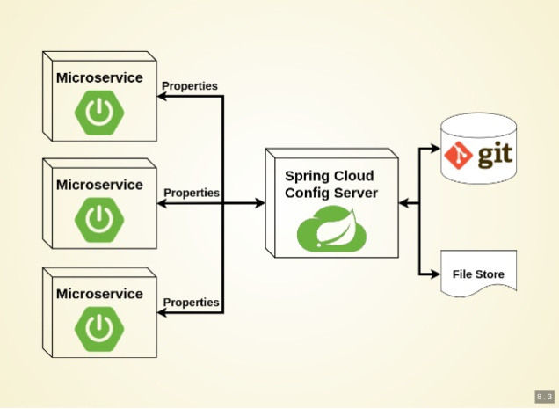
Working of Configuration Server

Slide 136
Types of Configuration
Global Configuration
  By Using application.yml or application.propeties
Application-Specific Configuration
  Serving only to a specific app.
  [APP-NAME].yml or [APP-NAME].properties
. Profile-Specific Configuration
  [APP-NAME]-[PROFILE-NAME].yml or [APP-NAME]-[PROFILE-NAME].properties

Slide 137
Git Repository
Can store the properties in git repository
Create or update a git repository.
Can Create and place the external property files
  Micro Service will be using external configuration of properties.
Can maintain same property name for different environment
It can be details of urls, credentials, database details etc.

Slide 138
Git Repository Directory Structure
https://github.com/vatsanTraining/spring-cloud-config
  common
    application.yml
  customer-service
    application.yml
  payment-service
    application.yml

Slide 139
Config Server
Spring Cloud Config Server provides an HTTP resource-based API for external configuration
@EnableConfigServer
  The server is embeddable in a Spring Boot application
  @SpringBootApplication
  @EnableConfigServer
  public class ConfigServer {
  public static void main(String[] args) { SpringApplication.run(ConfigServer.class, args);
  }
  }

Slide 140
Spring Cloud Configuration Server
Repository can also optionally store config files in sub-directories, and patterns to search for those directories can be specified as searchPaths.
  spring:
  cloud:
  config:
  server:
  git:
  uri: https://github.com/vatsank/spring-cloud-config.git
  search-paths:
  - '{application}'

Slide 141
Config Client Configuration
  spring:
  application:
  name: customer-service
  config:
  import: configserver:http://localhost:8888
  management:
  endpoints:
  web:
  exposure:
  include:
  - "*“
  http://localhost:8080/actuator/configprops

Slide 142
ADMINISTRATION SERVER

Slide 143
Spring Boot Administration- Server
Monitoring application by using Actuator Endpoint is slightly difficult.
  Every application has separate actuator endpoints,
  Need to thus making monitoring difficult.
Spring Boot Admin Server
  Used to manage and monitor Microservice application.
  Provides a UI to manage and monitor Actuator endpoints at one place.
Spring Boot Admin Client
  Need to add the Spring Boot Admin starter client dependency
  Applications should have a property to point out the Admin Server URI

Slide 144
@EnableAdminServer
@EnableAdminServer
  Added to the main Spring Boot application class file.
  Make the application as Admin Server to monitor all other microservices.
server:
port: 9494
spring:
application:
name: payment-service
boot:
admin:
client:
url:
- http://localhost:9494

Slide 145
Application
  @SpringBootApplication
  @EnableDiscoveryClient
  public class InvoiceServiceApplication {
  public static void main(String[] args) {
  SpringApplication.run(InvoiceServiceApplication.class, args);
  }

