Slide 1
Theory of thermopower in two-dimensional graphene
Srujan sapkal
14-04-2017
COM399

Slide 2
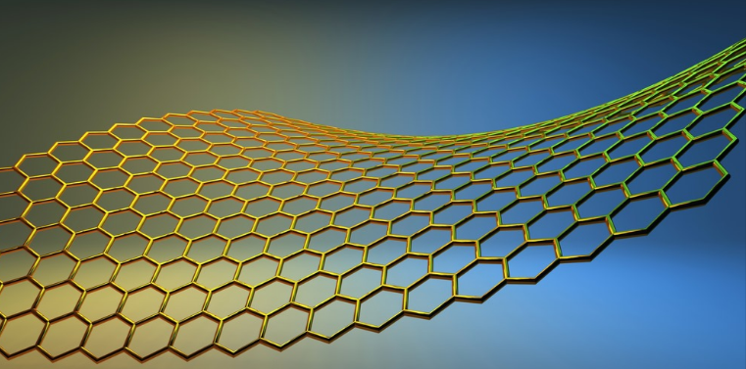
Outline
Introduction
Formalism for metals
Graphene
Extension of formalism
Results
Observations
Conclusion
http://www.androidpolice.com/2014/04/04/samsung-develops-new-method-for-producing-graphene-could-lead-to-lighter-faster-more-flexible-electronics/

Slide 3
Introduction
Transport Theory: attempt to build a theoretical model to relate material response to stimulus
allows us to design a theoretical model for given material
Theory developed for metals can be extended for graphene within certain approximations
Weak field
RTA

Slide 4

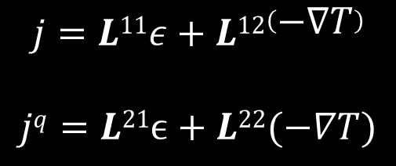


Formalism
For enough weak E and temperature gradient, we get
$$j=L11ε+L12\left(−∇T\right)$$
$$jq=L21ϵ+L22(−∇T)$$
Electric current density
Thermal current density
With coefficients defined as
Conductivity is given by
$L21=TL12= \frac{−1}{e}\frac{\left(πkBT\right)2}{3}σ^{′}\left(ε\right)$
$L22=\frac{1}{Te2}\frac{\left(πkBT\right)2}{3}σ^{′}\left(ε\right)$
$$L11= σ\left(ε\right)$$
$$σ\left(ε\right)=e2τρ\left(ε\right)v2(ε)$$
These approximations are correct up-to linear order without any loss of generality

Slide 5
Graphene
Graphene is a two-dimensional honeycomb arrangement of carbon atoms, the parent of all graphitic forms.
In graphene, absence of band-gap makes it a good conductor
helps us to predict how other conductors might behave in two-dimensional form
researchers magnetized graphene by placing it on an atomically smooth layer of magnetic yttrium iron garnet. The graphene's electronic properties were unaffected

Slide 6
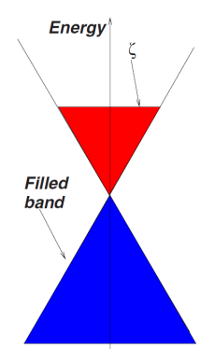

Extension of formalism
Same transport formalism extended for graphene
The ratio of the measured voltage to the temperature gradient applied across the sample is thermopower and given by
$$Q= \frac{L12}{L11}$$
Thermopower calculated for graphene shows different behaviour at high T and low T
Dirac cones in graphene in a situation of finite electronic density
N. M. R. Peres,J. M. B. Lopes dos Santos and T. Stauber. PHYSICAL REVIEW B 76, 073412 2007

Slide 7
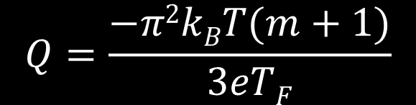

Results
For different scattering mechanism the dependence of scattering time on energy varies
Without loss of generality, we let
$$τ∝εm$$
Where different values of ‘m’ corresponds to different scattering mechanisms.
At low temperature, thermopower of graphene is given by
$$Q=\frac{−π2kBT(m+1)}{3eTF}$$

Slide 8
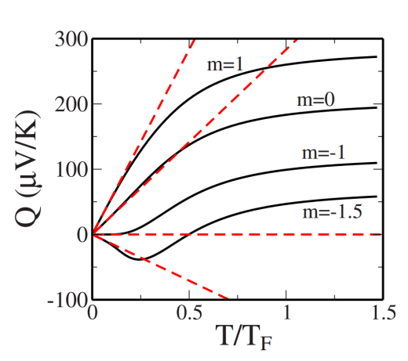
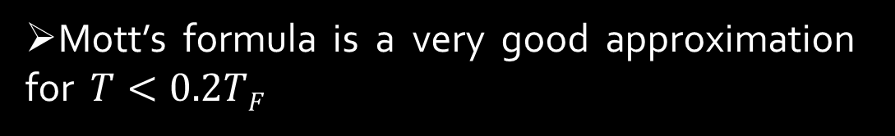
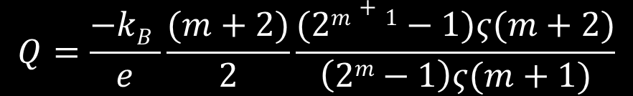
Where as for large T (w.r.t. Fermi temperature), thermopower reaches a limiting value
$$Q=\frac{−kB }{e}\frac{(m+2)}{2}\frac{(2m+1−1)ς(m+2)}{\left(2m−1\right)ς(m+1)}$$
Behaviour of thermopower can be well explained from the graph
Mott’s formula is a very good approximation for $T<0.2TF$
For m<-1, thermopower changes the sign
E. H. Hwang, E. Rossi, and S. Das Sarma. PHYSICAL REVIEW B 80, 235415 2009

Slide 9
Observations
Screened coulombic impurities provide an adequate description of electron transport in graphene
We find the effects of short-range scattering and phonons to be negligible in experimental temperature range
the expected change of sign in the thermopower is found across the charge neutrality point as the majority carriers change from electrons to holes
We also find that the thermopower scales with the normalized temperature does not depend on the impurity densities

Slide 10
Conclusion
we have developed a theory for the diffusive thermopower of 2D graphene
Scattering mechanism which contributes most in observed thermopower is screened coulombic potential
Understood variation in thermopower with respect to temperature in graphene

Slide 11
References
E. H. Hwang, E. Rossi, and S. Das Sarma. PHYSICAL REVIEW B 80, 235415 2009
N. W. Ashcroft and N. D. Mermin. Solid State Physics. Thomson Learning Inc., New York, 1976.
Babak Zare Rameshti and Ali G. Moghaddam arXiv:1412.3318v2 [cond-mat.mes-hall] 9 Apr 2015
N. M. R. Peres,J. M. B. Lopes dos Santos and T. Stauber. PHYSICAL REVIEW B 76, 073412 2007

Slide 12
Acknowledgment
Dr. Yashowanta Mohapatra
Haris Tom Jose
Vatshal Srivastav

Slide 13
THANK YOU any questions?

