Slide 1
Analyzing Coronavirus (COVID-19) Data From Perspective Of Data Science

Slide 2
Project outline:
Technology used
Visualizations
Conclusion
Problem statement
Data Sources

Slide 3
Problem statement
The purpose of the project is to explore Coronavirus dataset and get useful insights about the ongoing global pandemic. Through analysis, it is shown how world population has been effected globally since inception of the disease. Through data visualization, important aspects along with their effects have been highlighted in this project, for example impact on the global economy and business.

Slide 4
Data sources:
The dataset is made available by Johns Hopkins University for educational and academic research purposes. URL of dataset is https://www.kaggle.com/sudalairajkumar/novel-corona-virus-2019-dataset
https://www.statista.com/statistics/1105021/coronavirus-outbreak-stock-market-change/
https://www.statista.com/statistics/1104036/novel-coronavirus-weekly-flights-change-airlines-region/
https://www.statista.com/statistics/1105235/coronavirus-2019ncov-cases-recoveries-deaths-most-affected-countries-worldwide/
https://www.buzzfeednews.com/article/lamvo/coronavirus-update-charts-unemployment-claims-laid-off-jobs
https://fred.stlouisfed.org/series/ICSA
https://www.ons.gov.uk/peoplepopulationandcommunity/healthandsocialcare/conditionsanddiseases/articles/coronaviruscovid19roundup/2020-03-26
Note:
For the analysis, the data set is taken starting from 22nd January 2020 up to 24th March 2020, a time period when the number of cases sored exponentially throughout the world.

Slide 5




Technologies used:

Slide 6
Visualizations

Slide 7
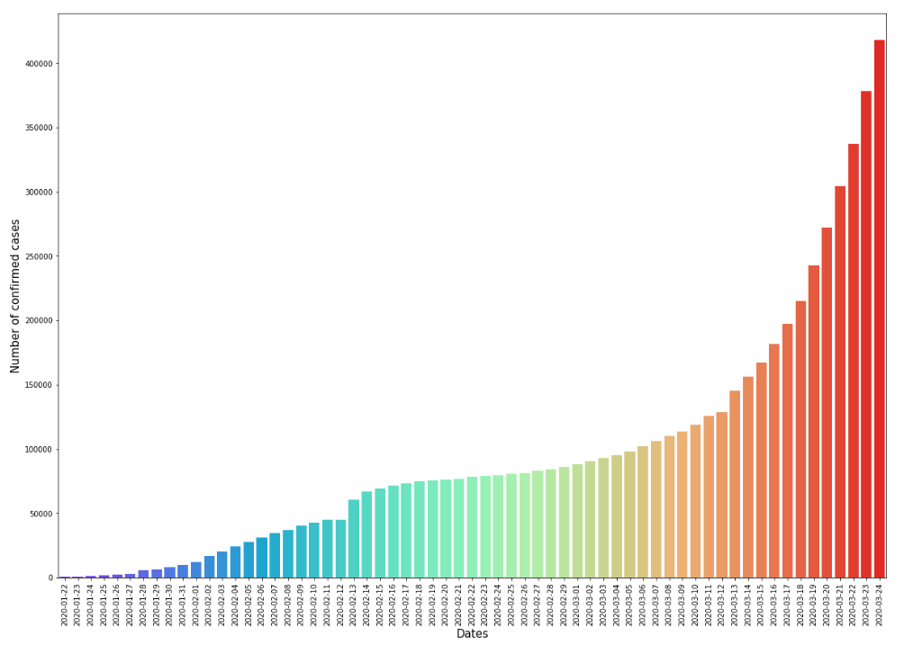
Number of confirmed cases over given period

Slide 8
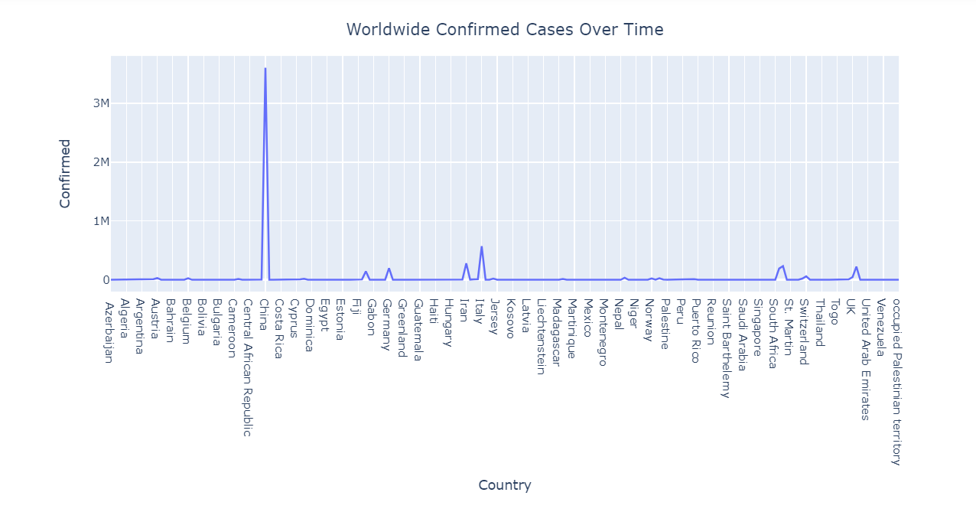
Worldwide confirmed cases

Slide 9
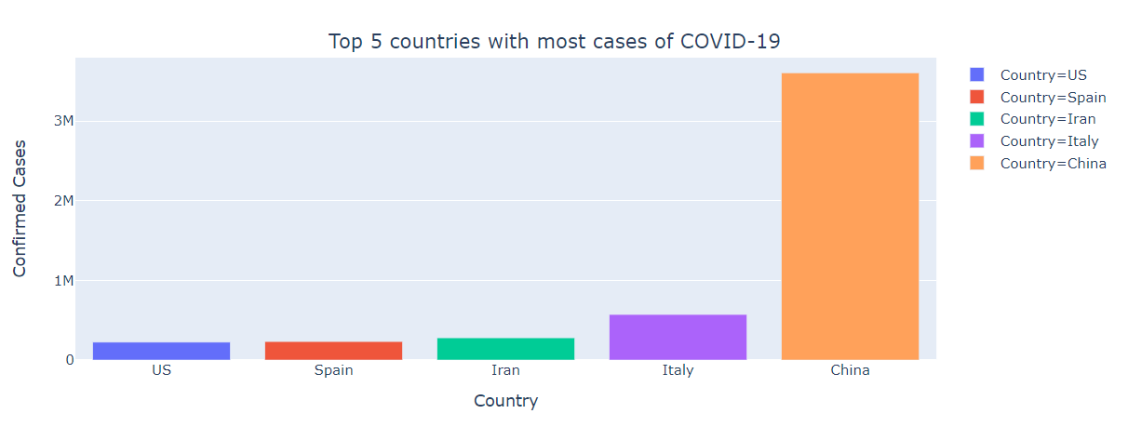
Top 5 countries with most confirmed cases

Slide 10
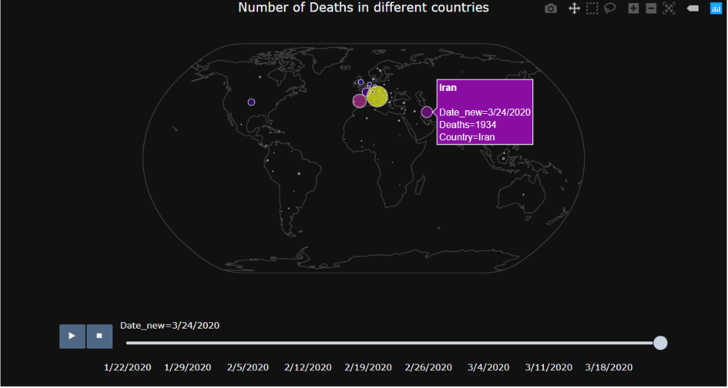
Number of deaths in different countries

Slide 11
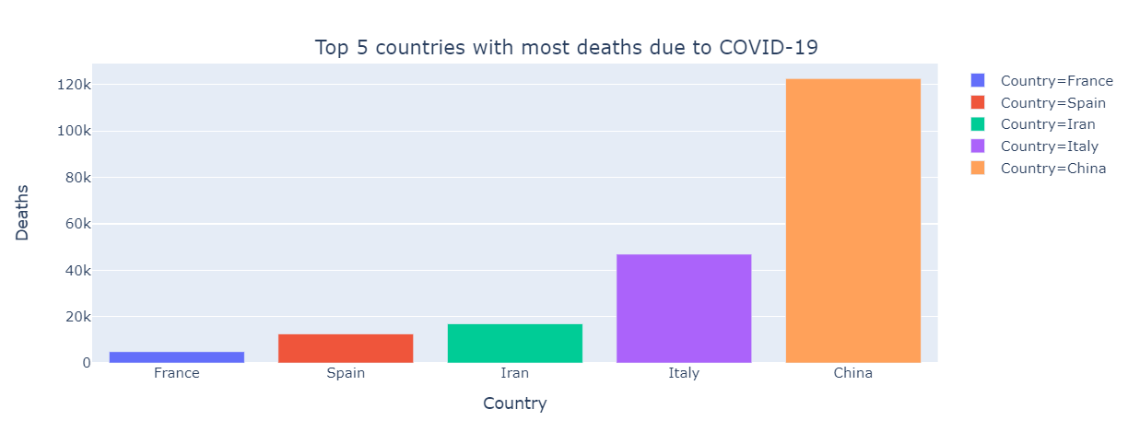
Top 5 countries with most deaths

Slide 12
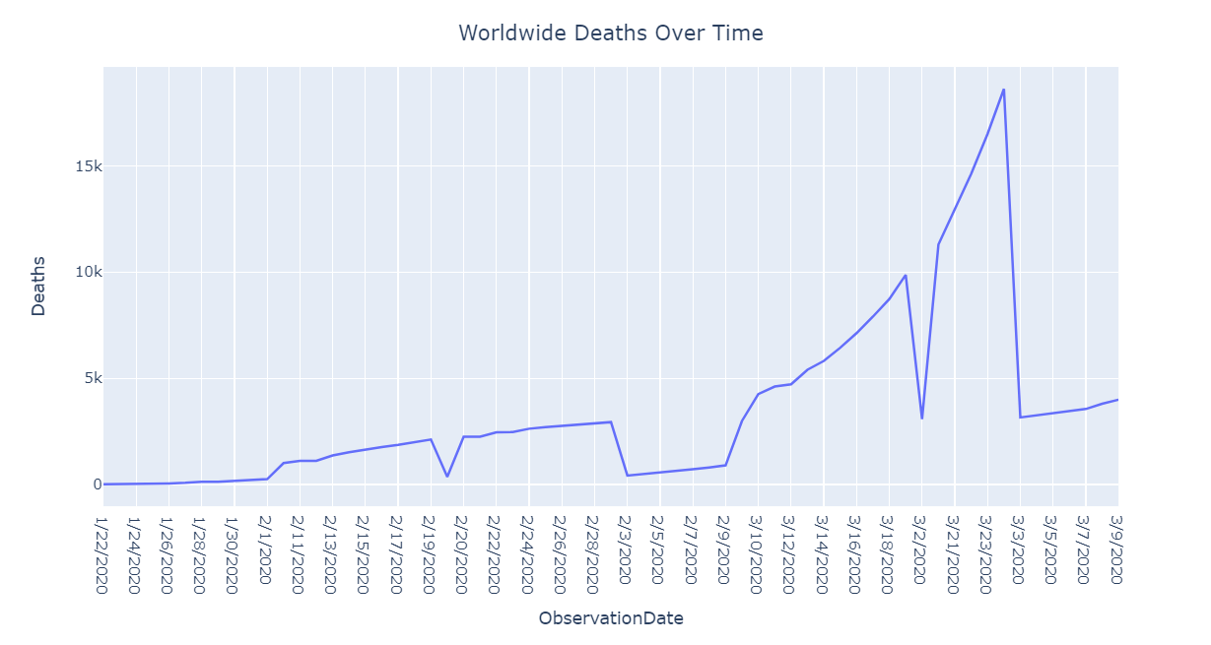
Deaths in a given period worldwide

Slide 13
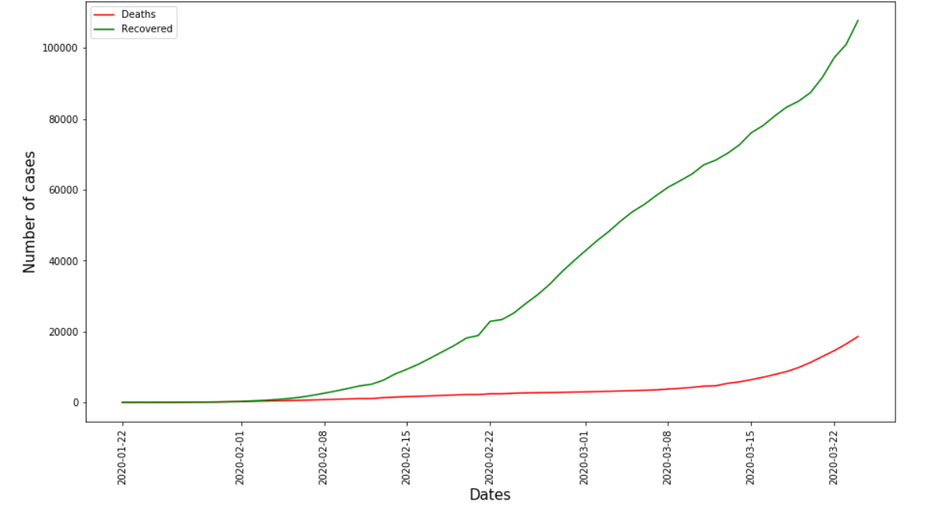
Total Fatalities and recoveries over the period

Slide 14
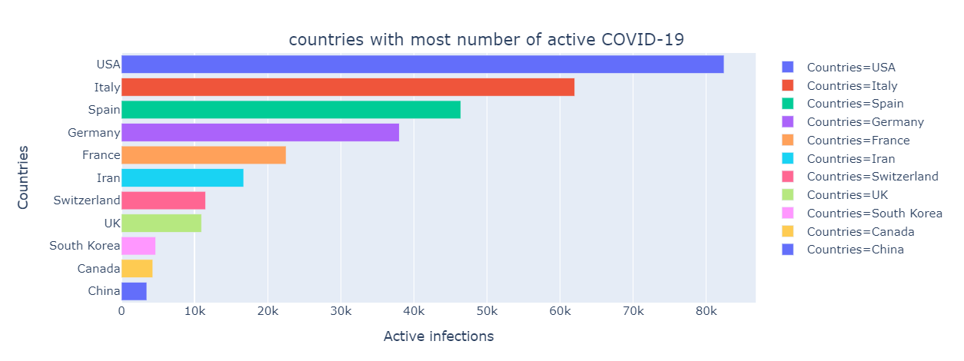
Number of Active infections as of March 27th, 2020

Slide 15
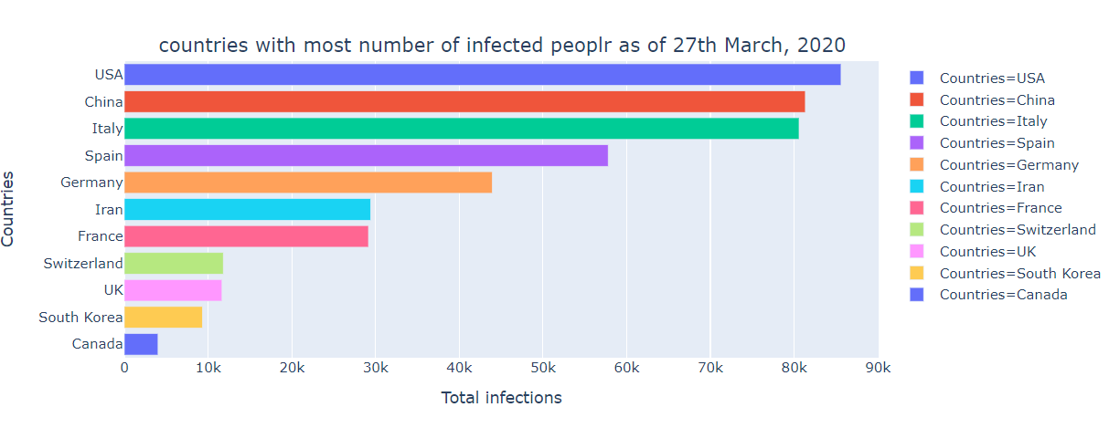
Number of Total infections as of March 27th, 2020

Slide 16
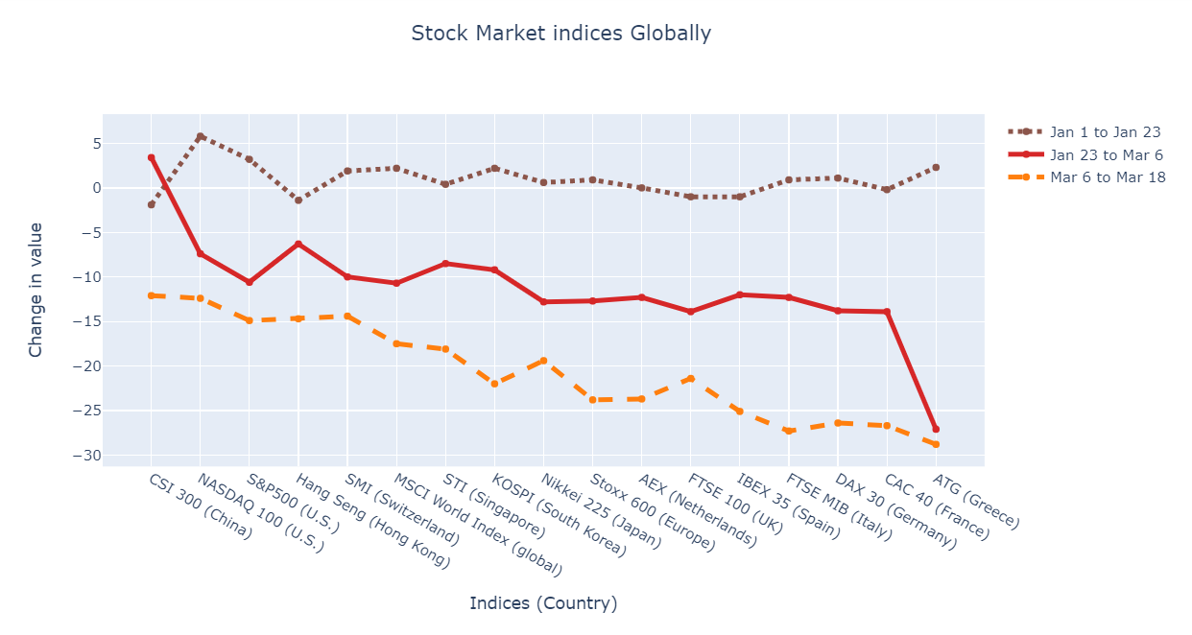
Impact on stock market

Slide 17
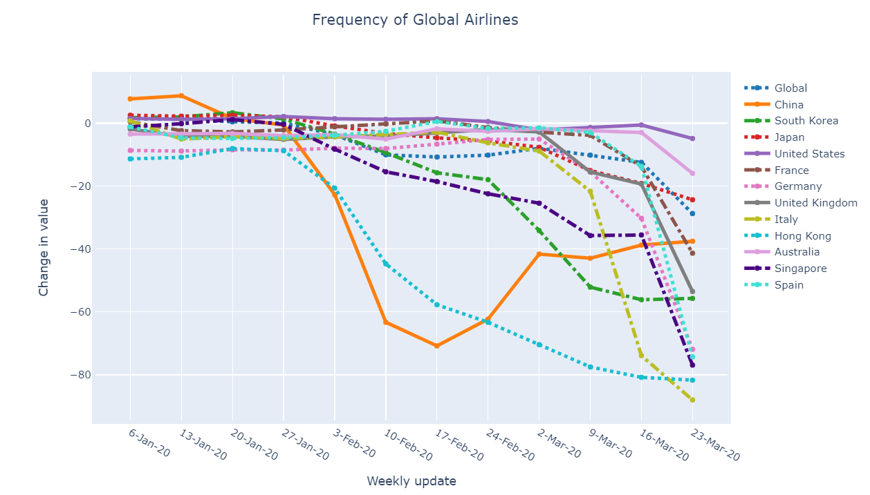
Impact on Airline Business

Slide 18
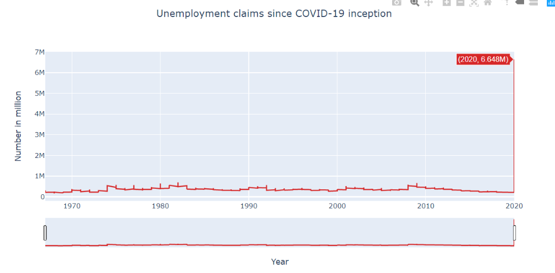
Significant increase in unemployment in USA due to COVID-19

Slide 19
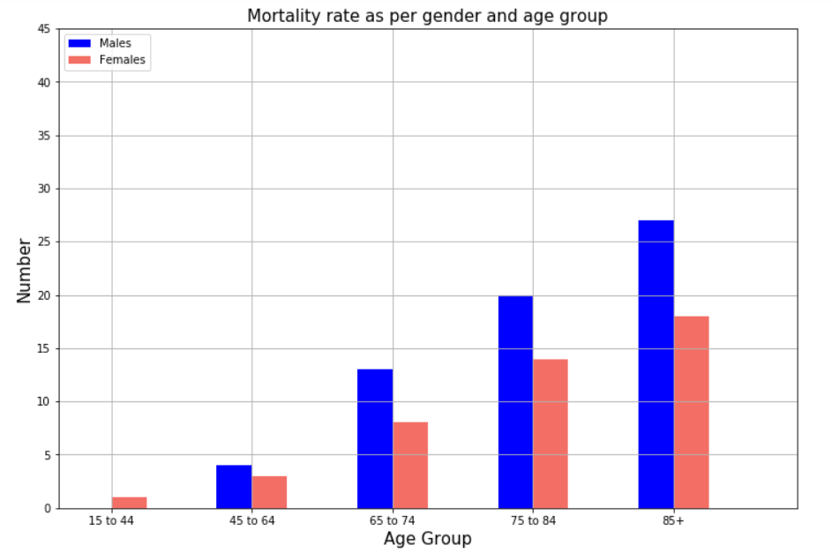
Mortality rate as per gender and age group

Slide 20
Conclusion
From the analysis of COVID-19, currently the pandemic is increasing across the globe and it is estimated by a Harvard University epidemiologist that as much as 70 percent of the world’s population could get the coronavirus. It has not only impacted human health but is effecting businesses and economy on global scale. Through visualization, current situation and its effects have been shown.

Slide 21
Thank You

