Slide 1
Bank Market Campaign Machine Learning 2
Manish Kumar
D19018

Slide 2

Dataset Description

Slide 3
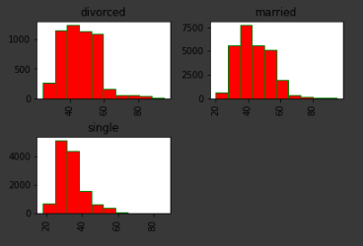
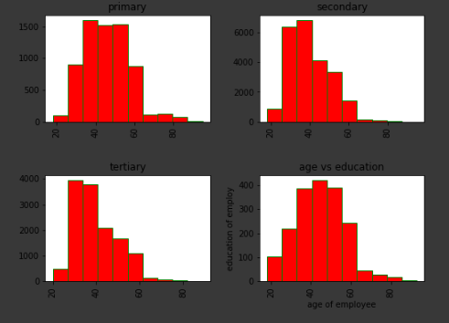
Marital status and education of customers

Slide 4
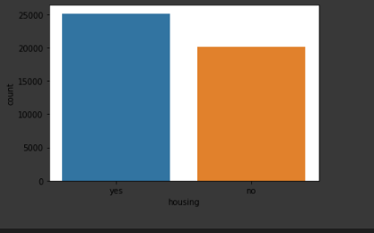
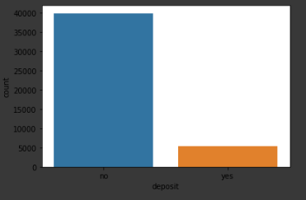
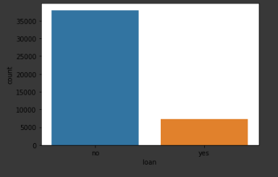
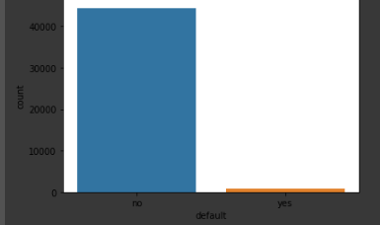
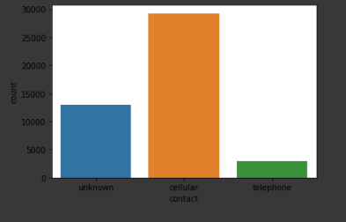
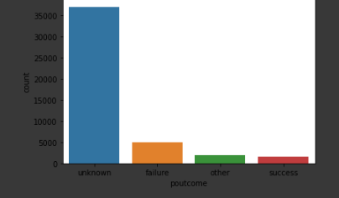
Distribution of housing, deposit, loan, default, contact,Poutcome

Slide 5
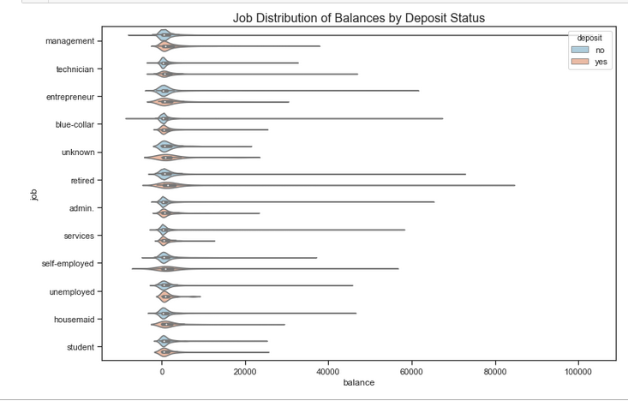
Job Distribution of Balances by Deposit Status

Slide 6
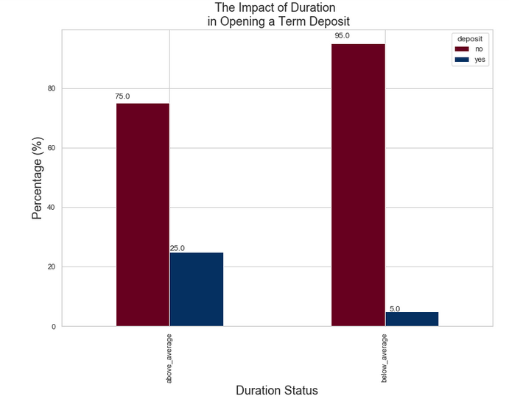
The Impact of Duration in Opening a Term Deposit

Slide 7

Experiment of Models

