Slide 1
PORTFOLIO PROJECT 4
DATA SCIENTIST : SEIHA VAT
Customer Retention
Risk Analysis
Olist Brazilian E-Commerce · Churn Prediction Pipeline
74,899
97.82%
9 tables
Eligible customers
Base churn rate
Joined & engineered
CRISP-DM · NB00–NB07
Notes:
This is a full CRISP-DM project — 7 notebooks, 9 joined tables, built to production standards.

Slide 2
Why Churn Prediction Matters
🏪
Olist is a marketplace aggregator
R$ 13,664
Sellers list products; Olist handles logistics and payments. Acquiring a seller or customer has a cost — retention is cheaper than acquisition.
Max single order value
⏱
90-day repurchase window
2,801
Industry-standard for e-commerce; beyond 90 days a customer is structurally unlikely to return without intervention.
Customers with >1 order
0.61
💰
Cost asymmetry
Missing a churner (FN) costs more than a false alarm (FP). Breakeven cost ratio = 0.61: if recovering one customer is worth >0.61× the cost of an offer, the model adds value.
Model breakeven ratio
Notes:
The cost asymmetry framing is key: even at AUC 0.626, the model adds value if the breakeven ratio holds.

Slide 3
01
The Data Challenge
9 tables · ~1.4M rows · Complex joins · Identity problem
Notes:
The dataset complexity is a feature of this project, not a problem. Navigating it correctly is the skill being demonstrated.

Slide 4
9 Tables, One Customer View
orders
order_items
order_payments
order_reviews
customers
02_master_table
products
sellers
geolocation
cat_translation
customer_id ≠ customer_unique_id
Payments: multi-row per order
Geolocation: ~1M rows
Every order creates a new customer_id; only customer_unique_id tracks the true person
Must aggregate before joining — voucher + credit card splits inflate row counts
Deduplicated to 19,015 zip→state pairs before joining
Notes:
The join order matters enormously — payments must be aggregated before joining or you get row explosion. This is a real wrangling trap.

Slide 5
The customer_id Trap
orders.customer_id → order-scoped (new ID per order) customers.customer_id → join key only customer_unique_id → TRUE customer identity A customer with 5 orders has:
· 5 different customer_ids
· 1 customer_unique_id
99,441
Total orders
93,358
Unique customers (after dedup)
~6,000+
Duplicate customer_ids avoided
Using customer_id for groupby would produce silently wrong retention rates — the most common wrangling error on this dataset.
Notes:
customer_id vs customer_unique_id is the #1 silent error on this dataset. Catching it separates careful analysts from those who just run code.

Slide 6
Engineering a Clean Master Table
1
Filter delivered orders — 99,441 → 96,478 rows (2,963 non-delivered excluded)
Join step | Before | After
Delivered filter | 99,441 | 96,478
All 7 left joins | 96,478 | 96,478
Collapse to customer | 96,478 | 93,358
Cutoff exclusion | 93,358 | 74,899
2
Aggregate payments — multi-row → one row per order: total_payment_value, max_installments, used_voucher, primary_payment_type
3
Deduplicate geolocation — ~1M rows → 19,015 zip→state pairs via modal state per zip
4
Aggregate reviews — keep latest review per order; add has_review binary flag
5
Aggregate items — item_count, total_freight, avg_item_price, n_unique_sellers per order
6
Join all tables — left joins from orders anchor outward; zero row inflation across 7 joins
7
Collapse to customer level — 96,478 orders → 93,358 unique customers
8
Apply cutoff exclusion — 93,358 → 74,899 eligible (18,459 excluded: last order after 2018-05-31)
Notes:
Zero row inflation across all 7 left joins is a key data quality signal — confirms join keys are clean and consistent.

Slide 7
02
What the Data Reveals
Before modelling, what does the dataset actually tell us?
Notes:
EDA is where the real insights live on this project — the model results require context from here.

Slide 8
Defining & Constructing the Churn Label
Dataset end
2018-08-29 — max delivered order date
74,899
97.82%
Eligible customers
Churn rate
Cutoff date
2018-05-31 — dataset_end − 90 days
2,801
90 days
Eligible
last_order_date ≤ cutoff_date — customer had time to return
Customers with >1 order
Repurchase window
churn = 1
No subsequent delivered order within 90 days of last order
churn = 0
Any consecutive order gap ≤ 90 days (consecutive-gap method)
Why 90 days? Shorter windows (60d) over-label seasonal buyers as churned; longer windows (120d) shrink the eligible pool too aggressively. 90 days maximises label reliability given the 25-month dataset span.
Notes:
The cutoff exclusion is critical — without it you would label customers who haven't had time to return as churned, biasing the label distribution.

Slide 9
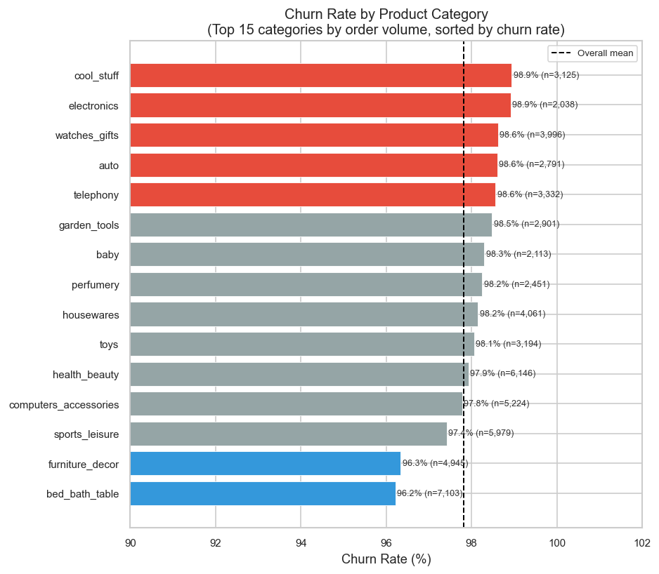
Churn Varies — But Narrowly
[INSERT PLOT: Churn rate by product category — top 15 categories, horizontal bar chart]
📦
Product category is widest driver
bed_bath_table (96.2%) vs cool_stuff (98.9%) — 2.73pp gap, the largest single categorical spread found.
💳
Voucher users churn less
95.65% vs 97.86% — counter-intuitive; voucher users are more engaged shoppers.
📅
Item count is protective
Single-item orders: 97.92% churn; 3+ item orders: ~96%.
🌎
Geography matters
State churn rates range from 96.8% (MT) to 100% (RR).
The range across all variables is ≤3pp — the dataset has a structural churn ceiling near 97%. This is real behaviour, not a data quality issue.

Slide 10
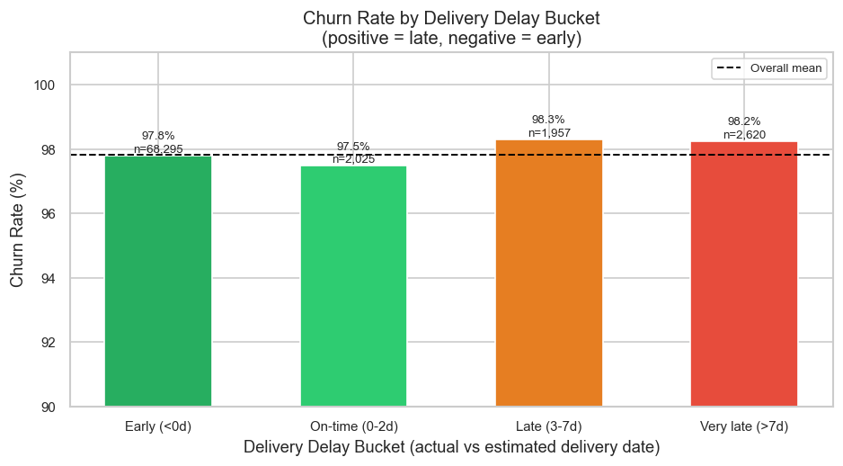
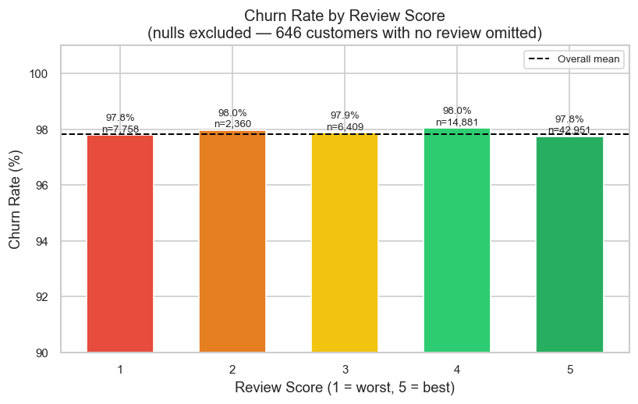
Delivery Experience: A Surprising Pattern
[INSERT PLOT: Churn rate by delivery delay bucket (Early / On-time / Late / Very late)]
[INSERT PLOT: Churn rate by review score (1–5 stars)]
DELIVERY
REVIEW SCORE
91.2% of orders arrived early. On-time (0–2d) customers churn least (97.48%); early arrivals churn slightly more (97.80%). The relationship is non-monotonic — delivery delay alone is not a reliable churn predictor.
Review score range is only 0.29pp (97.75%–98.04%). No monotonic relationship. r_pb = −0.0024, p = 0.51 — statistically indistinguishable from noise.

Slide 11
03
Feature Engineering
27 features across 7 groups — from raw tables to model-ready signals

Slide 12
From 28 Raw Columns to 27 Engineered Features
⏰
Temporal
🚚
Delivery Experience
📦
Order Complexity
n = 3 features
n = 5 features
n = 7 features
recency_days, is_weekend_purchase, approval_delay_days
delivery_delay_days, freight_to_price_ratio, is_cross_state_order
item_count, max_installments, used_voucher, multi_payment_method
💵
Monetary (log-transformed)
⭐
Review
🛍
Product
n = 4 features
n = 4 features
n = 2 features
log_avg_item_price, log_total_payment_value
review_score, has_negative_review, has_positive_review
category_churn_rate (target encoded)
🌎
Geographic
n = 2 features
state_churn_rate, seller_state_churn_rate
Monetary features log1p-transformed (3.78–4.84% extreme outliers). Target encoding for category and state — ⚠️ recomputed on training set only in NB05 to prevent label leakage.

Slide 13
04
Modelling
Time-based split · 3 candidate models · Optuna tuning · SHAP explainability

Slide 14
Methodology: Why Each Decision Was Made
📅
⚖️
🤖
Time-Based Split
(not random)
class_weight='balanced'
Three Candidate Models
Train < 2018-04-01 | Test ≥ 2018-04-01
Random splitting would leak future purchase behaviour into training. Time-based split respects the temporal nature of churn.
SMOTE tested but discarded — synthetic minority oversampling inflated metrics without improving real-world discrimination.
Balanced class weights applied to all models.
· Logistic Regression — interpretable baseline
· Random Forest — non-linear ensemble
· LightGBM — gradient boosting (primary candidate)
Tuned winning model with Optuna (50 trials, ROC-AUC objective)
Train: 61,696 customers · Test: 13,203 customers
Churn : Retained = 53 : 1 in training data
Notes:
Random split would let the model see December 2017 data in training while predicting November 2017 in test — temporal leakage. Time-based split is the methodologically correct choice.

Slide 15
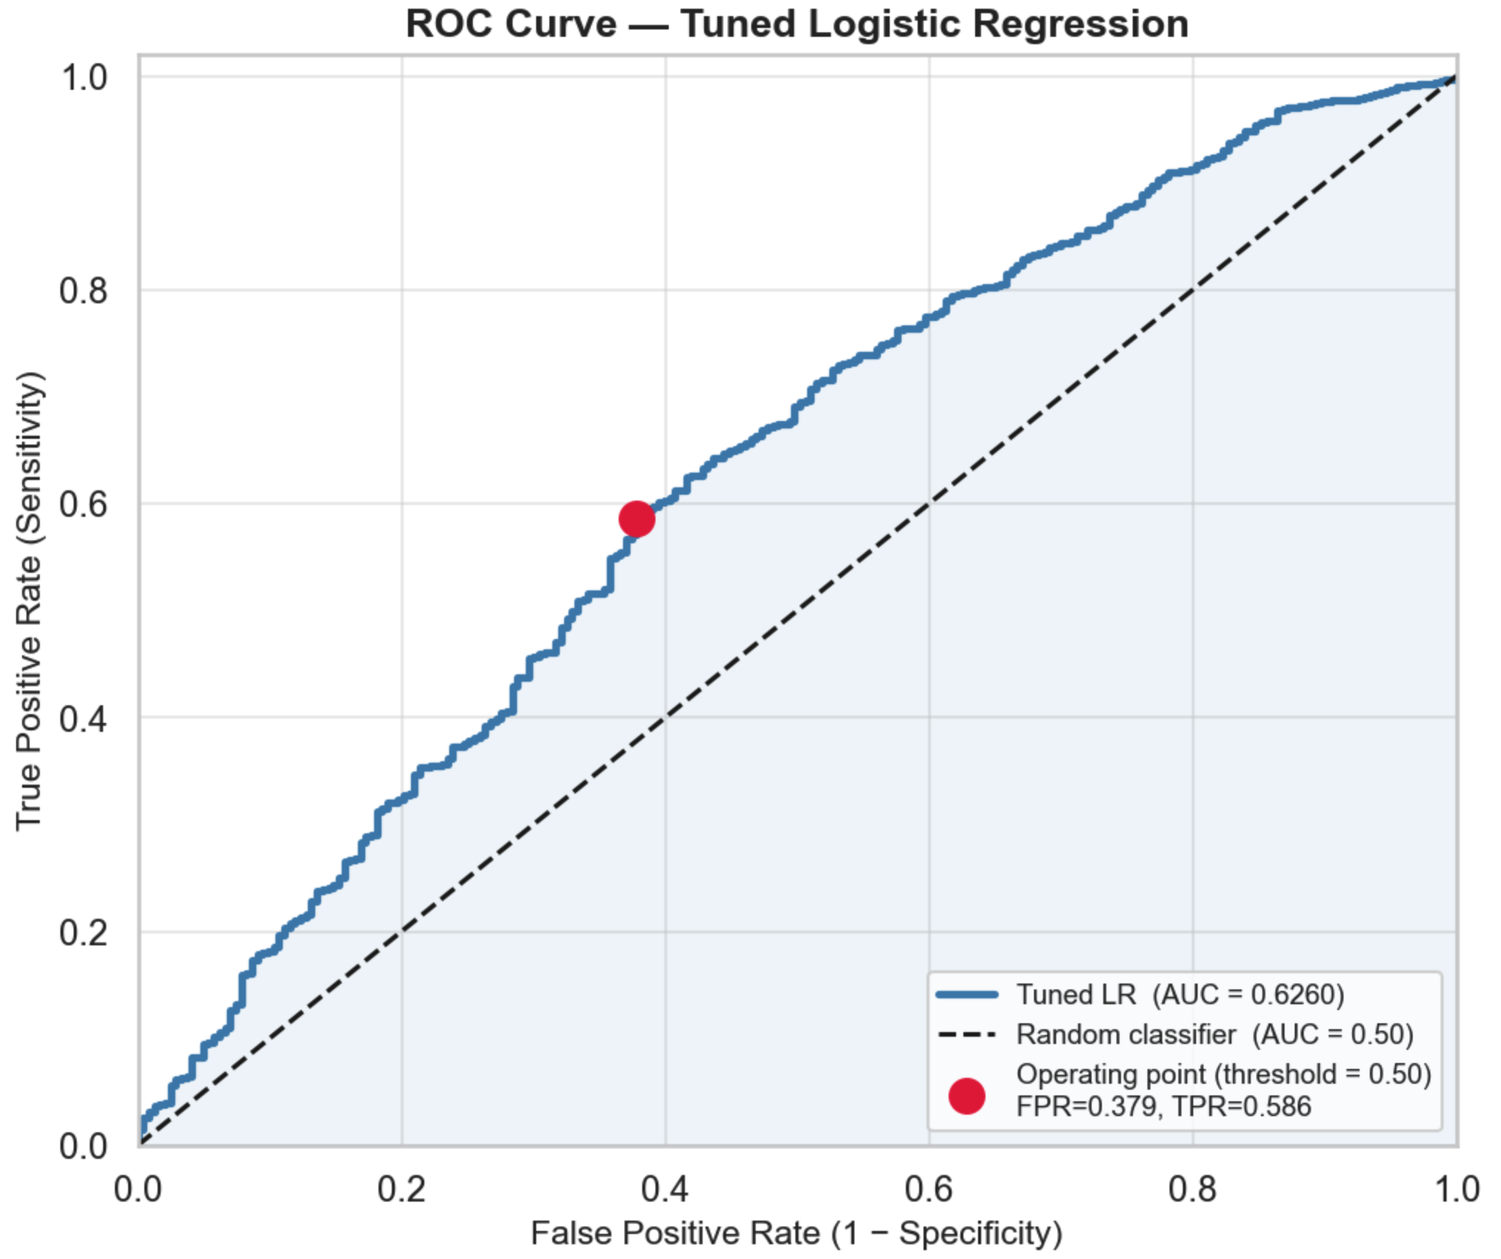
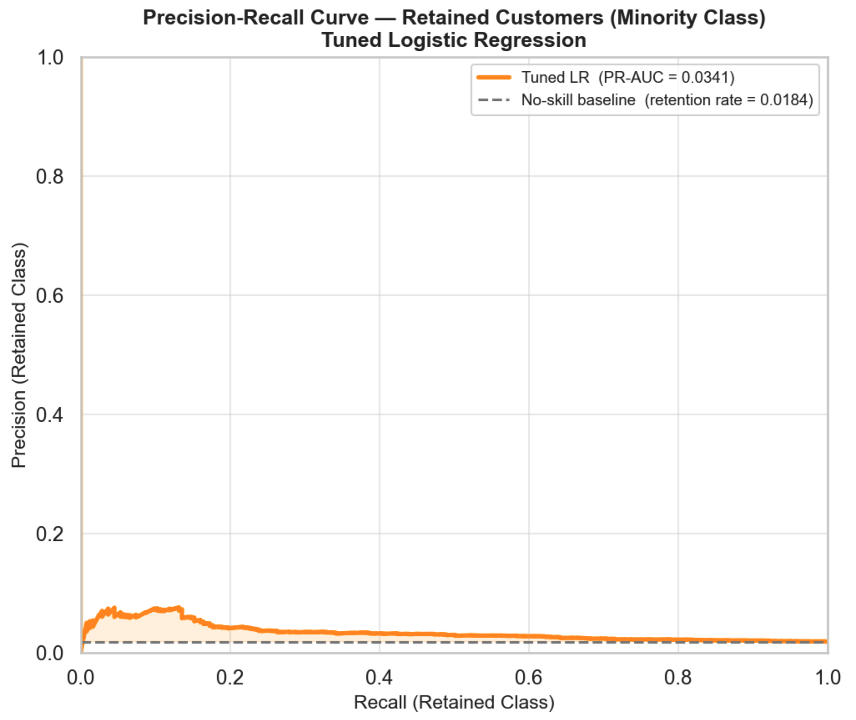
Model Comparison — The Honest Results
Model | ROC-AUC | PR-AUC | Recall | Precision
Logistic Regression | 0.6267 | 0.0343 | 0.617 | 0.027
Random Forest | 0.5837 | 0.0268 | 0.210 | 0.027
LightGBM | 0.5990 | 0.0310 | 0.284 | 0.032
Tuned LR (winner) ★ | 0.6260 | 0.0341 | 0.621 | 0.027
Logistic Regression wins: higher ROC-AUC and recall than RF and LightGBM despite being the simplest model. Signal in this dataset is largely linear.
Notes:
The ceiling is in the data, not the model. LR winning over LightGBM tells you the signal is largely linear. More data and richer features are what this problem needs.

Slide 16
Why 0.626? The Dataset Ceiling Explained
The Mathematics
The Business Reality
What Would Actually Help
· Max feature-target correlation: r = 0.07 (item_count)
· 97.82% of Olist customers buy exactly once
· Browsing / session history
· With r_max = 0.07, theoretical AUC ceiling ≈ 0.65
· Typical for general merchandise marketplaces (not subscription)
· App engagement signals
· 243 retained customers in test set = extremely sparse minority class
· Customers discover Olist via a specific product, buy it, and may never have a reason to return
· Return / refund history
· This is not a model failure — it is a fundamental property of the data generating process
· Repeat purchase intent is not encoded in a single transaction record
· Multi-year purchase data
· Category affinity from search behaviour
· A richer feature set, not a better algorithm
Notes:
The ceiling is in the data. Tried LightGBM and Random Forest — LR won. That tells you the signal is largely linear. More data and richer features are what this problem needs.

Slide 17
05
What the Model Tells Us
SHAP analysis · Risk segmentation · Actionable signals

Slide 18
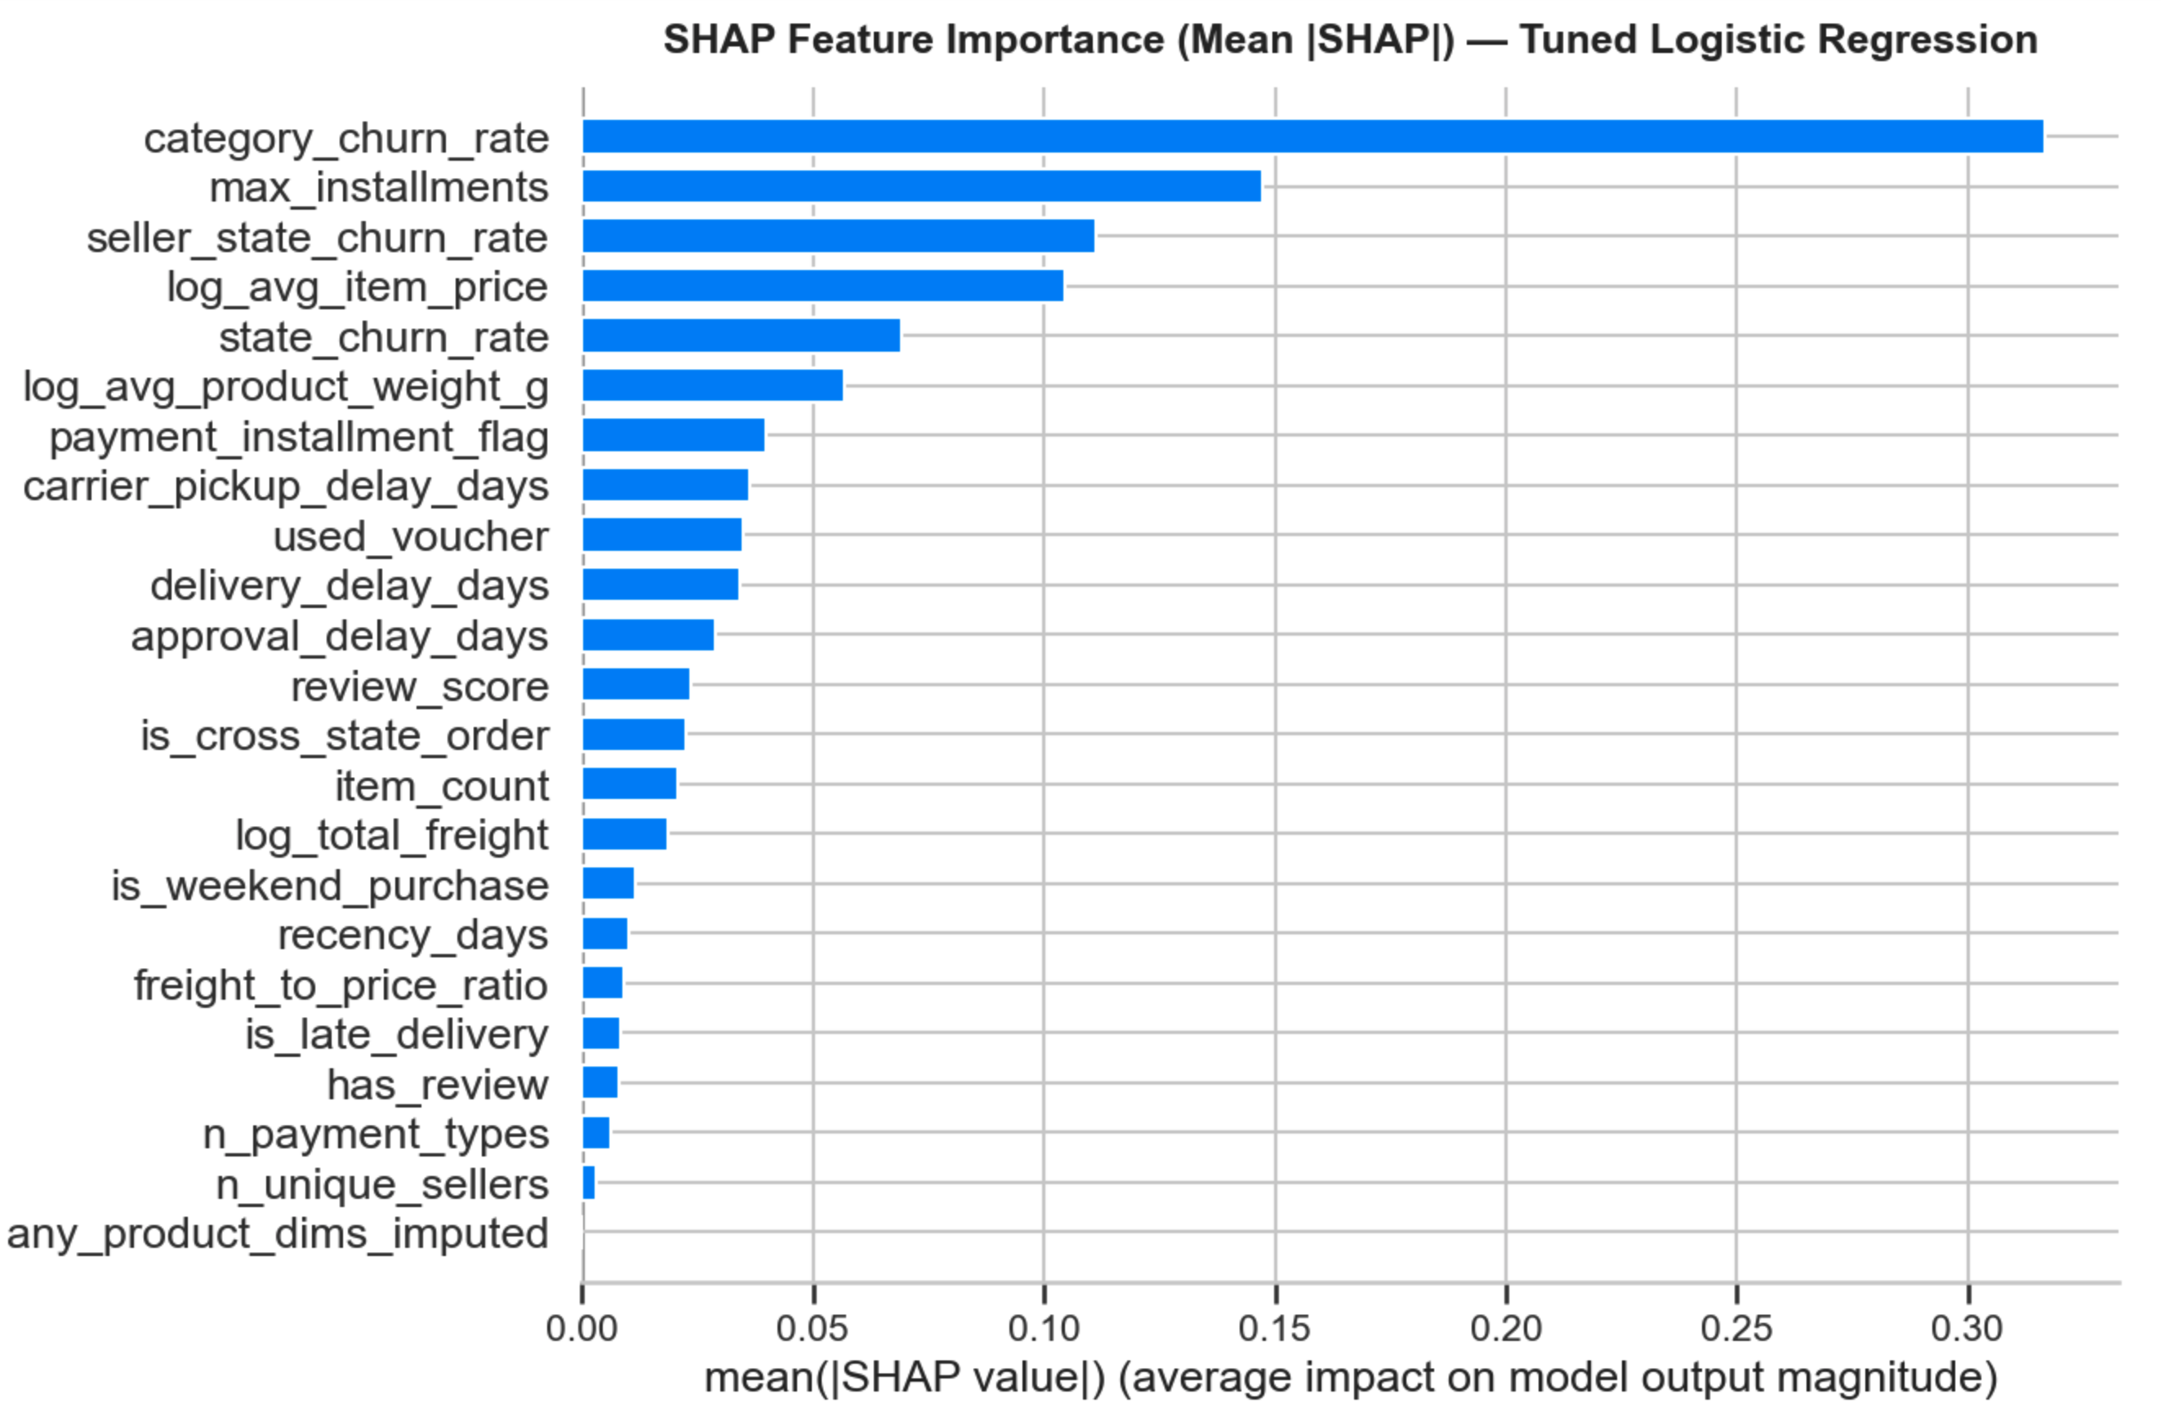
The 5 Levers of Churn Risk
[INSERT PLOT: SHAP feature importance bar chart (mean |SHAP|), top 10 features]
0.317
Product category
What was bought matters most — lifestyle/home goods retain better
0.147
Payment instalments
More instalments = less churn. Offering instalment options is actionable
0.111
Seller geography
Sellers in certain states have structurally higher-churn customer bases
0.105
Item price
Higher-priced one-off purchases signal discretionary, non-repeat buying
0.069
Customer state
Regional retention patterns exist across Brazil's 27 states
Notes:
Product category drives 2× more SHAP than the next feature. The actionable insight is instalments: offer them, and customers come back.

Slide 19
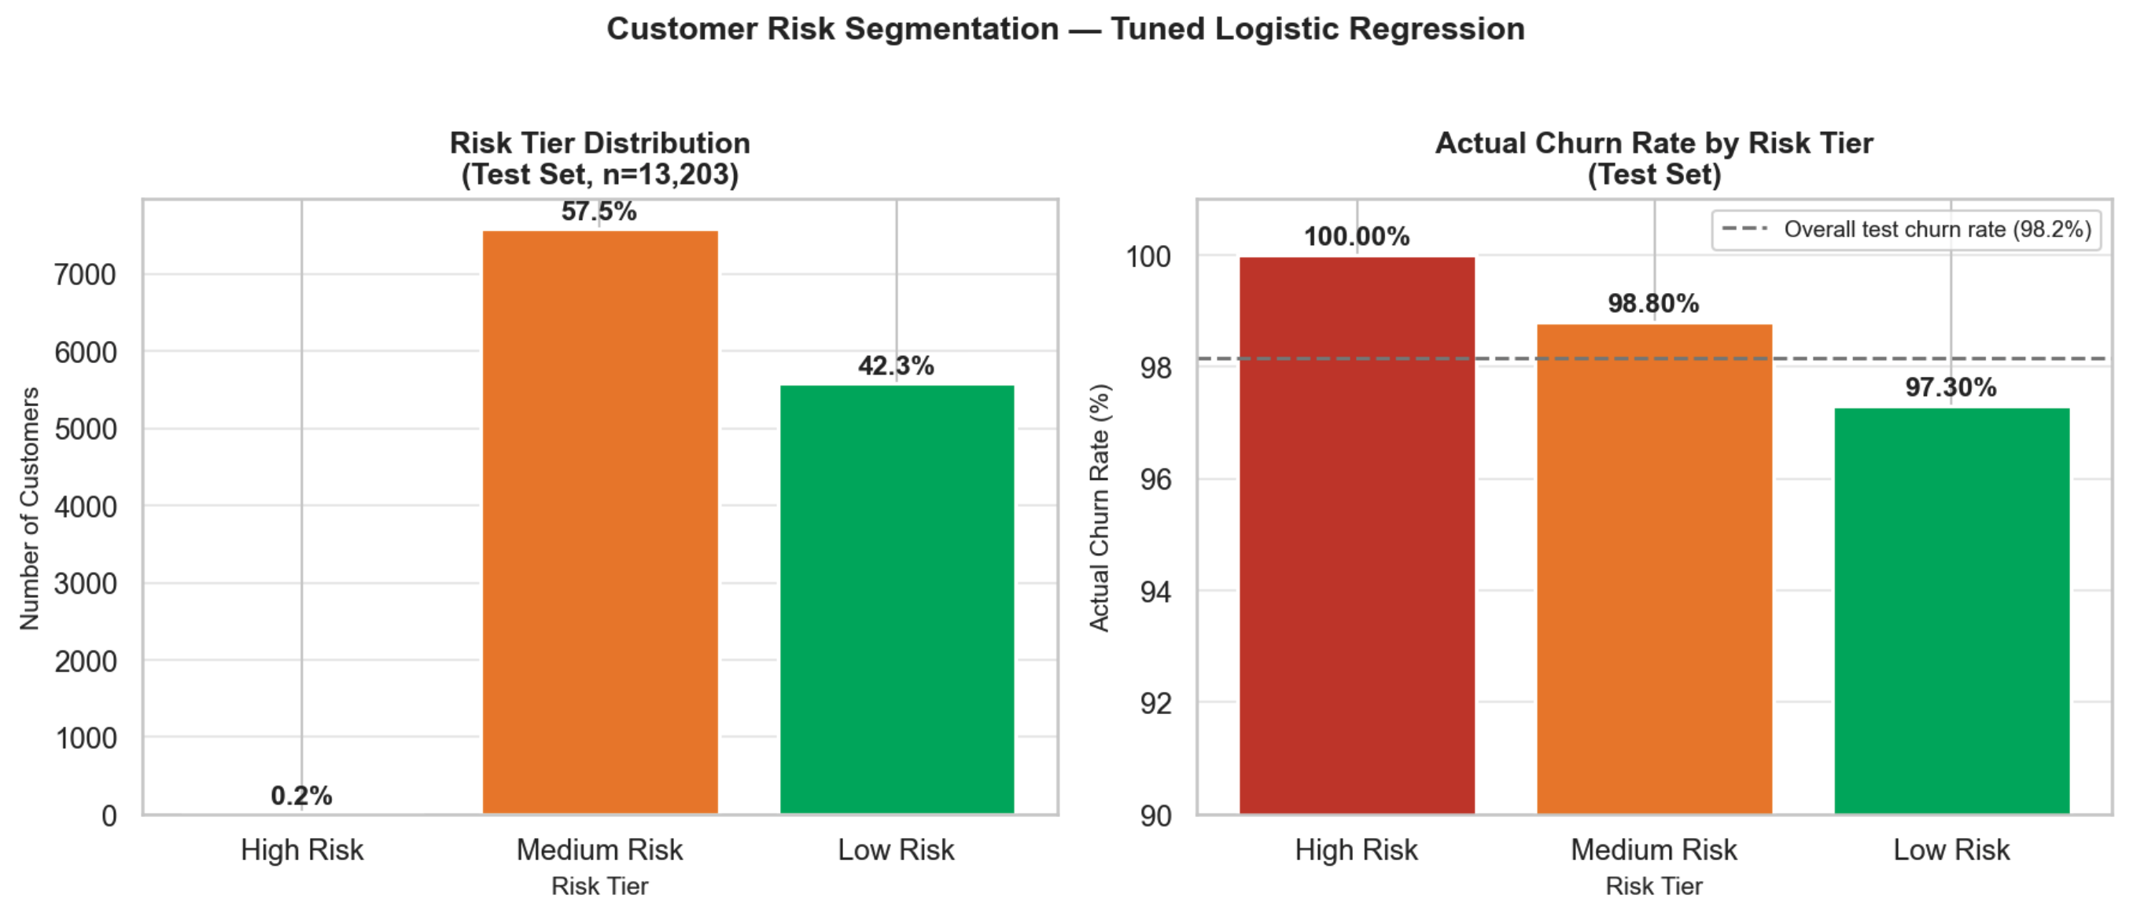
Risk Segmentation: What the Model Can Do
[INSERT PLOT: Risk tier distribution (n customers) + actual churn rate by tier, side-by-side bar charts]
Tier | n | Churn rate | Avg instal. | Action
High Risk (≥0.80) | 24 | 100.00% | 2.54 | Low-cost re-engagement only
Medium Risk (0.50–0.80) | 7,591 | 98.80% | 2.38 | Rank by score; targeted vouchers
Low Risk (<0.50) | 5,588 | 97.30% | 3.40 | Bottom decile = premium outreach
Key insight: No threshold achieves precision above the 1.84% retention baseline at scale. Use churn_proba as a continuous rank, not a binary classifier, for campaign prioritisation.
Segmentation insight — voucher users in Low Risk tier show 5.3% voucher usage vs 0% in High Risk, suggesting engaged shoppers self-select into lower-risk behaviour.
Notes:
The model's real value isn't a binary prediction — it's a probability rank. Sort 74,000 customers by churn_proba, target the bottom 500 with your best offer, and measure lift.

Slide 20
What This Project Demonstrates
⚙️
End-to-End Pipeline Rigour
📊
Honest Evaluation
Joined 9 tables across 1.4M+ rows; resolved customer identity; engineered 27 features with documented leakage controls; time-based train/test split.
Model did not hit AUC ≥ 0.75. The evaluation explains why — signal ceiling, class imbalance, dataset structure. AUC = 0.626 with a clear justification is more credible than 0.91 without one.
🔍
SHAP Explainability
💼
Business Translation
LinearExplainer applied to 13,203 customers. Top driver: product category (mean |SHAP| = 0.317). Individual waterfall analysis. Every finding grounded in EDA numbers.
Breakeven ratio 0.61 — model adds value even at modest AUC. Risk tier profiles with specific intervention recommendations. Limitations and next steps documented.
Next: Survival analysis for time-to-churn · NLP on review text · Seller-side churn analysis
https://github.com/vatsun07-web
Notes:
The honest AUC is a feature, not a bug. A recruiter who understands data science knows that 0.626 with a clean explanation is more credible than 0.92 without one.

