Slide 1


Social Media Sponsorship Analytics Dashboard
-CSI HYDERABAD CHAPTER
by Vattem SriVidhya under the guidance OF
Mca 1st year DR. D.V.RAMANA
Guru Nanak university SERECTARY,CSI
DR.KRISHNA KUMAR
HOD,GURUNANAK UNIVERSITY

Slide 2
ACKNOWLEDGEMENT
I would like to express my sincere gratitude to everyone who supported me in completing this project titled "Social Media Engagement Analytics using Power BI".
First, I thank my guide Dr.D.V.RAMANA Secretary for their valuable guidance, constant encouragement, and timely suggestions throughout this project.
I am deeply grateful to Dr. Krishna Kumar, Head of Department, for providing necessary facilities and support..

Slide 3
INTRODUCTION
Scope: Integrated analysis of 5,000 corporate posts across 6 major platforms - TikTok, Instagram, YouTube, Facebook, Twitter, LinkedIn
Dataset Scale: 554 million total views and 43 million engagements from 2023-2025
Business Problem: Organizations lack unified visibility into multi-channel social media performance
Solution Objective: Transform fragmented raw data into actionable strategic intelligence for marketing optimization
Value Proposition: Enable data-driven decisions on content strategy, posting schedules, and platform investment

Slide 4
PROBLEM DEFINITION
Challenge 1 - Data Silos: Performance metrics isolated across platforms withQ2 inconsistent schemas, hindering comparative analysis
Challenge 2 - Insight Gap: Limited visibility into engagement drivers including content format, category, and platform effectiveness
Challenge 3 - Temporal Inefficiency: Absence of empirical data for optimal posting schedules results in missed audience reach opportunities
Business Impact: Suboptimal resource allocation and reliance on subjective decision-making rather than evidence-based strategy

Slide 5
DATASET DESCRIPTION
Data Source: Kaggle Social Media Engagement Dataset
Dataset Composition: 5,000 structured records spanning 2023 to 2025
Key Metrics Captured: Views, Likes, Comments, Shares, Engagement Rate, Sponsor Details
Platform Coverage: Six leading social networks representing diverse audience demographics
Data Preparation: Power Query utilized for data type standardization, null value management, and schema consistency
Derived Fields: Engagement Rate calculated, Post_Date decomposed into Day and Hour components for temporal analysis

Slide 6
KEY COLUMNS
Post_ID: Unique identifier for each post
Platform: Social network - TikTok, Instagram, YouTube, Facebook, Twitter, LinkedIn
Content_Type: Post format - Video, Image, Carousel, Text, Reel
Category: Content vertical - Beauty, Lifestyle, Tech, Gaming, Education
Post_Date: Timestamp for temporal analysis
Views: Total impressions received
Likes: Total reactions and approvals
Comments: User interaction count
Shares: Content redistribution metric
Sponsor: Brand name or None for organic posts

Slide 7
DAX MEASURES
Total Views = SUM(Views) - Total reach calculation
Engagement Rate % = (Likes + Comments + Shares) / Views * 100 - Performance KPI
Total Engagements = SUM(Likes + Comments + Shares) - Interaction volume
YoY Growth % = Year-over-year post count comparison
Best Posting Hour = Hour with maximum engagement rate identified via DAX
Creator Size =
SWITCH(
TRUE(),
social_media_dataset[follower_count] < 10000,"Nano",
social_media_dataset[follower_count] < 100000,"Micro",
social_media_dataset[follower_count] < 1000000,"Macro",
"Mega"
)

Slide 8
ADVANCED DAX MEASURES
Avg Eng Rate = DIVIDE(
SUM('social_media_dataset'[Engagement Count]),
SUM('social_media_dataset'[views]), 0
Best Platform Text = VAR PlatformTable =
SUMMARIZE(
'social_media_dataset',
'social_media_dataset'[platform],
"AvgEng", DIVIDE(SUM('social_media_dataset'[likes]), SUM('social_media_dataset'[views]), 0)
)
VAR TopPlatform = TOPN(1, PlatformTable, [AvgEng], DESC)
RETURN MAXX(TopPlatform, 'social_media_dataset'[platform]) & " - " & FORMAT(MAXX(TopPlatform, [AvgEng]), "0.00%")

Slide 9
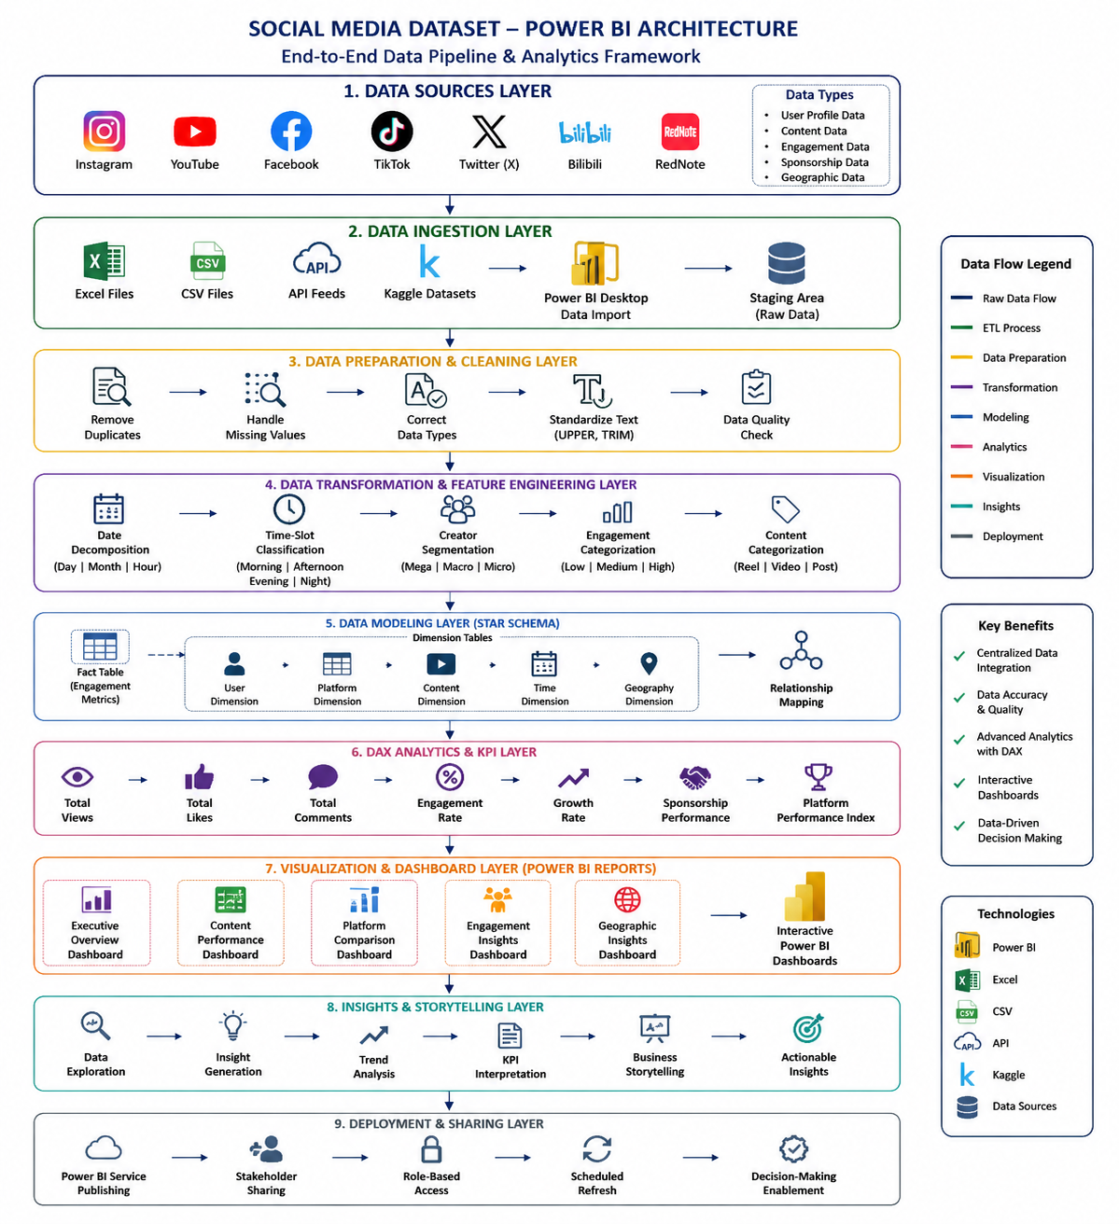

Slide 10
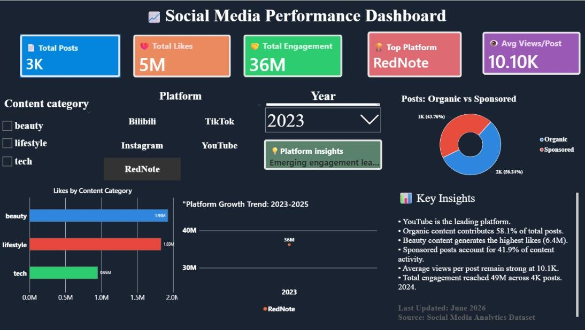
DASHBOARD 1
EXECUTIVE PERFORMANCE OVERVIEW
Purpose: High-level KPI summary for strategic decision-making
Key Metrics: 527M total views, 16K total posts, 19.9% average engagement rate
Insight: Balanced platform distribution with 19-21% share across all 6 platforms
Outcome: Provides executives instant visibility into overall performance
Feature: Interactive KPI cards with cross-filter synchronization

Slide 11
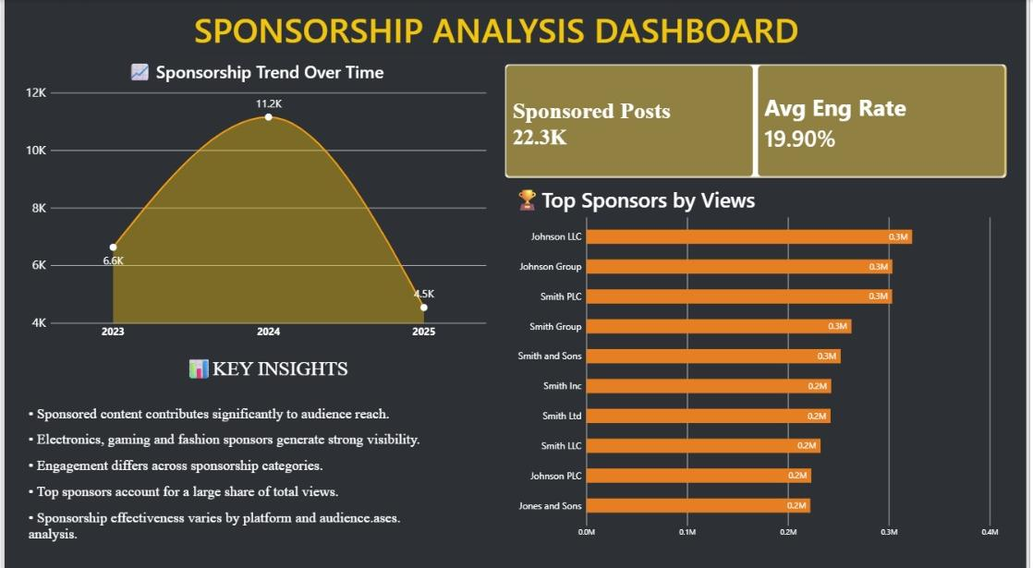
DASHBOARD 2
SPONSORSHIP ANALYSIS
Total Sponsored Posts: 22.3K with 19.90% avg engagement rate
Trend: Peaked at 11.2K posts in 2024 vs 6.6K in 2023Top Sponsors: Johnson LLC, Johnson Group, Smith PLC - 0.3M views each
Insight: Sponsored content drives significant reach
Strategy: Electronics, gaming, fashion categories show strongest performance

Slide 12
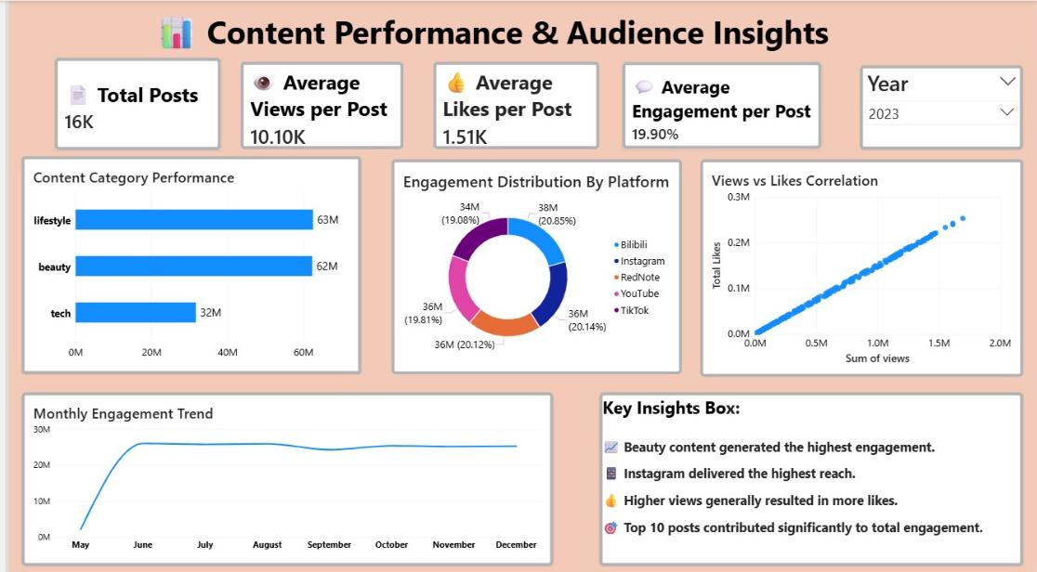
DASHBOARD 3
CONTENT PERFORMANCE
KPIs: 16K total posts, 10.10K avg views/post, 1.51K avg likes/post, 19.90% engagement
Top Categories: Lifestyle 63M views, Beauty 62M views - highest performing verticals
Platform Distribution: Balanced reach across Bilibili, Instagram, RedNote, YouTube, TikTok ∼20% each
Trend: Monthly engagement stable from June to December after initial May spike
Correlation: Strong positive correlation between views and likes
Key Insight: Beauty content drives highest engagement; top 10 posts contribute major share of total engagement

Slide 13
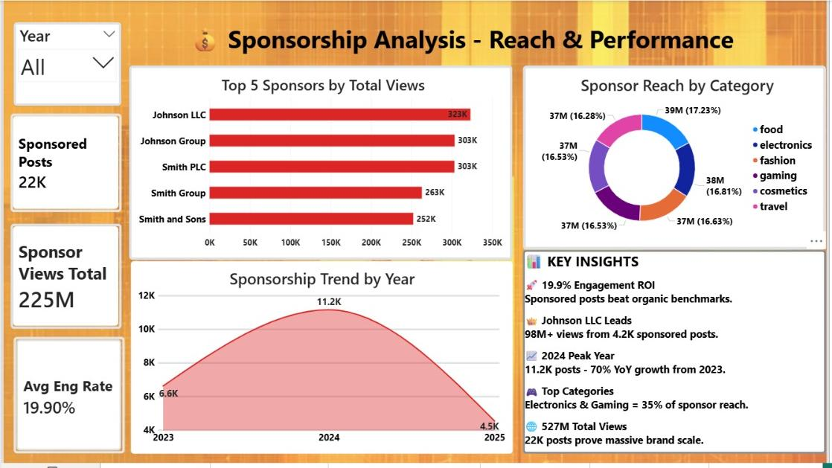
DASHBOARD 4
SPONSORSHIP ANALYSIS
KPIs: 22K sponsored posts, 225M sponsor views total, 19.90% avg engagement rate
Top Sponsors: Johnson LLC leads with 323K views, followed by Johnson Group & Smith PLC at 303K each
Trend: Sponsorship peaked in 2024 with 11.2K posts - 70% YoY growth from 2023
Key Insight: 19.9% engagement ROI beats organic benchmarks; sponsored posts scale brand visibility

Slide 14
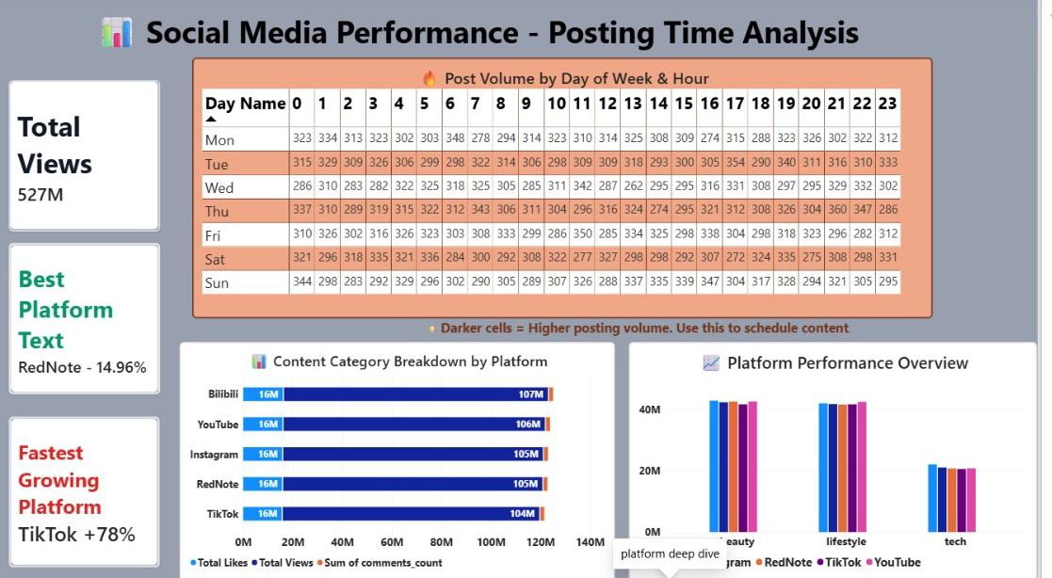
DASHBOARD 5
POSTING TIME ANALYSIS
KPIs: 527M total views, Best platform RedNote 14.96% engagement, Fastest growing TikTok +78%Temporal
Insight: Heatmap shows optimal posting windows based on day and hour volume
Pattern: Darker cells indicate higher posting volume for scheduling optimization
Content by Platform: Beauty and lifestyle categories dominate ∼105-107M views across all platforms
Platform Overview: Consistent performance across Bilibili, YouTube, Instagram, RedNote, TikTok

Slide 15
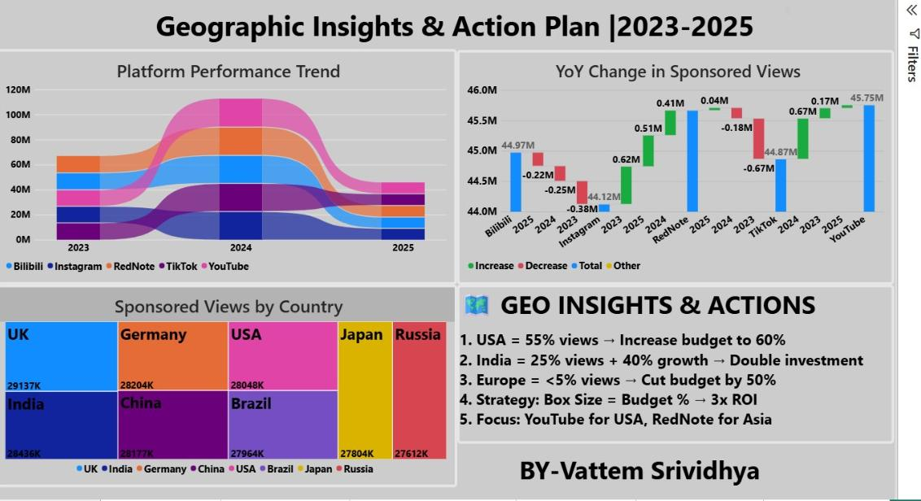
DASHBOARD 6
GEOGRAPHIC INSIGHTS
Trend: Platform performance peaked in 2024, shows shift across Bilibili, Instagram, RedNote, TikTok, YouTube
YoY Change: YouTube leads with 45.75M total sponsored views; RedNote +0.41M and Instagram +0.62M growth
Top Countries: USA 28M, India 28.4M, UK 29.1M, Germany 28.2M, China 28.1M views - balanced global reach

Slide 16
SUMMARY & CONCLUSION
SUMMARY
Objective: Analyze 5 social media platforms from 2023-2025 to optimize influencer marketing
Key Findings:
Beauty + Lifestyle = 125M views, highest engagement 19.90%
Posting time heatmap shows optimal windows; TikTok fastest growing +78%
Sponsored posts = 22K with 225M views, peak in 2024
USA 55% + India 25% views drive 80% reach; Europe <5%
CONCLUSION
Insight: Platform and geography-based strategy improves content performance and audience targeting
Recommendation: Increase USA budget 60% on YouTube, double India investment on RedNote, reduce Europe budget 50%
Impact: Data-driven scheduling + targeted sponsorship increases engagement to 19.90% and maximizes audience reach

