Slide 1
Dictionary Viet Nam -Laos
Myfriend
Nguyen Cong Kieu Tam
Le Do Dang Khoa
Duong Hai Minh
Khammone Phommaly
Vatthana Vongpaxa

Slide 2
MENU
Project introduction
Plan overview
Database
SQL-Select
Stored procedures
Function
Triggers

Slide 3
Project introduction
Dictionary
Viet Nam - Laos
What
Who
Why

Slide 4
What is Dictionary Viet Nam – Laos ?
The free offline software Viet-Lao Dictionary application explains the meaning of Viet-Lao words!
It work offline and won’t further download
Quick search
User-Friendly interface

Slide 5




Features

Slide 6



Who need to use it ?
Student
Traveler
Worker

Slide 7
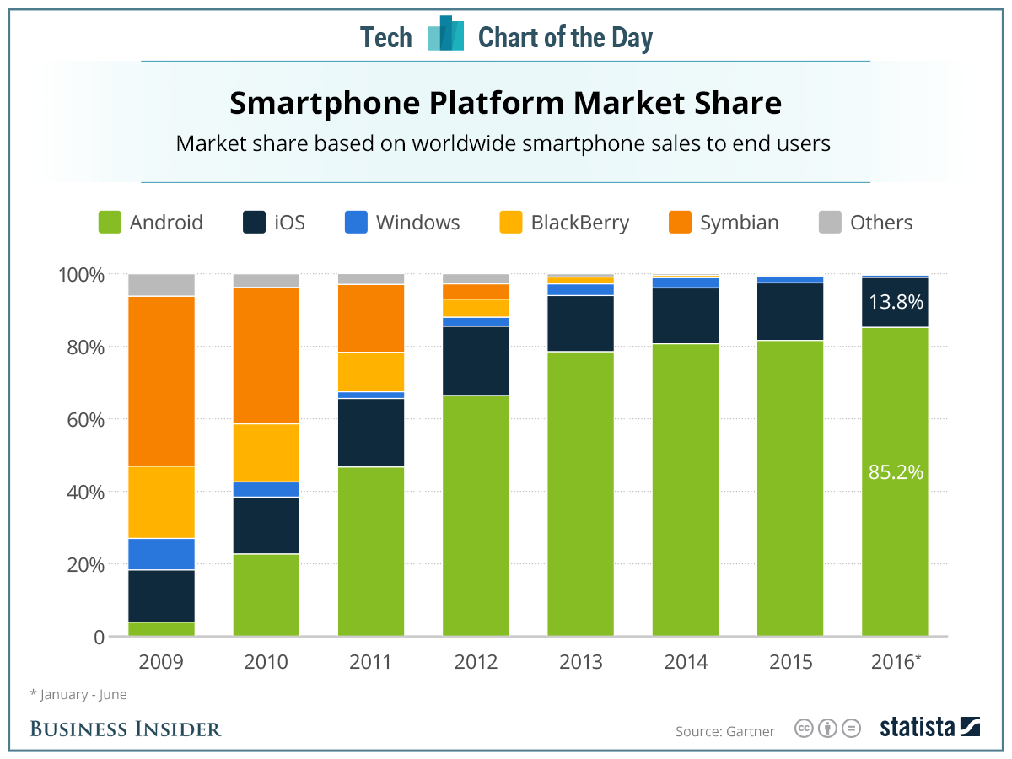
Why we use ?

Slide 8
Why we use ?
Easy
Small
Free
No Ads
Quick

Slide 9
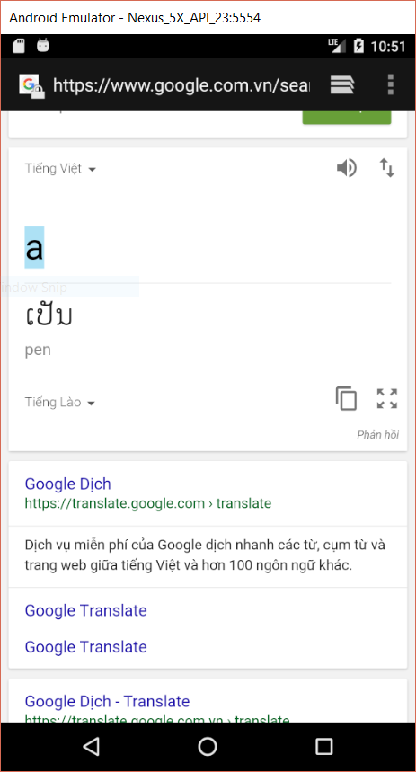
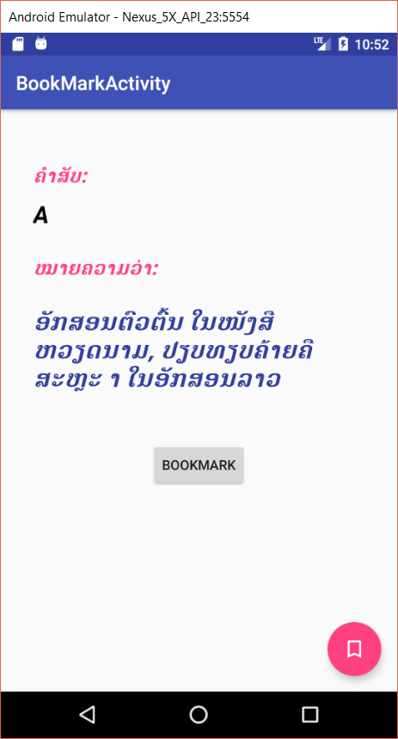
Difference
VS
Google Translate
Our App

Slide 10
Plan overview
Date & time | Tasks | Time frame (man hour) | Products
20/2/2017 Starting | Divide group & Choose topic | 1day | Name group: MyFriend App: Dictionary Viet Nam - Laos
21/02/2017 | Requirement | 6 day | Identify user needs. Programming on android platform
27/02/2017 | System analysis | 7 day | Using SQLite Data base. User interface
6/3/2017 | Data base design | 7 day | Database is complete (db_TUDIEN.db)
13/3/2017 | User Interface design | 14 day | Dictionary Viet Nam – Laos for Android
27/3/2017 | Testing | 7 day | Fix bug. Fix logic error.
03/4/2017 | Implementation | 7 day
10/4/2017 | Presentation

Slide 11
Database Table TUDIEN
Attributes | Data Type | Allow Nulls | Detail
ID(PK) | INTERGER | Not Null | The primary key for a word, each word will carry a different key
VNWORD | TEXT | Null | Words are written in Vietnamese
LAOWORD | TEXT | Null | Words are written in Lao language
BOOKMARK | BOOLEAN | Null | Mark the words of interest

Slide 12
Table TUDIEN backup
Attributes | Data type | Allow Null | Detail
ID | INTERGER | Not null | The primary key for a word, each word will carry a different key
VNWORD | TEXT | Not null | Words are written in Vietnamese
LAOWORD | TEXT | Not null | Words are written in Lao language
BOOKMARK | BOOLEAN | Default(0) | Mark the words of interest
TIME | DATETIME (CURRENT_TIMESTAMP) | Not null | Time of back up words
NEW

Slide 13
SQL-Select
Quick search command
SELECT *
FROM TUDIEN
WHERE VNWORD LIKE ‘ tu tieng viet % ’
Show bookmark word
SELECT *
FROM TUDIEN
WHERE BOOKMARK = 1
Translate
SELECT *
FROM TUDIEN
WHERE VNWORD = ‘ ai ai ’
Show all words
SELECT *
FROM TUDIEN

Slide 14
Stored procedures
Update word
Delete Word
Set Bookmark
Add new word

Slide 15
Function
T
Translate
S
Show bookmark
S
Search

Slide 16
Triggers
Backup Word
CREATE TRIGGER BACKUP AFTER UPDATEON TUDIEN FOR EACH ROW BEGIN INSERT INTO BACKUP (ID, VNWORD, LAWORD, TIME) VALUES (OLD.ID, OLD.VNWORD, OLD.LAWORD, CURRENT_TIMESTAMP); END;

Slide 17
Application overviews

