Slide 1

MOBILE QA FRAMEWORK | ANDROID & iOS
QAlprit
Mobile QA. Caught with Proof.
Author tests in readable Markdown and YAML. Execute reliably on real devices, emulators, and simulators. Deliver masked audit reports.
Version 0.1.1 · MIT License
pip install qalprit
qalprit.vattitude.ca
Plain Markdown
Static Execution
RAM Redaction
github.com/vattitude-me/QAlprit
No script boilerplate
Zero runtime AI calls
Secrets masked pre-save
QAlprit | Mobile QA Framework
qalprit.vattitude.ca
1 / 7

Slide 2
01 | MARKET POSITIONING
How QAlprit Compares Against Paid & Open Alternatives
Positioned against code frameworks, paid commercial SaaS suites, and runtime AI runners.
CODE FRAMEWORKS
PAID QA PLATFORMS
RUNTIME AI AGENTS
QALPRIT (MIT)
Appium / XCUITest
Cloud & Low-Code SaaS
LLM Vision Runners
Markdown + Appium
Code-first scripts
Per-seat / minute fees
Inference on every step
AI heals · Local static runs
• Heavy Python / Java boilerplate
• QA blocked on dev time
• Manual screenshot cleanup
• Separate OS test suites
• Recurring seat & device fees
• APK / IPA uploaded to vendor
• Proprietary format lock-in
• Staging apps need VPN tunnels
• Non-deterministic run drift
• Token cost & latency per tap
• Screens leave your network
• Can bypass real UI defects
• $0 license & Git-owned specs
• Zero cloud upload or tunnels
• Zero runtime AI call drift
• RAM-redacted HTML proof
QAlprit | Mobile QA Framework
qalprit.vattitude.ca
2 / 7

Slide 3
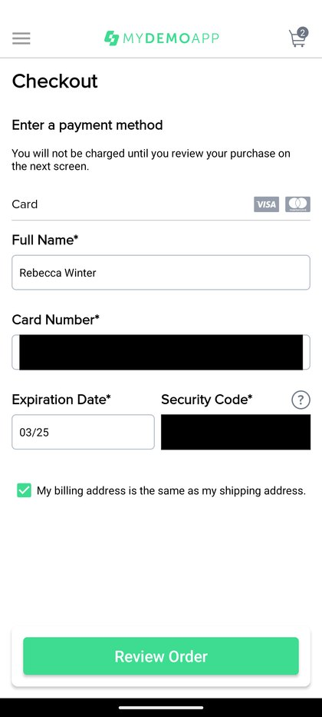
02 | CORE DIFFERENTIATORS
Built for Determinism, Privacy, and Audit Proof
Four foundational design choices that keep mobile releases fast and defensible.
01 | DETERMINISTIC RUNS
02 | PRIVACY FIRST
EXHIBIT | PILLOW RAM MASK
Zero Runtime AI
In-Memory Redaction
Specs map 1:1 to validated Appium locators. Every step runs identically with zero LLM cost.
Secrets marked sensitive are masked in RAM by Pillow before PNG images hit disk.
03 | CROSS-PLATFORM + 2FA
04 | PORTABLE EVIDENCE
Android & iOS Parity
Single-File Reports
Shared steps with clean android: / ios: overrides plus built-in RFC 6238 TOTP.
Exports self-contained report.html, summary.md, and results.json for instant sharing.
Card & CVC redacted prior to disk save
QAlprit | Mobile QA Framework
qalprit.vattitude.ca
3 / 7

Slide 4
03 | OPERATING MODEL
AI Authors & Repairs. Appium Executes Cleanly.
Separating AI maintenance from runtime execution prevents flaky runs and protects assertions.
LOOP A | OFFLINE AUTHORING & SELF-HEALING
AI Guidance: docs/agent-instructions.md
1. Preflight
2. Inspect UI
3. Patch Spec
4. Validate
doctor & devices
→
qalprit inspect
→
MD & YAML
→
qalprit validate
Verify SDK, Xcode, targets
Capture live IDs & XPaths
Set android: / ios: keys
Lint schema pre-run
LOOP B | DETERMINISTIC EXECUTION (ZERO RUNTIME LLMs)
Command: qalprit run
1. Boot Driver
2. Run Steps
3. RAM Mask
4. Emit Proof
Managed Appium
→
Exact Playback
→
Pillow + TOTP
→
HTML + FAIL XML
Auto-start server & device
Static taps & assertions
Redact PII & live 2FA
Portable report & dumps
Product Integrity Rule: Failed assertions always stop and save *_FAIL.png + *_FAIL.xml — real bugs are never masked.
QAlprit | Mobile QA Framework
qalprit.vattitude.ca
4 / 7

Slide 5
04 | TECHNICAL STACK
Architecture Components & Why Each Exists
Clean separation between Python test orchestration, Node-hosted Appium, and native OS SDKs.
Layer | Components Required | Why Needed
Core CLI & Workbench | Python 3.10+, Click, stdlib http.server | Executes all commands (doctor, run, ui) and serves local workbench with zero Node frontend.
Spec & Schema Layer | PyYAML, python-frontmatter, Pydantic | Parses Markdown specs & YAML flows; enforces strict field validation before device boot.
Appium Server Host | Node.js LTS + Appium 2 / 3 Server | Appium itself is built on Node.js; Node hosts the local WebDriver server & OS drivers.
Android Execution | Java JDK + Android SDK (ADB) + UiAutomator2 | Java & SDK compile/bridge device instrumentation, discover AVDs, and run UI gestures.
iOS Execution | Xcode + simctl + XCUITest Driver | Builds Apple's WebDriverAgent runner on macOS to drive iOS Simulators and real devices.
Privacy & 2FA | Pillow (Python PIL), hmac / hashlib | Blacks out sensitive coordinates in RAM pre-save; computes RFC 6238 TOTP natively.
Reporting & AI Ops | Jinja2, JSON/MD + agent-instructions.md | Renders portable report.html via Python templates; guides AI offline locator repairs.
QAlprit | Mobile QA Framework
qalprit.vattitude.ca
5 / 7

Slide 6
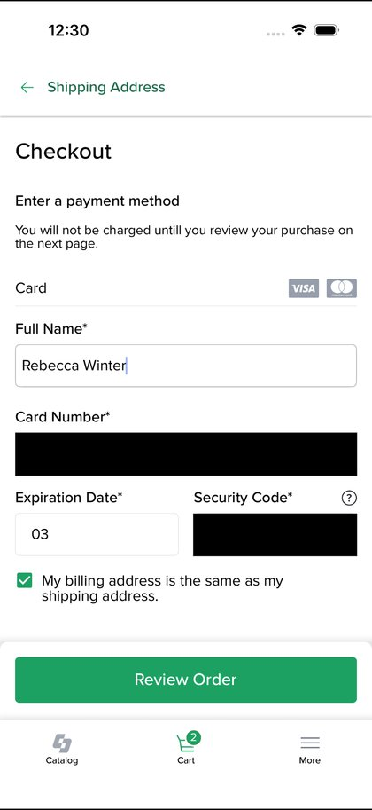
05 | VERIFIED RESULTS
End-to-End Sample Suite Runs Across Android & iOS
Clean-room runs executed via managed Appium with Pillow RAM redaction verified.
ANDROID EMULATOR
REDACTED PAYMENT CHECKOUT | LIVE ARTIFACTS
5 / 5 Specs Passed (100%)
Completed in 2m 1.1s · 104 total steps checked
iOS SIMULATOR (iPHONE 17)
3 / 3 Specs Passed (100%)
iOS 26.5 · Completed in 2m 21.9s · 80 steps
IN-MEMORY REDACTION
0 Secrets Leaked on Disk
Card number, CVC, and login credentials masked
PYTEST CORE SUITE
27 / 27 Unit Tests Passed
Loaders, validator, Pillow masking, HTML reporter
Android · Masked
iOS · Masked
QAlprit | Mobile QA Framework
qalprit.vattitude.ca
6 / 7

Slide 7
06 | SUMMARY
Predictable Mobile QA for Teams and AI.
01
02
03
Author in Markdown
Static Execution
Ship with Audit Proof
Readable tests and shared YAML flows without Selenium or Appium script sprawl.
Use AI to inspect and fix selectors offline — pay zero LLM cost or drift mid-run.
In-memory Pillow redaction, single-file HTML reports, and exact DOM failure dumps.
pip install qalprit
Live Reports & Docs: qalprit.vattitude.ca
Managed by vattitude.ca · MIT
QAlprit | Mobile QA Framework
qalprit.vattitude.ca
7 / 7

