Slide 1
Introduction to Svelte.js
What is Svelte.js?: - A modern front-end framework for building user interfaces. - Created by Rich Harris in 2016. - Emphasizes compile-time optimization.
Unique Features and Advantages: - No virtual DOM. - Small bundle size. - Reactive declarations. - Better performance and simplicity.

Slide 2
Core Concepts of Svelte.js
Reactive Programming in Svelte: - Automatically updates the DOM when state changes. - Uses $: reactive assignments for declarative updates.
Svelte's Compilation Process: - Converts components into highly optimized imperative code. - No runtime overhead.
Component Structure: - Simplistic approach to components with HTML, CSS, and JavaScript all in one file. - Clear and concise syntax.

Slide 3
Svelte.js vs. Other Frameworks
Comparison with React, Vue, and Angular: - Svelte is a compiler, not a runtime framework. - No virtual DOM, unlike React. - Simplifies learning and development with a minimal API.
Performance and Bundle Size Benefits: - Smaller bundle sizes lead to faster loading times. - Pre-compiled code offers better runtime performance.

Slide 4

Building a Svelte.js Application
Setting up a Svelte Project: - Use Svelte’s CLI to create a new project: `npx degit sveltejs/template my-svelte-project`. - Understand the basic project structure and setup.
Basic Example: Creating a Component: - Write a simple component with HTML, CSS, and JavaScript in one file. - Display dynamic data using Svelte’s reactive assignments.
Handling State and Props: - Manage component state using reactive declarations. - Pass data between components using props.
Photo by Nate Grant on Unsplash

Slide 5

Advanced Features of Svelte.js
Svelte Stores: - Centralized state management with writable and readable stores. - Simplifies data sharing and state management across components.
Transitions and Animations: - Built-in support for smooth transitions and keyframe animations. - Create custom animations using `@keyframes` directive.
Custom Directives: - Extend Svelte functionality with custom directives. - Use custom directives for advanced DOM manipulations.
Photo by Markus Spiske on Unsplash

Slide 6
SvelteKit Overview
Introduction to SvelteKit: - A powerful framework for building modern web applications with Svelte. - Provides features like routing, SSR (Server-Side Rendering), and static site generation.
Benefits of Using SvelteKit: - Simplifies the process of building and deploying Svelte applications. - Supports both client-side and server-side rendering out of the box. - Flexible and powerful for developing complex web applications.
Photo by Nate Grant on Unsplash

Slide 7

Ecosystem and Community
Popular Svelte.js Tools and Libraries: - Svelte Material UI, Svelte Headless UI for building UI components. - Sapper, the predecessor to SvelteKit, for full-stack development. - Svelte DevTools for debugging Svelte applications.
Community Resources and Support: - Official documentation and extensive tutorials on svelte.dev. - Active community on Discord, Reddit, and Stack Overflow. - Numerous blogs, video tutorials, and online courses.
Photo by Nandha Kumar on Unsplash

Slide 8
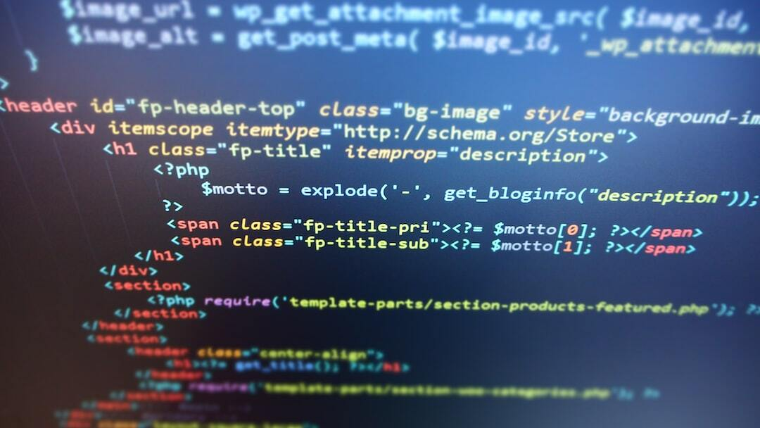
Conclusion
Summary of Key Points: - Svelte.js provides a unique compile-time approach with no virtual DOM. - It offers smaller bundle sizes and reactive programming for efficient UI updates. - SvelteKit enhances Svelte for building full-stack applications.
Future of Svelte.js: - Growing adoption and community support in web development. - Continuous innovation and expansion of the ecosystem. - Potential to influence future web development practices significantly.
Photo by Datahjelpen AS on Unsplash

Slide 9

Performance Metrics
Initial Load Time: - Svelte: 0.9 seconds - React: 1.1 seconds - Vue: 1.0 seconds - Angular: 1.2 seconds
Runtime Performance: - Svelte: Minimal runtime overhead due to pre-compiled code. - Efficient DOM updates leading to faster rendering times.
Memory Usage: - Svelte: Uses less memory during execution. - Optimized rendering process reduces memory footprint compared to React, Vue, and Angular.
Photo by Agence Olloweb on Unsplash

Slide 10
Bundle Size Comparison
Svelte: - Typical bundle size: ~3.6 KB (minified + gzipped)
React: - Typical bundle size: ~43 KB (minified + gzipped)
Vue: - Typical bundle size: ~23 KB (minified + gzipped)
Angular: - Typical bundle size: ~68 KB (minified + gzipped)
Implications: - Smaller bundle sizes lead to faster load times and improved user experience. - Svelte’s pre-compilation reduces the need for a large runtime library.
Photo by Nate Grant on Unsplash

Slide 11

Code Snippet Comparison
React Code Snippet: ```javascript import React, { useState } from 'react'; function Counter() { const [count, setCount] = useState(0); return ( ); } ```
Svelte Code Snippet: ```html ```
Key Differences: - Svelte uses a more declarative approach with reactive assignments. - All logic, styling, and markup are in a single file in Svelte. - React relies on hooks and JSX for state management and UI updates.
{count}
{count}
Photo by Arnold Francisca on Unsplash

