Slide 1
FuzzyWuzzy Project
UndefinedOffsetNine:
Cortney Mood
Courtney Profera
Ronald Zielaznicki
Katherine Vaughan

Slide 2
Introduction
FuzzyWuzzy
Comparing strings with python difflib
Notes:
( If you all feel like we should put a link to the website where our project was found then add it) Here is the link: http://chairnerd.seatgeek.com/fuzzywuzzy-fuzzy-string-matching-in-python/.
https://docs.python.org/2/library/difflib.html (difflib)

Slide 3
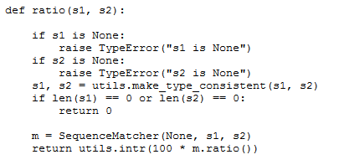
The Testing Process
Methods Tested:
ratio()
fuzzRatioDriver
partial_ratio()
fuzzPartialRatio
token_sort_ratio()
fuzzTokenSortRatio
token_set_ratio
fuzzTokenSetRatio
Script:
Notes:
For each method we used the same input types to catch potential problems with the input space. This involved sending empty strings, and special characters.

Slide 4
Testing Framework
The framework
Sets up the HTML log file
Pulls in/parses a test case
Runs the test case
Then adds the test case to the log
Repeat from step 2 for all test cases

Slide 5
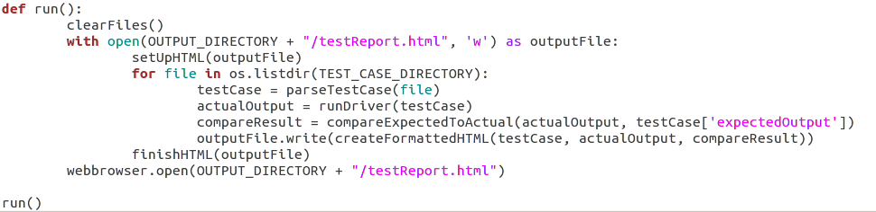
Script

Slide 6
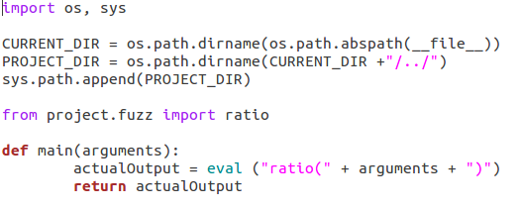
Driver
Ratio Driver:

Slide 7
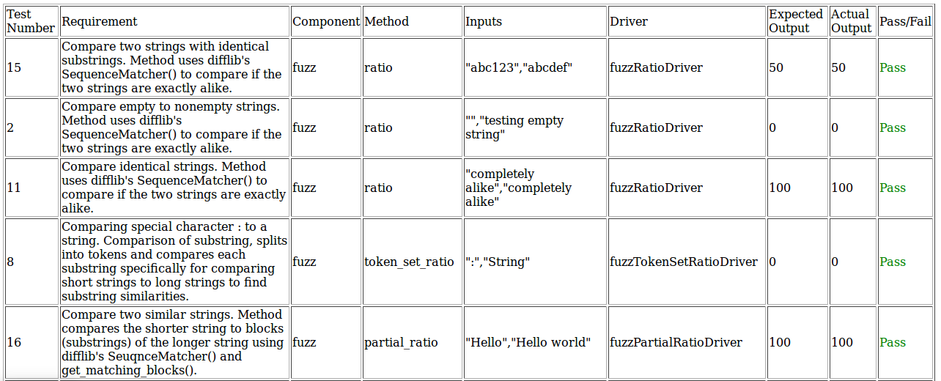
Ex. Inputs/Results

Slide 8
Fault Injections
We injected 5 faults into our project. Each fault was intended to break a different test case. We injected the faults individually and all at once. Oddly enough, some of the faults did not affect some of the test cases they were intended to break.

Slide 9
Conclusion
Cortney - “Cooperate and communicate effectively”
Courtney - “Don’t let your brother install things for you”
Katie - “Learned a lot, glad to be done”
Ronald - “Face to face meetings are key”

