Slide 1



PAGE 1
Sophal Vaung
ddos detection
USING MACHINE LEARNING
American University of Phnom Penh
COSC 221 001 - Computer Science B
Dr. Abdallah Altrad
December 2, 2024

Slide 2



PAGE 2
introduction
Distributed Denial of Service (DDoS) attacks are a major concern in cybersecurity, because they flood networks with too much traffic, causing services to stop working. To deal with this concern, I built a project uses machine learning to detect and classify these attacks. To make it easier for users, I created a user-friendly interface using Streamlit UI that allows real-time analysis of network traffic data.
SOPHAL VUANG

Slide 3

PAGE 3
Objective
The primary objective of this project is to develop an efficient and scalable machine learning-based system for the detection and classification of DDoS attacks. By analyzing key features from network traffic, the system aims to show the difference between normal and harmful patterns with high accuracy. The project also focuses on building a simple interface that makes it easy to upload data, choose a model, and see the results. This includes preparing the data, selecting the best features, and testing the system to make sure it works well and can be used in real-life cybersecurity situations.
SOPHAL VAUNG

Slide 4



PAGE 4
PROGTAMING LANGAUGE
Technology used
-PYTHON
LIBRARIES:
- Streamlit for the user interface
- Scikit-learn for machine learning models and metrics
- Pandas and NumPy for data manipulation
- Matplotlib and Seaborn for visualization
- Joblib for model saving/loading
VAUNG SOPHAL

Slide 5
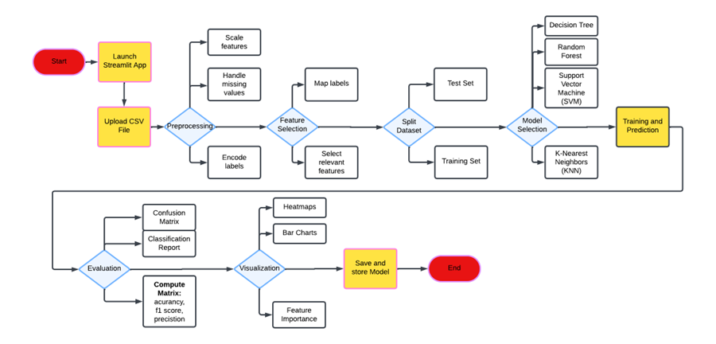
FLOWCHART
PAGE 5
VAUNG SOPHAL

Slide 6
PAGE 6
Sophal Vaung
CODE DEMO
AMERICAN UNIVERSITY OF PHNOM PENH

Slide 7
REFERENCES
PAGE 7
These references refer to the project idea, concept code, and datasets explored.
Kaggle: Your machine learning and data science community. (n.d.). Retrieved from https://www.kaggle.com/
Najafimehr, M., Zarifzadeh, S., & Mostafavi, S. (2023). DDoS attacks and machine‐learning‐based detection methods: A survey and taxonomy. Engineering Reports, 5(12). https://doi.org/10.1002/eng2.12697
Samruddhid. (n.d.). GitHub - DDoS Detection using Machine Learning. Retrieved from https://github.com/samruddhid5/DDoS-Detection-using-Machine-Learning
Sophal Vaung
American University of Phnom Penh
COSC 221 001 - Computer Science B
Dr. Abdallah Altrad
December 2, 2024
THANK YOU
THANK YOU

