Slide 1
FINAL PROJECT · ARTIFICIAL INTELLIGENCE
What the market
will ask next
Forecasting food commodity prices in Cambodia — from World Food Programme price monitoring to a web app and a Telegram bot.
46 COMMODITIES · 76 MARKETS · XGBOOST, PORTED TO TYPESCRIPT

Slide 2
PROBLEM & SOLUTION
An early warning
only works if it arrives
PROBLEM
SOLUTION
A price rise lands hardest on the people with the least slack.
Make the answer reachable in two clicks or one message.
For a low-income household food is the largest monthly cost, so a price rise is not an inconvenience.
→
3,442 price series across 46 commodities and 76 markets, charted for anyone with a browser.
WFP tracks these markets to catch that early, but publishes what prices were — not what they will be.
A next-period forecast on each, with the line between recorded and predicted drawn honestly.
And the record itself ships as a 85,107-row CSV: readable by analysts, nobody else.
Free to run — so a ministry, an NGO or a co-op could stand the same thing up on its own feed.
A demonstration on a snapshot, not a deployed service — the data ends March 2026 and the app says so, series by series.
01

Slide 3
THE DATA
Twenty-three years
of market visits
SOURCE
WFP Global Food Prices — Cambodia (HDX)
FILTERING
OBSERVATIONS
85,107
85,107 rows
2003-01-15 to 2026-03-15
everything WFP has recorded
RANGE
↓
from 2019 onward
COMMODITIES
50 raw
older reporting is sparse and pre-dollarisation
↓
MARKETS
86 raw
commodities with 300+ rows
a series needs history to have a lag
TARGET
usdprice — price per unit in USD
↓
67,654 modelled rows
46 commodities · 76 markets · 4,035 series
02

Slide 4
FRAMING IT AS A LEARNING PROBLEM
The split is the
whole experiment
Each (commodity, market, pricetype) forms a time series. The model predicts the next observation in that series from its own recent history.
CHRONOLOGICAL HOLD-OUT
Cut point
2025-04-15 (85th percentile of dates)
Train
57,878 rows · everything before the cut
THE TRAP
A random train/test split lets the model learn from June to predict April. Prices are autocorrelated, so it scores brilliantly and forecasts nothing. The split has to be chronological.
Test
9,776 rows · everything after
Never seen
the test period, by any model, at any point
03

Slide 5
FEATURE ENGINEERING
Ten features, built
inside each series
PRICE HISTORY
CALENDAR
IDENTITY
lag_1
month
commodity_enc
the previous reported price
1-12, seasonality of harvest
which food
lag_3
quarter
market_enc
the price three reports back
1-4, coarser seasonality
which market
rolling_mean_3
admin1_enc
mean of the last three
which province
category_enc
cereals, meat, pulses …
pricetype_enc
retail or wholesale
Lags are computed within each series (grouped shift), never across them — a rice price in Battambang can never leak into a pork price in Phnom Penh. Rows without three prior observations are dropped rather than imputed.
04

Slide 6
MODEL COMPARISON
Beating “tomorrow
equals today”
The naive baseline — predict the last price — already scores R² 0.92, because prices are sticky. It is the number any model has to beat to be worth deploying.
MODEL
MAE (USD)
RMSE (USD)
R²
Naive baseline (lag_1)
0.1799
0.4088
0.9239
Random Forest (reproduced)
0.1690
0.3352
0.9489
XGBoost (final model)
0.1642
0.3295
0.9506
Random Forest reproduced locally from the notebook's settings (n=300, depth 15, seed 42). XGBoost figures come from the trained price_model.pkl itself, evaluated on the held-out period.
05

Slide 7
RESULT
The model earns
its place
$0.164
0.951
8.7%
MEAN ABSOLUTE ERROR
R² ON THE TEST PERIOD
BETTER THAN NAIVE
on held-out 2025-26 prices
variance explained
MAE reduction vs. last price
An average miss of about sixteen US cents on a basket whose prices mostly sit between $0.30 and $3.00 — accurate enough to plan around, not precise enough to trade on. Both halves of that sentence matter.
06

Slide 8
INTERPRETATION
It learned to be
a very good smoother
rolling_mean_3
56.3%
THE HONEST READING
lag_1
41.1%
97% of the model
rests on two features: the recent mean and the last price.
Commodity, market, province and season together account for barely two percent. This is a well-calibrated smoother, not a market oracle — and saying so is part of the result.
lag_3
0.9%
commodity_enc
0.4%
category_enc
0.4%
month
0.2%
Gain-based feature importance from the trained booster.
07

Slide 9
FROM NOTEBOOK TO PRODUCT
The model fit.
The libraries didn’t.
A notebook that only runs in Colab isn't a product. Deploying to Vercel's free tier meant meeting a hard limit: 250 MB unzipped per serverless function.
250 MB · VERCEL HOBBY LIMIT
xgboost
84 MB
scipy
111 MB
numpy
58 MB
pandas
42 MB
scikit-learn
32 MB
TOTAL
327 MB
The deploy fails before a single prediction is ever served.
08

Slide 10
THE INSIGHT
A boosted tree is
just a lot of if-statements
Training needs XGBoost. Predicting does not. Inference is: walk each tree comparing one feature to one threshold, sum the leaf weights, add the base score. Fifteen lines in any language.
function rawPredict(features: number[]): number {
let total = BASE_SCORE
for (const tree of TREES) {
let node = 0
while (tree.l[node] !== -1) {
400
10
2.4 MB
0
node = features[tree.f[node]] < tree.t[node]
? tree.l[node]
trees traversed
features each
of JSON
ML dependencies
: tree.r[node]
}
total += tree.w[node]
The model exports to JSON: tree arrays, encoder maps, feature order, and a 24-point price history per series. The deployed function ships none of the Python stack.
}
return total
}
09

Slide 11
VERIFICATION
Two languages,
one number
A port is only worth anything if it agrees with the original. The test suite pins the TypeScript traversal to the Python model's own answer for a known series — a wrong feature order or a flipped comparison changes that number, and nothing else would catch it.
REFERENCE CASE
commodity
Rice (mixed, low quality)
market
Phnom Penh · Wholesale
last recorded
2022-06 · $0.44
19 tests cover the traversal, the fuzzy matching, the commodity/market splitter and every failure path.
python xgboost
0.460955
typescript port
0.4609556
agree to 1e-5 · asserted on every test run
10

Slide 12
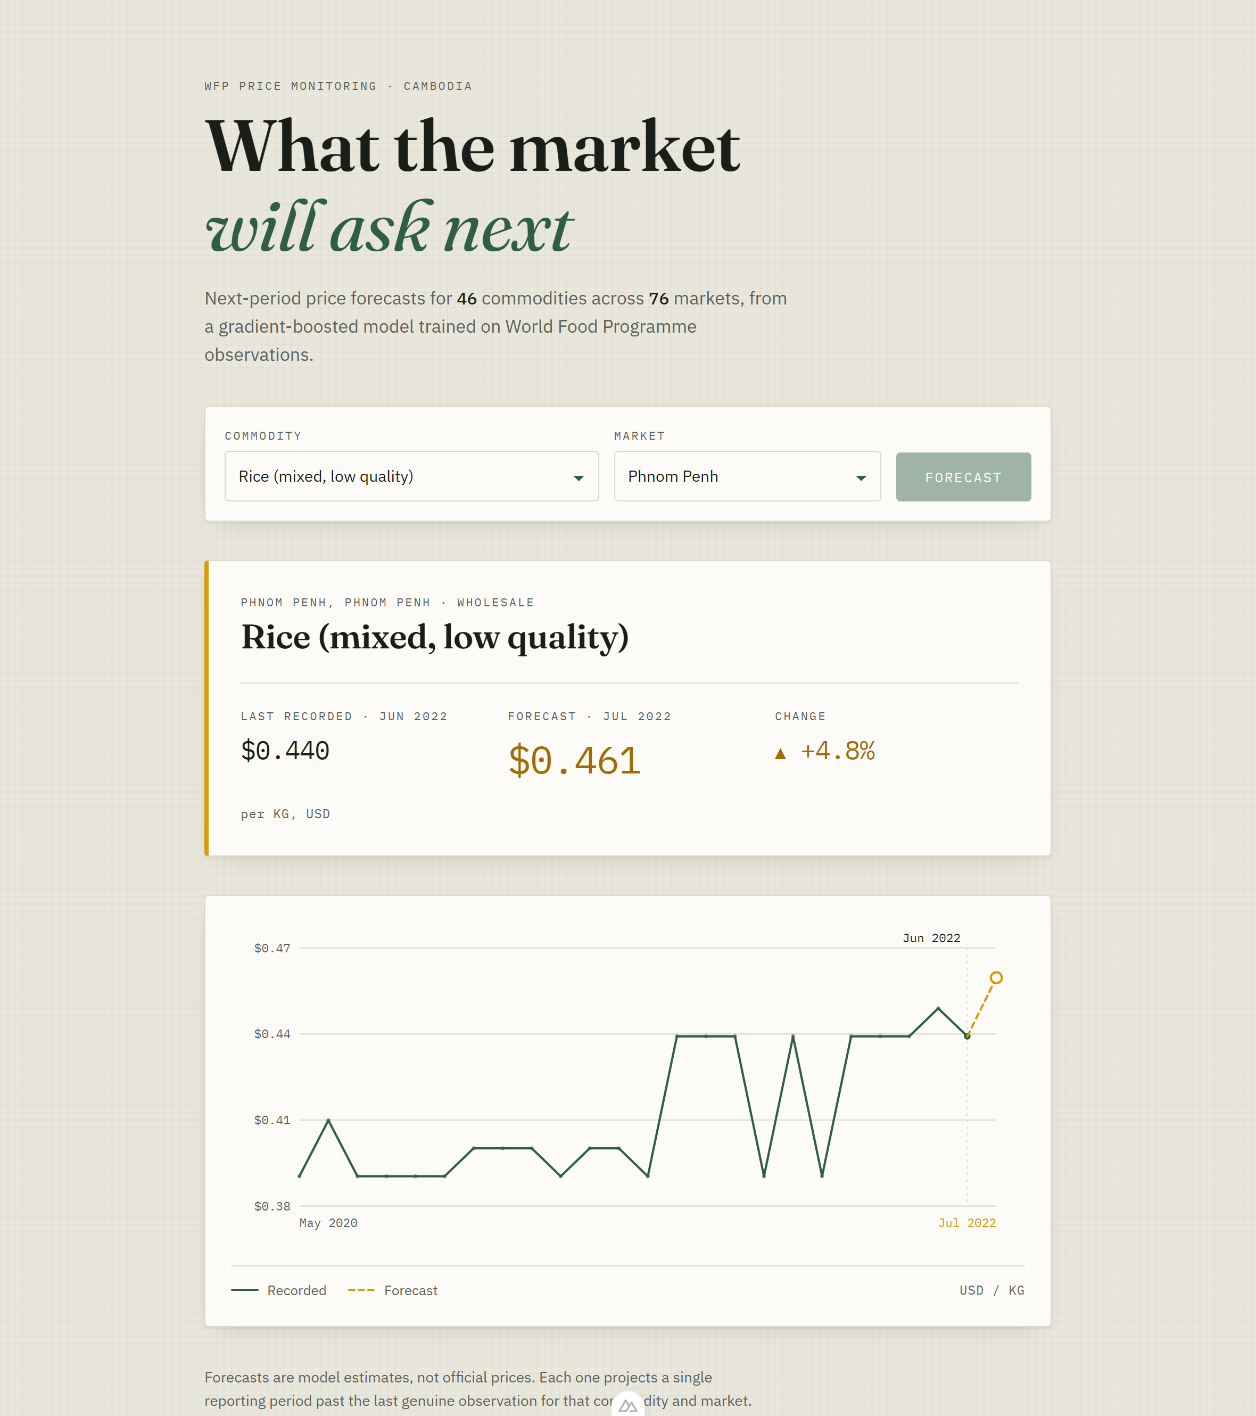
THE RESULT
It runs
in a browser
Nuxt 4 on Vercel. The default forecast is server-rendered, so the chart is on screen at first paint — no spinner, no empty state.
Dependent dropdowns
picking a commodity narrows the markets to those that carry it
Fuzzy input
"rice" resolves to Rice (mixed, low quality) — shortest match wins
Cached at the edge
options for a day, forecasts for an hour
Responsive to 390px
the chart switches to a narrower viewBox, not smaller type
11

Slide 13
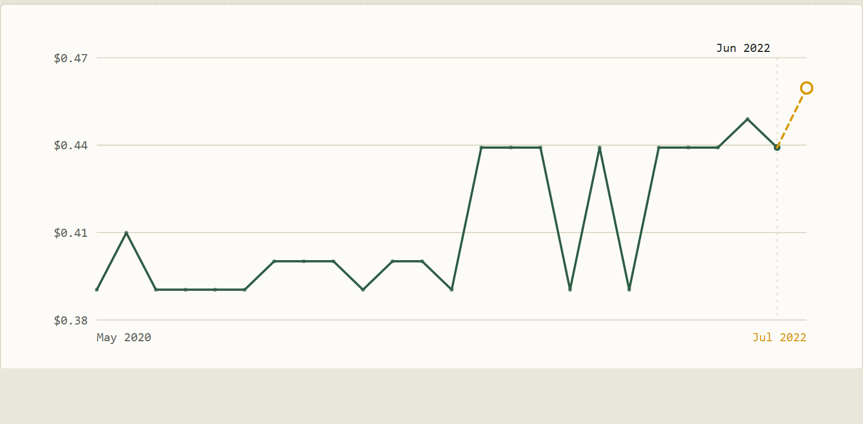
DESIGN DECISION
Where the record ends
must be unmistakable
A charting library would draw the forecast as the next point on the same line. That is a lie of omission: it renders a model estimate with exactly the same authority as a recorded observation.
Solid green
prices actually recorded
Dashed amber
the model's estimate, rising
Dashed red
the model's estimate, falling
Hollow ring
not an observation
Hand-rolled SVG — about 200 lines, no charting library.
12

Slide 14
FORECAST HORIZON
One period past the record,
not one month past today
The model forecasts one reporting period past each series' own last observation — not one month past today. Series stopped reporting at very different times, so that date differs for every commodity and market.
SO IS IT ACTUALLY FORECASTING?
Yes — and that is what the test period measures.
Training stopped at 2025-04-15; all 9,776 test rows fall after it. The model was scored on dates it had never seen — a real out-of-sample forecast.
What it cannot do is forecast today from a series that went quiet in 2022 — and the app prints the real date rather than hiding it.
LAST OBSERVATION ACROSS 3,442 SERVED SERIES
34%
2026-03 — still reporting · 1,163
10%
2025 — recently stopped · 348
56%
2024 or earlier — stale · 1,931
Rice at Phnom Penh, wholesale: last recorded June 2022, so the app labels its forecast July 2022 — not next month.
13

Slide 15
SECOND SURFACE
The same engine,
in a chat window
One prediction engine, two front doors. The bot shares the exact code the web app calls — a Telegram update in, a formatted forecast out.
/predict rice phnom penh
Rice (mixed, low quality)
Phnom Penh, Phnom Penh · Wholesale
Reply in the response body
the webhook returns the sendMessage call itself — no outbound request, and the bot token never reaches Vercel
Last recorded (2022-06): $0.440 / KG
Next period forecast: $0.461
Always HTTP 200
▲ +4.8%
a non-2xx makes Telegram retry the same update forever
▁▃▁▁▁▁▂▂▂▁▂▂▁▇▇▇▁▇▁▇▇▇█▇
2020-05 → 2022-06, 24 observations
Sparkline in Unicode blocks
the only chart a chat window can render inline
14

Slide 16
LIMITATIONS
What this model
cannot do
One period ahead, and no further
Every feature is a recent price. Feed the model its own output and error compounds fast — there is no multi-step forecast here.
It cannot see shocks coming
Fuel costs, export bans, floods, festival demand. None are in the feature set, and they are exactly what moves prices sharply.
Stale series forecast from stale prices
A series last reported in 2022 gets a 2022-shaped answer. Honest, but not useful for today.
No uncertainty interval
A single number, not a range. The dashed line signals doubt visually, but does not quantify it.
15

Slide 17
IF I KEPT GOING
Three things
I would add next
Prediction intervals
Exogenous features
Retraining on a schedule
Quantile regression at 10/90 to turn the dashed line into a shaded band — the honest version of the same signal.
Fuel price, rainfall, and the lunar calendar for festival demand. The categorical features contribute two percent; these might not.
The export script already runs headless. A monthly job against the live HDX feed would keep every series current.
16

Slide 18
THANK YOU
Questions
welcome
DATA
WFP Global Food Prices — Cambodia
MODEL
XGBoost · 400 trees · scikit-learn pipeline
RUNTIME
Nuxt 4 · Nitro · TypeScript tree traversal
SURFACES
Web app · Telegram bot · one shared engine

