Slide 1
FINAL PROJECT · ARTIFICIAL INTELLIGENCE
What the market
will ask next
Forecasting food commodity prices in Cambodia — from World Food Programme price monitoring to a web app and API.
46 COMMODITIES · 76 MARKETS · XGBOOST, PORTED TO TYPESCRIPT

Slide 2
PROBLEM & SOLUTION
An early warning
only works if it arrives
PROBLEM
SOLUTION
No simple food-price forecast exists.
Make the forecast easy to reach.
→
Prices are public, but hard to use.
46 commodities and 76 markets.
People need warning before prices rise.
Choose a food and market.
A CSV is not enough for everyday users.
See price history, trend and forecast.
Core claim: this project does not invent new food-price data; it makes public data predictive, accessible and honest about uncertainty.
01

Slide 3
THE DATA
Twenty-three years
of market visits
SOURCE
WFP Global Food Prices — Cambodia (HDX)
FILTERING
OBSERVATIONS
85,107
85,107 rows
2003-01-15 to 2026-03-15
everything WFP has recorded
RANGE
↓
from 2019 onward
COMMODITIES
50 raw
older reporting is sparse and pre-dollarisation
↓
MARKETS
86 raw
commodities with 300+ rows
a series needs history to have a lag
TARGET
usdprice — price per unit in USD
↓
67,654 modelled rows
46 commodities · 76 markets · 3,280 series
02

Slide 4
FRAMING IT AS A LEARNING PROBLEM
The split is the
whole experiment
Each (commodity, market, pricetype) forms a time series. The model predicts the next observation in that series from its own recent history.
CHRONOLOGICAL HOLD-OUT
Cut point
2025-04-15 (85th percentile of dates)
Train
57,878 rows · everything before the cut
THE TRAP
A random train/test split lets the model learn from June to predict April. Prices are autocorrelated, so it scores brilliantly and forecasts nothing. The split has to be chronological.
Test
9,776 rows · everything after
Never seen
the test period, by any model, at any point
03

Slide 5
FEATURE ENGINEERING
Ten features, built
inside each series
PRICE HISTORY
CALENDAR
IDENTITY
lag_1
month
commodity_enc
the previous reported price
1-12, seasonality of harvest
which food
lag_3
quarter
market_enc
the price three reports back
1-4, coarser seasonality
which market
rolling_mean_3
admin1_enc
mean of the last three
which province
category_enc
cereals, meat, pulses …
pricetype_enc
retail or wholesale
Lags are computed within each series (grouped shift), never across them — a rice price in Battambang can never leak into a pork price in Phnom Penh. Rows without three prior observations are dropped rather than imputed.
04

Slide 6
MODEL COMPARISON
Beating “tomorrow
equals today”
The naive baseline — predict the last price — already scores R² 0.92, because prices are sticky. It is the number any model has to beat to be worth deploying.
MODEL
MAE (USD)
RMSE (USD)
R²
Naive baseline (lag_1)
0.1799
0.4088
0.9239
Random Forest (retrained)
0.1690
0.3352
0.9489
XGBoost (final model)
0.1641
0.3303
0.9504
Random Forest reproduced locally from the notebook's settings (n=300, depth 15, seed 42). XGBoost figures come from the trained price_model.pkl itself, evaluated on the held-out period.
05

Slide 7
RESULT
The model earns
its place
$0.164
0.950
8.8%
MEAN ABSOLUTE ERROR
R² ON THE TEST PERIOD
BETTER THAN NAIVE
on held-out 2025-26 prices
variance explained
MAE reduction vs. last price
An average miss of about sixteen US cents on a basket whose prices mostly sit between $0.30 and $3.00 — accurate enough to plan around, not precise enough to trade on. Both halves of that sentence matter.
06

Slide 8
INTERPRETATION
It learned to be
a very good smoother
rolling_mean_3
68.2%
THE HONEST READING
lag_1
29.9%
98% of the model
rests on two features: the recent mean and the last price.
Commodity, market, province and season together account for barely two percent. This is a well-calibrated smoother, not a market oracle — and saying so is part of the result.
category_enc
0.4%
commodity_enc
0.4%
lag_3
0.3%
quarter
0.2%
Gain-based feature importance from the trained booster.
07

Slide 9
FROM NOTEBOOK TO PRODUCT
The model fit.
The libraries didn’t.
A notebook that only runs in Colab isn't a product. Deploying to Vercel's free tier meant meeting a hard limit: 250 MB unzipped per serverless function.
250 MB · VERCEL HOBBY LIMIT
xgboost
84 MB
scipy
111 MB
numpy
58 MB
pandas
42 MB
scikit-learn
32 MB
TOTAL
327 MB
The deploy fails before a single prediction is ever served.
08

Slide 10
THE INSIGHT
A boosted tree is
just a lot of if-statements
Training needs XGBoost. Predicting does not. Inference is: walk each tree comparing one feature to one threshold, sum the leaf weights, add the base score. Fifteen lines in any language.
function rawPredict(features: number[]): number {
let total = BASE_SCORE
for (const tree of TREES) {
let node = 0
while (tree.l[node] !== -1) {
400
10
2.4 MB
0
node = features[tree.f[node]] < tree.t[node]
? tree.l[node]
trees traversed
features each
of JSON
ML dependencies
: tree.r[node]
}
total += tree.w[node]
The model exports to JSON: tree arrays, encoder maps, feature order, and a 24-point price history per series. The deployed function ships none of the Python stack.
}
return total
}
09

Slide 11
VERIFICATION
Two languages,
one number
A port is only worth anything if it agrees with the original. The test suite pins the TypeScript traversal to the Python model's own answer for a known series — a wrong feature order or a flipped comparison changes that number, and nothing else would catch it.
REFERENCE CASE
commodity
Rice (mixed, low quality)
market
Phnom Penh · Wholesale
last recorded
2022-06 · $0.44
17 tests cover the traversal, fuzzy matching, forecast periods and every failure path.
python xgboost
0.458068
typescript port
0.458068
agree to 1e-5 · asserted on every test run
10

Slide 12
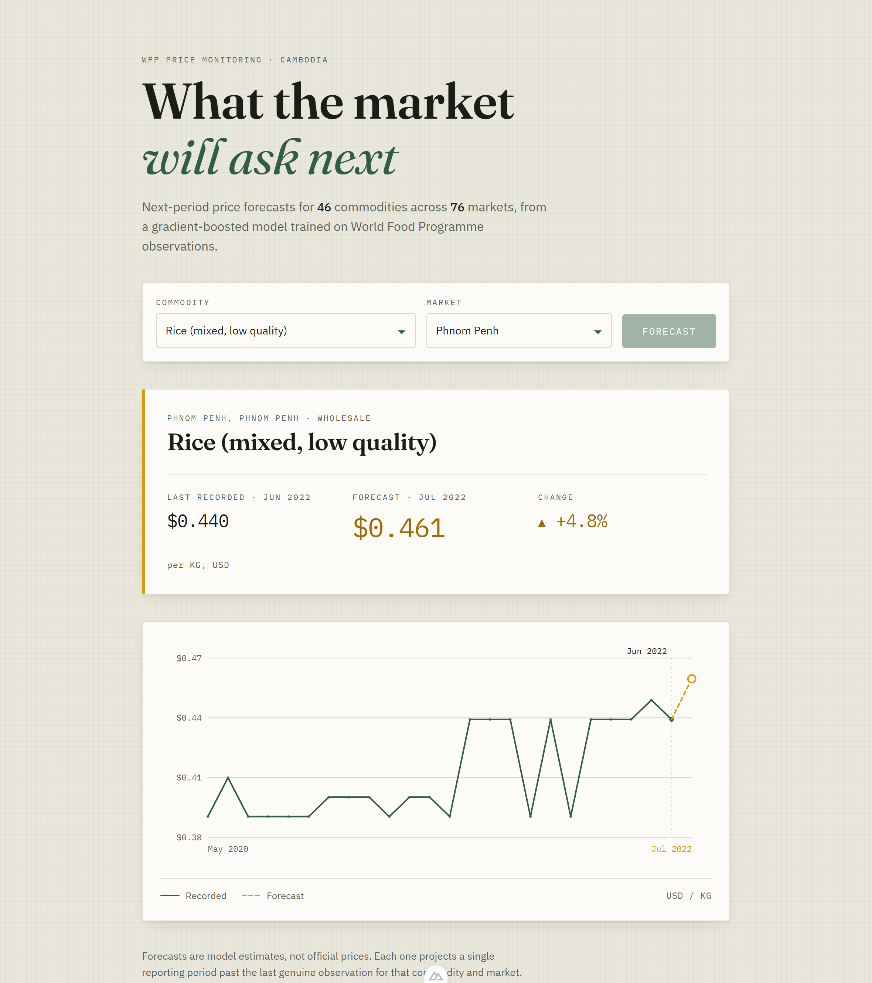
PRODUCT
A forecast people
can actually open
The model is not left in the notebook. Nuxt serves the same prediction engine through a web page and API routes.
Browser
Choose a commodity and market, then see the latest price, forecast and chart.
API
/api/predict returns the same forecast for the web UI and outside clients.
Deployment
Vercel only receives the Nuxt app and JSON artifacts, not Python ML libraries.
One trained model, one TypeScript engine, one focused web product.
11

Slide 13
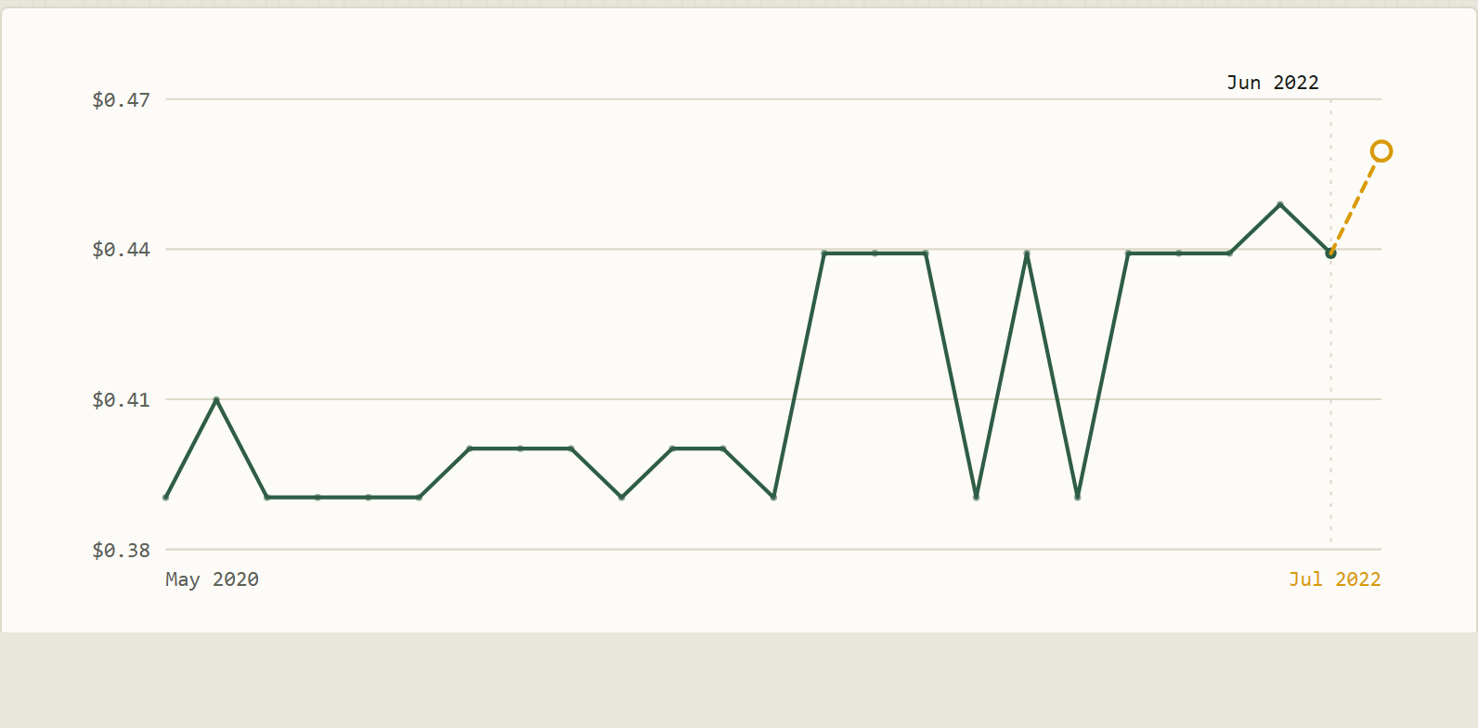
DESIGN CHOICE
The forecast must
look different
A normal line chart can accidentally overpromise. If the predicted point looks exactly like a real observation, the audience reads it as fact.
Solid green
prices actually recorded
Dashed segment
model estimate
Hollow ring
not an observed price
Stale warning
shown when the latest real data is old
The visual design protects the user from confusing an estimate with official market data.
12

Slide 14
LIMITS
Strong result,
clear next step
The model performs well, but the honest boundary is important: it forecasts from recent prices, so shocks and stale series remain hard.
WHAT WORKS
R2 = 0.950; average error about $0.164 on held-out prices.
WHAT IS MISSING
Fuel cost, rainfall, import pressure, holidays and local shocks are not in the model.
WHAT I WOULD ADD
Prediction intervals, external economic/weather features and scheduled monthly retraining.
This is a credible forecasting prototype, not a replacement for field data or official price monitoring.
13

Slide 15
FINAL TAKEAWAY
Public data becomes useful
when it answers tomorrow
Cambodia already has valuable food-price records. This project shows how AI can turn those records into a small, explainable forecasting tool that ordinary users can reach from a browser.
DATA
WFP Cambodia food prices
MODEL
XGBoost regression, tested chronologically
PRODUCT
Nuxt web app and API
15

