Slide 1

Inventory Management System
Presented By:-
Meet K Patel 170410116074
Parth R Patel 170410116080
Sanket V Vavadiya 170410116123
Kunj K Viradia 170410116124

Slide 2
What is Inventory?
Inventory is stock of items held to meet future
demand.
It is a list for goods and materials, or those
goods and materials themselves, held available in stock by a business.
It is collection of goods processed to form
desired output to the organization.

Slide 3
About our project
Our group has designed a Desktop Application which can be used for management of Stock/Inventory on an individual Shop for the better utilization of stock of Products.
Our Application helps shop manager to know their Products, Stock Availability ranging from a day to any year. One can enter the Product details whether it is available or not.
Then he/she can enter Stock availability corresponding that product on the corresponding dates and can get a daily/monthly/yearly report of Product and Stock List.

Slide 4
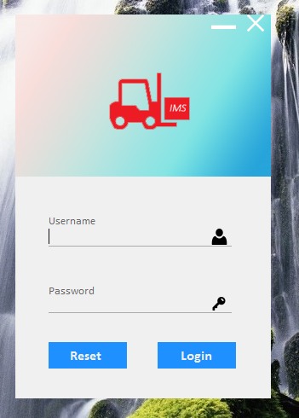
Features
1. Login: -
We have implemented a login page for our users to provide security to the user’s data.
One more feature of our application is that every user should have unique username.
With the help of this feature, any one user cannot manipulate or see other’s data.

Slide 5
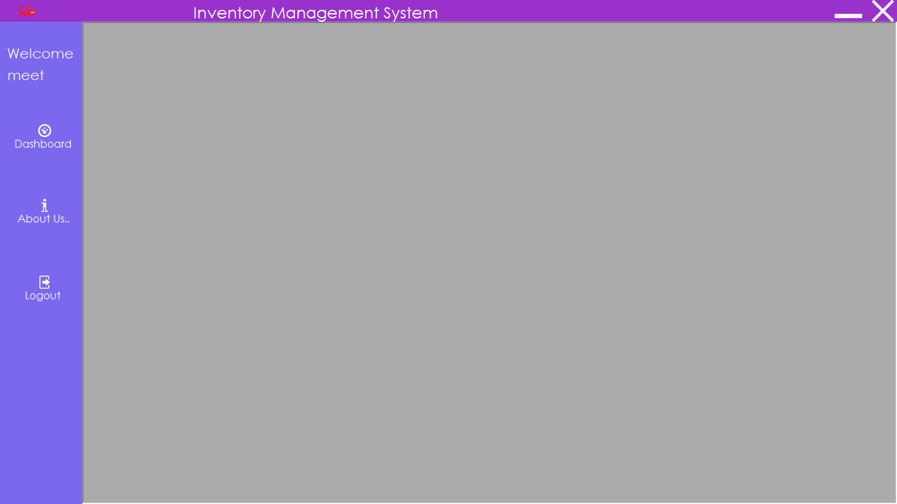
Features
2. Stock Main:
a) Dashboard
b) About Us
c) Logout

Slide 6
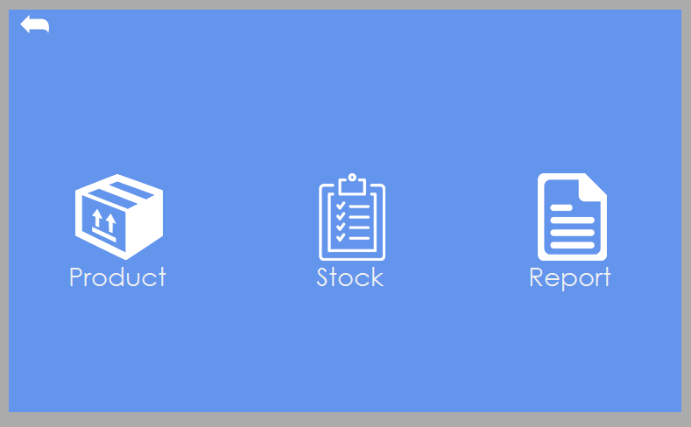
Features
3. Dashboard:
a) Product
b) Stock
c) Report

Slide 7
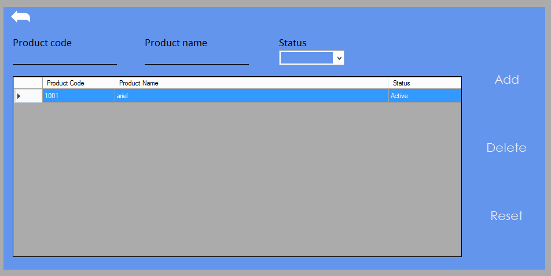
Features
4. Create/Update Product: -
 The Features provided in the Product page are: -
a) Add Product
b) Update Product
c) Reset Product

Slide 8
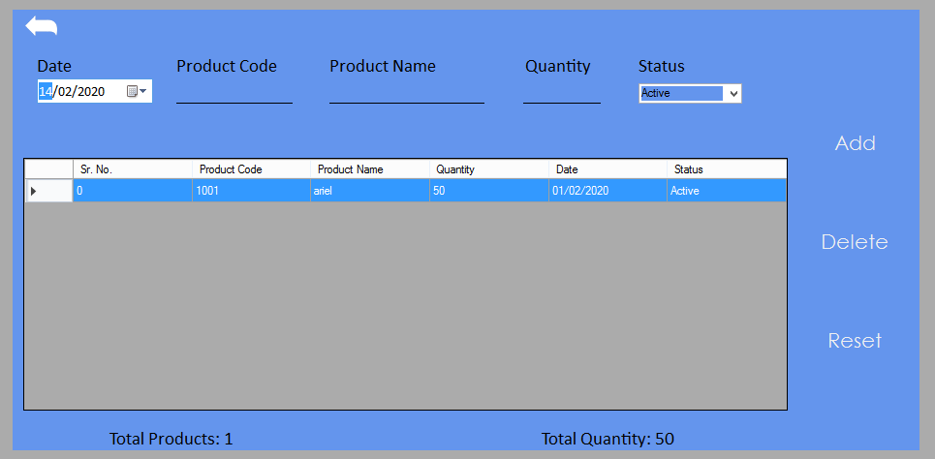
Features
5. Create/Update Stock:
 The Features provided in the Stock page are:
a) Add Stock
b) Update Stock
c) Reset Stock

Slide 9
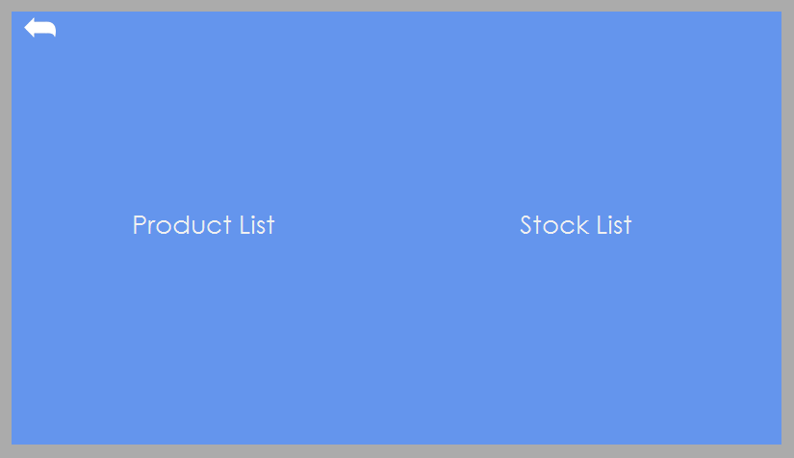
Features
6. Report: -
1 )The report page provides a user with the option to view his all Product Entries as well as Stock Entries.
2) User can export that report in pdf or it can be printed from the same panel.

Slide 10


