Slide 1

Privileged & confidential
© 2006 Sridhar Krishnan, Ram NM & Vinay Avasthi

Slide 2

Contents
Team
The idea
Use cases
Product roadmap
Market
Financial summary
Privileged & confidential
© 2006 Sridhar Krishnan, Ram NM & Vinay Avasthi

Slide 3
Promoters
Ramachandran Narasimhamurthy
  Industry veteran with over 16 years of experience in mobile handset development
  Engineering management at Nokia, Motorola and other leading software solutions vendors in the mobile space
  Proven track record of product development and deployment with operators in different parts of the world
  Ram is Director, Engineering of Xurmo
Sridhar Gopalakrishnan
  Telecom software services professional with experience in business planning, product management and entrepreneurship
  Experience in business development with handset OEMs/ ODMs
  B. Tech graduate from IIT Madras & MBA from XLRI, Jamshedpur (India)
  Sridhar is Director, Sales & Marketing of Xurmo
Vinay Avasthi
  Industry veteran with over 15 years of experience in future mobility research at Motorola
  Expertise in Mobility in the enterprise, Machine learning, Unified modeling language, WAP Forum & W3C standards
  Interests in social impact of mobility, mobility in high growth markets, leveraging activity context in mobile phones
  MBA from IIM, Bangalore and MS from Illinois Institute of Technology
  Vinay is Director, Technology of Xurmo
Privileged & confidential
© 2006 Sridhar Krishnan, Ram NM & Vinay Avasthi

Slide 4
The idea
Xurmo: Extend Your Mobile
A platform that uses the key attributes of a mobile handset - Contacts list & Location – to provide various secure services to users
A client-server model with an agent in the mobile handset for profile, database & contacts management; message propagation logic in server
  Each service is launched as a different application from the Xurmo agent
User initiates discussion with relevant contacts; Message is automatically propagated to relevant users at degrees of separation from initiator
Communities are created spontaneously and destroyed when the discussion is complete
The mission of the business:
  Enable more efficient and wide spread communication possible for users
  Create revenue from mobile data transmission
Privileged & confidential
© 2006 Sridhar Krishnan, Ram NM & Vinay Avasthi

Slide 5
Xurmo – Scenario 1
Message to Xurmo community
Value prop: Connect participants relevant to discussion based on their profile
Xurmo Server
A6
A4
A5
A2
F
A1
Value prop: User defined contacts per discussion
A
A3
E
G
Legend
A, B… Participants
A1, A2… Transaction incidence
Message to & from server
Introduction of contacts relevant to discussion managed by Xurmo server
C
Value prop: Increased contact base/ network
D
B
Degrees of separation
Value prop: Xurmo users are trusted because profile is linked to phonebook and link to other users’ contact list is by invitation only
Privileged & confidential
© 2006 Sridhar Krishnan, Ram NM & Vinay Avasthi

Slide 6
Xurmo – Scenario 2
Query to Xurmo Partners
Xurmo Server
Value prop to partners: Focused prospect management
Value prop to user:
Replies to specific queries
No telemarketing cold calls
Citibank
HSBC
A
Thomas Cook
Value prop to partner:
Focused promotions based on user messaging patterns, interests & approval
Value prop to user:
Receive more relevant promos/ offers/ communication in areas of interest
Cox & Kings
Other categories
Privileged & confidential
© 2006 Sridhar Krishnan, Ram NM & Vinay Avasthi

Slide 7




Use cases – Basic services
Query
  When a user’s car breaks down and she needs a pick up from her community
  Message is propagated to contacts at varying degrees of separation but only to those in the vicinity of the break down
Query
  A user may ask his community at varying degrees of separation in the city for a rare music CD or book to lend it to him
Recommendation
  When a user visits his book store, he can seek messages left for him by his community of users at varying degrees of separation
  The messages may be recommendations of a new book or DVD
Blogs
  A user may capture an amusing picture at a party and can share it with his extended community through a mobile blog
Privileged & confidential
© 2006 Sridhar Krishnan, Ram NM & Vinay Avasthi

Slide 8




Use cases – Premium services
Calendar sync-up
  Two users can get the Xurmo applications on their mobile handsets to negotiate a mutually acceptable meeting time based on their calendars
Expense account management
  A group of users go out for dinner and one of them foots the bill
  Each user can have an account summary with debit/ credit statements for everyone in his community
Query to service providers
  A user who wants to buy a new home can query financial institutions who are Xurmo partners for their offers on home loans for her
?
?
Trade in XurmoMarket
  A user who wants to buy a used game CD may search for it in her community at varying degrees of separation and buy it
  A user may sell his paintings to interested buyers in the community
Privileged & confidential
© 2006 Sridhar Krishnan, Ram NM & Vinay Avasthi

Slide 9
Product roadmap
Phase 1: Community Creation
V1.0
Phase 2: Peer-to-peer
V2.0
Phase 3: Mcommerce
V3.0
Invitation of contacts in phone book
Basic applications include:
  Query
  Recommendation
  Blogs
  Promotions from Xurmo partners
Premium agent download
Query to Xurmo partners
Calendar sync-up
Specialized community
  For professionals
  Institutions/ Enterprises
Introductions
Xurmo Market: Users can search and buy wares from other users
Search & buy from Xurmo partners
Expense account management
Features
Privileged & confidential
© 2006 Sridhar Krishnan, Ram NM & Vinay Avasthi

Slide 10
Revenue model – Basic transactions
6. 2% of final price from seller; Insertion fee of $10 per institutional seller per item code
Xurmo Server
1
Xurmo
Merchandise
2
Operator
3
XurmoMarket
Partner 1
4
6
Operator
5
Partner 2
Partner 3
1. Free basic agent download; Reward for download & profile completion
2. $20 premium agent download
3. Reward for inviting other members; Community messaging @ ¢20 per message from all participants; 50% rev share with operator
4. Premium agent txns @ ¢40 per message; 50% rev share with operator
5. Buying, selling & auctions; 2% of final price from seller; 50% of messaging revenue shared with operator
Privileged & confidential
© 2006 Sridhar Krishnan, Ram NM & Vinay Avasthi

Slide 11
Revenue model – Premium transactions
Xurmo Server
2
Partner 1
1
Operator
Partner 2
3
5
Partner 3
4
1. Traffic analysis of mBlog @ $1 per month
2. Annual membership to partners charged on slabs starting at $100 p.a.
3. Query to Xurmo Partner; $1 per query from partner
4. Introduction to Xurmo Users; $5 per introduction
5. Targeted communication to Xurmo users from partners; Charged at $5 per user to partner
NOTE: 50% of messaging revenues (¢20 per message) from these txns will be shared with operator
Privileged & confidential
© 2006 Sridhar Krishnan, Ram NM & Vinay Avasthi

Slide 12
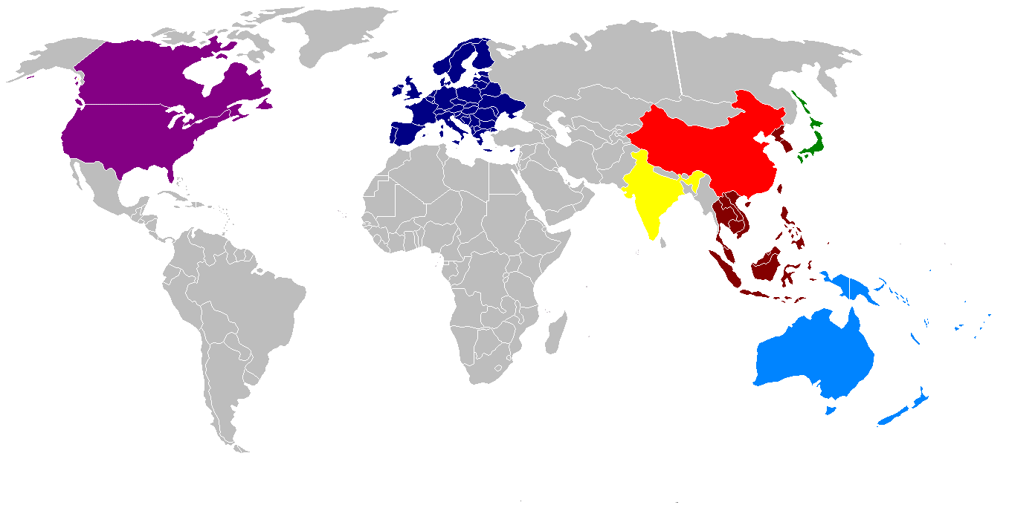
The Market: 2007 to 2009
Western Europe
Market universe: 170 M
Addressable market: 43 M
Max subscribers: 4.3 M
Launch: H1, 2008
Japan
Market universe: 75 M
Addressable market: 18.75 M
Max subscribers: 1.9 M
Launch: H1, 2008
Competition Profile:
Customer share of mind: MySpace, Orkut
Customer share of wallet: Mobile apps (video streaming etc.)
Target Markets
APAC
Market universe: 170 M
Addressable market: 43 M
Max subscribers: 4.3 M
Launch: H2, 2007
North America
Market universe: 122 M
Addressable market: 30 M
Max subscribers: 3 M
Launch: H2, 2008
India
Market universe: 4 M
Addressable market: 1 M
Max subscribers: 0.1 M
Launch: H2, 2007
ANZ
Market universe: 10 M
Addressable market: 2.5 M
Max subscribers: 0.25 M
Launch: H1, 2007
China
Market universe: 6.3 M
Addressable market: 1.6 M
Max subscribers: 0.16 M
Launch: H1, 2008
Market Universe:
Youth & young professionals with 2.5G+ connection
Privileged & confidential
© 2006 Sridhar Krishnan, Ram NM & Vinay Avasthi

Slide 13
Financial projections summary
(USD Million) | FY-1 | FY-2 | FY-3
Revenues | 0.18 | 5.45 | 43
Engineering Costs | 2.1 | 3.8 | 3.6
Operations Costs | 3.2 | 30.8 | 17.9
CAPEX & One-time Costs | 1.67 | 2.1 | 0
Net Cash Flow | (7.9) | (30.7) | 21.5
Total Investment Required: 41.8
Entry Barriers
Provisional patent filing (to be done)
Early mover advantage
Operator relationship and alliance partnerships
Privileged & confidential
© 2006 Sridhar Krishnan, Ram NM & Vinay Avasthi

Slide 14
Thank you
Contact: Sridhar Krishnan
Sridhar@xurmo.com
+91 98867 95065
Privileged & confidential
© 2006 Sridhar Krishnan, Ram NM & Vinay Avasthi

