Slide 1
Xurmo Architecture
The world in your mobile

Slide 2
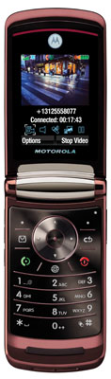
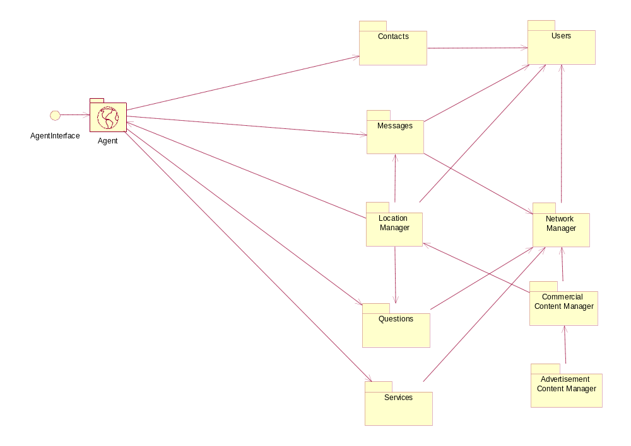
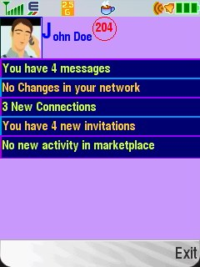
Xurmo Architecture

Slide 3
Modules
Agent
Contacts
Messages
Questions
Services
Users
Location Manager
Network Manager
Commercial Content Manager
Advertisement Manager

Slide 4
Agent
Agent is a proxy of every connect client and is running on server.
Agent keeps track of the client that it is running for and receives updates from it and sends update to it
When two clients communicate, it results in their respective agents actually completing the interaction

Slide 5
Contacts
Contacts are users with their mobile numbers which are otherwise not users in the Xurmo server.
These are generally personal phone book items of users

Slide 6
Users
Users are individuals that have registered with the Xurmo Server and have downloaded client.
Contacts could become users if they register as users with Xurmo Server

Slide 7
Messages
This module keeps track of all the messages being interchanged across the system
Messages could be of multiple types
  Messages delivered when user is in a location
  Message delivered to a set of users in ones network
  Messages delivered to users who are online
  Messages delivered to users based on their interest

Slide 8
Questions
Question module keeps track of conversation that is of Question and Answer type
  These are like messages except that a response is expected for every initiated interaction

Slide 9
Services
Services are like Q & A and are initiated by users with specific privileges
  These users are classified as service providers

Slide 10
Location Manager
Location manager keeps track of every users’ location and initiates interaction with that user based on his location

Slide 11
Network Manager
Network manager module maintains the relationships among the users
Network manager is queried to find if a user can initiate an interaction with another user or not. This depends on
  If a user is connected to another
  If the destination user has permitted such interaction
  Special interests of user
  His location
  Etc.

Slide 12
Commercial Content Manager
This module will make paid content available to the user
The payment could be part of monthly fees or per download basis

Slide 13
Advertisement Manager
This is a specialized case of commercial content where the payment is done by the advertiser and the content is delivered to end user based on his preferences and his profile

Slide 14
Xurmo Location Based Service
System and Method

Slide 15
Determining Location
The mobile device is used with cell tower ids and mac addresses of bluetooth nodes in proximity
  Most of the cellular operators send a textual description of the cell site on a broadcast channel
  This name is used to define the location
Bluetooth nodes and their names are used to further pinpoint locations

Slide 16
Determining Location
Bluetooth nodes are not mandatory but would provide much finer granularity in defining location
A many-to-many hierarchical relationship is build in bluetooth nodes and cell towers
The location update is triggered every time a new cell name message is received on broadcast channel

Slide 17

Internet
3
1
XurmoConnect
4
Cellular Operator
Network
5
7
6
2
Location Database
Host with
bluetooth
Phone starts listening for cell broadcast on channel on which operator broadcasts cell name
Phone looks up for existing bluetooth devices in proximity
Phone Receives cell name on cell broadcast
Phone looks up the device for cell Id, site Id, country Id and network Id
Phone sends cellId, siteId, country Id and network Id with cell name to the server using a SOAP request to service endpoint published by the system
On receipt of the message by the application server, the application server looks up the message and checks if the location already existed in the location database.
If the location did not exist in the database, then it is added in database and the location data is returned to the phone as a SOAP message otherwise the location information that existed in the database is retrieved and returned to the phone

Slide 18
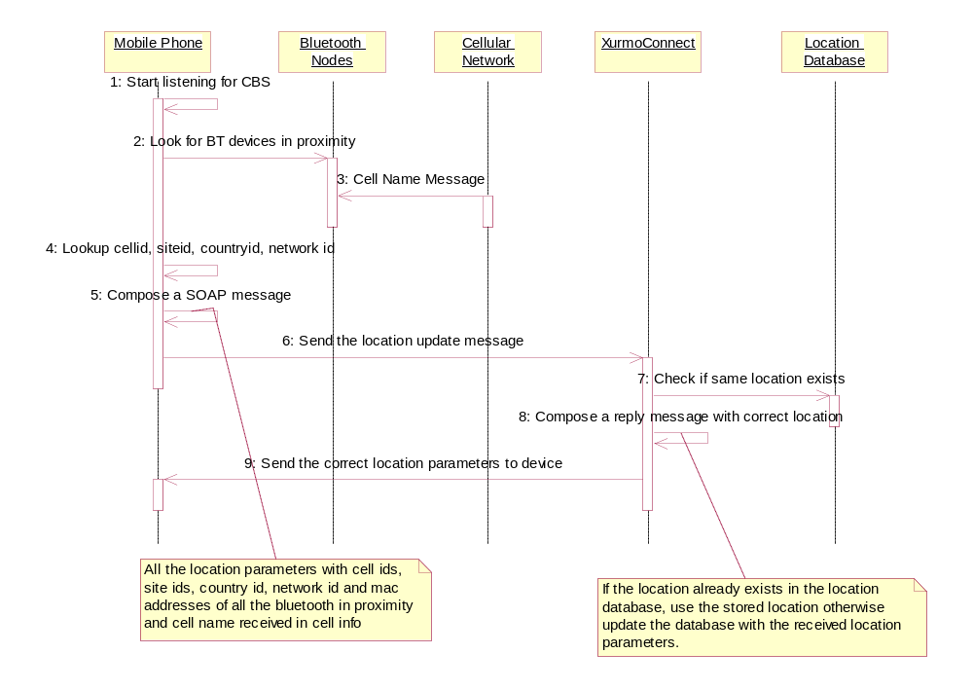
Message flow

