Slide 1
Determining Location
The mobile device is used with cell tower ids and mac addresses of bluetooth nodes in proximity
  Most of the cellular operators send a textual description of the cell site on a broadcast channel
  This name is used to define the location
Bluetooth nodes and their names are used to further pinpoint locations

Slide 2
Determining Location
Bluetooth nodes are not mandatory but would provide much finer granularity in defining location
A many-to-many hierarchical relationship is build in bluetooth nodes and cell towers
The location update is triggered every time a new cell name message is received on broadcast channel

Slide 3
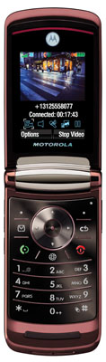
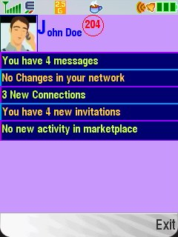

Internet
3
1
XurmoConnect
4
Cellular Operator
Network
5
7
6
2
Location Database
Host with
bluetooth
Phone starts listening for cell broadcast on channel on which operator broadcasts cell name
Phone looks up for existing bluetooth devices in proximity
Phone Receives cell name on cell broadcast
Phone looks up the device for cell Id, site Id, country Id and network Id
Phone sends cellId, siteId, country Id and network Id with cell name to the server using a SOAP request to service endpoint published by the system
On receipt of the message by the application server, the application server looks up the message and checks if the location already existed in the location database.
If the location did not exist in the database, then it is added in database and the location data is returned to the phone as a SOAP message otherwise the location information that existed in the database is retrieved and returned to the phone

