Slide 1

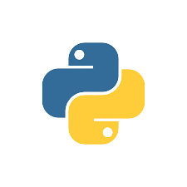
WEB DEVELOPMENT THE ULTIMATE DJANGO
WEB FRAME WORK FOR BEGINNERS

Slide 2
what is Django ?
Django is a free and open-source web framework that is written in Python. It follows the Model-View-Controller (MVC) architectural pattern and is designed to help developers build complex, data-driven web applications quickly and easily. Django provides a number of built-in features and tools to help developers create scalable, secure, and maintainable web applications. Some of the key features of Django include :
* Object-relation Mapping * Admin Interface * URL Routing * Template Engine * Security
Django can be used for a wide range of web development projects, from simple websites to complex web applications. Some common use cases for Django include:
* Content Management Systems (CMS) * E-commerce Platforms * Social Networks * Business Applications

Slide 3
PYTHON INSTALLATION
Step 1 : Go to the official Python website (https://www.python.org/downloads/) and download the latest version of Python for Windows.
Step 2 : Go to download folder and run the installer and select the "Install Now" option.
Step 3 : Select the "Add Python to PATH" option and click "Install”
Step 4 : Wait for the installation to complete. This may take several minutes. After the installation is complete, open a command prompt by pressing the Windows key + R and typing "cmd" in the Run dialog box. Press Enter to open the command prompt.
Step 5 : In the command prompt, type "python" and press Enter. You should see the Python interpreter start up.

Slide 4
DJANGO INSTALLATION
Step 1 : Create a New Folder and Open Visual Studio Code.
Step 2 : Check Python Version (“ >python –version”).
Step 3 : Install Pipenv Package(“>pip3 install virtualenv”)
Step 4 : Check Virtual Environment(“>virtualenv –p python3 env”)
Step 5 : Active Virtual Environment(“>.\env\Scripts\Active.bat”)
Step 6 : Install Django Package(“>pip install Django”)
Step 7 : Check Django-Admin Commands(“>Django-admin startproject my_site”)
Step 8 : Create a New Project in the Directory(“>cd my_site”)------>(“>python manage.py startapp djapp”)
Step 9 : Run the Project(“>python manage.py runserver”)

Slide 5
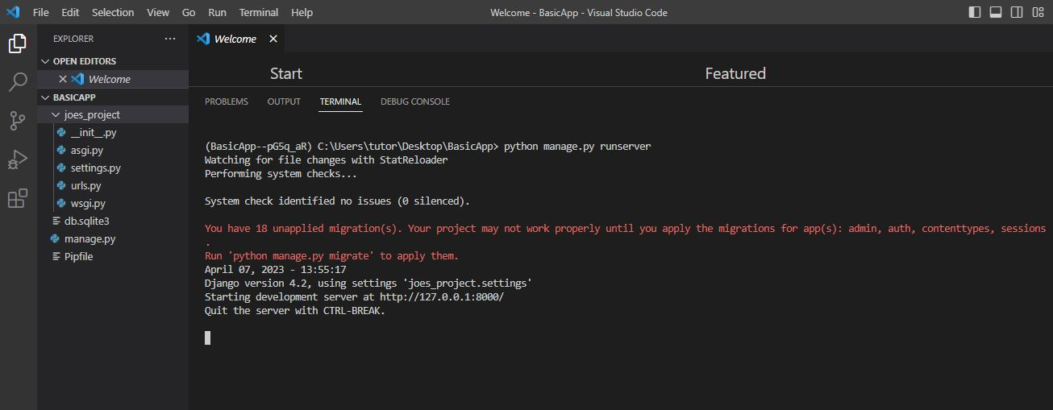
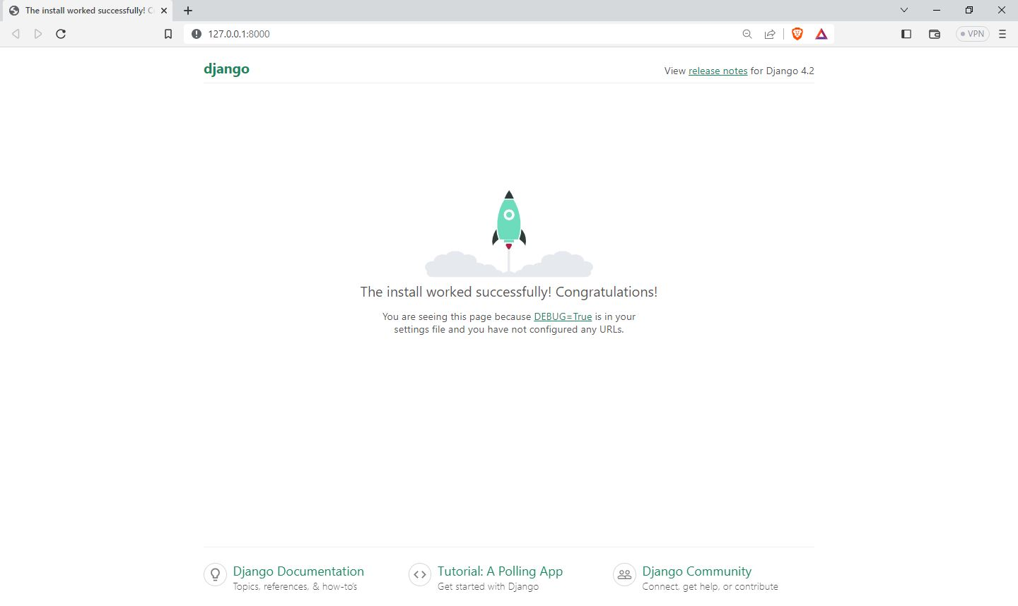
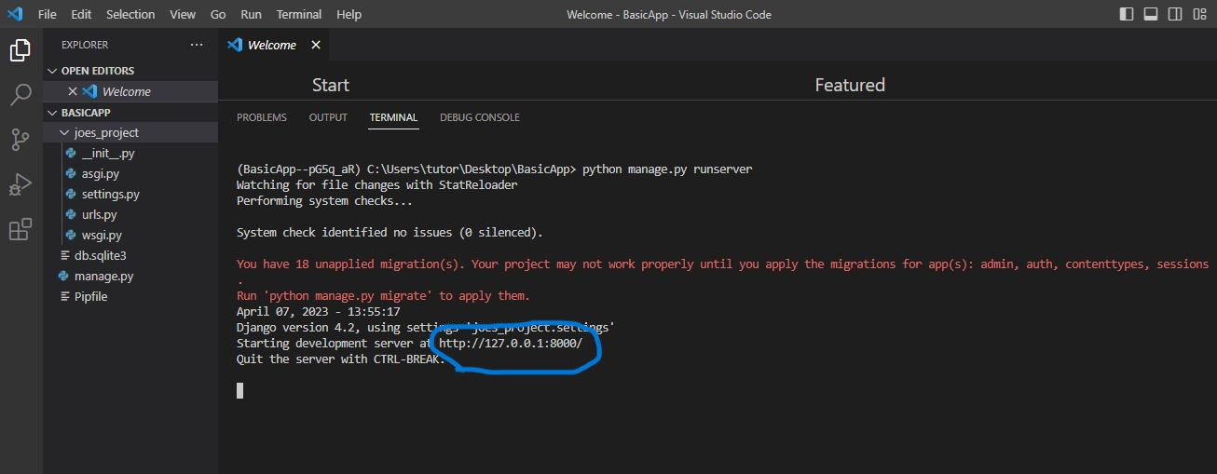
Now click the URL (local host)
FINAL STEP:
To run the project, navigate to the “my_site" directory by typing “my_site" in the terminal and pressing Enter. Then, type "python manage.py runserver" and press Enter. This will start the Django development server
INSTALLATION PROCESS COMPLETE

Slide 6
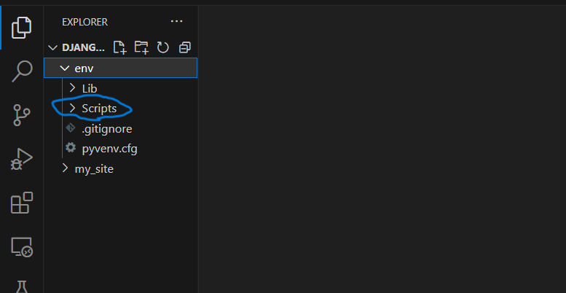
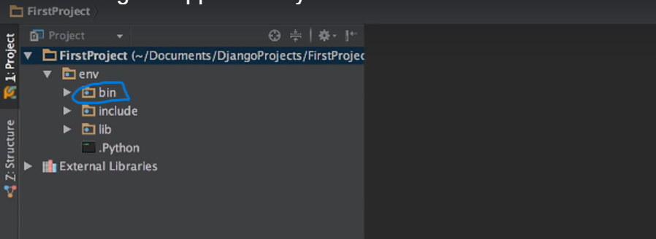
ERROR ENCOUNTER
* THIS INSTALLATION PROCESS IS ONLY FOR WINDOWS.
* FOLDER STRUCTURE SHOULD BE IMPORTANT
IN WINDOWS IN LINUX
* IN WINDOWS PROJECT APPLICATION FOLDER WILL HAVE THE (LIB) FOLDER AND
(SCRIPT)FOLDER. BUT OTHER THAN WINDOWS, IT WILL HAVE LIB AND BIN FOLDER. BIN FOLDER IS EQUAL TO SCRIPT FOLDER AND ACTIVATE.
IN WINDOWS→ (“>.\env\Scripts\Active.bat”) , IN OTHERS → (“>.\env\bin\Active.bat”)
* IN OTHER OS LINUX , MAC HAVE THE BIN FOLDER.

Slide 7
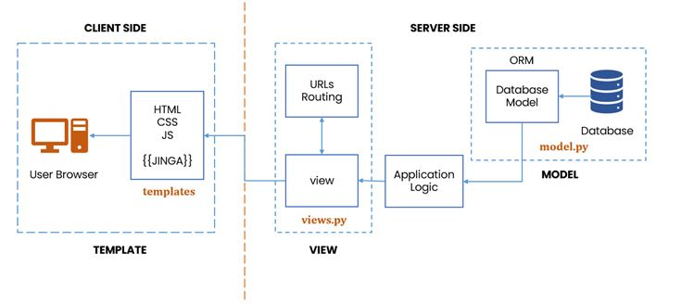
In Django, the Model represents the database schema and the data that is stored in it. The View is responsible for handling HTTP requests and returning responses. The Template is used to generate HTML pages that are sent back to the user.
Here's a brief overview of each component in Django's MTV pattern

Slide 8
Here are some of the most commonly used manage.py commands: runserver: Starts the development server. startapp: Creates a new Django app within your project. makemigrations: Creates new database migration files based on changes to your models. migrate: Applies database migrations to create or update database tables. createsuperuser: Creates a new superuser account for the Django admin. test: Runs tests for your Django project.
Here's a brief overview of each component in Django's MTV pattern:
Model : Defines the database schema and contains methods for interacting with the data. Models are typically defined in the models.py file of an app.
View : Handles HTTP requests and returns HTTP responses. Views can be defined as functions or classes, and are typically stored in the views.py file of an app.
Template : Defines the structure of the HTML pages that are sent back to the user. Templates are typically stored in the templates directory of an app.

Slide 9
Here is an overview of some of the most important settings in settings.py:
SECRET_KEY : A secret key used for cryptographic signing and validation. This should be kept secret and not shared with others
ALLOWED_HOSTS : A list of strings representing the host/domain names that this Django site can serve. This is a security feature that helps prevent HTTP Host header attacks.
DATABASES : A dictionary containing the configuration for the project's databases, including the engine, name, user, and password.
INSTALLED_APPS : A list of strings representing the names of the installed apps in the project. Each app can define its own models, views, and templates.
MIDDLEWARE : A list of middleware classes that are run in the request-response cycle. Middleware can modify requests, responses, or both.
STATIC_URL and STATIC_ROOT : Settings related to serving static files such as CSS and JavaScript files.
MEDIA_URL and MEDIA_ROOT : Settings related to serving user-uploaded media files such as images and videos.

Slide 10
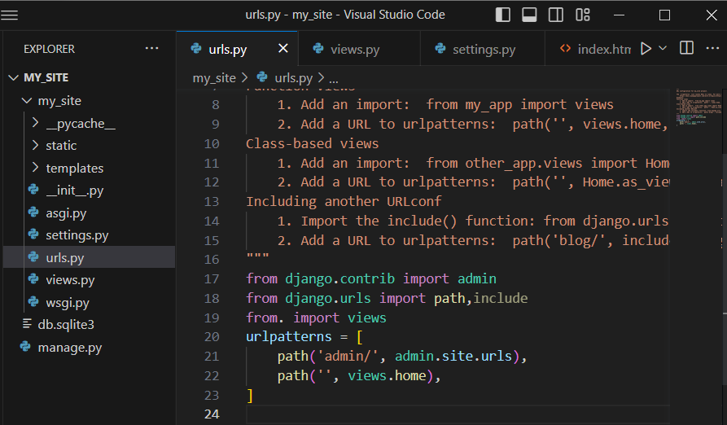
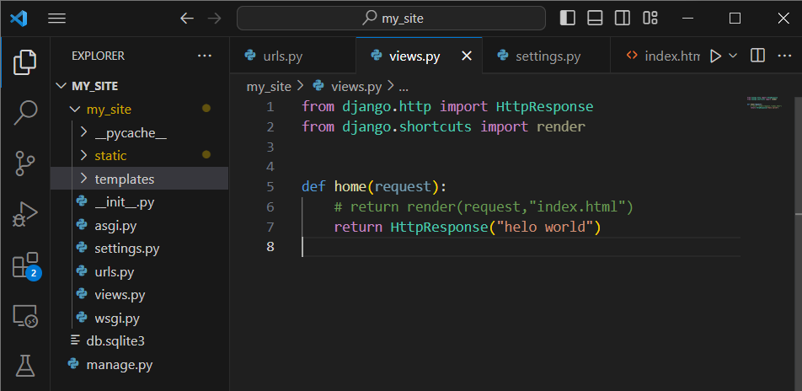
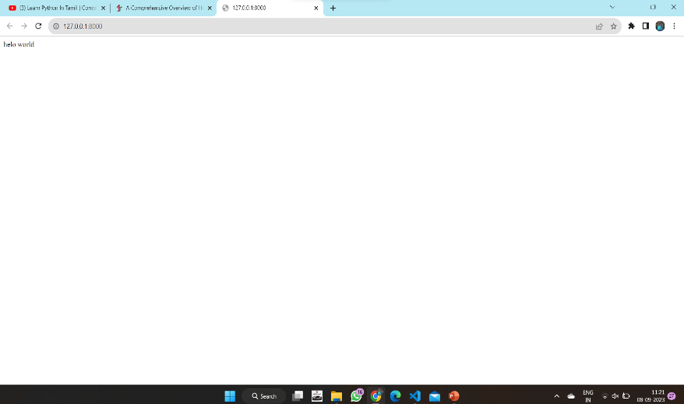
Views.py , now go to this file in your project and view some content in an web page like this
Then go the urls.py file set the path like this
Output:
Now run the program python manage.py runserver

Slide 11
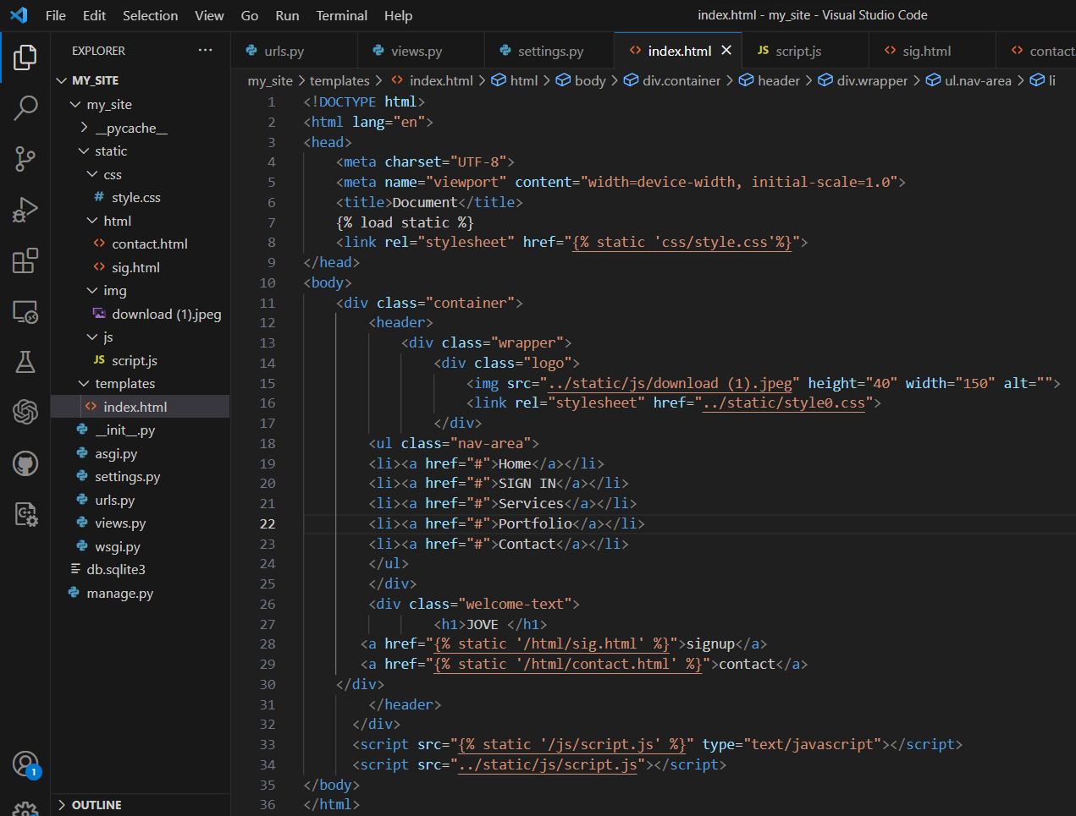
still we added a less amount of content in a webpage they loaded quickly , but we need big content page and multipage website are load slowly and there are lots of problem . That problem overcome method is add the HTML page. In Django , HTML files are create in templates folder . Js , css , image , html(multipage),etc…Files are created in static folder . Here create a html file in template folder and link the views.py. File structure like

Slide 12
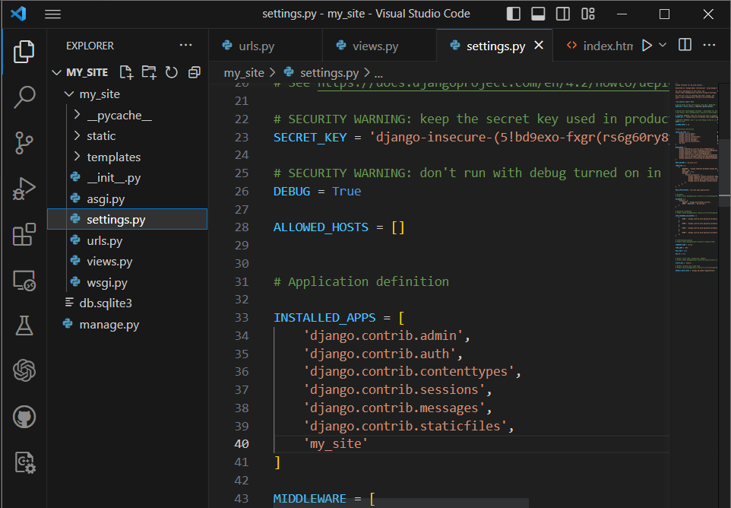
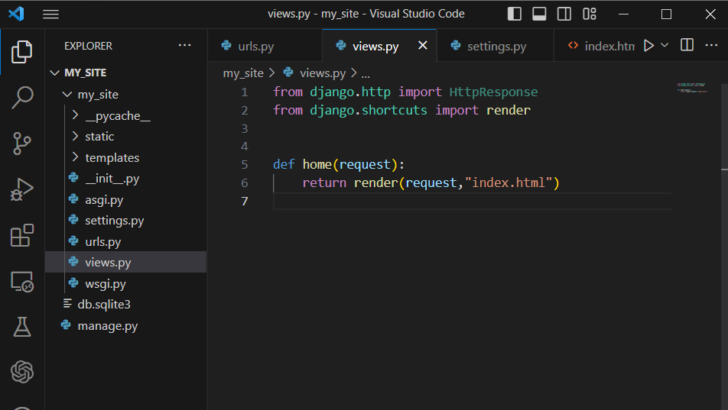
Go to settings.py installed_app list here install your app name like ‘my_site’
Go to views.py and link the html file “index.html”
Don’t change the urls.py file

Slide 13
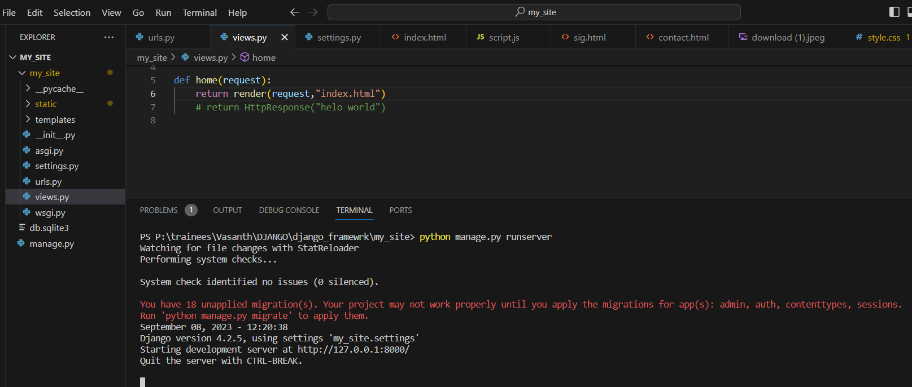
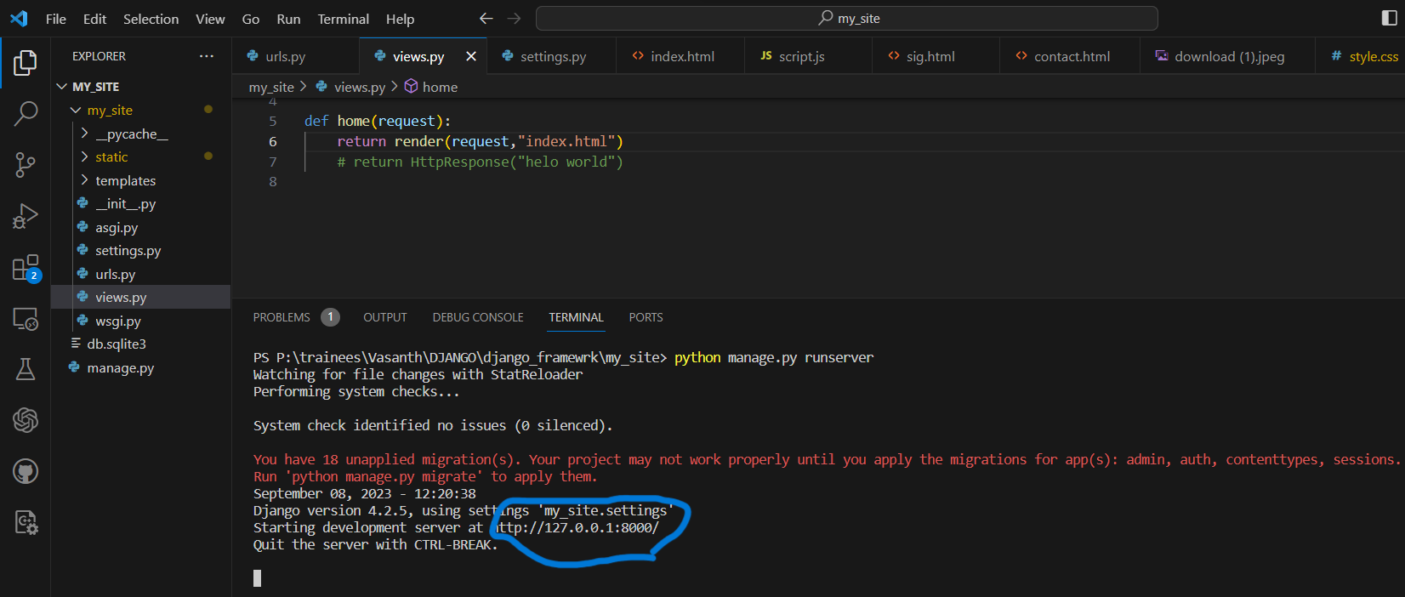
Finally run the server python manage.py runserver
(ctrl + click) the url http://127.0.0.1:8000/

Slide 14
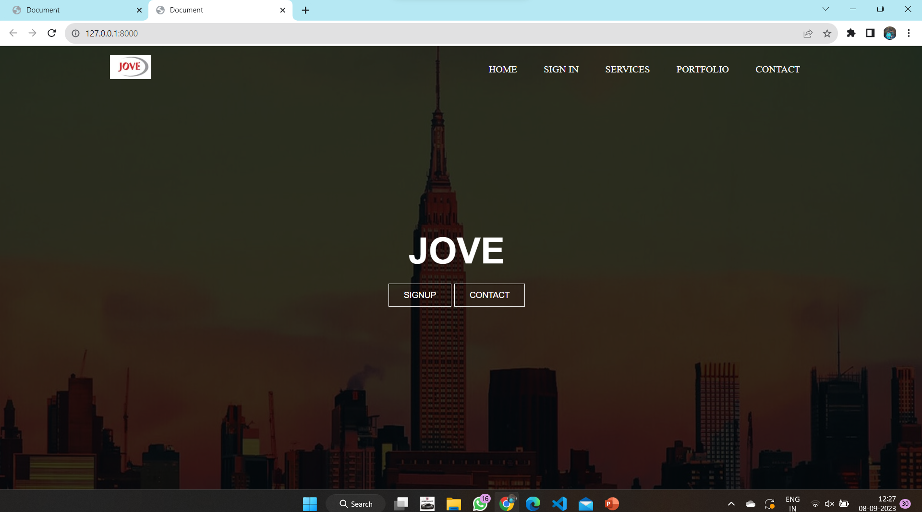
Final output

Slide 15
THANK YOU !.....

