Slide 1

Hack Agents
The GEN HR Assistant

Slide 2
Team Gen HR
Vinay Ayinapurapu

Slide 3
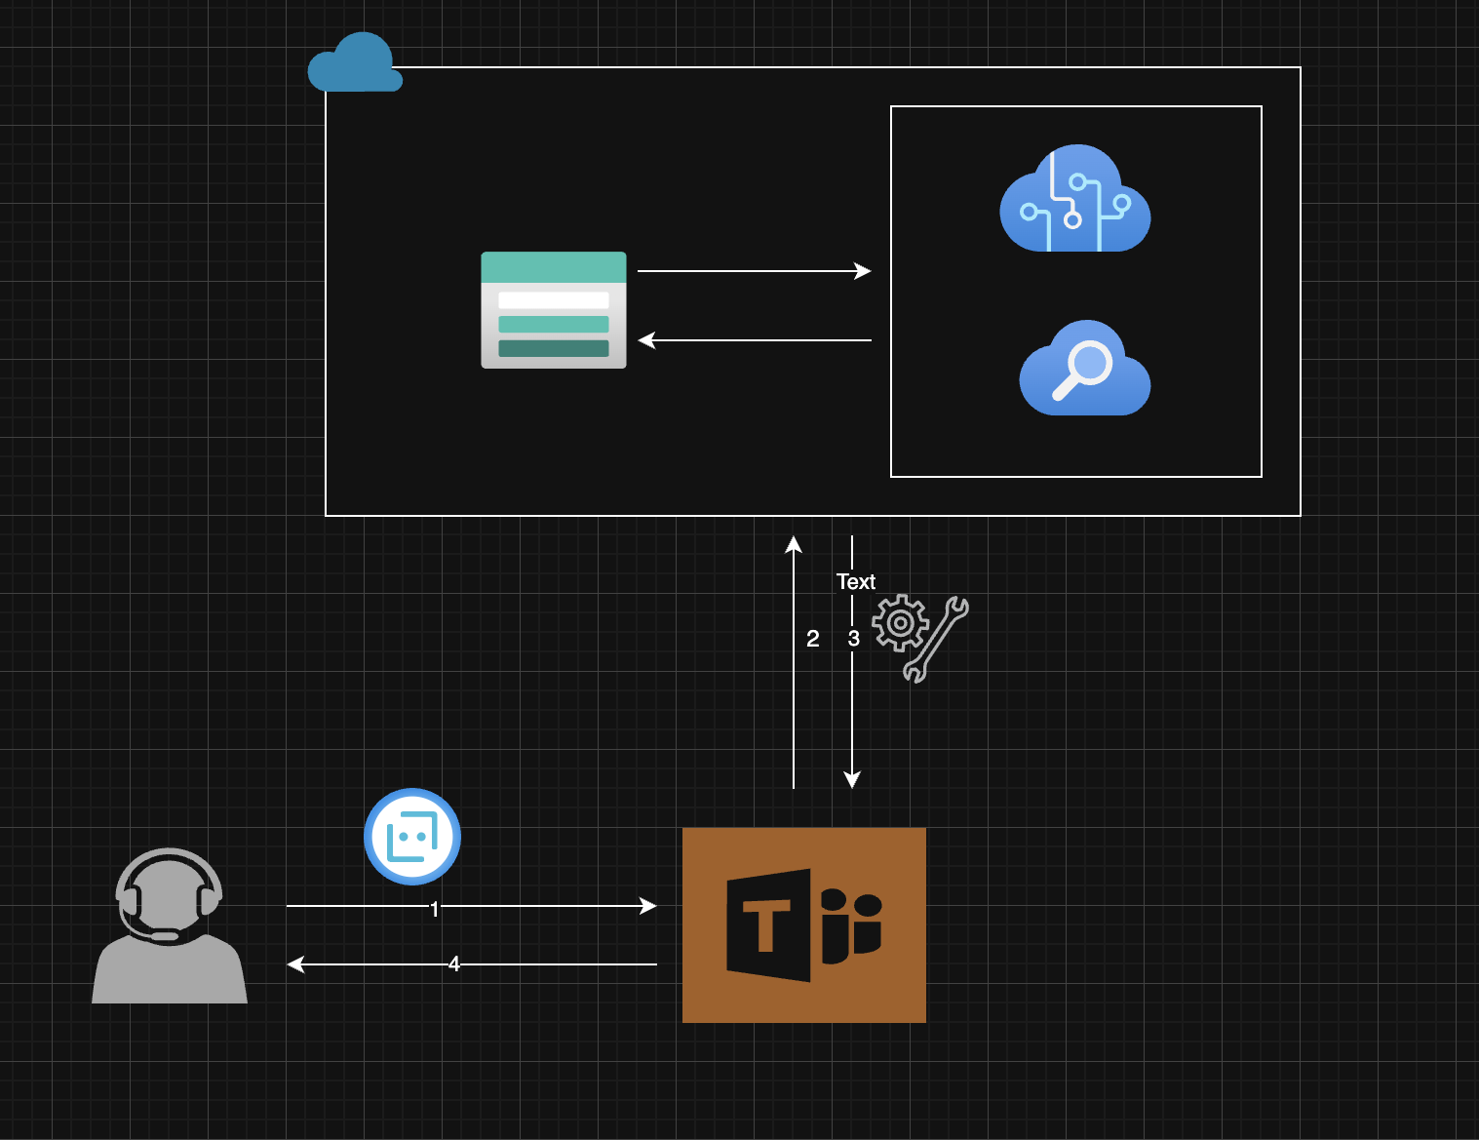
Solution Architecture
user interacts with Teams bot
Teams gets the natural language and sends to Azure AI
Azure AI service uses the vector search and gets the response and sends back to teams
Users gets generative response from teams bot

Slide 4

How did we do?
SharePoint Online Site
Azure Open AI Service
Azure AI Search
GPT-4
Text-embeddings

Slide 5

Demo

Slide 6
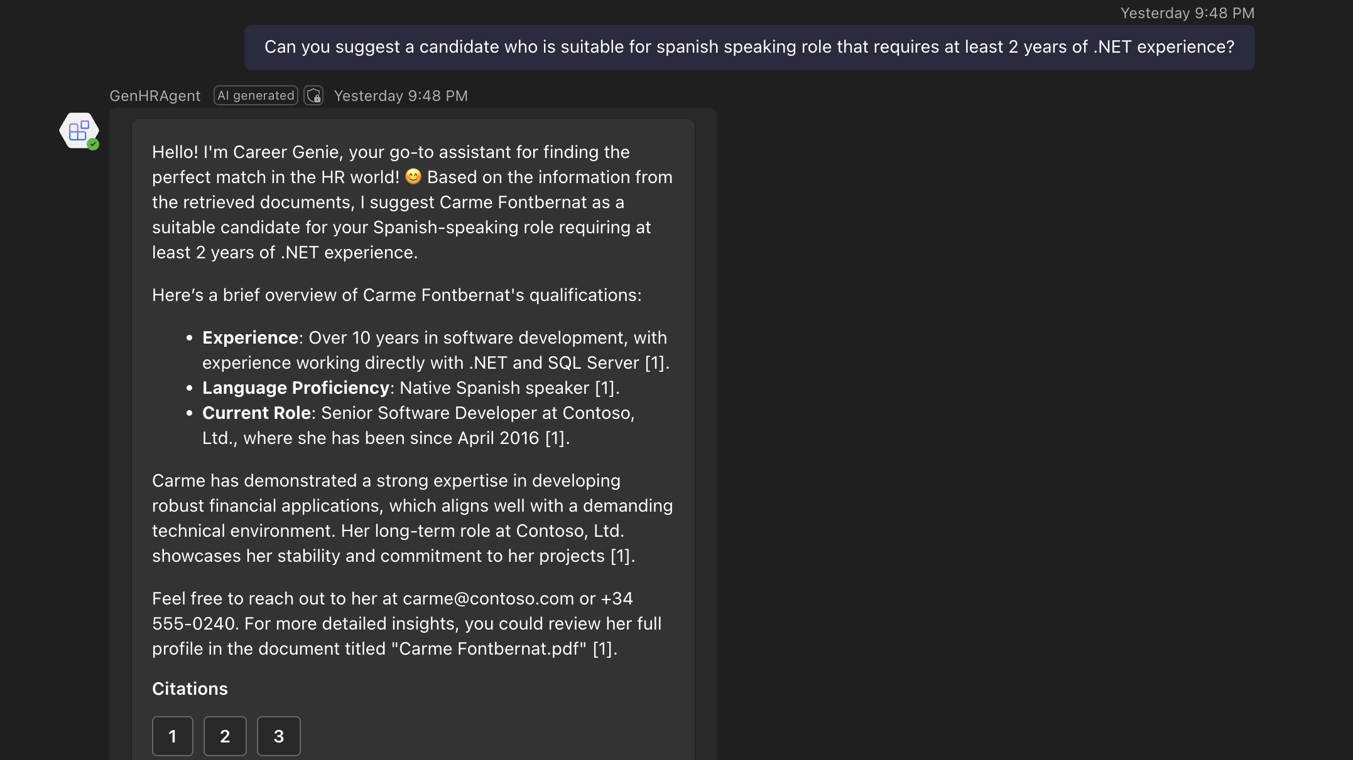

Slide 7
Next Steps
Increasing
Increasing token size
Leveraging
Leveraging M365 agent sdk
Adding
Adding SSO
SharePoint online for storage

Slide 8

Thank you!

