Slide 1

SharePoint Hackathon
The New Adaptive Learning Portal

Slide 2

🌟 About Me
🚀 Passionate about technology, collaboration, and continuous learning. I thrive in dynamic environments and love turning ideas into impactful solutions.
Hobbies
🏏 Cricket
🎸 Guitar
🎤 Singing
Skate (just started)
👨‍👧‍👧 Proud dad of two amazing girls
Vinaydeep Ayinapurapu
PnP first time presenter
🔗 https://linkedin.com/in/vinaydeep

Slide 3
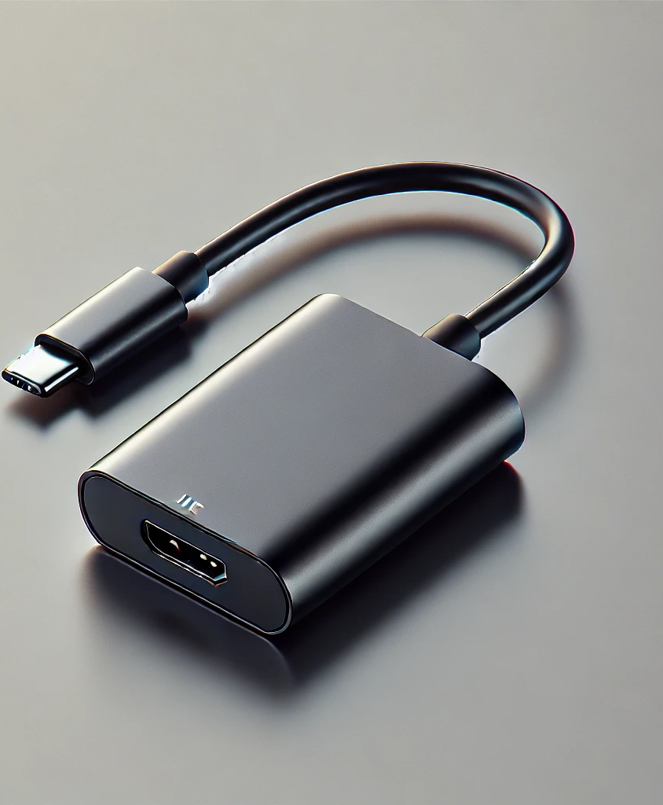
Team Adapters
Vinay Ayinapurapu
Radhakrishna Thatavarthy

Slide 4
Solution Architecture
Hub Site
Site 1
Site 2
Site 3

Slide 5

How did we do?
SharePoint Online Site
SharePoint View Formatting
Hero Webpart
Sites Webpart
Documents Webpart
Highlighted Content Webpart
Site Pages
Document Library

Slide 6

Demo

Slide 7
Next Steps
Adding personal assistant using Azure Open AI
Reminders for completion
Ability to register as a speaker
Quizzes

Slide 8
References
https://www.youtube.com/watch?v=IgvKu5oxCkE
https://github.com/vayinapurapu/SPHack2025/
https://support.microsoft.com/en-us/office/what-is-a-sharepoint-hub-site-fe26ae84-14b7-45b6-a6d1-948b3966427f
https://learn.microsoft.com/en-us/sharepoint/dev/declarative-customization/column-formatting

Slide 9
Prompts
explain the current json file what this does with SharePoint online view formatting?

Slide 10

Thank you!

