Slide 1

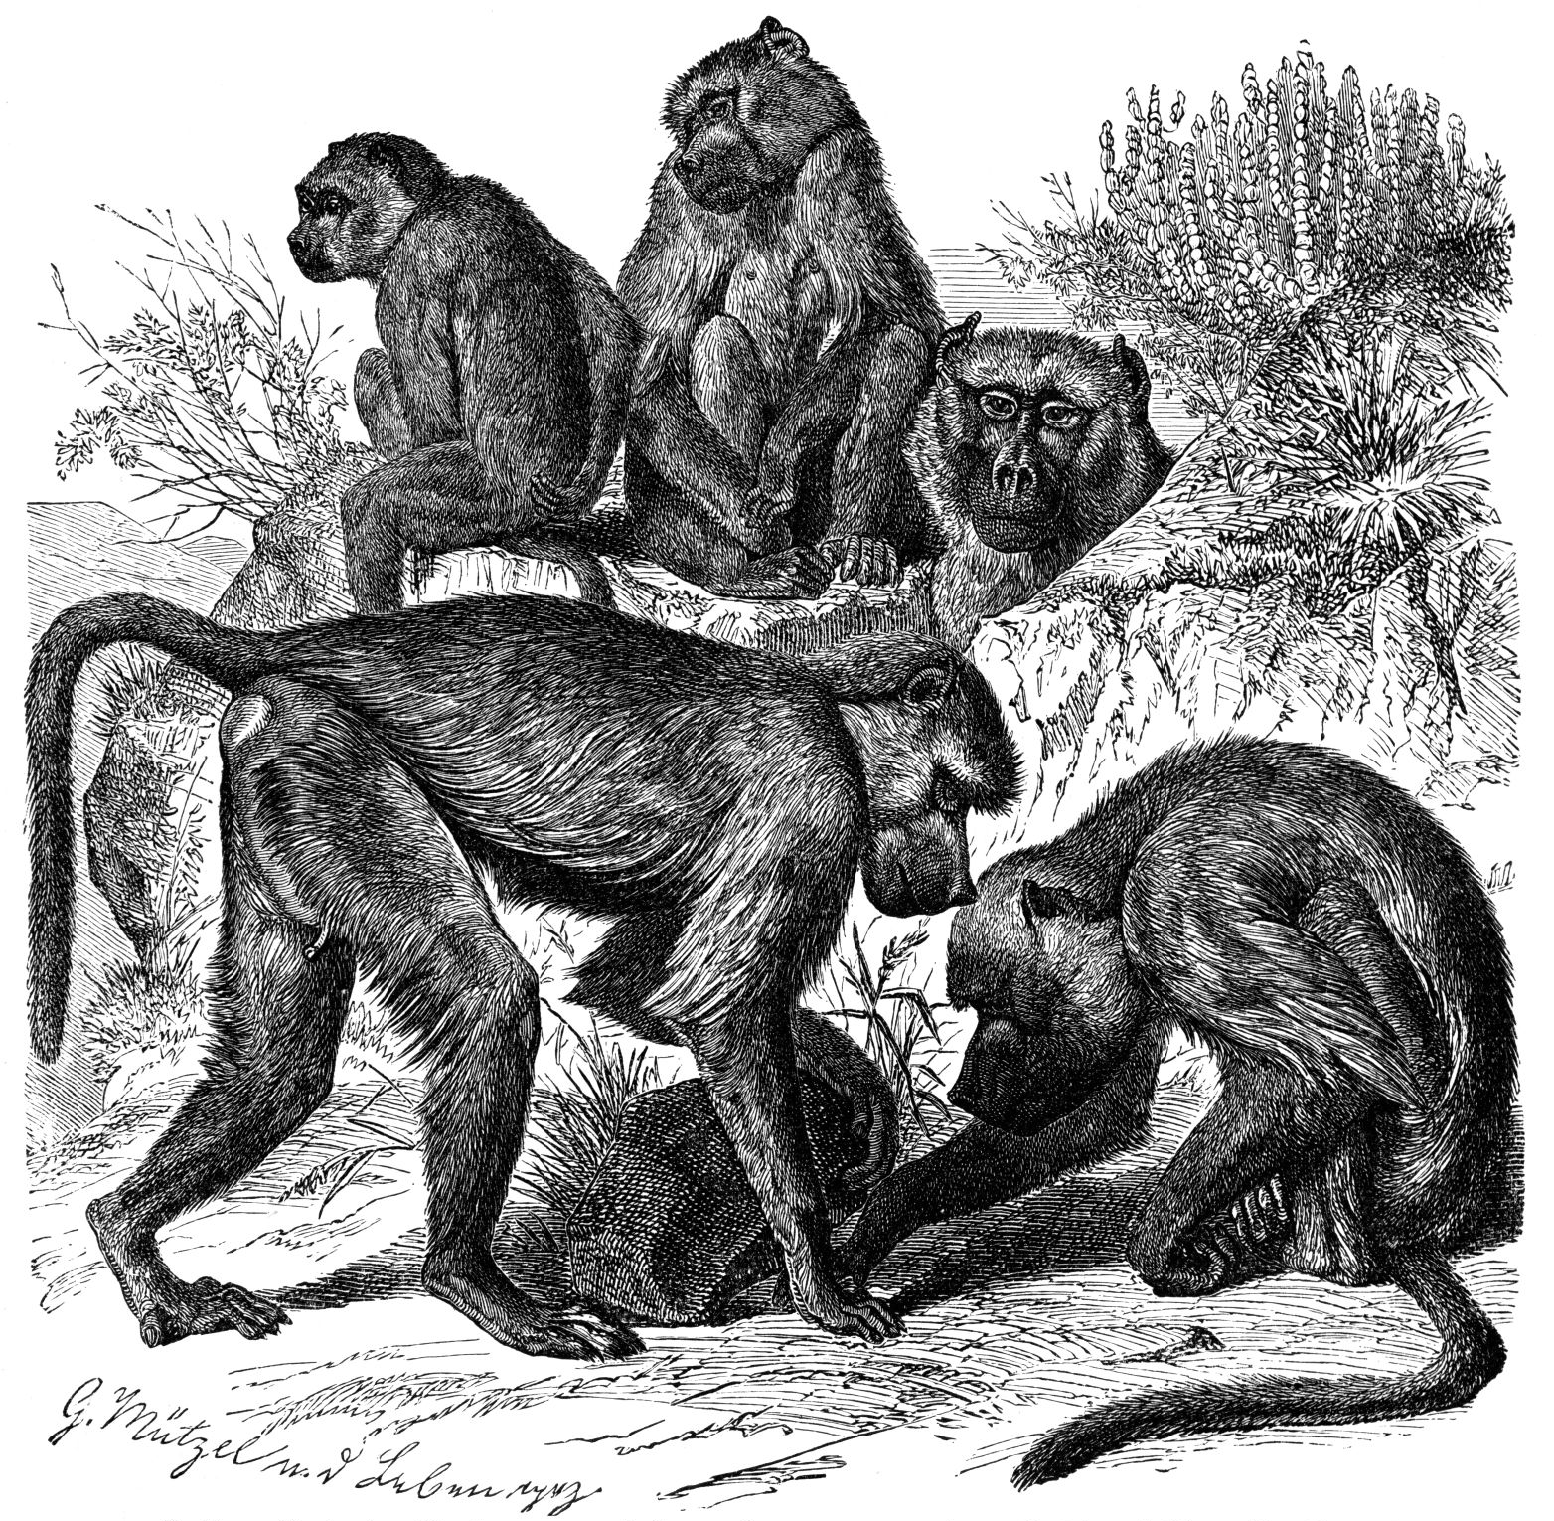
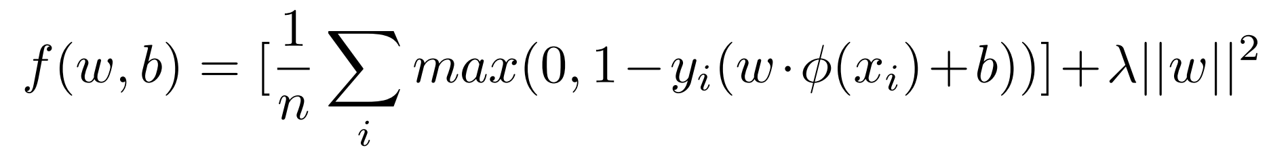
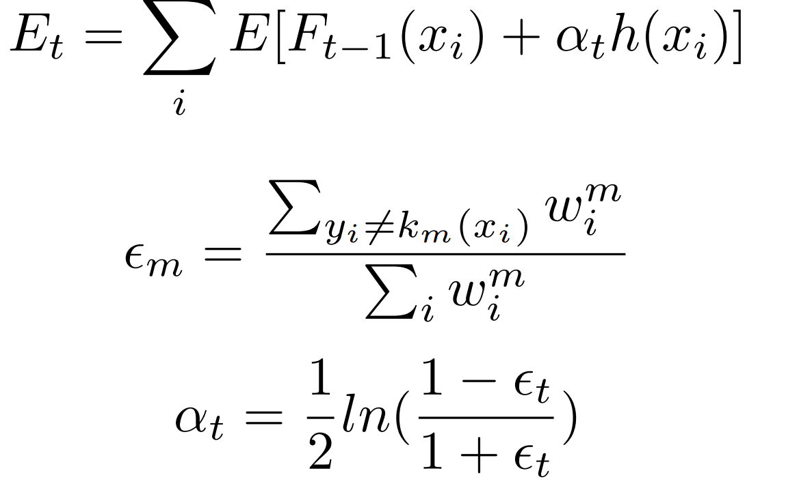
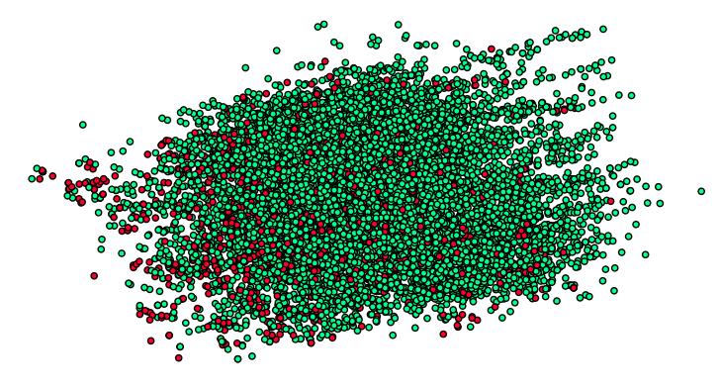
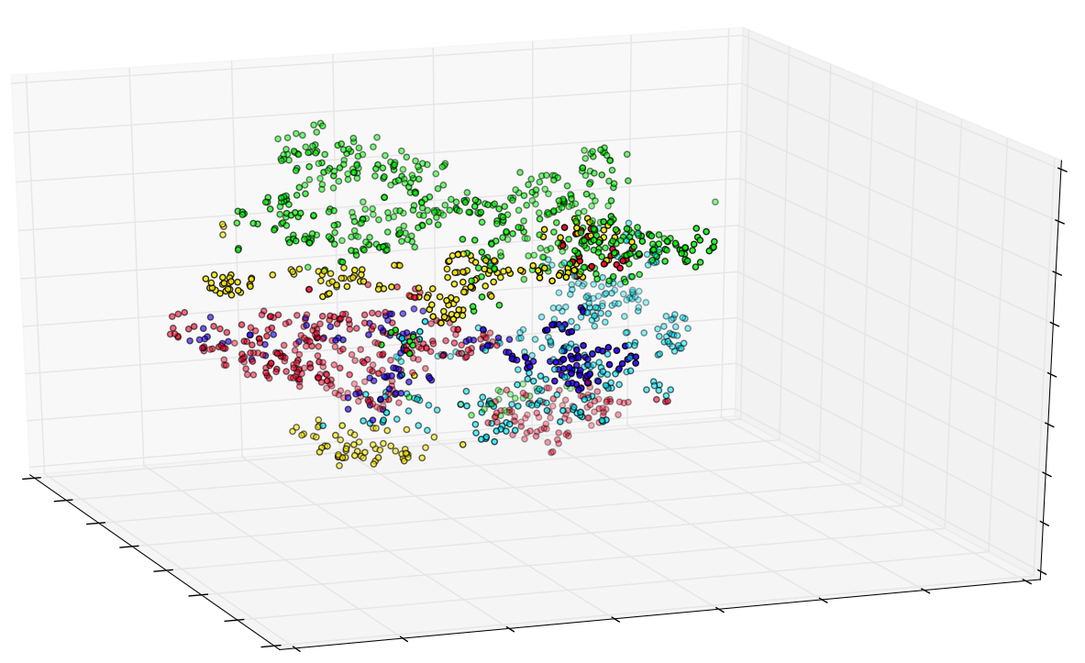
Applying Machine Learning to Predict and Explain Primate Consortship
Josh King, Vayu Kishore, Filippo Ranalli {jking9,vayu,franalli}@stanford.edu
Predicting
We investigate the reasons for success and failure of mating between wild yellow baboon pairs. Our analysis applies classification methods to examine whether successful consortships can be predicted, and whether certain behavioral or genetic features are especially relevant in determining consortship.
Models
Gaussian SVM AdaBoosting with Decision Stumps Random Forest Edge Prediction For all models, Classes were weighted to address imbalanced dataset.
Results
AdaBoosting Feature Selection
Features | Error | Precision | Recall | Fischer | AUC
1 | 0.410 | 0.177 | 0.565 | 0.269 | 0.578
4 | 0.394 | 0.183 | 0.563 | 0.277 | 0.587
6 | 0.382 | 0.210 | 0.660 | 0.318 | 0.637
7 | 0.375 | 0.211 | 0.652 | 0.318 | 0.636
9 | 0.368 | 0.214 | 0.656 | 0.323 | 0.641
Gaussian SVM Feature Selection
Features | Error | Precision | Recall | Fischer | AUC
2 | 0.458 | 0.161 | 0.561 | 0.249 | 0.552
3 | 0.483 | 0.169 | 0.641 | 0.267 | 0.575
4 | 0.406 | 0.190 | 0.627 | 0.291 | 0.605
5 | 0.396 | 0.202 | 0.660 | 0.309 | 0.627
6 | 0.362 | 0.228 | 0.689 | 0.343 | 0.663
7 | 0.352 | 0.231 | 0.680 | 0.344 | 0.664
8 | 0.339 | 0.237 | 0.661 | 0.349 | 0.665
9 | 0.324 | 0.242 | 0.664 | 0.355 | 0.671
Data
Our input dataset, from Tung et al (2012) is a set of genetic and behavioral features between potentially mating pairs, and a label indicating whether consortship occurred. 12,000 observations, 115 females, 121 males 1648 consorts, 10493 non-consorts Additional preprocessing applied to standardize features and remove points that had conflicting labels. We also tried PCA whitening and data augmentation but found that they did not improve results.
Cross-Validation Training and Test Metrics
 | Train Error | Test Error | Train F1 | Test F1
Gaussian SVM | 0.242 | 0.362 | 0.491 | 0.357
AdaBoosting | 0.313 | 0.355 | 0.381 | 0.3312
Random Forest | 0.019 | 0.145 | 0.925 | 0.229
Edge Prediction | 0.131 | 0.167 | 0.31 | 0.236
Discussion
Could predict consortship to some extent, but high false positive rate, even after trying to account for data imbalance. Both social and genetic factors contribute to models. AdaBoosting: female hybrid score, male genetic diversity, female age, male rank, males present. Gaussian SVM: male/female hybrid scores, male/female genetic diversity, female age, male/female rank, males present, females present. Difficult to cluster non-consorting pairs. No gains from using researcher-added transformed features from initial dataset. Graphical features helped marginally. Relationships in social mammals are messy, even machine learning can only do so much.
2-D PCA visualization of dataset
High male rank
Old females
Low number of males present
Low number of females present
High number of males present
Normalized Confusion Matrix for AdaBoosting
 | Predicted Consort | Predicted Non-Consort
True Consort | 0.647 | 0.3525
True Non-Consort | 0.363 | 0.637
Normalized Confusion Matrix for SVM
 | Predicted Consort | Predicted Non-Consort
True Consort | 0.686 | 0.314
True Non-Consort | 0.31 | 0.691
Features
Genetic/Biological: two measure of genetic diversity of each of the pair, estimated genetic distance of the pair, age, conceptiveness of female. Social/Behavioral: male rank, males/females present during consortship. Transformations: non-linear transformations of genetic distance rank, and age, as well as indices derived from the combination of genetic diversity of the pair. Graph-Based: PageRank, HITS.
Future Work
Model groups separately. Continue to investigate graphical methods and other ways to augment features for existing dataset. Find or generate a larger dataset with additional features.
References
Jenny Tung, Marie J. E. Charpentier, Sayan Mukherjee, Jeanne Altmann, and Susan C. Alberts (2012) Genetic Effects on Mating Success and Partner Choice in a Social Mammal. The American Naturalist, 2012 180:1, 113--129.

