Slide 1



CAPSTONE PROJECT
Cinema Seat
Booking System
Vayyala Dhikshitha - 2620030310
Rishvika Reddy - 2620080099
Section - 2
Notes:
We built the Cinema Seat Booking System as a local Java console application. This presentation explains the problem, the project goals, the development process, and how the system works.

Slide 2
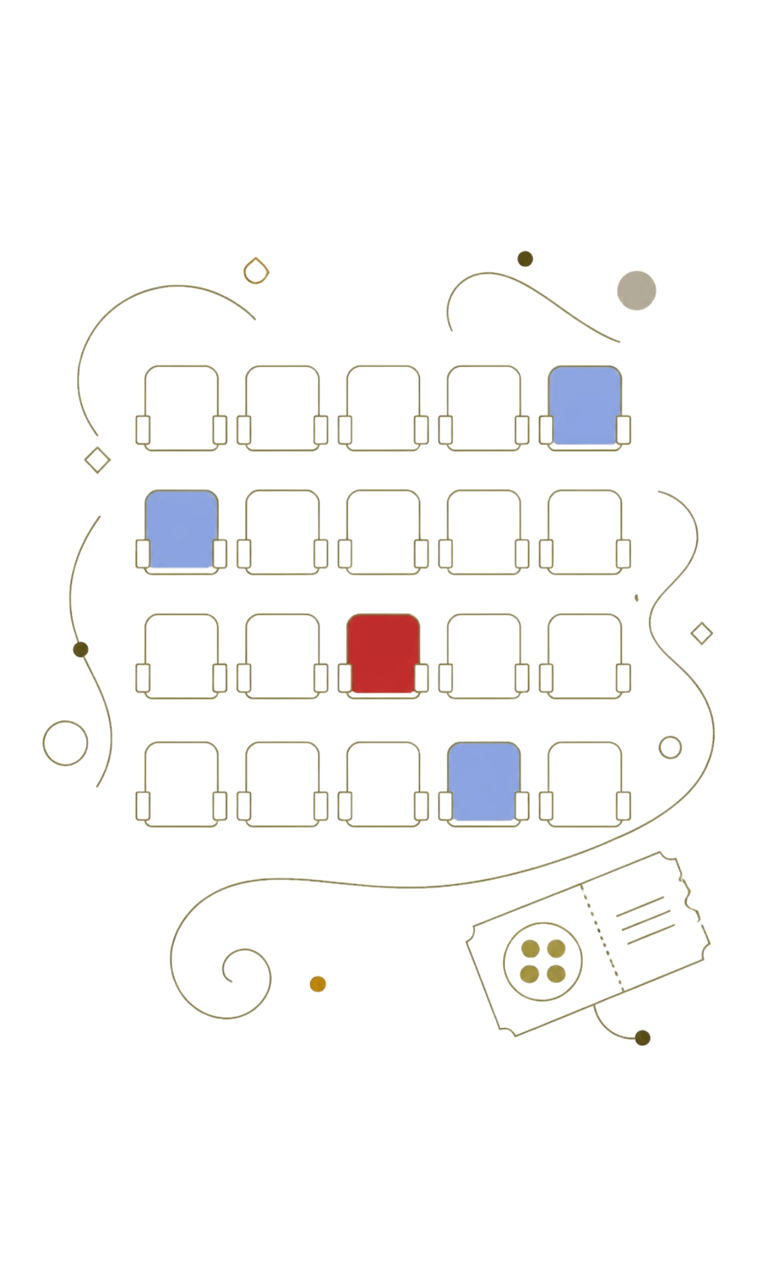

01 · INTRODUCTION
A simple way to manage cinema seats
The system lets a user check availability, book a seat, cancel a booking, and view booking information from one console menu.
View seats — See which seats are available or already booked.
Book or cancel — Choose an operation and follow the prompts.
Check information — Review the booking details kept by the program.
Notes:
The project focuses on the basic booking journey. A user does not need a complex interface: the console presents the available operations and responds to each choice.

Slide 3




02 · PROJECT OBJECTIVES
Make every booking step clear and reliable
Show availability
Book safely
Keep control
Display the current seat layout so the user can make a choice.
Allow seat selection while preventing double bookings.
Supports cancellation and retains booking information.
Simplify the process
Organize the actions in a direct, easy-to-follow console flow.
03
Notes:
The objectives guided the design of the program: make seat status visible, keep booking actions simple, avoid duplicate selections, and make cancellation possible.

Slide 4
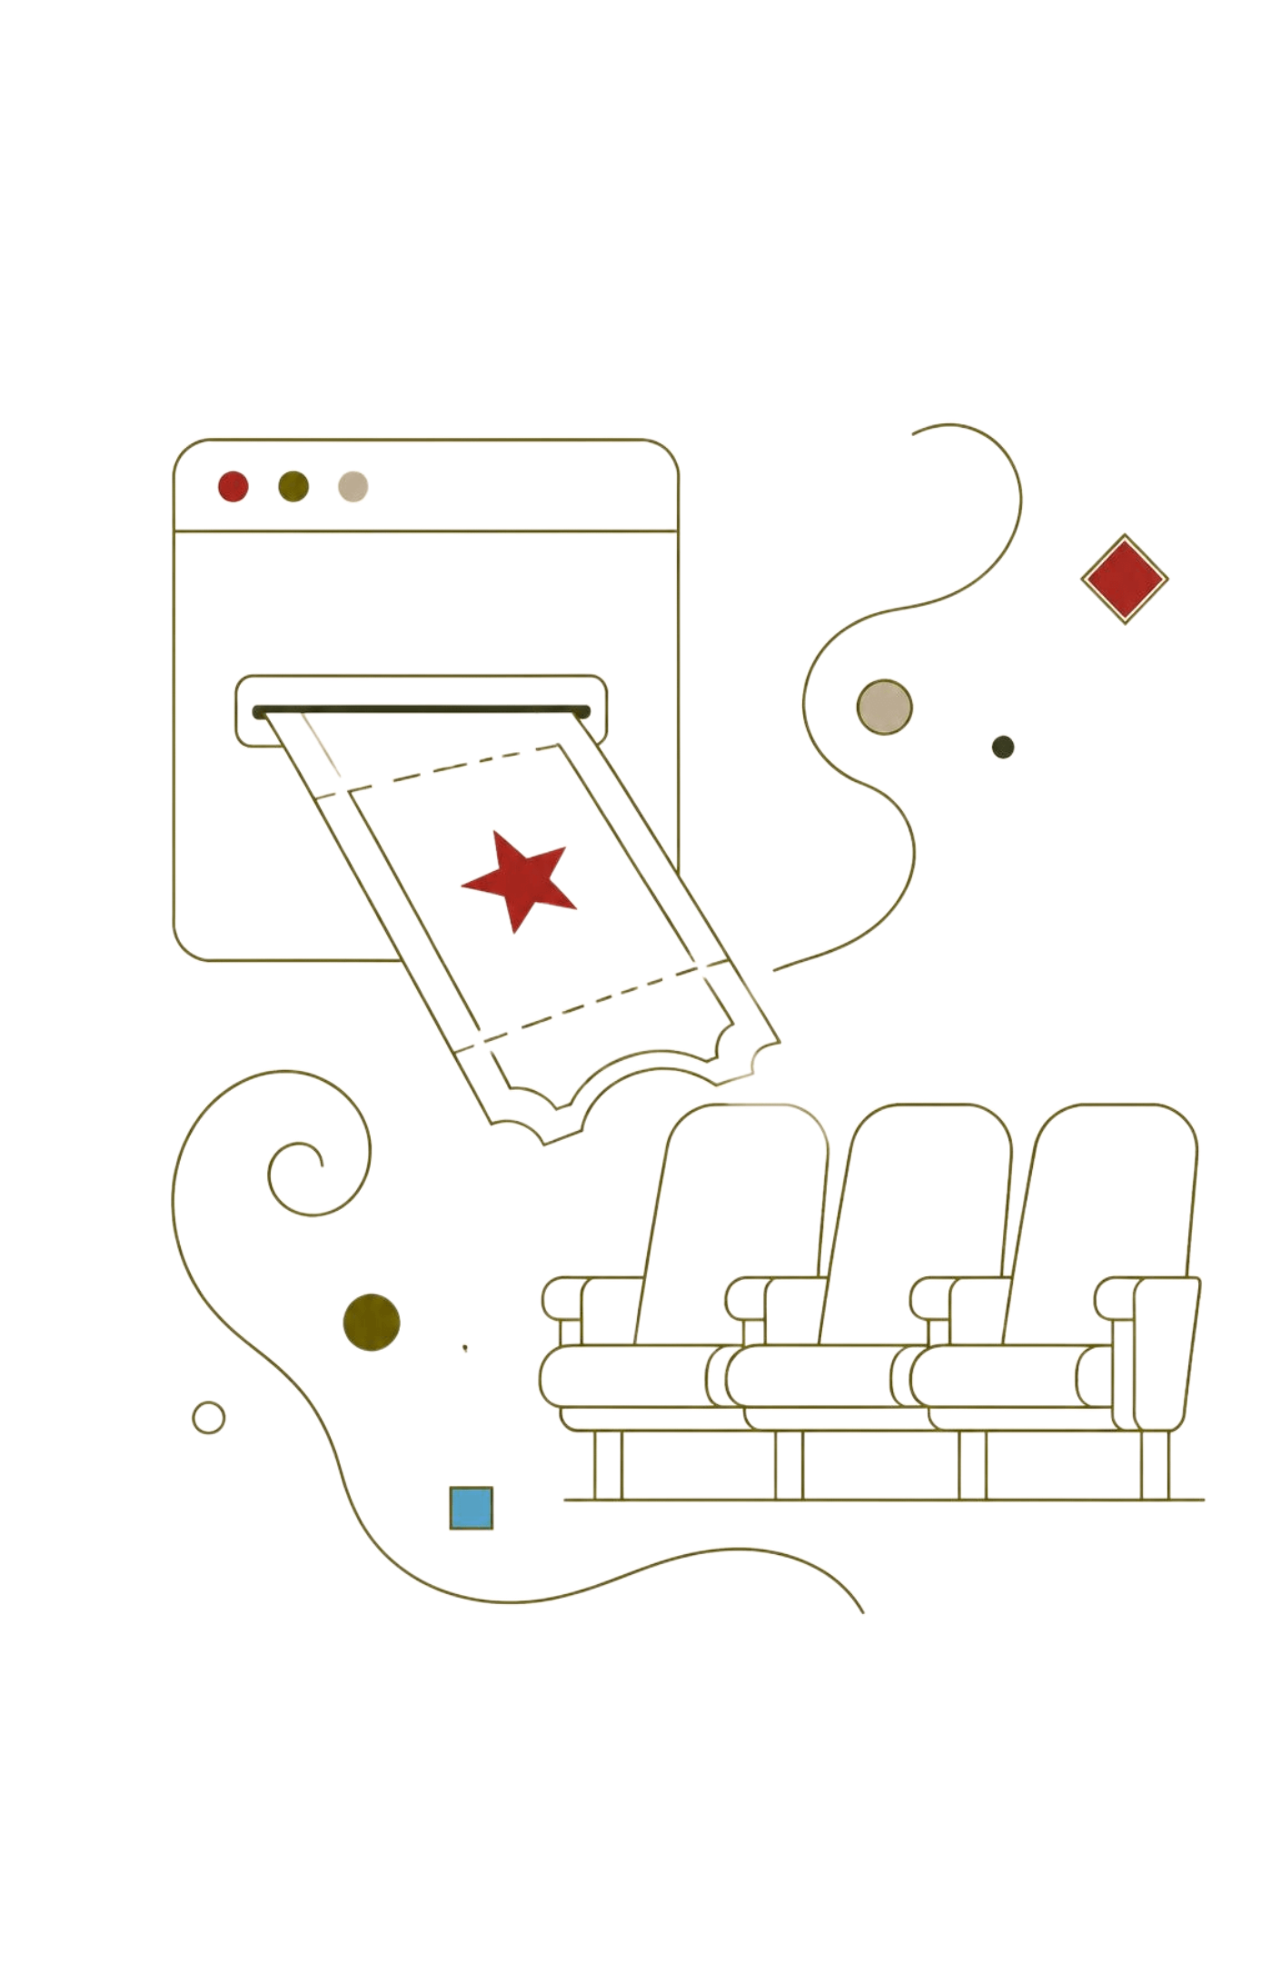
03 · ADVANTAGES
Less confusion at the point of booking
Easy to use
A menu-based console keeps the main actions direct.
Faster booking
Users can check and reserve a seat without manual tracking.
Fewer errors
Validation and double-booking prevention support accurate choices.
Organized information
Availability, cancellation, and booking details stay in one flow.
04
Notes:
The main advantage is clarity. The user sees the available action, receives a response, and can continue or return to the menu without handling a paper list or separate record.

Slide 5
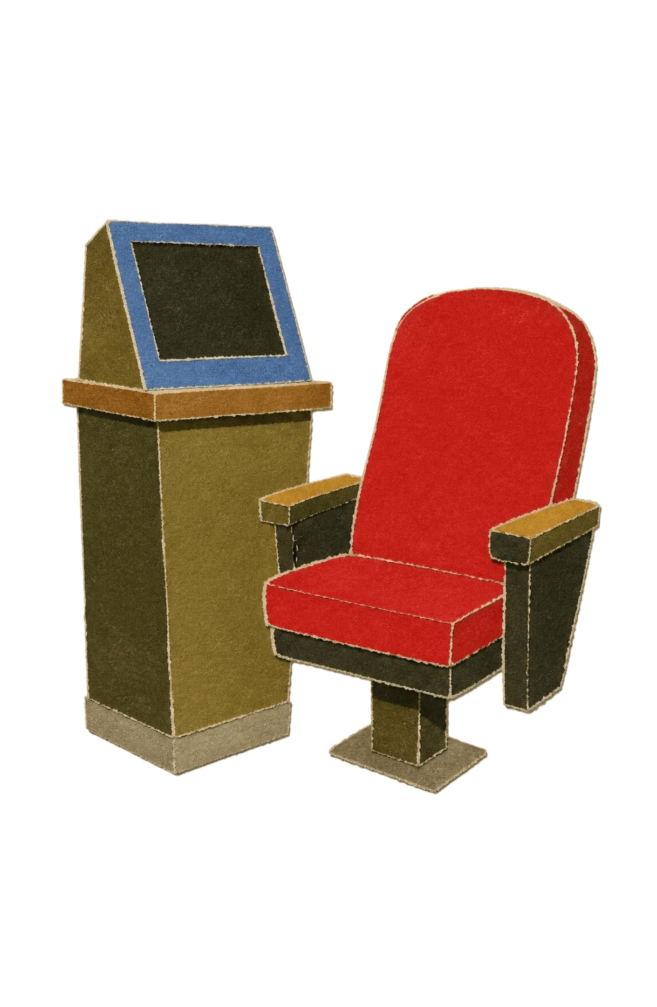

04 · LIMITATIONS
Useful locally.
Not yet a full platform.
Console interface only
No graphical user interface
No database or online payment
Local execution and no permanent storage after the program ends
Notes:
These boundaries are part of the current version. The program runs locally, uses a console interface, does not connect to a database or payment service, and does not preserve records after execution ends.

Slide 6
05 · PROJECT DEVELOPMENT
Built in small, testable steps
Identify
Develop
Improve
Define the cinema booking problem and requirements.
Build the local console program in Java.
Debug issues and refine the user flow.
1
2
3
4
5
Design logic
Test
Plan seats, operations, booking, and cancellation.
Check inputs, double bookings, cancellation, and results.
07
Notes:
Development moved from understanding the problem to implementing the booking logic, then checking how the program responds to different user actions. Testing and debugging helped improve the flow.

Slide 7


06· TECHNOLOGIES AND TOOLS
A focused technical foundation
Java
Console execution
The programming language used to build the Cinema Seat Booking System and its booking logic.
The program runs locally through a text-based console interface.
Project output
The output of our Java program is a live console user interface that shows the theater's seat map, handles user choices safely, updates seat availability in real time, and prints a final ticket receipt
08
Notes:
Only confirmed project basics are shown here: Java and console-based execution. The two marked areas are intentionally editable placeholders for real Java console output supplied by the team.

Slide 8
07 · JAVA CONCEPTS
Concepts that power the program
[CO1] :
Variables
Data Types
Operators
[CO2] :
1.Conditional Statements
2. Switch Statements
3. Loops
01
02
03 [CO3] :
1. 1D – Array
2. 2D – Array
3. Methods
09
Notes:
The brief did not confirm the exact Java concepts used by the team. These placeholders protect the accuracy of the presentation and can be replaced with the team’s verified concepts and explanations.

Slide 9
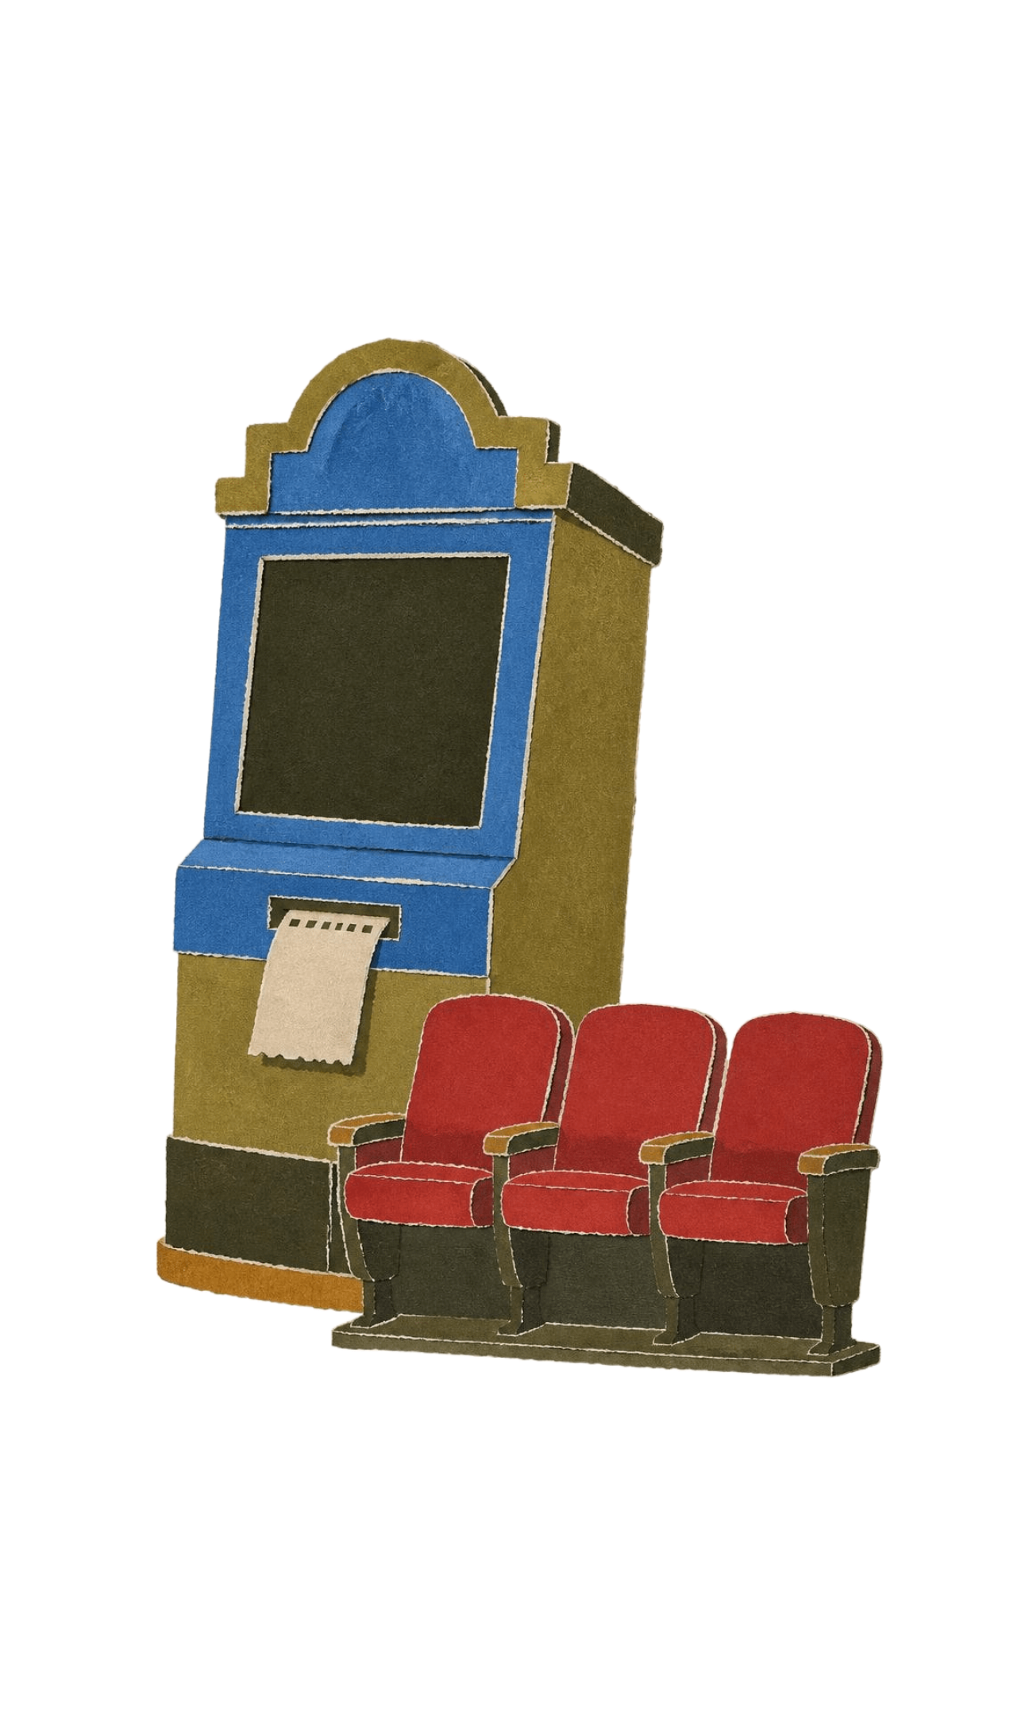
08 · FUTURE SCOPE
From local console to complete booking service
Interface — Add a web or graphical interface.
Data — Connect a database for permanent booking records.
Access — Add user login and account management.
Booking service — Support payments, movie and show-time selection, real-time availability, and ticket generation.
06
Notes:
The future scope follows directly from the limitations. A next version could add a visual interface, permanent data, user accounts, online payment, show selection, live availability, and generated tickets.

Slide 10
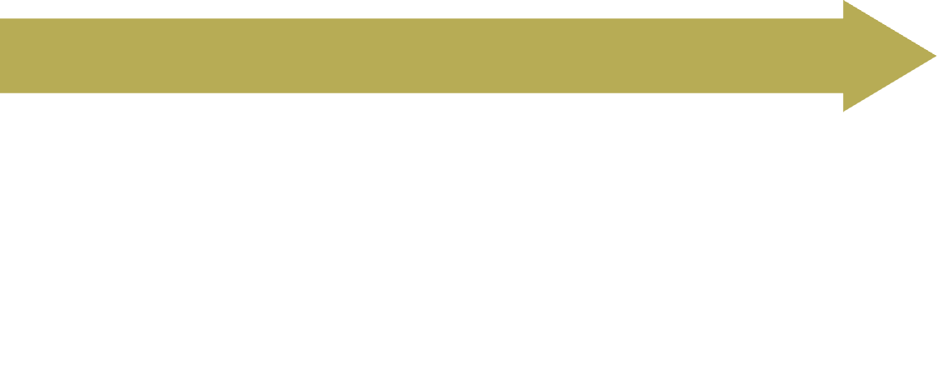

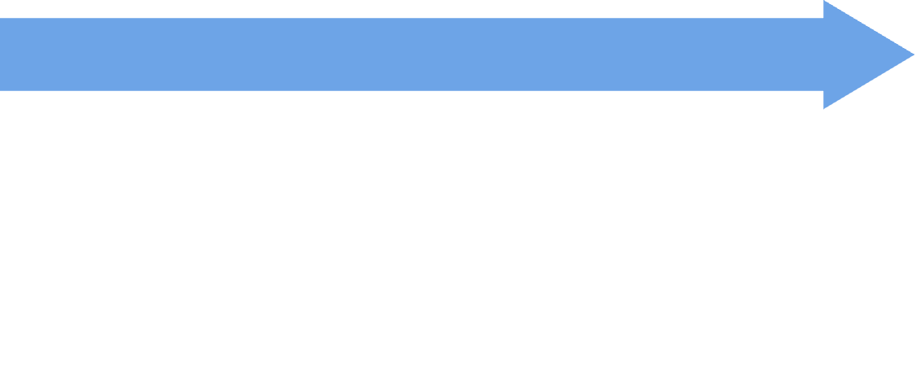
09 · SYSTEM WORKFLOW
One menu connects every booking action
Choose operation
Display menu
Select view, book, cancel, or history.
Start
Show the available operations.
Run the local program.
Show result
Update information
Display the response.
Validate input
Apply the booking or cancellation.
Check that the choice and seat action are valid.
Return or exit
Go back to the menu or end the program.
10
View seats · Book · Cancel · View history
Notes:
The workflow starts with the menu and ends only when the user exits. Each operation is validated, the booking information is updated when needed, and the result is shown before the user returns to the menu.

