Slide 1
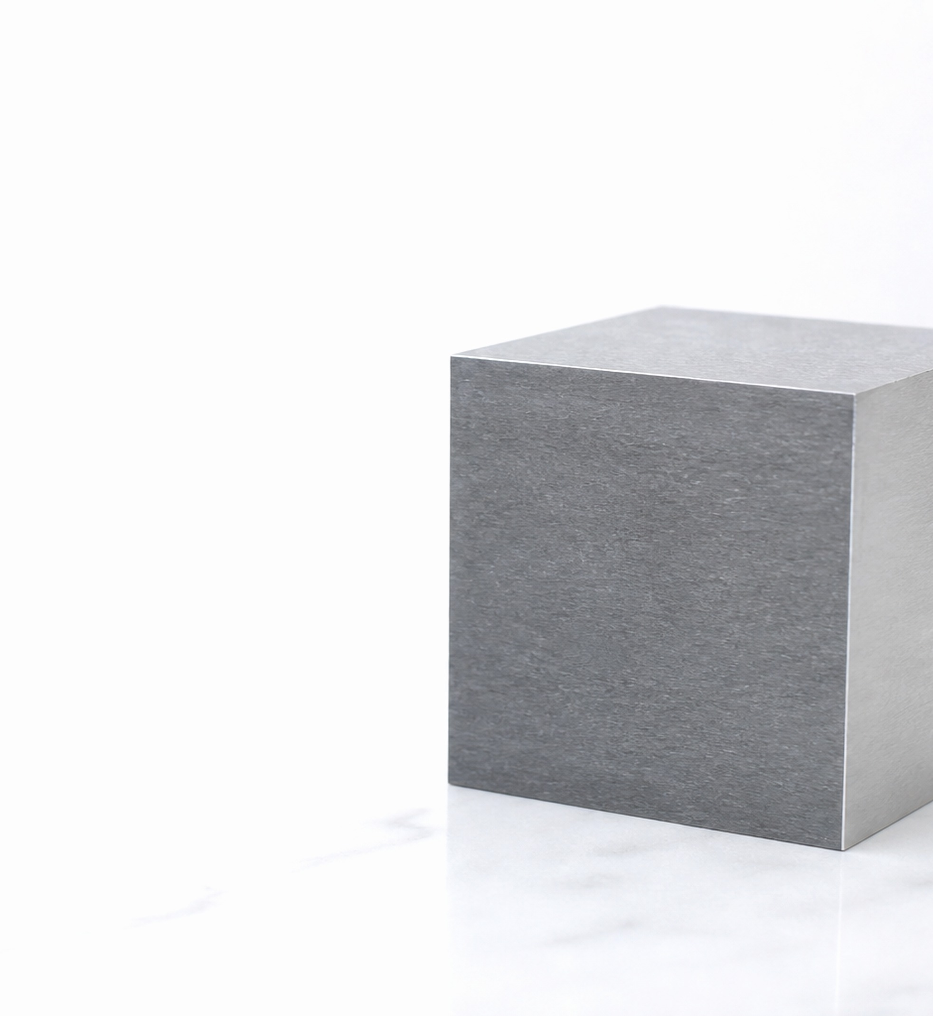
01
CHEMICAL ELEMENT
Iron: A Metal That Shaped Our World
WHAT IS IRON?
Iron is a strong metal and a chemical element with the symbol Fe.
It is used in buildings, transport, machines, and many objects around us.
SYMBOL: Fe
Iron in Everyday Life
Fe

Slide 2
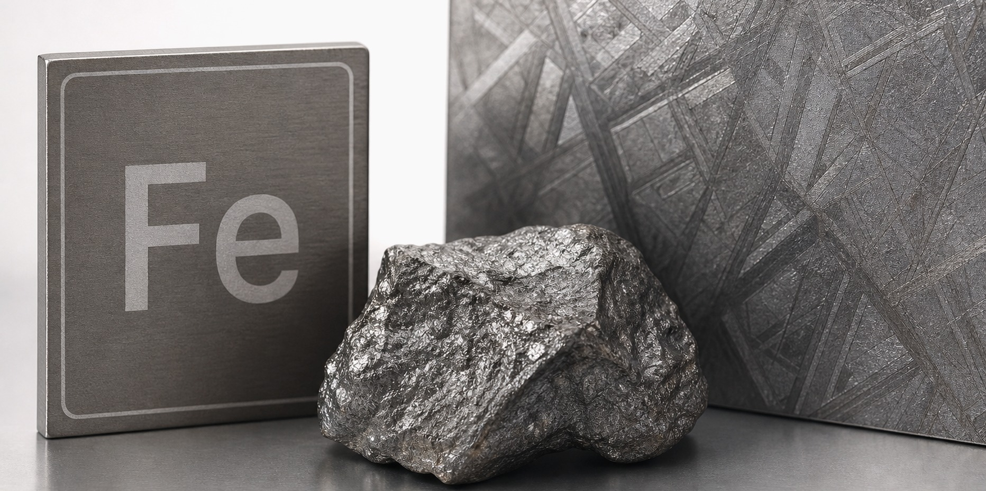
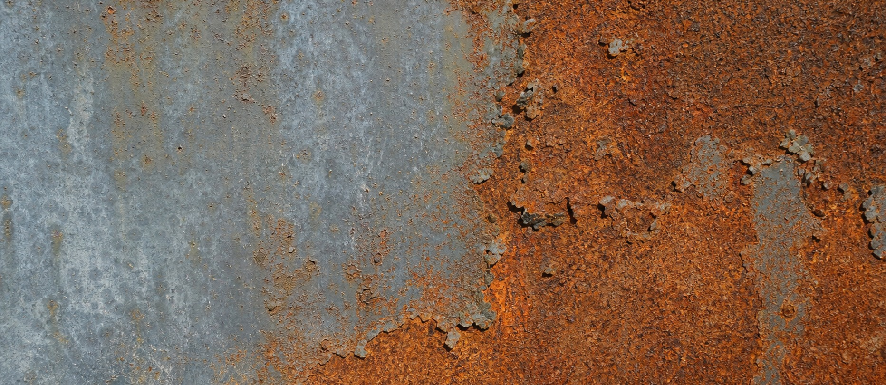
02
IRON AS AN ELEMENT
A closer look at iron
1
Iron is a chemical element with the symbol Fe and the atomic number 26.
Although it looks simple, it is one of the most common elements on Earth.
element sample
2
3
In pure form, iron is a grey metal that can be magnetic and reactive.
4
Because it easily combines with oxygen, it can form rust when air and water are present.
rust on iron
MINIMAL OVERVIEW
Iron in Everyday Life
Fe

Slide 3
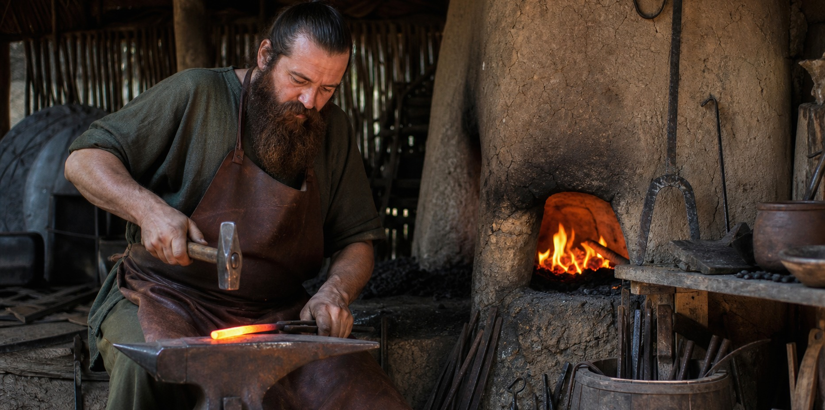
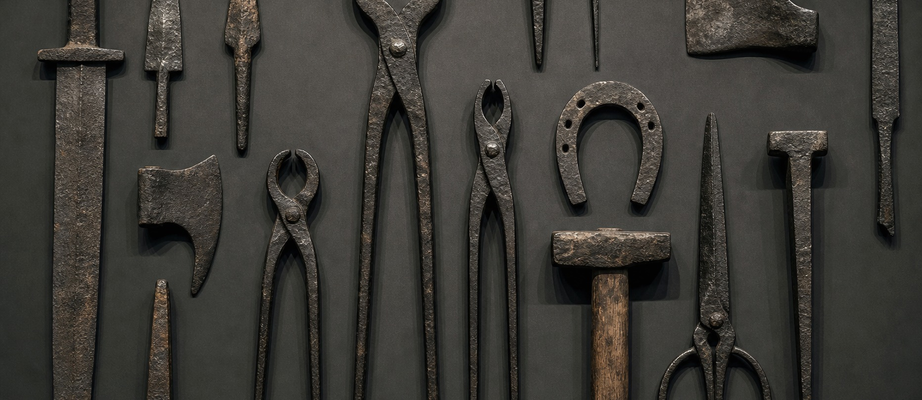
03
HISTORY
How people learned to use iron
1
People did not discover iron in one single moment; they learned to work with it over a long period.
Early iron objects were rare, and some of them were made from meteorite iron.
ancient iron work
2
3
When ancient craftsmen learned to heat iron ore, tools and weapons became stronger than many bronze ones.
4
This change helped start the Iron Age, which influenced farming, war, and daily life.
early tools
MINIMAL OVERVIEW
Iron in Everyday Life
Fe

Slide 4
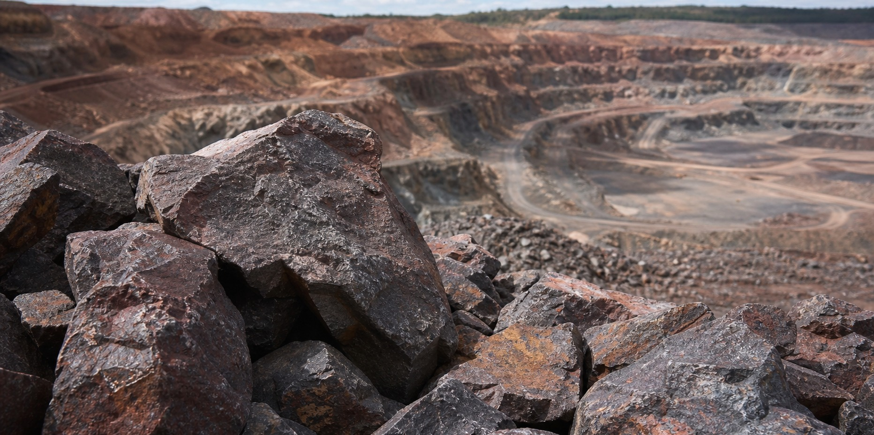
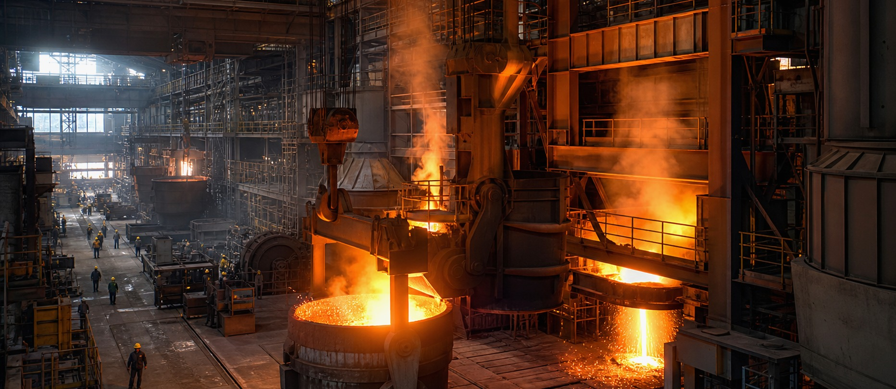
04
TODAY
Mining and modern use
1
Today, most iron comes from iron ore, especially minerals such as hematite and magnetite.
The ore is mined, crushed, and heated in large furnaces, where iron is separated from unwanted rock.
iron ore
2
3
Much of this iron is turned into steel, because steel is stronger and easier to use in construction.
4
Modern society depends on iron in buildings, bridges, cars, machines, and railways.
modern steel production
MINIMAL OVERVIEW
Iron in Everyday Life
Fe

Slide 5
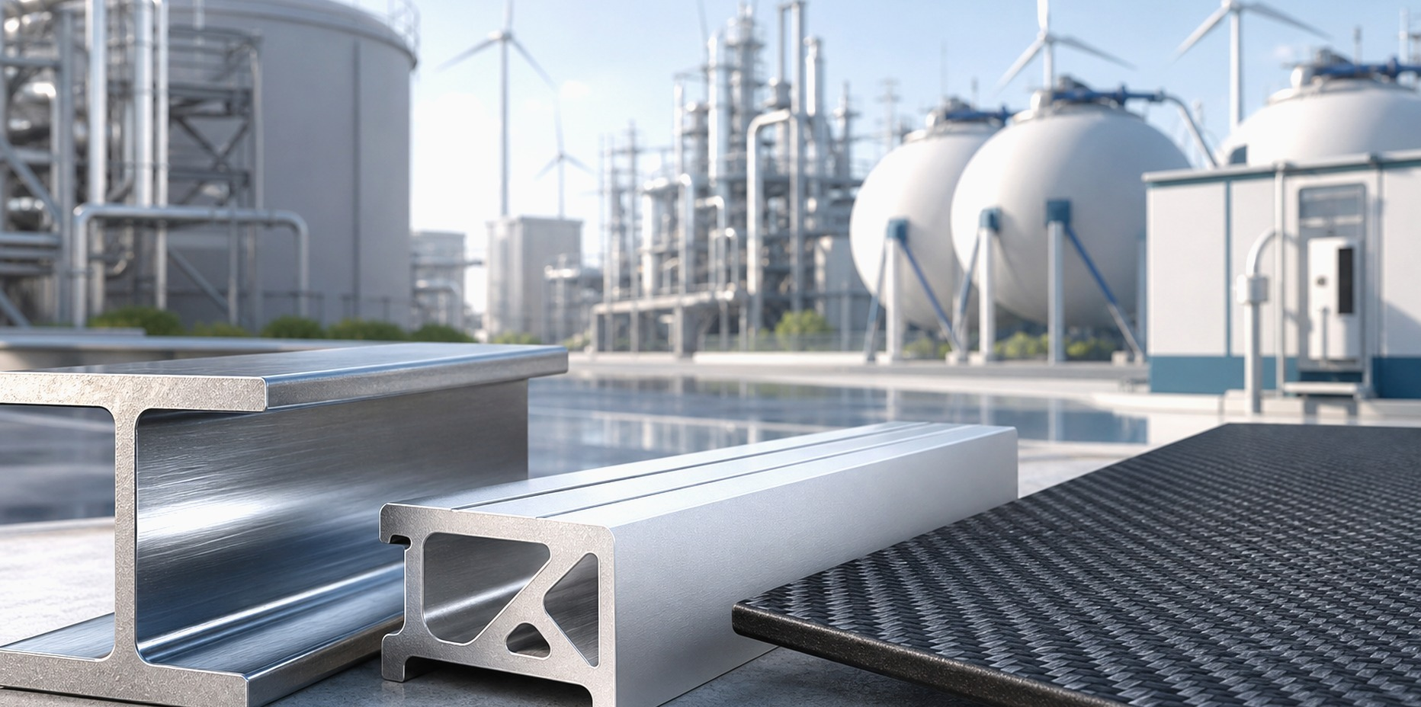
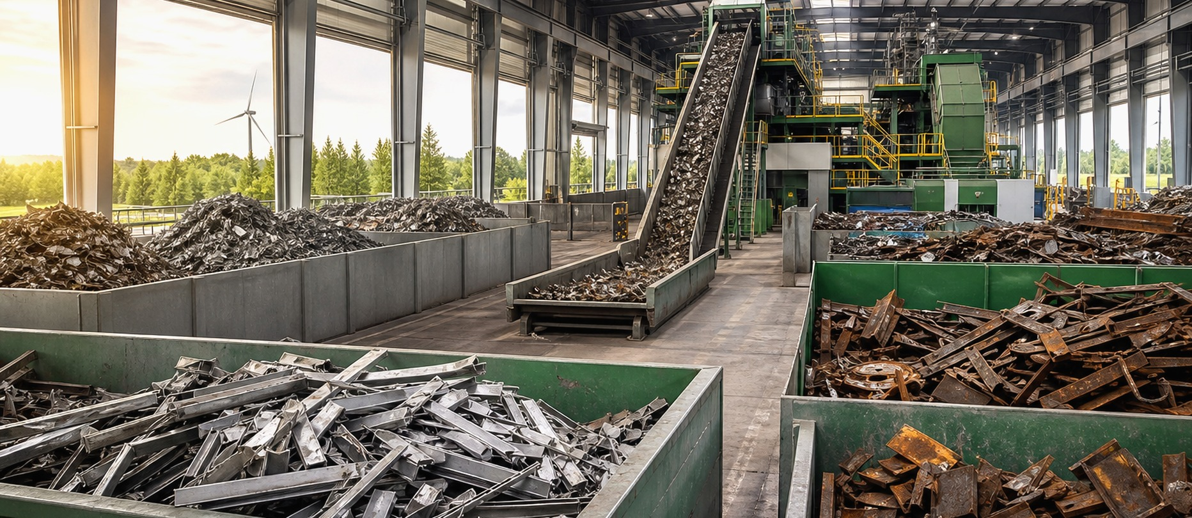
05
FUTURE
Perspectives and alternatives
1
In the future, iron will probably remain important, but the way we produce it may change.
Factories are trying to make green steel by using cleaner energy and less coal.
future materials
2
3
Aluminium, carbon fiber, and new composites can replace iron when low weight is more important than low cost.
4
Even so, iron is cheap, strong, and recyclable, so it is not likely to disappear.
recycling iron and steel
MINIMAL OVERVIEW
Iron in Everyday Life
Fe

Slide 6
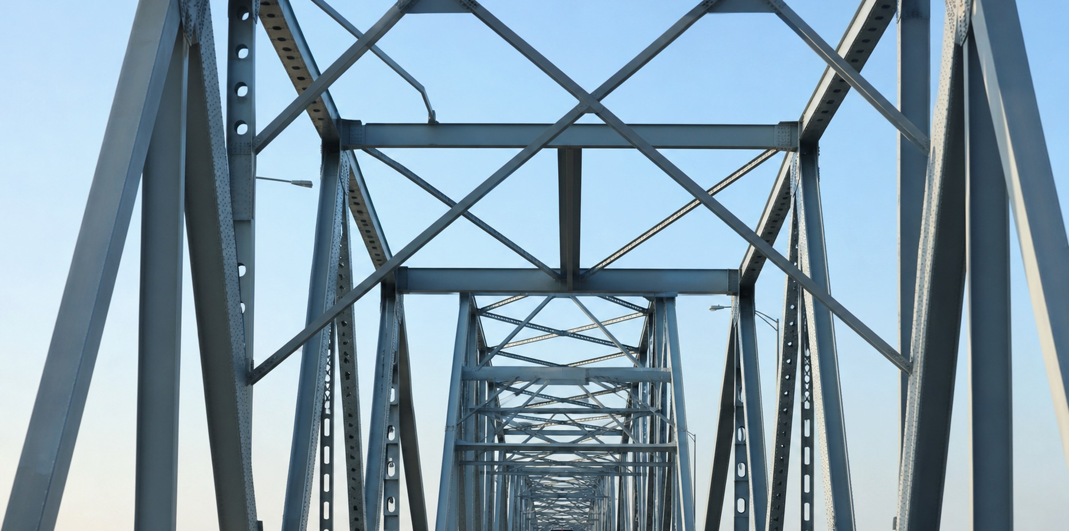
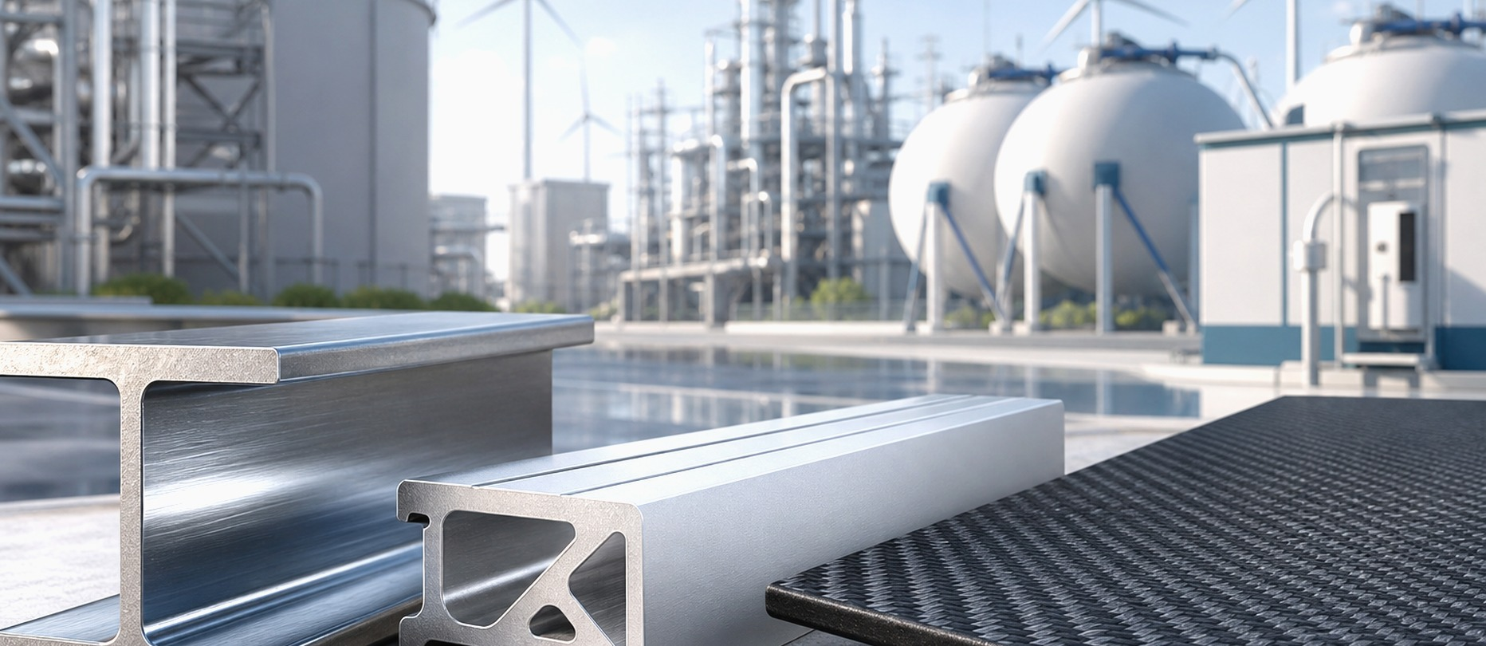
06
CONCLUSION
Why iron still matters
1
Iron is not the newest or the rarest element, yet it is one of the most useful.
steel structure
2
Its story connects chemistry, history, industry, and the future of technology.
3
By studying iron, we can see how one element can change the way people build, travel, and live.
future materials
MINIMAL OVERVIEW
Iron in Everyday Life
Fe

