Slide 1


ANALYSING
PRIME CINEMAS
BIG DATA -

Slide 2

AGENDA
1
INTRODUCTION
fi
EXTERNAL
ANALYSIS
3 KEY METRICS & KPIS
4
BUSINESS ANALYSIS
5
CONCLUSION & RECOMMENDATION

Slide 3
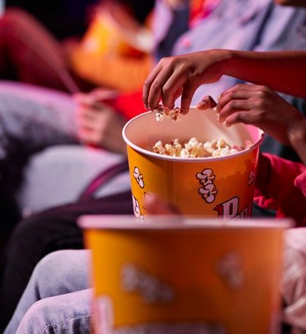
INTRODUCTION
INDUSTRY OVERVIEW
Highly competitive industry with top competitors dominating the market
Large technologically- driven shift over the last decade
PROBLEM IDENTIFICATION
Prime Cinemas i s looking to
gain insights into their
customer' s spending behaviour
and increase brand loyalty

Slide 4
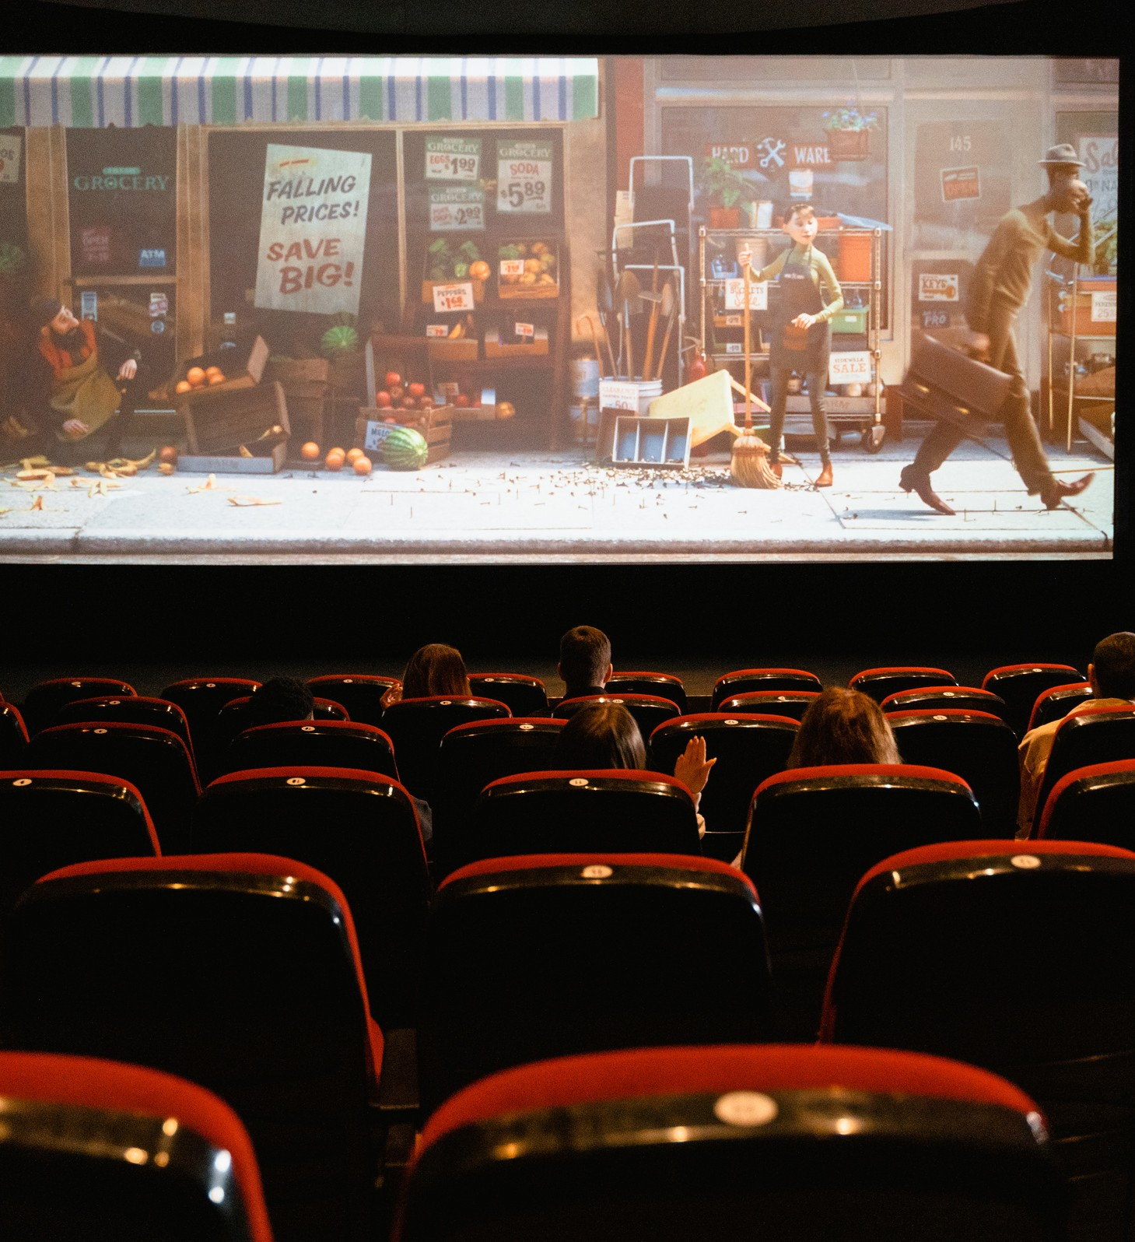
DATASET 1
CONSISTS OF:
8 COLUMNS
1 , 048 , 575 OBSERVATIONS
CONTAINS:
UNIQUE MEMBER IDENTIFIER SPEND AMOUNT
POINTS EARNED FROM EACH
TRANSACTION ( USING THE PRIME LOYALTY CARD)
POINT ID CODE
POINT TYPE ID CODE
TRANSACTION DESCRIPTION TRANSACTION DATE
TRANSACTION ID CODE

Slide 5
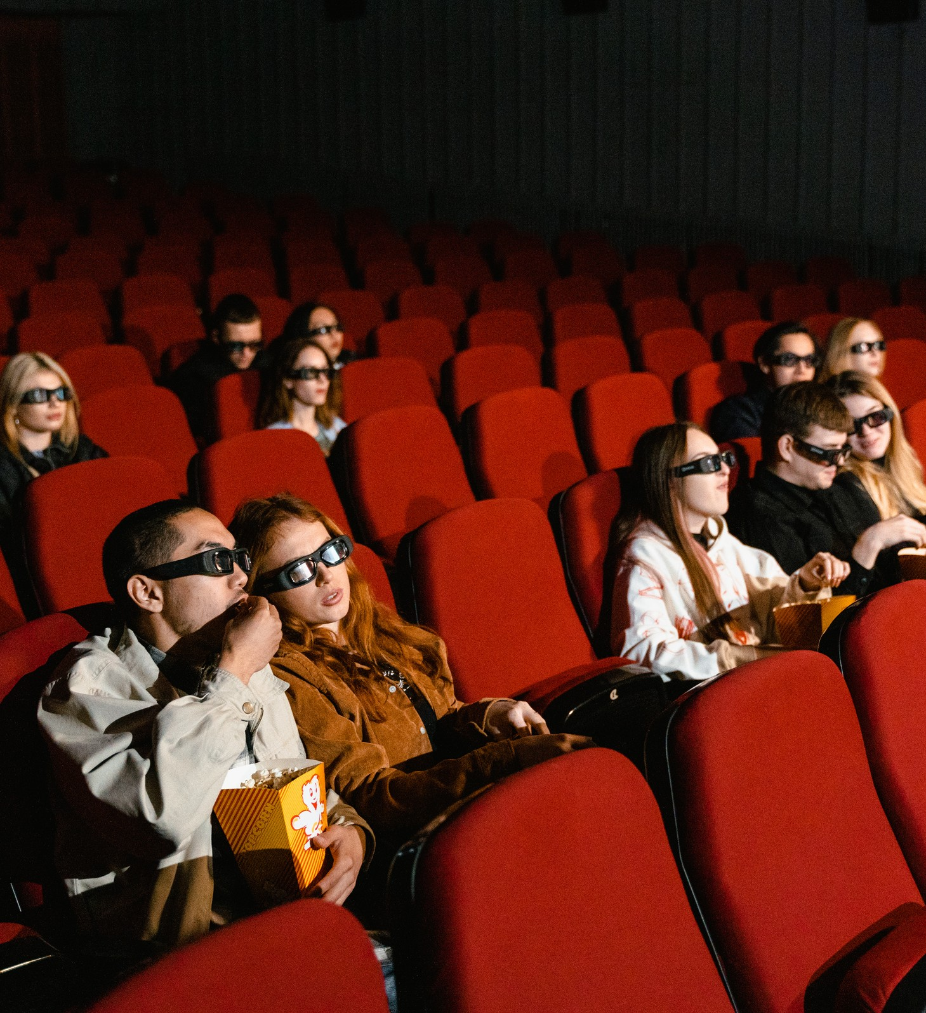
DATASET 2
CONSISTS OF:
8 COLUMNS
18 , 000 OBSERVATIONS
CONTAINS:
UNIQUE MEMBER IDENTIFIER DEMOGRAPHIC INFORMATION
CITY
STATE/PROVINCE FSA
POINTS TOTAL
LANGUAGE PREFERENCE GENDER
AGE CLASS

Slide 6
MACRO-LEVEL ASSESSMENT: PESTEL ANALYSIS
POLITICAL
ECONOMICAL
SOCIAL
Largely impacted by tax policies, trade
barriers, and
intellectual
property protection
Factors such as inflation,
employment rate
and income
distribution impact revenue
Influenced by
media trends ( TV, social media, etc.)
Shaped by social culture
Government
dictates what entertainment
facilities are public
Dependent on
disposable income
and spending power

Slide 7
MACRO-LEVEL ASSESSMENT: PESTEL ANALYSIS
TECHNOLOGICAL
Media and f i lm industry are
dominated by technological advancements
ENVIRONMENTAL
Leisure activities that stem from
entertainment affect the environment ( ex. amusement parks,
media)
LEGAL
Strict laws
regulate the industry
Copyrights ,
patents , and f ines
Companies are
forced to invest in tech- related R& D
protect content and are regularly enforced
Pollution increases
due to transportation

Slide 8

EXTERNAL ENVIRONMENT
ANALYSIS: PORTER'S 5 FORCES
Supplier Bargaining Power
High levels of power
Limited suppliers ( distribution of f i lm companies, equipment, and food)
Better brands attract more customers
Rivalry
High levels of competition
Low levels of brand loyalty As a conglomerate of the
f i lm industry, competing
f i rms offer s imilar services at comparable prices

Slide 9
EXTERNAL ENVIRONMENT
ANALYSIS: PORTER'S 5 FORCES
Buyer Bargaining Power
High levels of power
Threat of Substitutes
High threat levels
Threat of New Entrants
Low threat levels
Minimal conversion costs for customers Customers chose
cinemas based on
location
Development of technology has
offered attractive
alternatives
Users can receive
discounts for online services
High barriers to entry Many cinemas are
chained and require
economies of scale Significant r i sks to new entrants

Slide 10


RECOMMENDATIONS
BASED ON MACRO- LEVEL ASSESSMENTS:
Offer differentiated products or services,
unique to competitors
( ex. discounted t ickets, rental services)
Rely on high- quality
suppliers with strong
reputations to remain more
attractive to
customers and
Use methods of
promotions and
diversification of
services to maintain relationships with
cutomers
improve the user experience

Slide 11
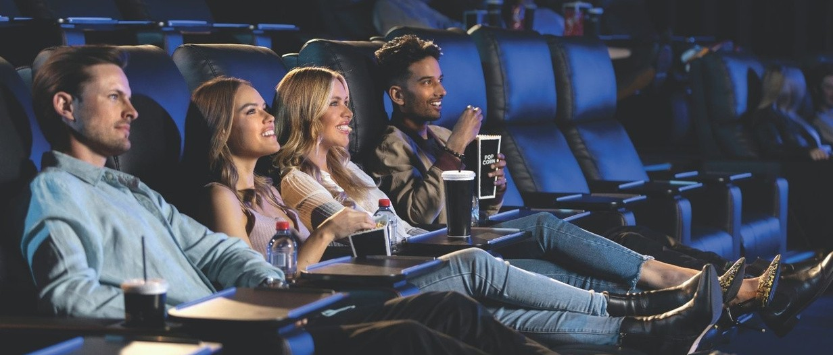
KEY METRICS
&
KPIS
1
2
3
THE NUMBER OF TRANSACTIONS
[ EX_TRANSACTION DESCRIPTION]
EARNED POINTS BY CUSTOMERS [ POINTS > 0 ]
AMOUNT SPENT BY CUSTOMERS
[ TRANSAMOUNT > 0 ]

Slide 12
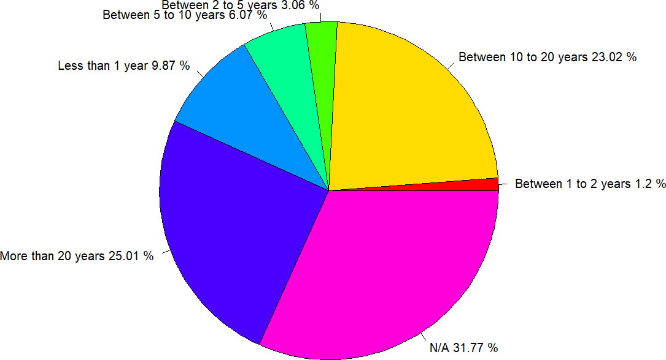
PROPORTION OF LENGTH OF MEMBERSHIP WITH NO TRANSACTIONS
INSIGHTS
31.77% of all customers did not have any transactions (N/A)
Why?
Members created their Prime loyalty card but never used the card

Slide 13
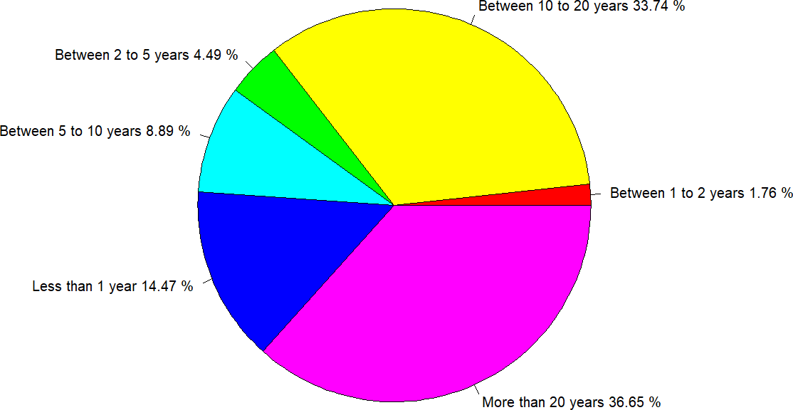
PROPORTION OF LENGTH OF MEMBERSHIP WITH TRANSACTIONS
INSIGHTS
After dropping the N/A, more than 70% (36.65% +
33.74%) of all
customers use their Prime loyalty card for more than 10 years

Slide 14
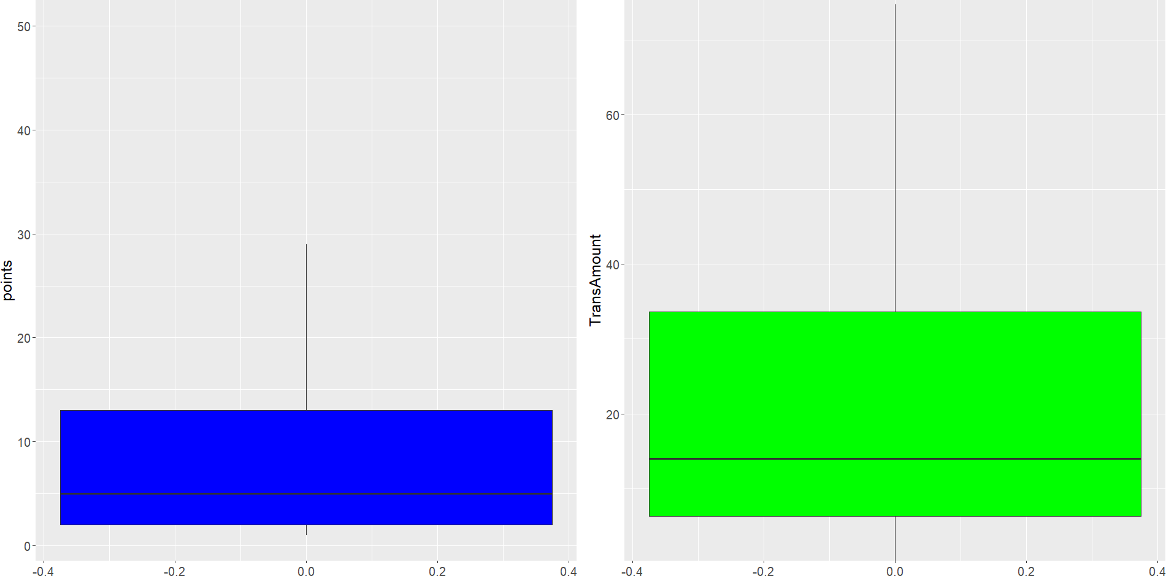
DISTRIBUTION OF EARNED POINTS & AMOUNT SPENT
Most of the points that
customers earned are from 0 to 29
Most of the amounts that
customers spent are from 0 to 75
** Outliers and extremes have been removed

Slide 15
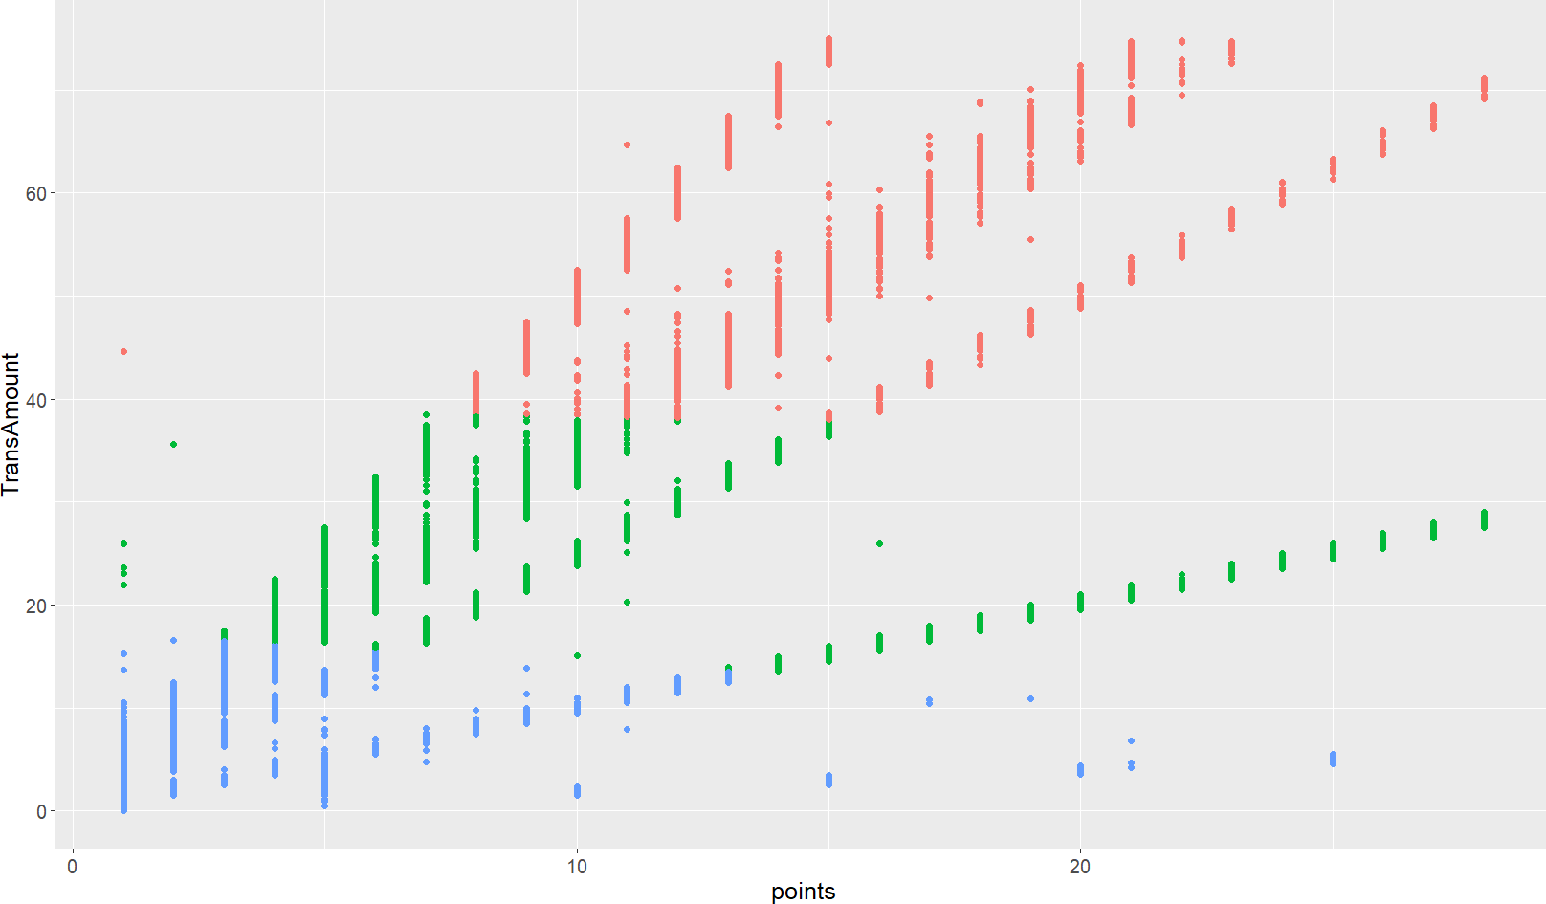
DATA ANALYSIS: K-MEAN CLUSTER
INSIGHTS
Using k=3, we observe that 62.08%
(Cluster 3)
of the total customer transactions are in the spending bracket of 0-
19 and
earned points of 0-
15
Using Cluster 3 to explore the top 5 categories based on the number of transactions
Cluster 1
11.47%
67997 observations
Cluster 2
26.45%
156874 observations
Cluster 3
62.08%
368141 observations

Slide 16
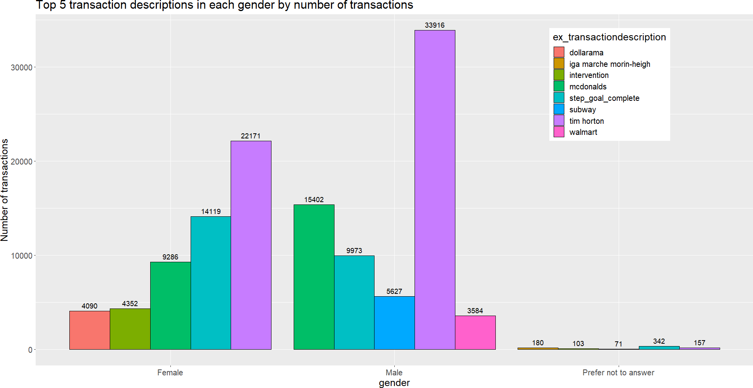
INSIGHTS
ANALYSIS BASED ON GENDER:
45% of the transactions across all customers originate from Tim Hortons
61% of these transactions are from male customers
Dollarama (3%) is the least popular among the female population
Walmart (3%) is the least popular among the male population

Slide 17
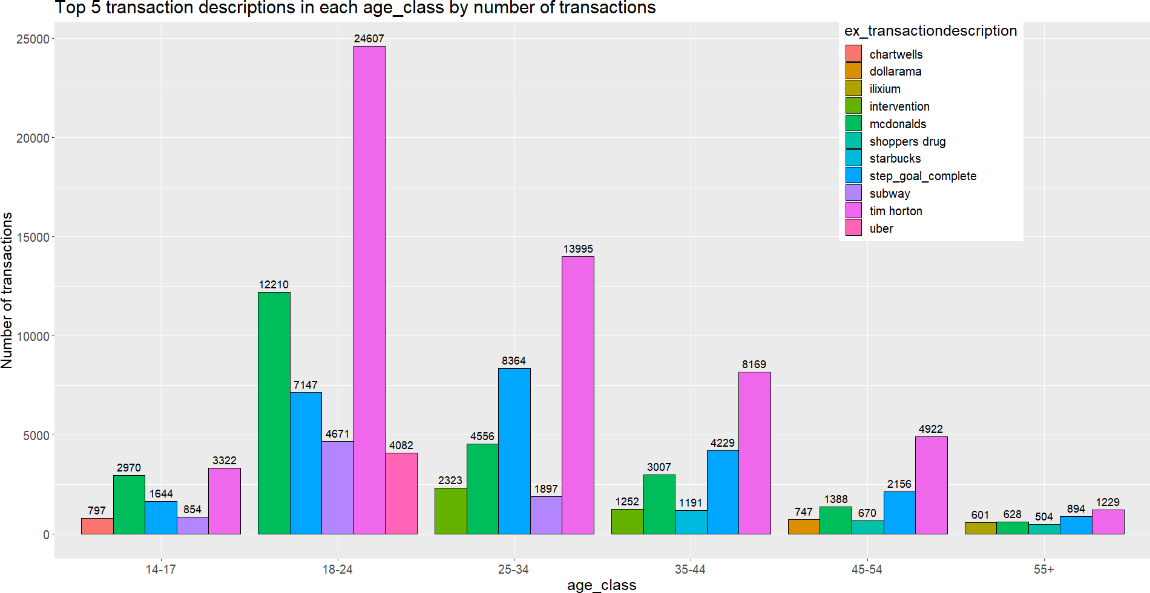
ANALYSIS BASED ON AGE:
INSIGHTS
Tim Hortons had the highest number of transactions for each age group
The age is less than 25, love McDonald's the most

Slide 18
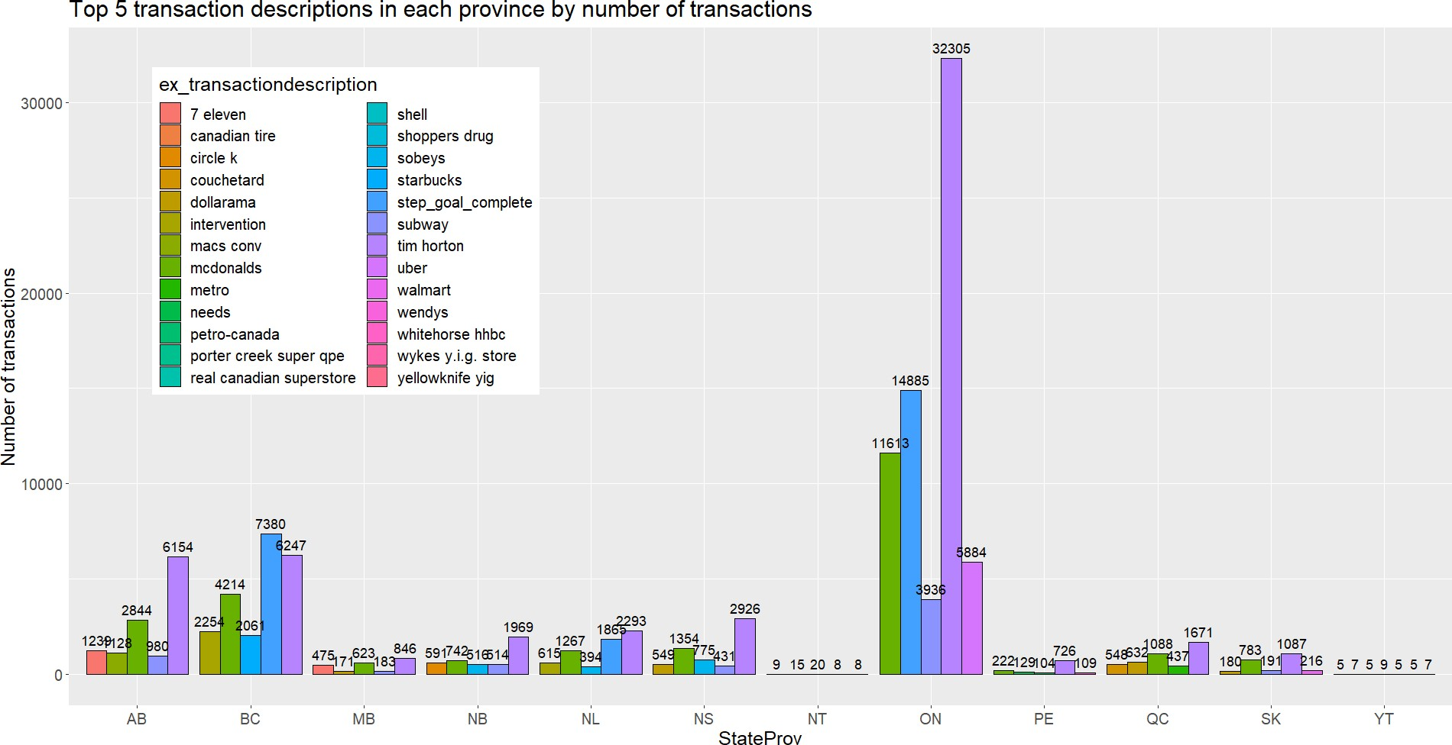
ANALYSIS BASED ON PROVINCES:
INSIGHTS
Tim Horton’s is the most popular among all provinces except BC
Customers from Ontario are the most active
Northwest Territory (NT) and Yukon (YT) have the least number of Prime customers

Slide 19
CONCLUSION
BASED ON THE DEMOGRAPHIC
INFORMATION, WE CAN PREDICT THE TRANSACTION CONTENT MEMBERS ARE
INTERESTED IN AND ATTRACT THEM TO USE THE PRIME LOYALTY CARD

Slide 20

PROVINCIAL ENGAGEMENT
Understand the least participating provinces and think of ways to increase the number of prime members in those locations
RECOMMENDATIONS
1
2
IMPROVE REWARDS PROGRAM
Reviewing the spend pattern on age and category, which can help attract more customers
3
IMPROVE THE LOYALTY PROGRAM
Reduce churn by improving loyalty program for members
BASED ON KPI
ANALYSIS

Slide 21
THANK YOU

