Slide 1

Shop 24x7
Group 9:
Jack Owen, Poojith Kumar Gannamaneni, Varun Gaddam

Slide 2
Technologies
NodeJS
AngularJS
ExpressJS
Mongo
Bootstrap

Slide 3
Group Responsibilities
Jack
Login
Registration
User Profile
User Edit Profile
Homepage
Poojith
Product Page
Cart
Checkout
User Orders
Varun
Category Listing
Admin Add Product
Admin Manage Product
Admin Manage Order

Slide 4
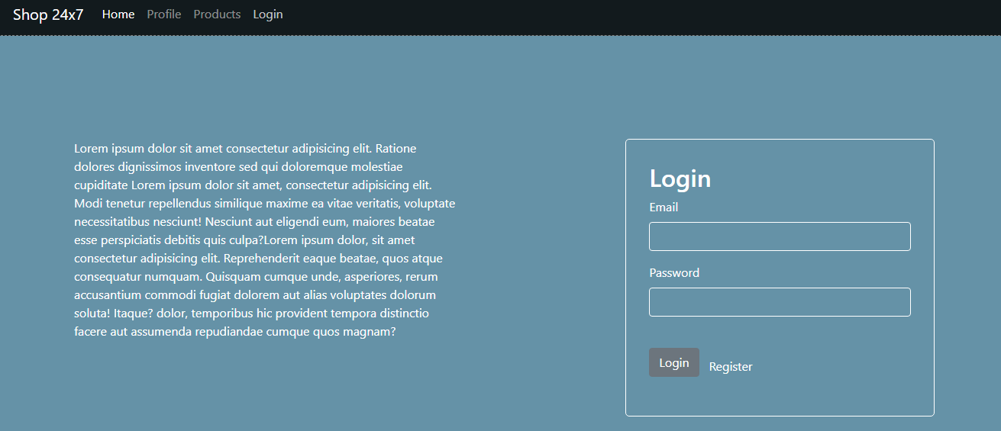
Login

Slide 5
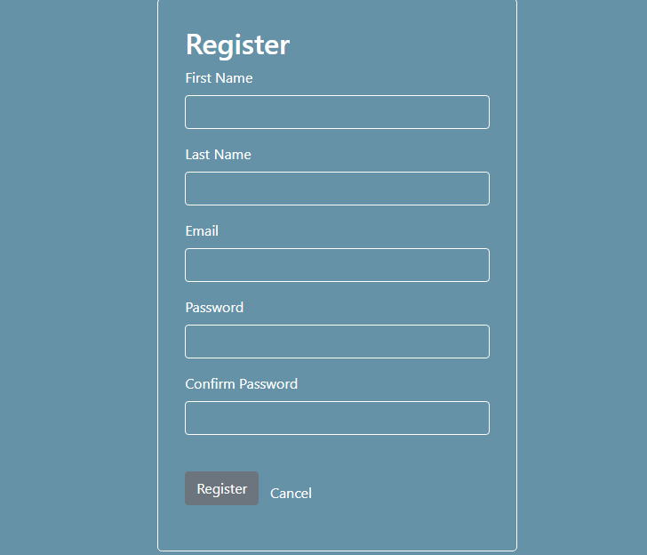
Register

Slide 6
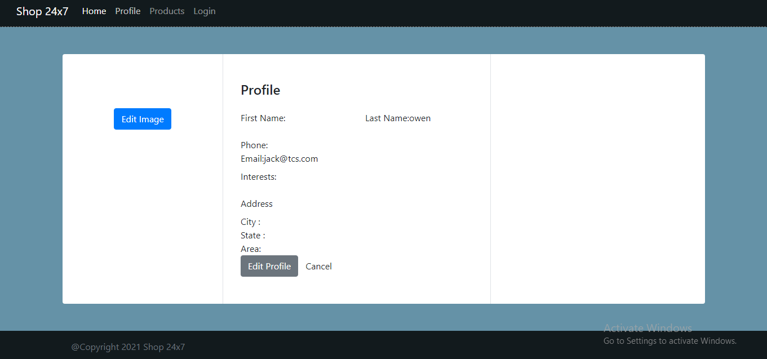
User Profile

Slide 7
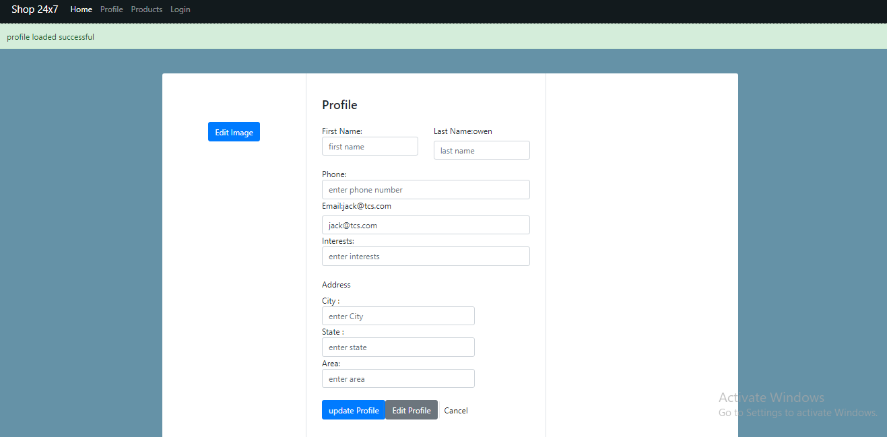
User Edit Profile

Slide 8
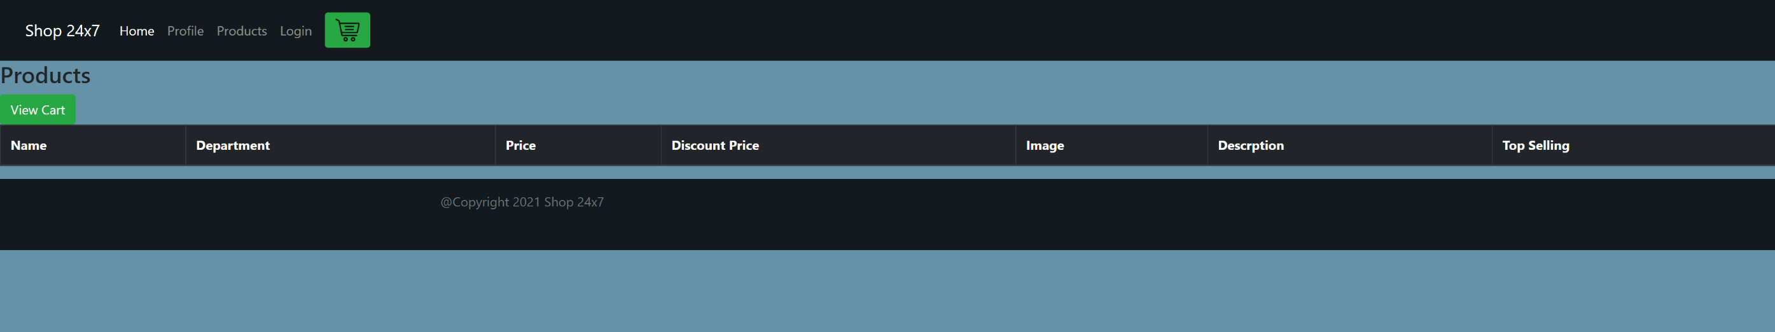
Product page

Slide 9
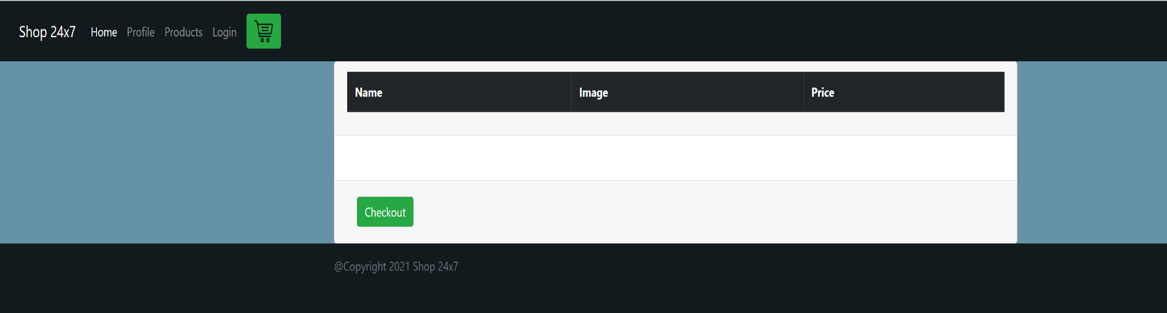
Checkout Page

Slide 10
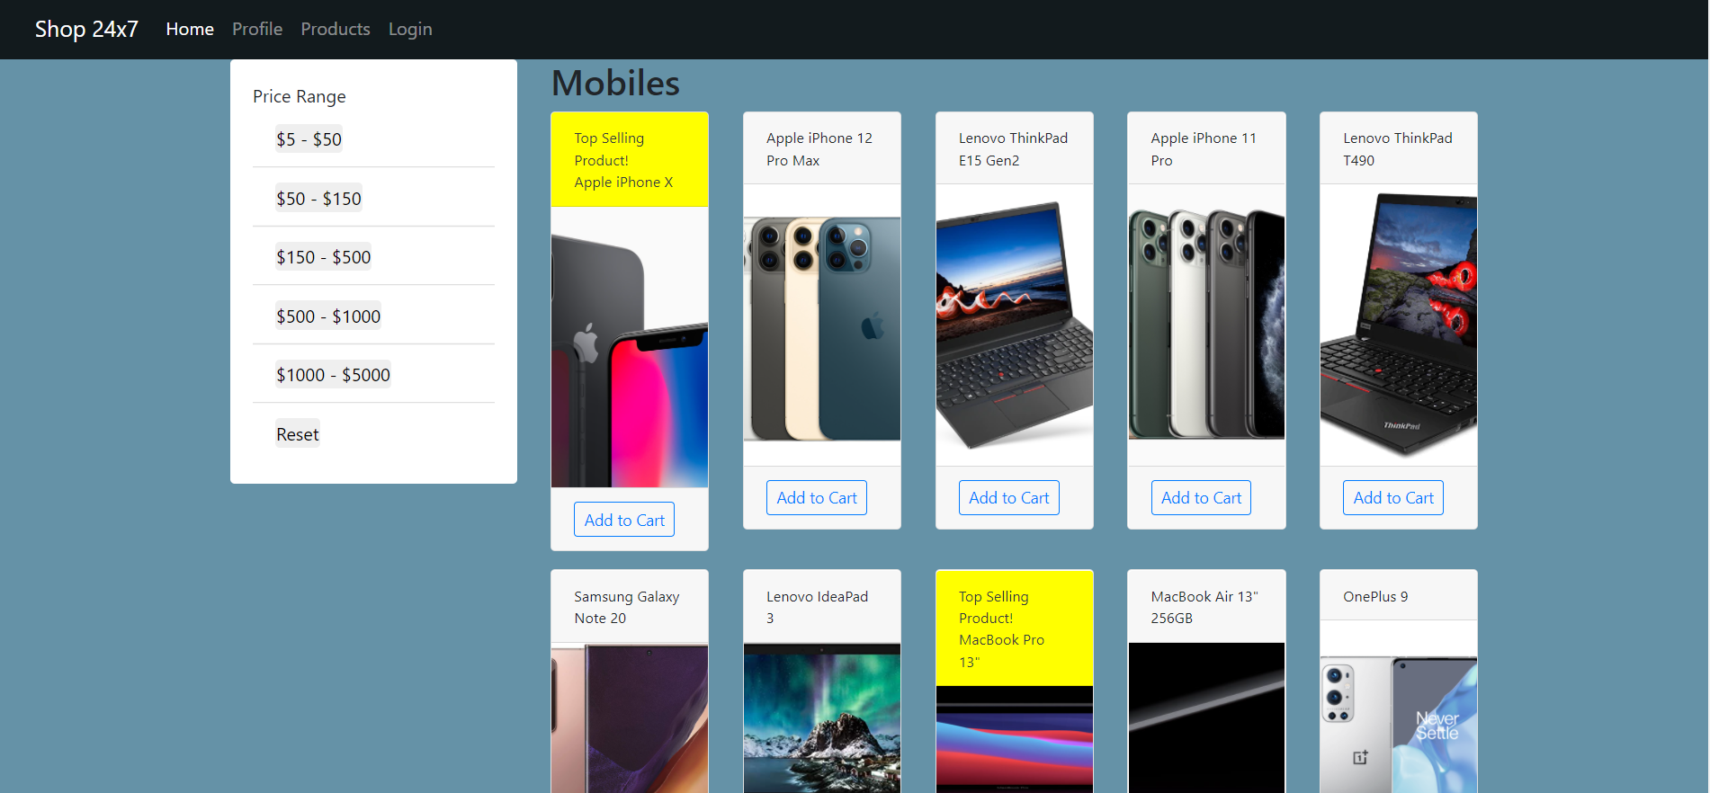
Category Listing

Slide 11
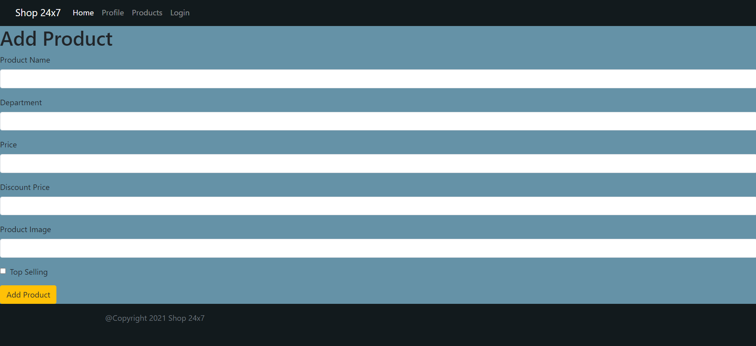
Admin Add- new Product

Slide 12
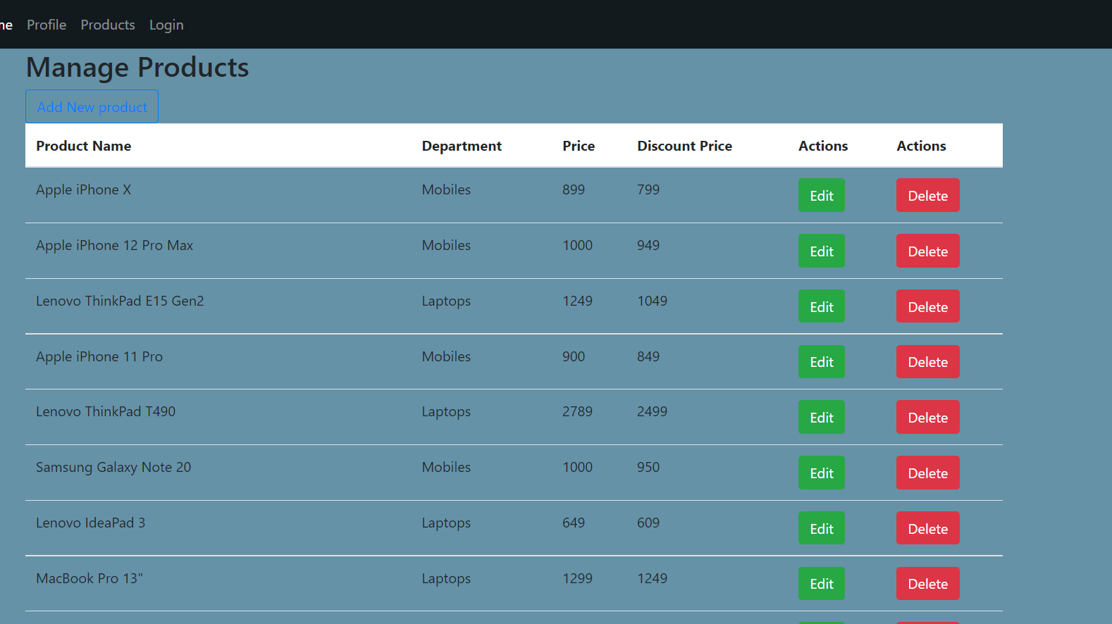
Manage Products

Slide 13
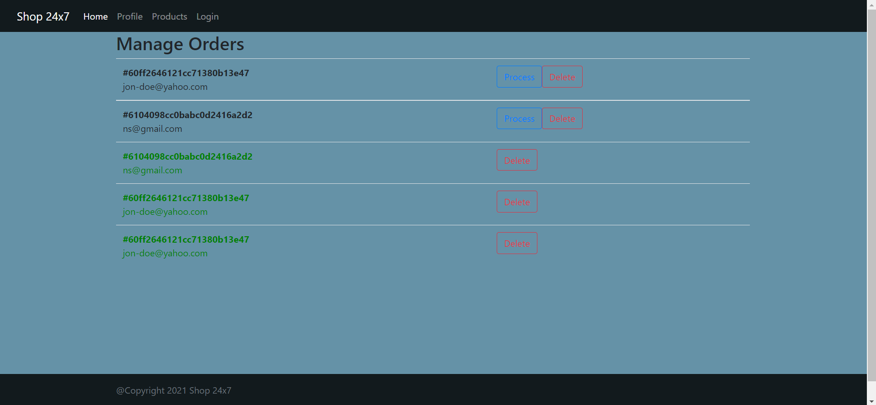
Manage Orders

