Slide 1
Neurolabware collected wisdom
Neurolabware sucks.

Slide 2
General
Last group of digits in file name has to have three digits 000
sbxread_all() reads all frames in file and returns raw data and info struct

Slide 3
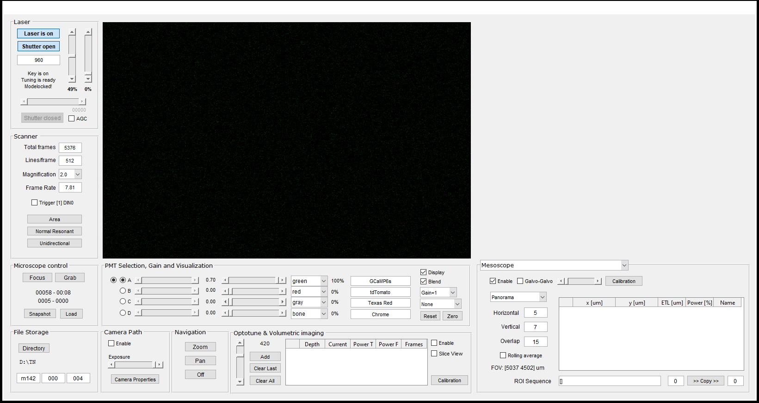
Mesoscopic panorama
Set Magnification >= 2x. The larger the magnification the more even the brightness across columns in the panorama
Choose no of patches such that calculated FOV indicator is not red
E.g. for good coverage of most of the 5 x 4.5 mm FOV:

Slide 4
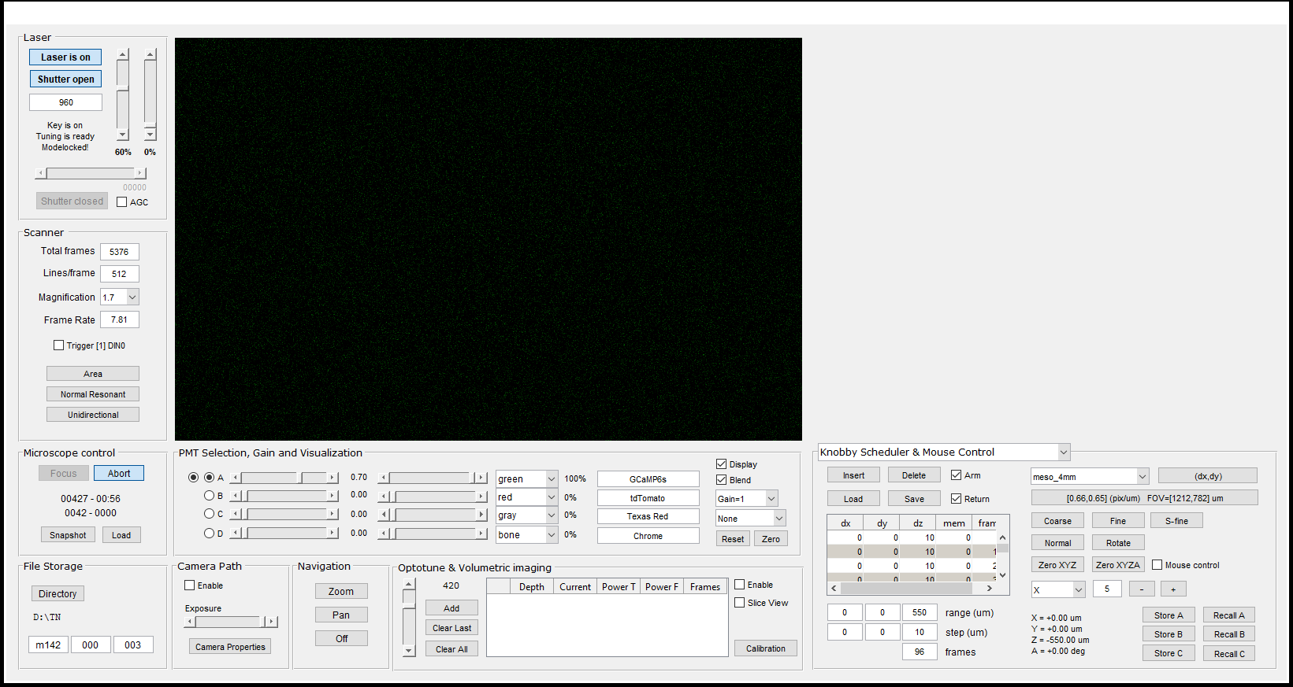
Mesoscopic panorama + z stack
First set up panorama as on previous slide (disable rolling average)
Move to deepest position (here: -550 um)
Set up knobby scheduler as shown here, using range, step, frames inputs
Enable arm and return
Grab
Adjust laser power manually during acquisition to avoid overexposure
Use function mesoscope_stack_to_tif() to convert

Slide 5
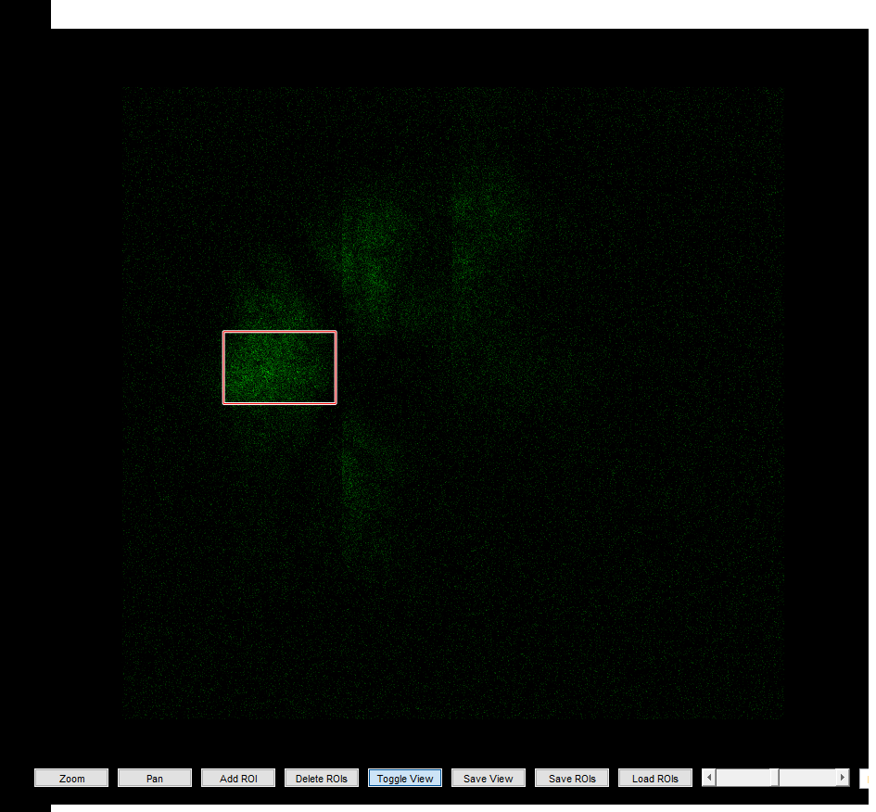
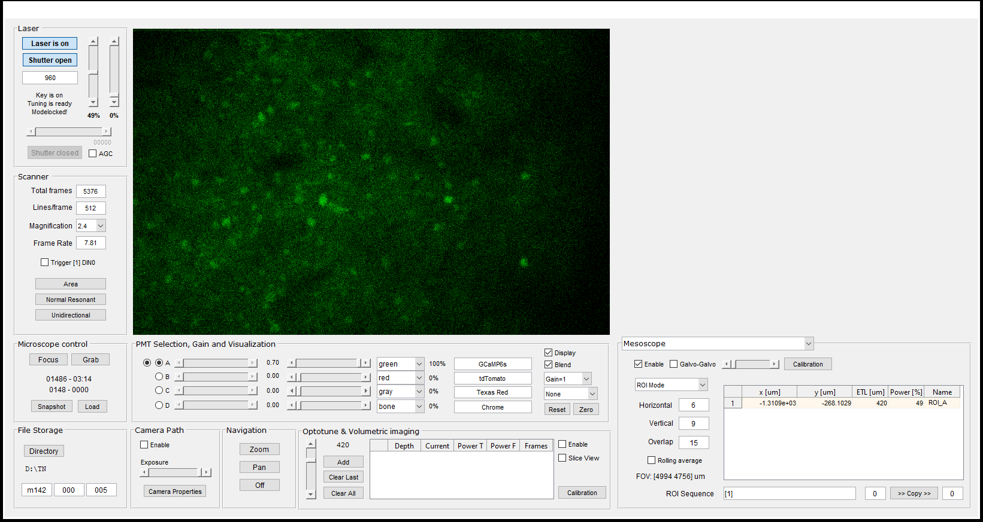
Defining ROIs in mesoscope window
Click “Add ROI”
Position ROI
Double-clicking ROI adds it to Mesoscope panel

Slide 6
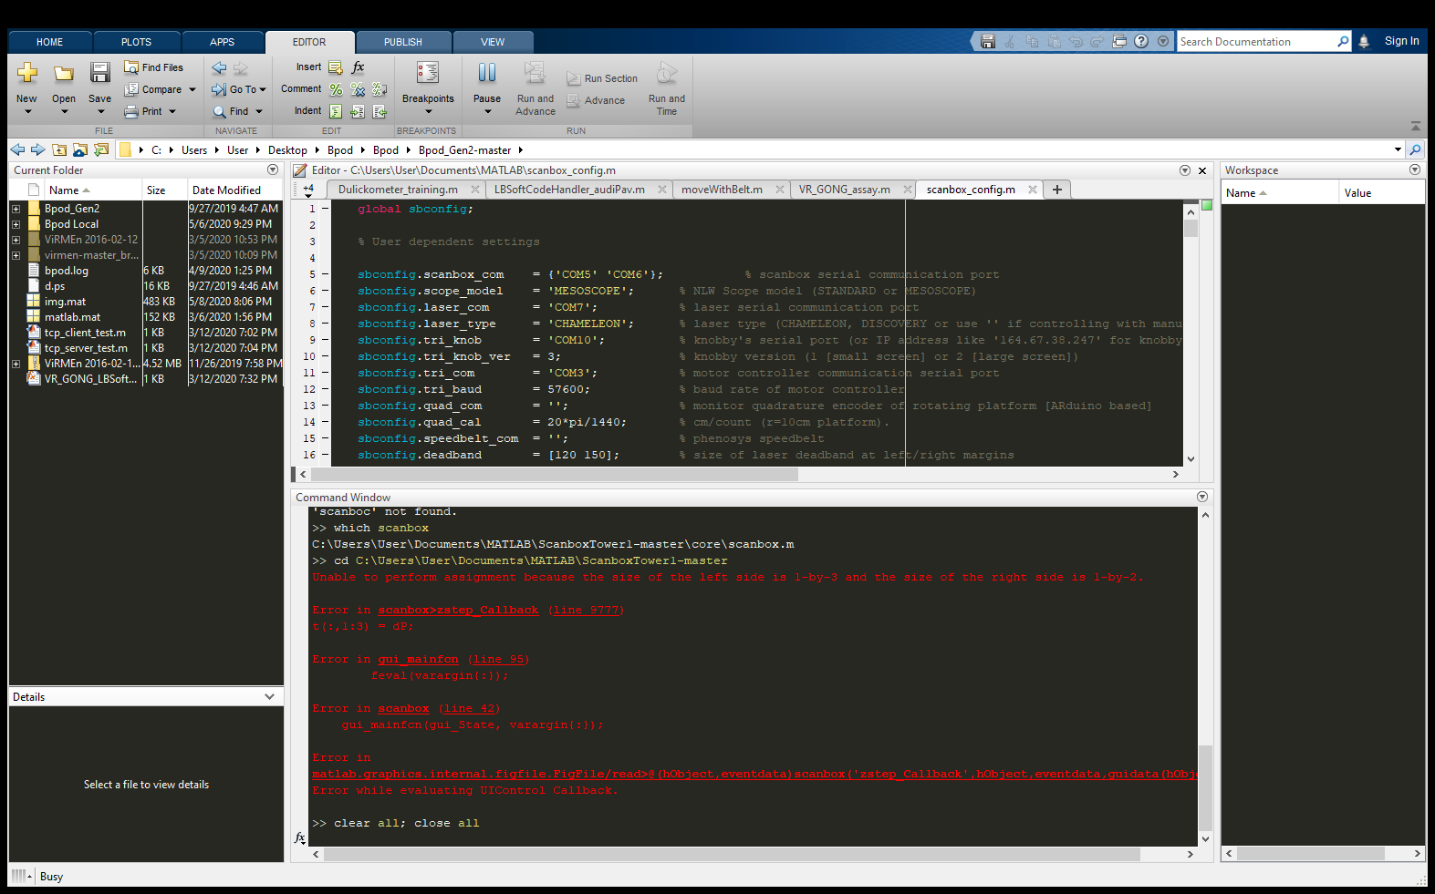
Error after manual z move and pressing focus: (mesoscope panorama enabled)

Slide 7
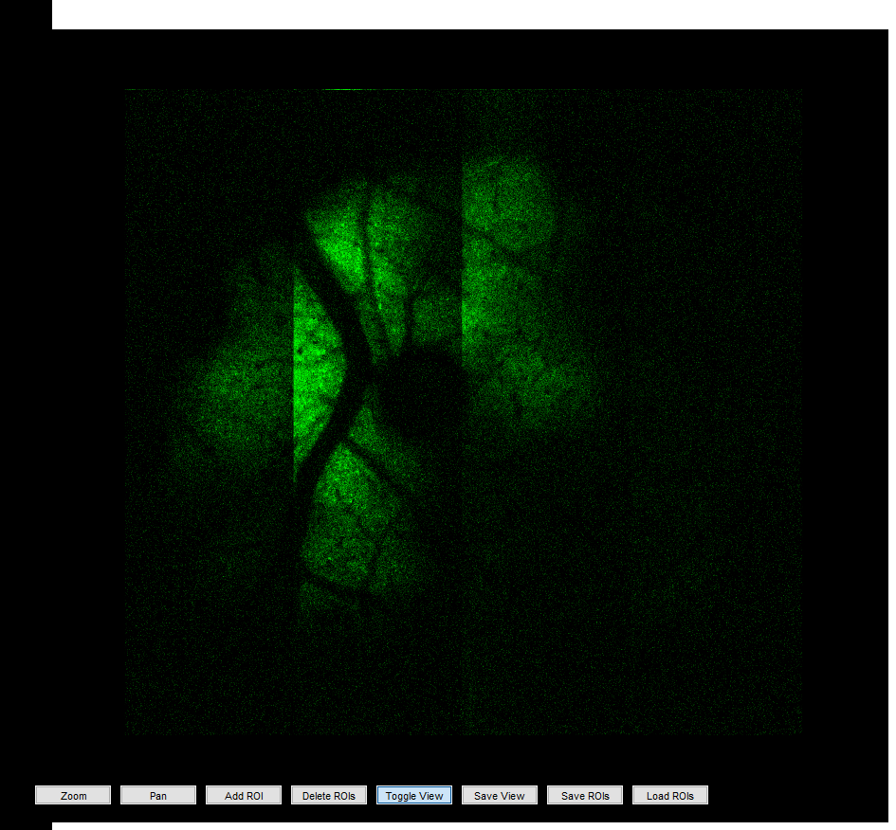
Problem: stripe brightness mismatches in mesoscope panorama mode
Yang advises:
Observe beam at entrance port iris with IR viewer and center if necessary
Alternatively, walk beam during acquisition until brightness flatness improves

Slide 8

Tobias’s notes 2020-06-24
M142 004: movie, 550 um, 7.81 fps, 3 min, one ROI

