Slide 2
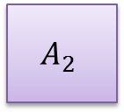
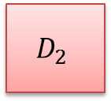
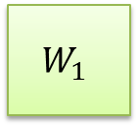
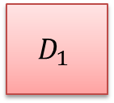
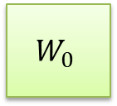
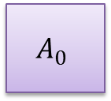

$$W_{0}$$
$$W_{1}$$
$$A_{0}$$
$$A_{1}$$
$$A_{2}$$
$$D_{1}$$
$$D_{2}$$
threadIdx.x
0
1
2
3
4
5
6
7
threadIdx.y
8
9
10
11
12
13
14
15

Slide 3
threadIdx.x
threadIdx.y
0
1
2
3
0
4
8
12
4
5
6
7
1
5
9
13
threadIdx.y
threadIdx.x
8
9
10
11
2
6
10
14
12
13
14
15
3
7
11
15

Slide 4
row major layout
column major layout

Slide 5





$$A$$
$$C=A⋅B$$
$$B$$
$$C=A^{T}⋅B$$
$$A^{T}$$

