Slide 2
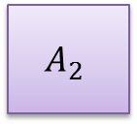
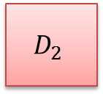
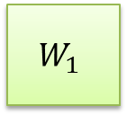
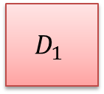
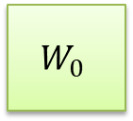
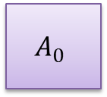

$$W_{0}$$
$$W_{1}$$
$$A_{0}$$
$$A_{1}$$
$$A_{2}$$
$$D_{1}$$
$$D_{2}$$
threadIdx.x
0
1
2
3
4
5
6
7
threadIdx.y
8
9
10
11
12
13
14
15

