Slide 1
Introduction

Slide 2
Describe Data

Slide 3
Describe Objectives

Slide 4
After much explaratory analysis, we’ve concluded that the top three attributes for discerning potential exmployee attrition are…
There were many paths traveled that led us to this conclusion. These are the paths we took…

Slide 5
Path Title (* Figure a bunch of these type of slides to pass time and highlight insights)
Notion/Idea behind test or plot analysis
GRAPH/T-TEST proving/disproving point
Insight from test/plot

Slide 6
Conclusion
From graphs, reiterate the variables we’ve chosen and the trends we find most interesting.

Slide 7
Imported data
library(openxlsx)
attritionData <- read.xlsx("CaseStudy2-data.xlsx")

Slide 8
Inspected Data
names(attritionData)
[1] "Age" "Attrition" "BusinessTravel" "DailyRate" "Department"
[6] "DistanceFromHome" "Education" "EducationField" "EmployeeCount" "EmployeeNumber"
[11] "EnvironmentSatisfaction" "Gender" "HourlyRate" "JobInvolvement" "JobLevel"
[16] "JobRole" "JobSatisfaction" "MaritalStatus" "MonthlyIncome" "MonthlyRate"
[21] "NumCompaniesWorked" "Over18" "OverTime" "PercentSalaryHike" "PerformanceRating"
[26] "RelationshipSatisfaction" "StandardHours" "StockOptionLevel" "TotalWorkingYears" "TrainingTimesLastYear"
[31] "WorkLifeBalance" "YearsAtCompany" "YearsInCurrentRole" "YearsSinceLastPromotion" "YearsWithCurrManager"
Potential Trends related to attrition:
Age related to Attrition
People retire, midlife crisis?
WorklifeBalance
People retire, midlife crisis?
JobInvolvment/JobSatisfaction
Are people bored? Are they engaged? Too much work?
Years at company
Do the longer people work at company deter them more from leaving?
Job Role
What jobs have the most people leaving?
Monthly Income
Is there an average wage that causes people to leave?
Gender
Which gender is leaving more?

Slide 9
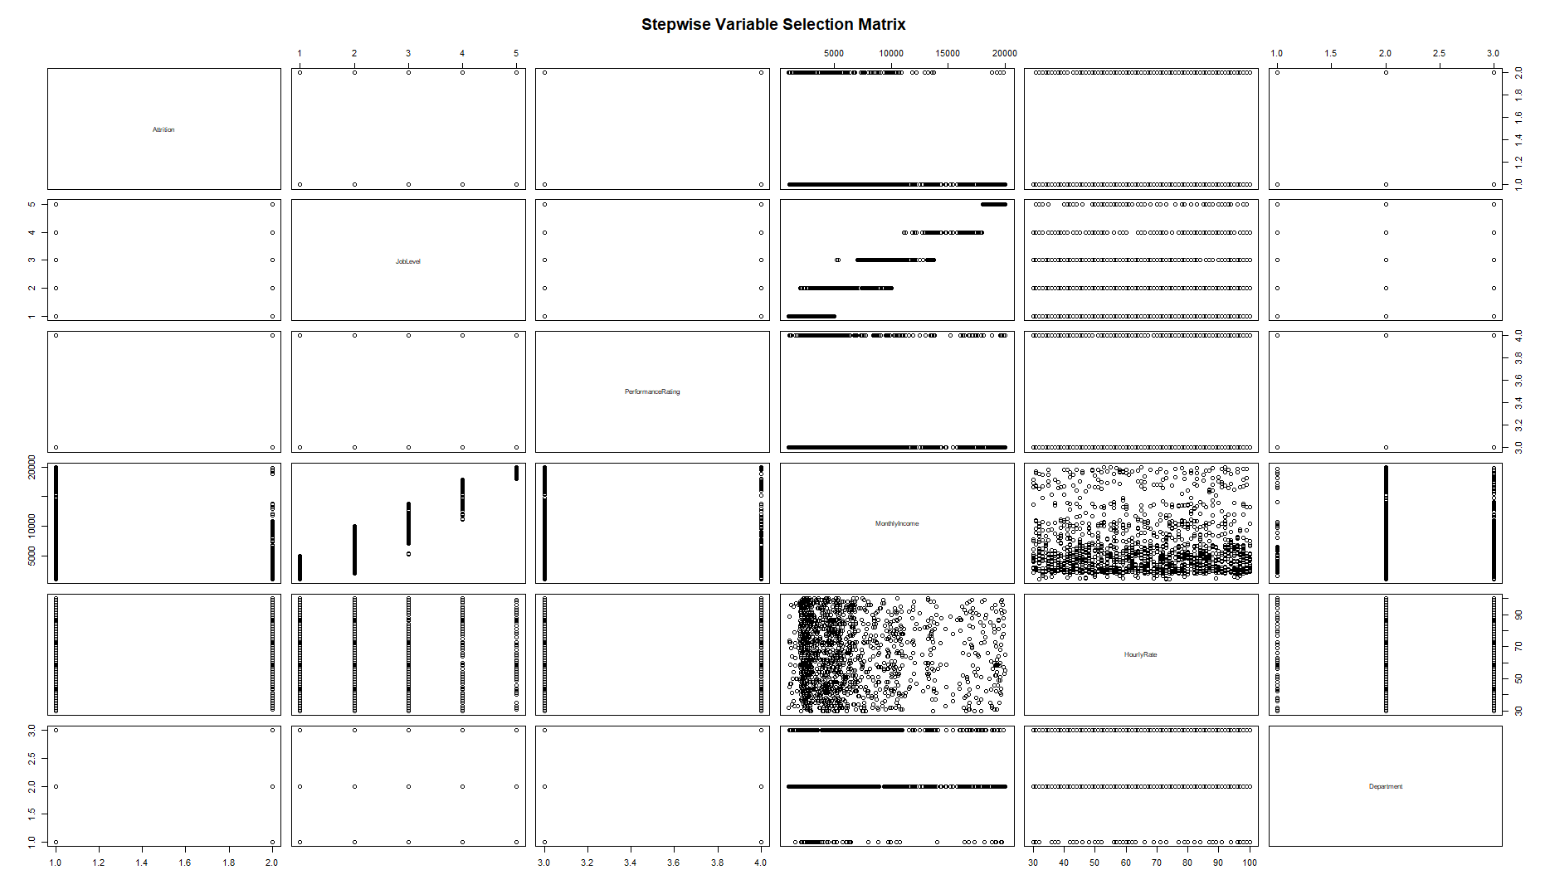

Slide 10
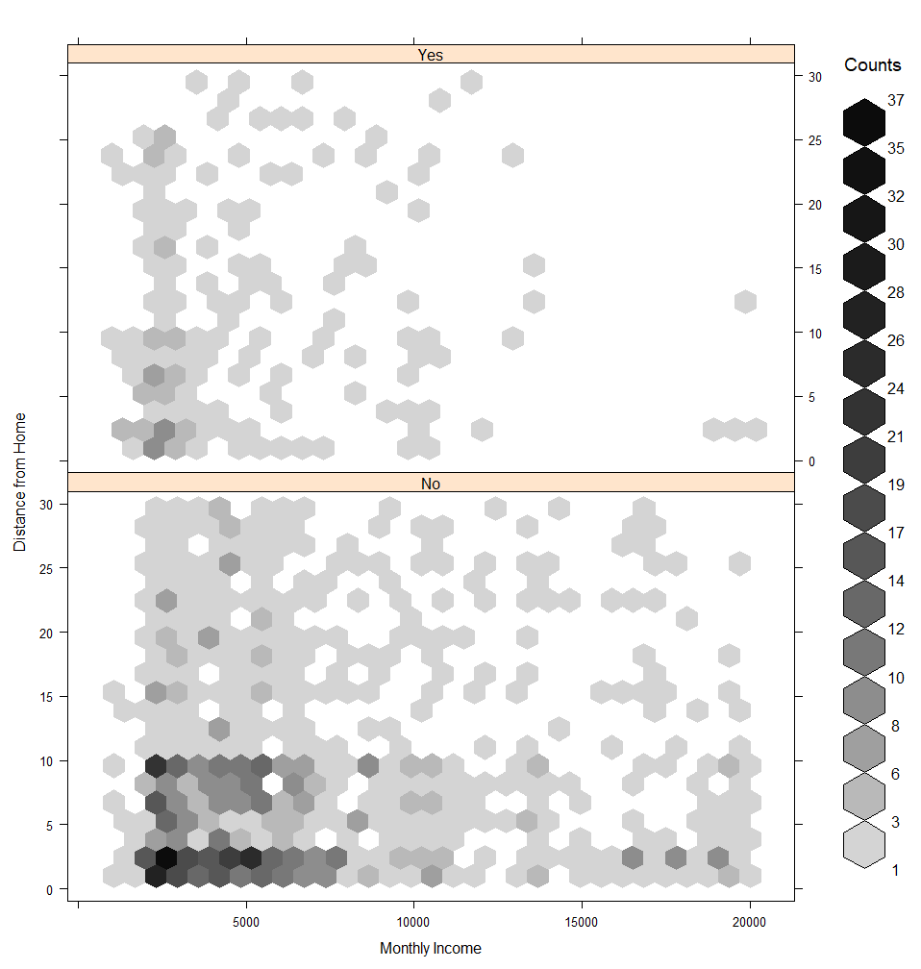
I suspect these are

Slide 11
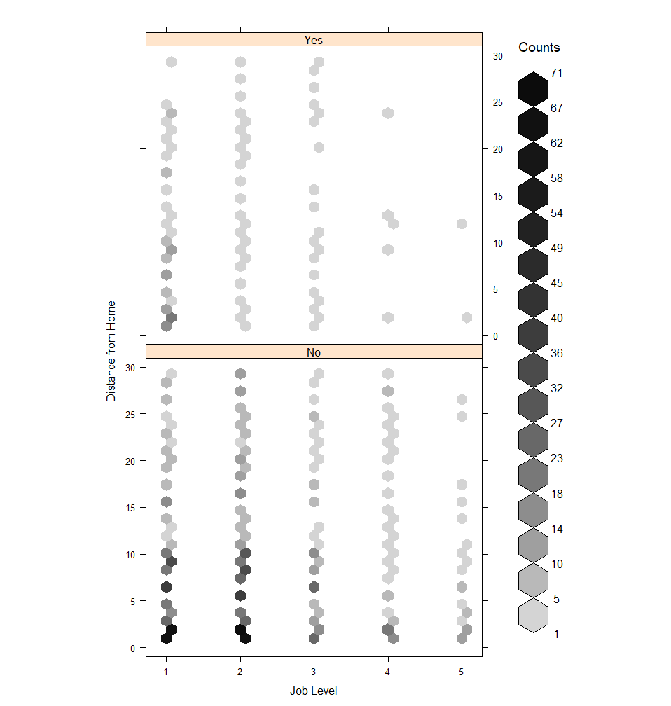

Slide 12
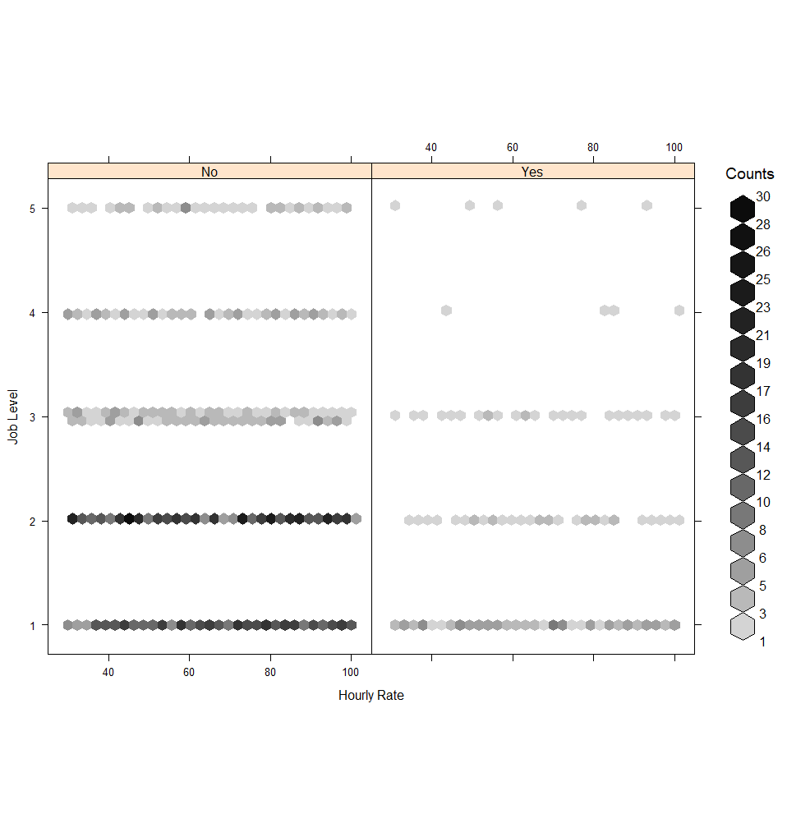

Slide 13
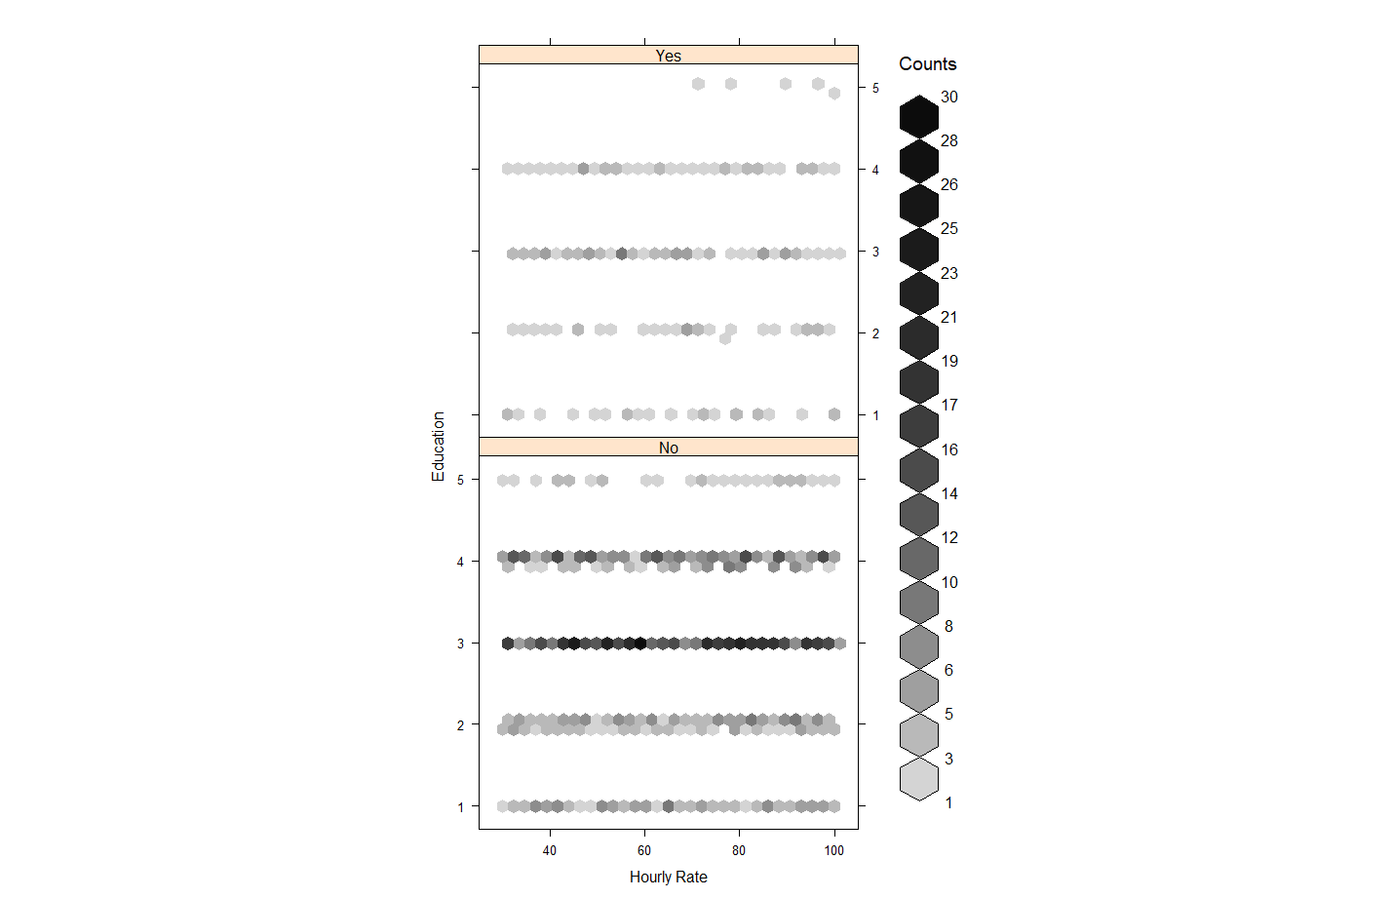

Slide 14
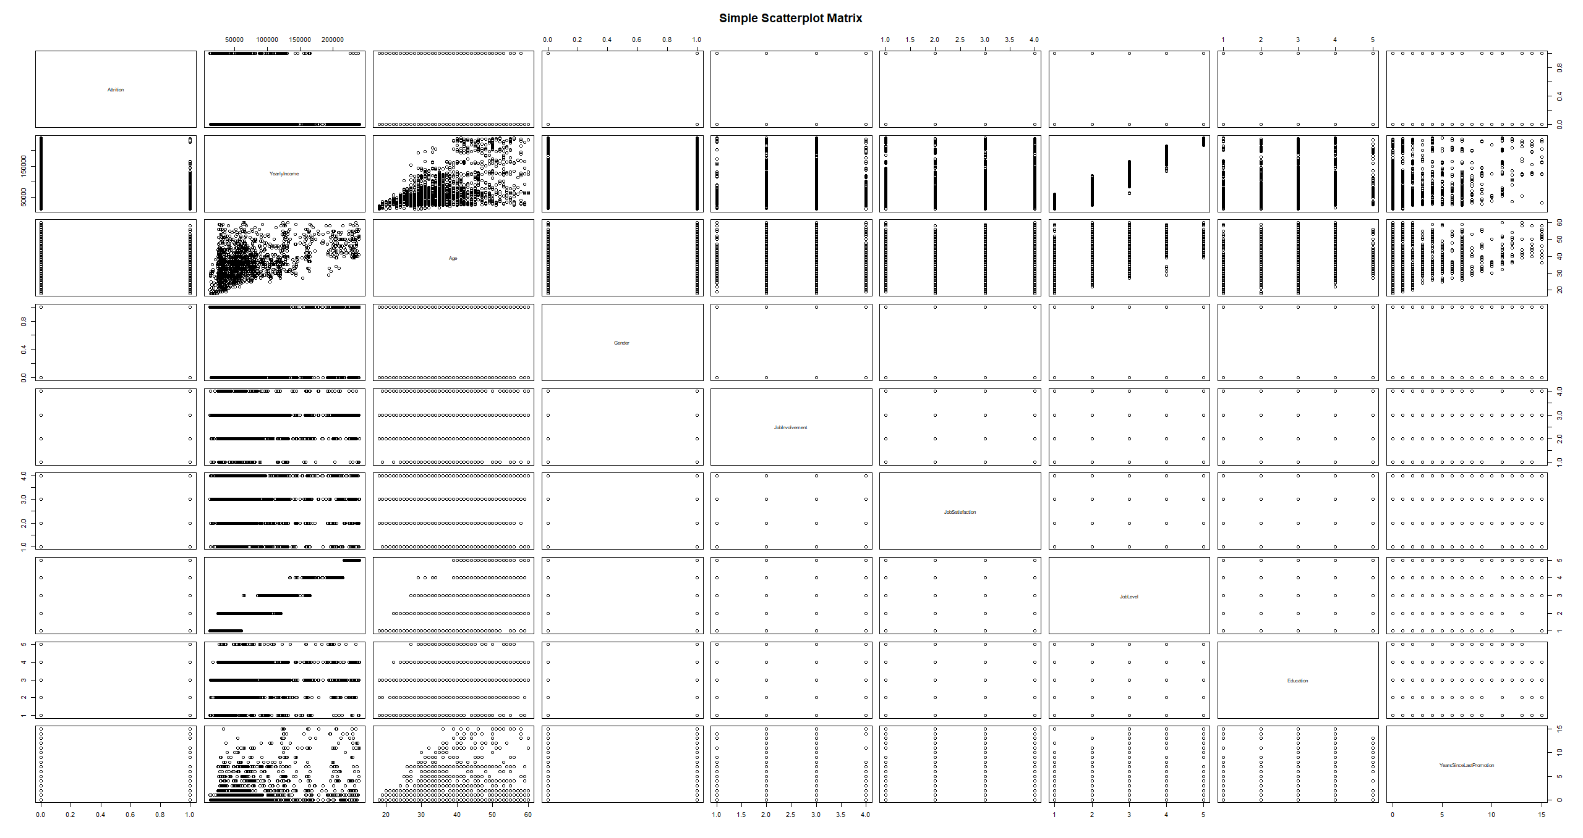

Slide 15
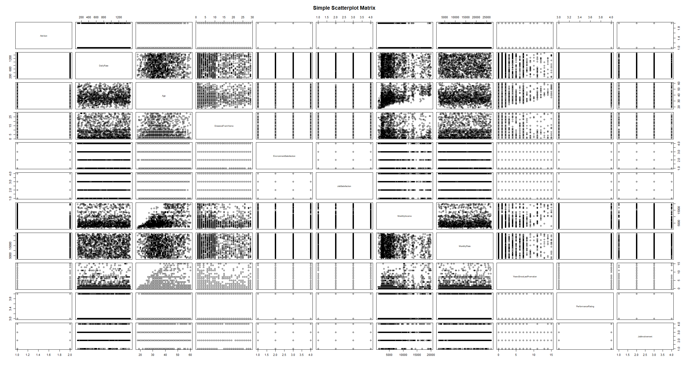

Slide 16
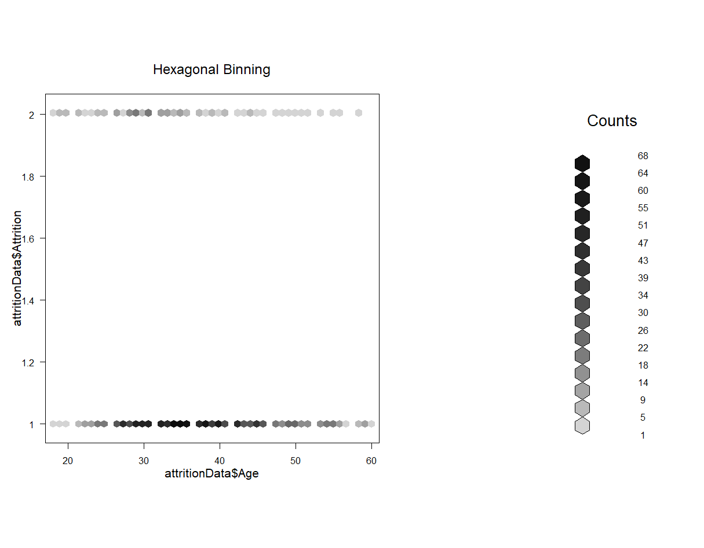

Slide 17
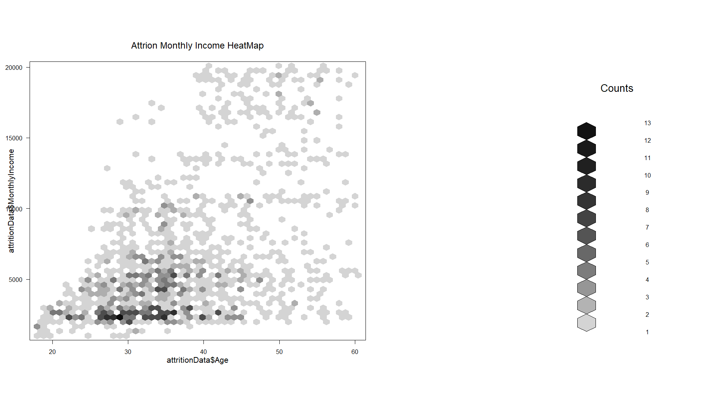

Slide 18
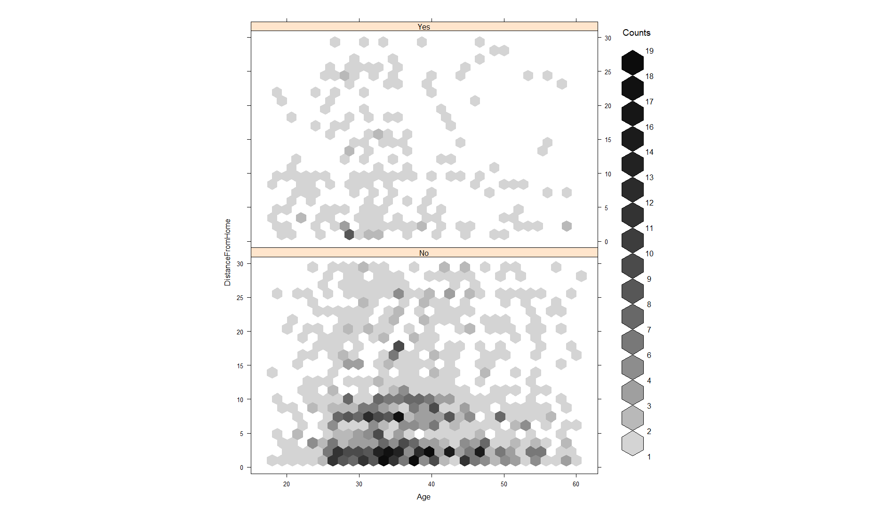
Interesting, what age is this?

Slide 19
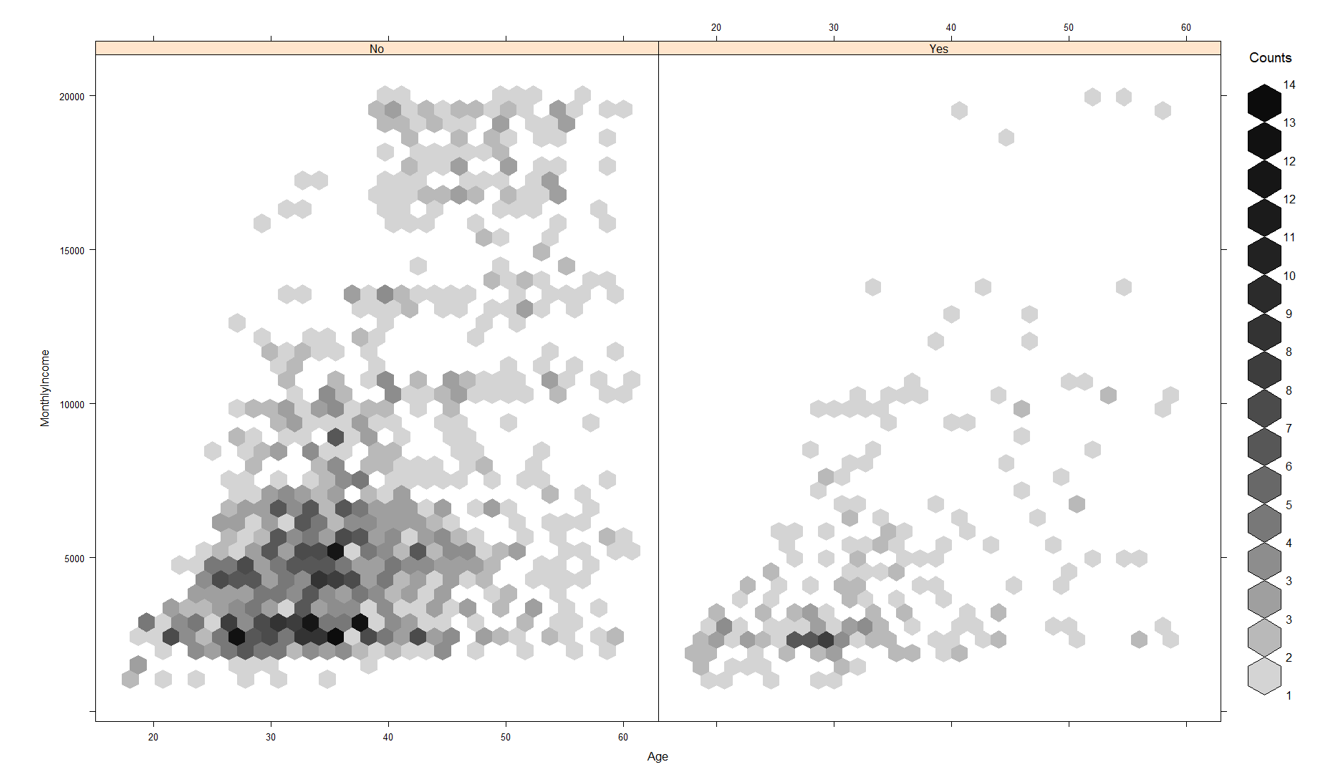

Slide 20
