Slide 1


Job Attrition Study
Team “Greco-Roman”
Brady Arendale
John Partee
Steven Vazquez

Slide 2
Study Overview
Why does an employee quit a job?
Do they hate their boss?
Is the work unfulfilling?
We can answer this, with DATA!

Slide 3
Data Analyzed
DDSAnalytics provided 1470 surveys replies, to help predict job attrition.
30+ variables were provided, some including:
Age
Marital Status
Education Level
Hours Worked
Job level/Role
Compensation
Education Field/level
Gender

Slide 4
What do we want to know?
Who has the highest job attrition rates? What contributes to this?
Who can we hire that is less likely to quit?
How can we retain employees?
How can we use this data to deliver value?

Slide 5
Background Information
Hiring a new employee can be expensive – as much as 40% of an employee’s salary for entry-level
The national average attrition rate is estimated to be 15-19%
The attrition rate in our data set was 16.1%
Lowering our clients’ attrition rate can save them money and create a more positive work environment
Source: https://business.dailypay.com/blog/employee-retention-rate

Slide 6
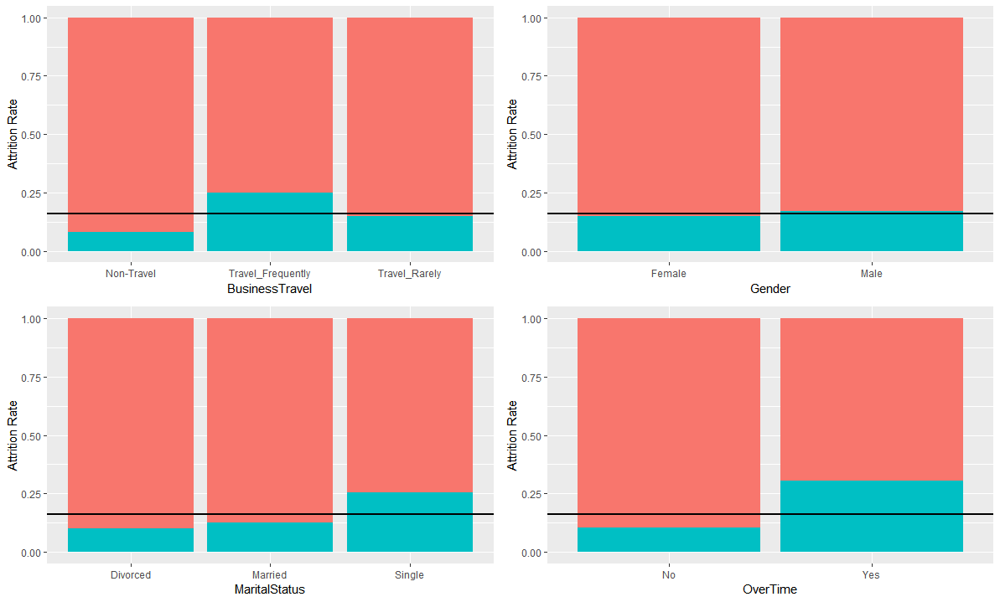

Selected factors vs. attrition

Slide 7
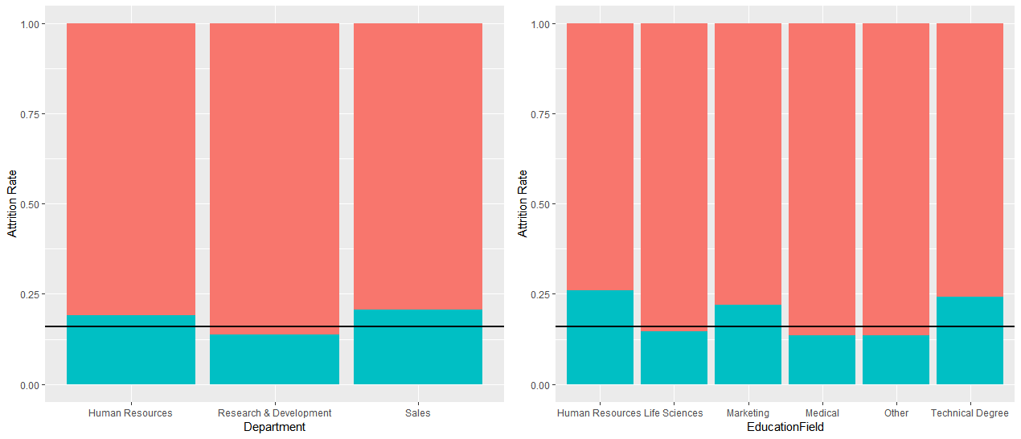
Selected factors vs. attrition

Slide 8
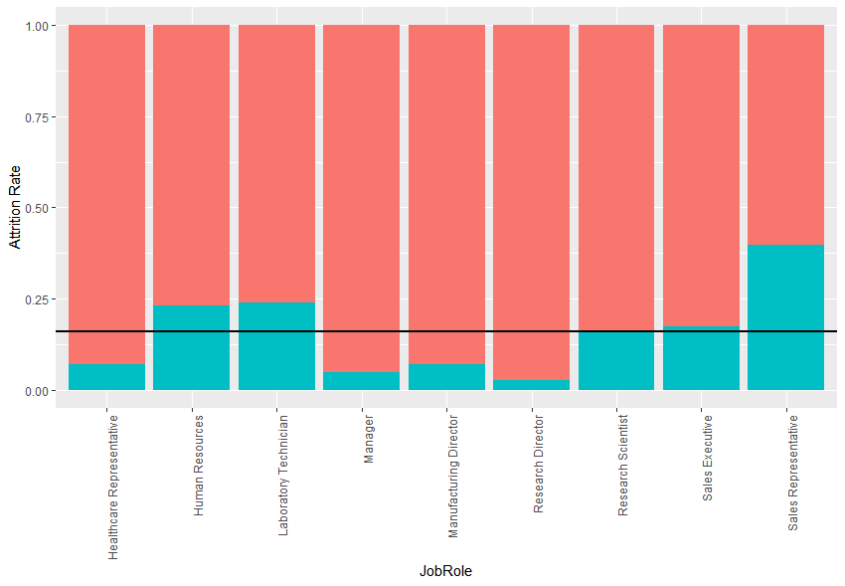
What job roles have high turnover?
High turnover: Laboratory technician, sales representative
Low turnover: Healthcare representative, manager, manufacturing director, research director
Attrition for human resources was not found to be statistically significantly higher than average (may need to collect more data)

Slide 9
What are the top factors contributing to attrition?
Using a forward selection logistic regression model, the top three factors we found to be associated with attrition are:
1) Overtime – Employees who work overtime have a 30.5% attrition rate, compared to 10.4% for those without overtime
2) Job role – as mentioned in the previous slide
3) Marital status – single people are more likely to leave, with a 25.5% attrition rate, compared to 10% for divorced and 12.5% for married

Slide 10
Controlling for discrimination
We can’t discriminate on the basis of age, gender, or marital status, so we ran another model controlling for those variables. The top three factors in this model were:
1) Overtime
2) Job role
3) Environment satisfaction – workers who reported low environment satisfaction had a 25.4% attrition rate, compared to 13-15% for medium to very high

Slide 11
What factors are driving attrition in high turnover roles?
We are interested specifically in controlling attrition rates for our high attrition job roles: sales representatives and laboratory technicians.
Sales representatives had the highest attrition rate, at 39.8%.
Laboratory technicians had an attrition rate of 23.9%.
We again used forward selection logistic regression models to determine the leading factors associated with attrition.

Slide 12
What leads to high turnover for sales representatives?
1) Travel frequency – sales reps who travelled frequently left the company at a 65% rate. No non-travel sales reps have left the company, although we only have a sample size of 5.
2) Overtime – 66.7% attrition rate for sales reps who work overtime, 28.8% for those who do not
3) Years in current role – lower attrition for those who have worked longer
4) Job satisfaction – workers who reported low job satisfaction had a 58.3% attrition rate, 47.6% for medium

Slide 13
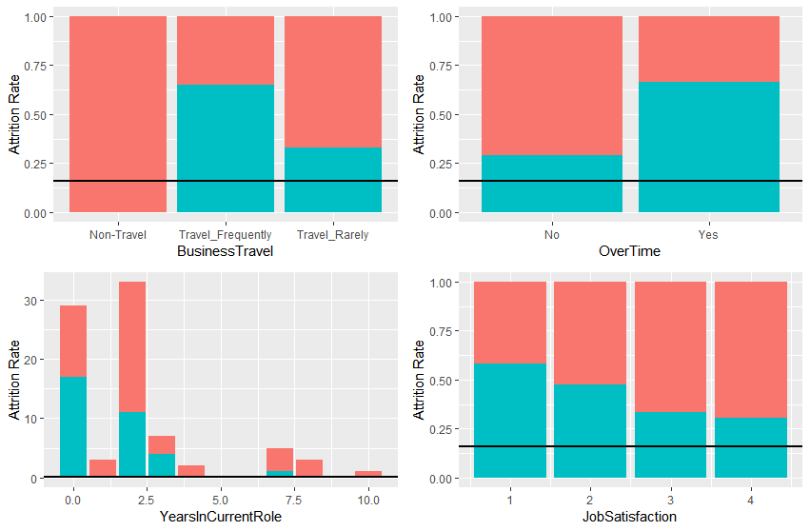
What leads to high turnover for sales representatives?

Slide 14
What leads to high turnover for laboratory technicians?
1) Overtime – lab techs who work overtime have an attrition rate of 50%, compared to 15.7% for no overtime
2) Years at company - lower attrition for those who have worked longer
3) Stock option level – 30.4% attrition rate for the lowest stock option level, compared to 10% for the highest
4) Environment satisfaction – 41.5% attrition rate for lab techs who reported low environment satisfaction

Slide 15
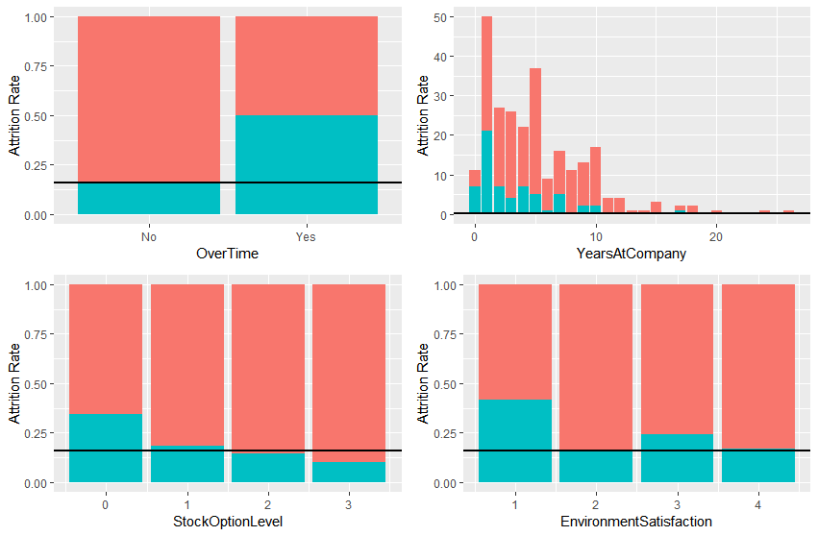
What leads to high turnover for laboratory technicians?

Slide 16
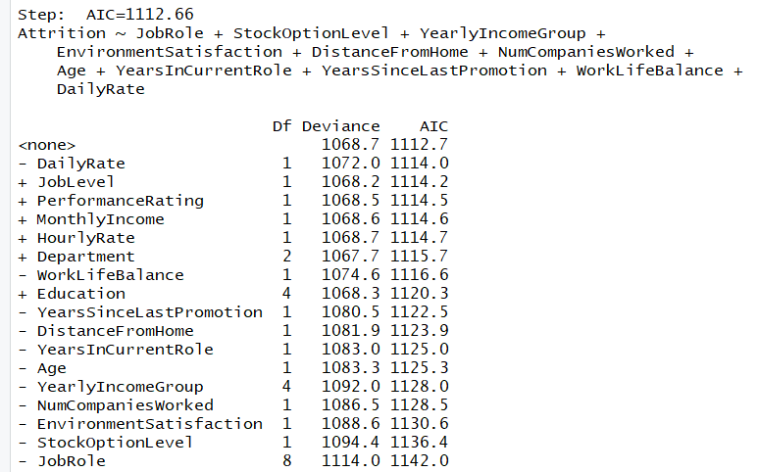
Can a stepwise selection method help us find top attributes?
From stepwise selection method we produce the below model:
Attrition = JobRole + StockOptionLevel + YearlyIncomeGroup + EnvironmentSatisfaction + DistanceFromHome + NumCompaniesWorked + Age + YearsInCurrentRole + YersSinceLastPromotion + WorkLifeBalance + DailyRate
Top 3 attritbutes:
1. Job Role
2. Stock Option Level
3. Environment Satisfaction

Slide 17

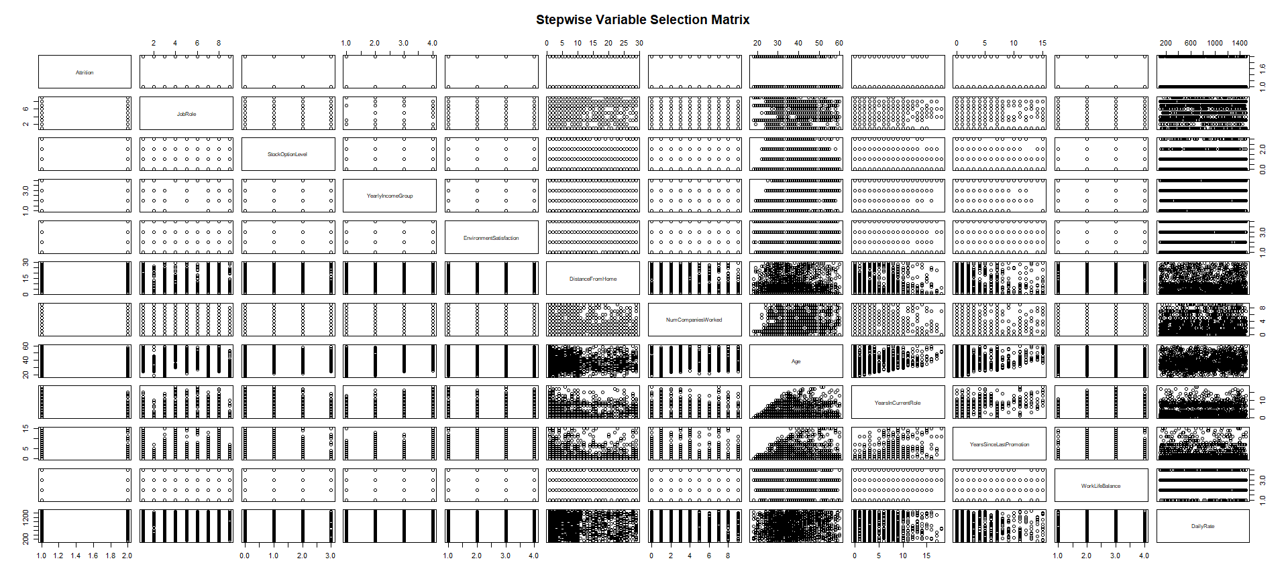



Slide 18
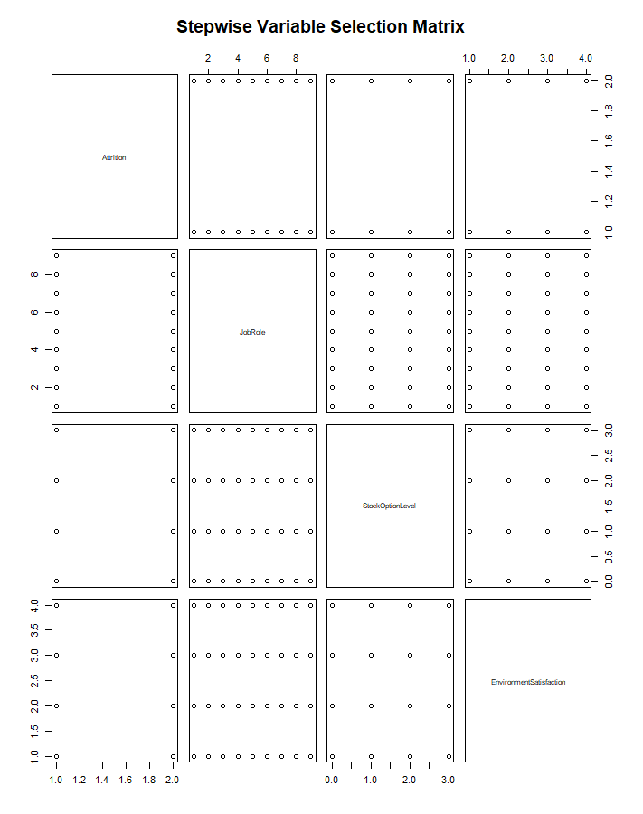
Normality and independence met!

Slide 19
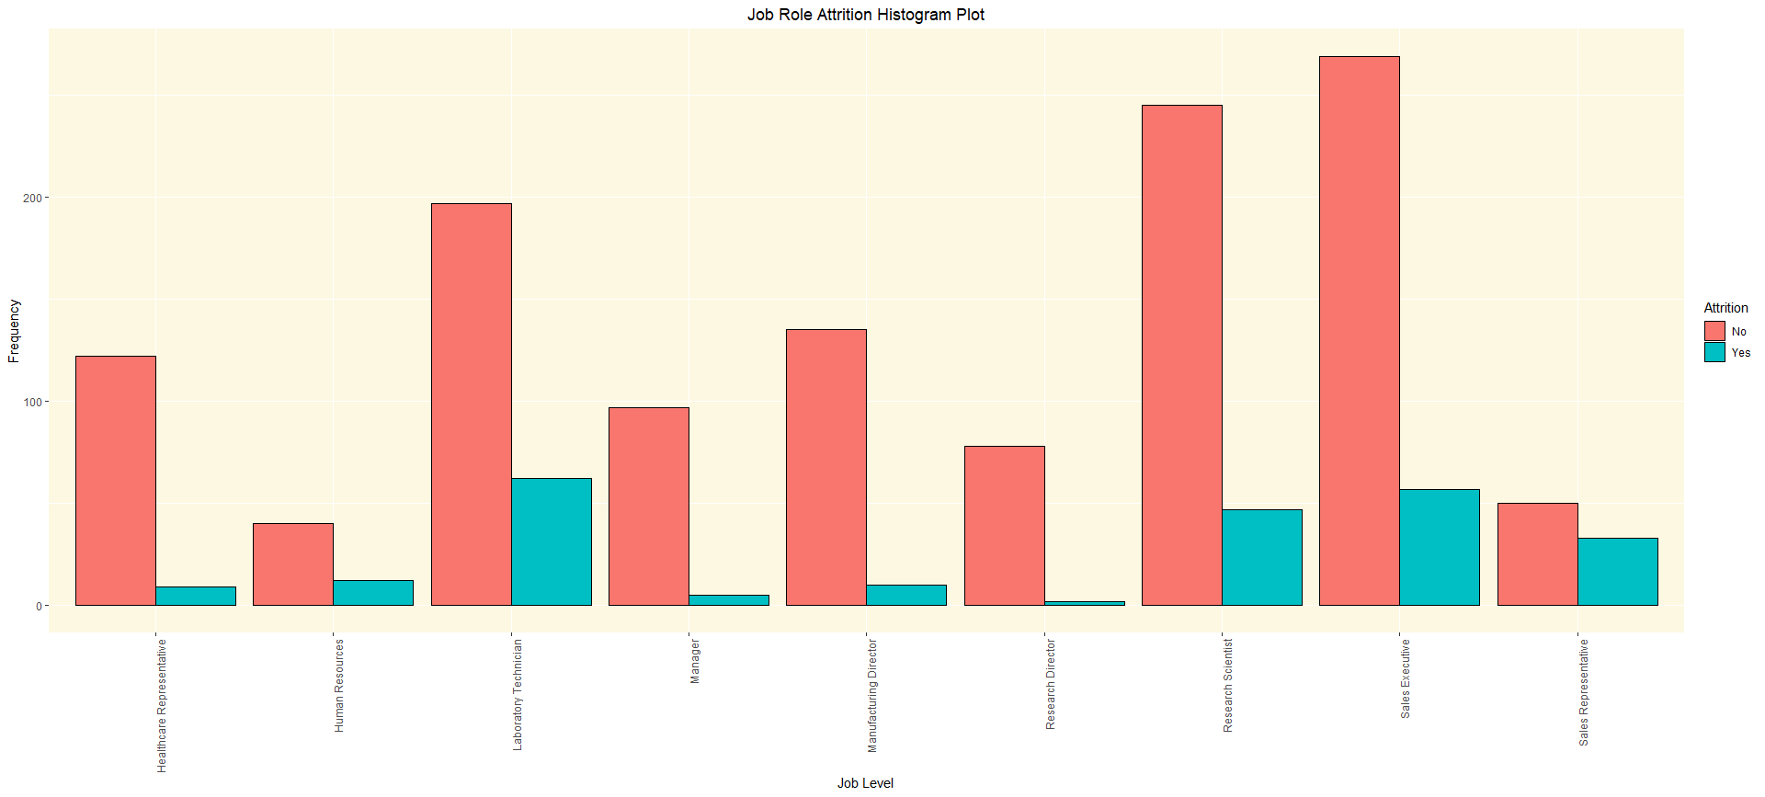
What does Job Role show us?
70% of ALL attrition
Job Role with Highest Attrition Rate
Job Role with Lowest Attrition Rate
23.9%
17.5%
16.1%
39.8%
6.9%
23.1%
4.9%
6.9%
2.5%
Job Role

Slide 20
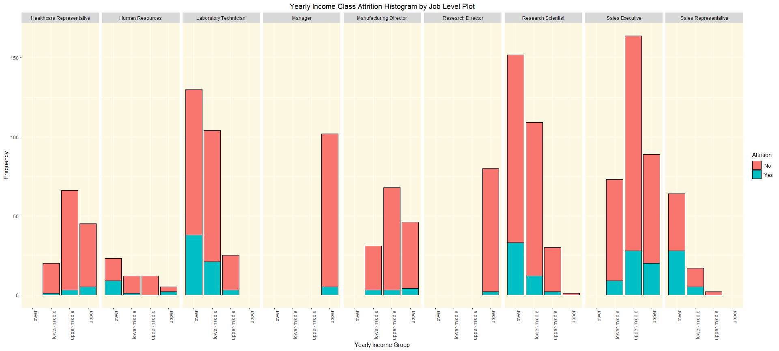
What does Income Group by Job Role show us?
Yearly Income Class Attrition Histogram by Job Role Plot
Income Class Turnover %
Lower: 29.3%
Lower-Middle: 14.2%
Upper-Middle: 10.6%
Upper: 10.3%
Manager’s and Research Directors only in upper class
11.1%
43.8%
4.5%
29.4%
5%

Slide 21
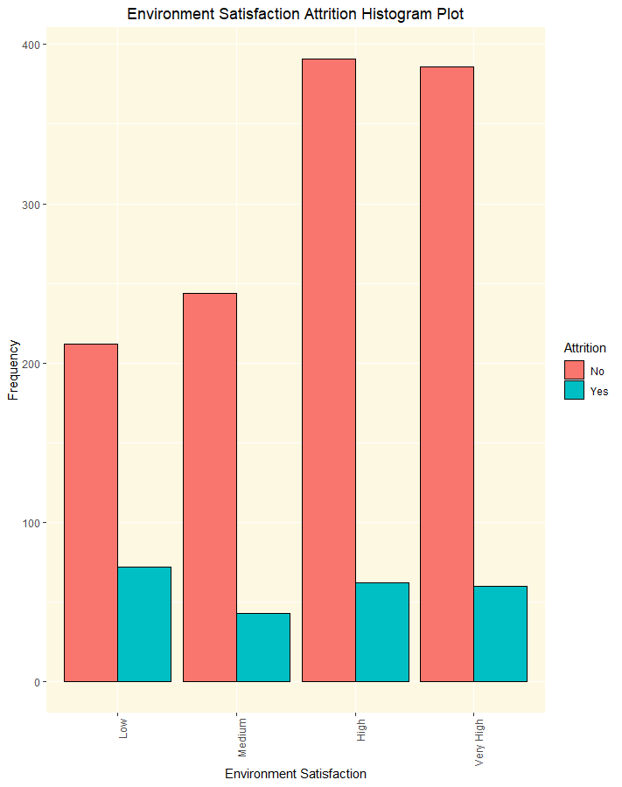

What does Environment Satisfaction show us?
~ 1 in 4 people leave when environment Satisfaction is low
25.4%
13.7%
13.5%
15.0%

Slide 22
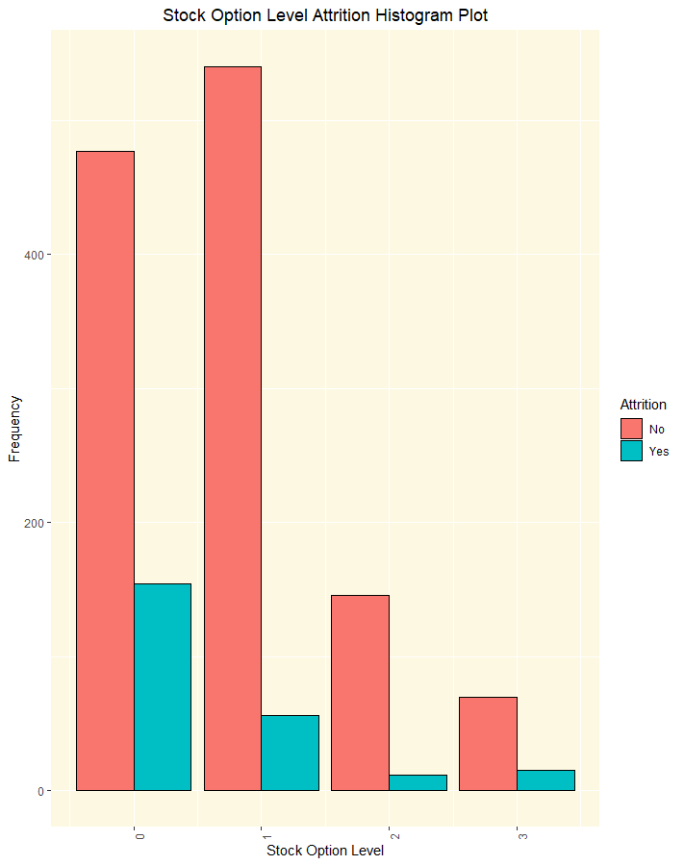

What does Stock Option Level show us?
More likely to leave if Stock Option is at ends.
24.4%
9.4%
7.6%
17.6%

Slide 23
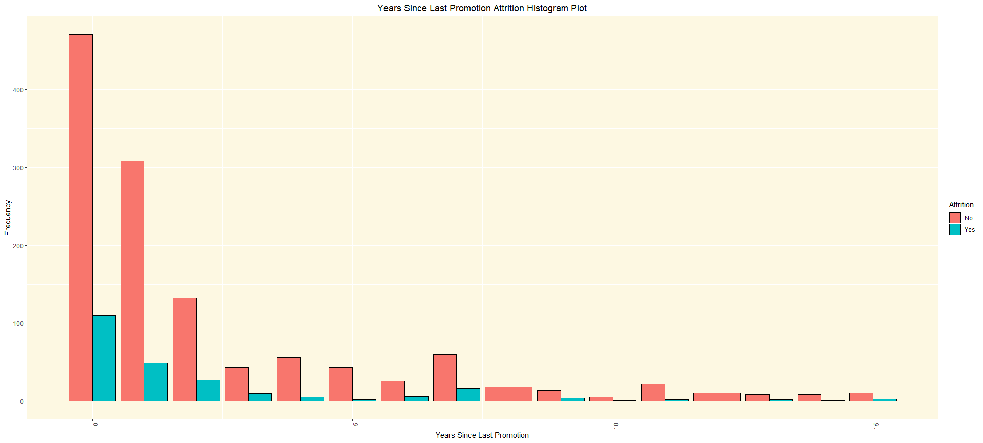

What does Years Since Last Promotion show us?
What’s happening between 4-5 years causing people to stay?
18.9%
13.7%
17.0%
21.1%
17.3%
8.2%
4.4%
18.8%
23.5%
20%
8.3%
25%
11.1%
23.1%

Slide 24
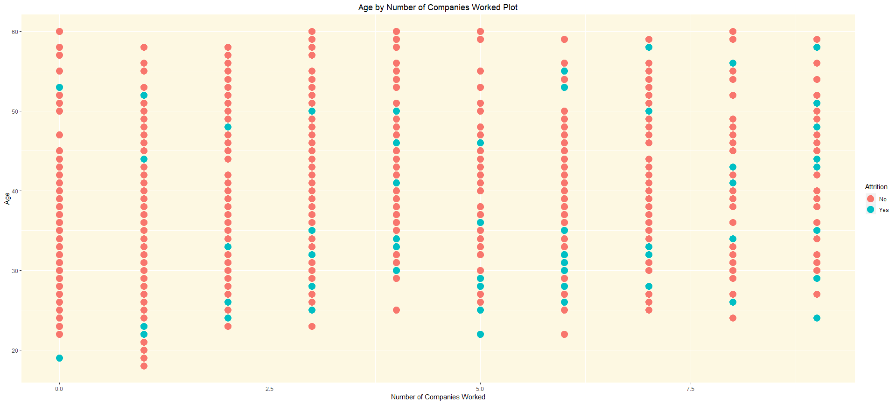
What does age related to the number of companies show us?
Most attrition cases as expected.

Slide 25
What does Income Group by Job Role show us?
Yearly Income Class Attrition Histogram by Job Role Plot
Income Class Turnover %
Lower: 29.3%
Lower-Middle: 14.2%
Upper-Middle: 10.6%
Upper: 10.3%
Manager’s and Research Directors only in upper class
11.1%
43.8%
4.5%
29.4%
5%

Slide 26
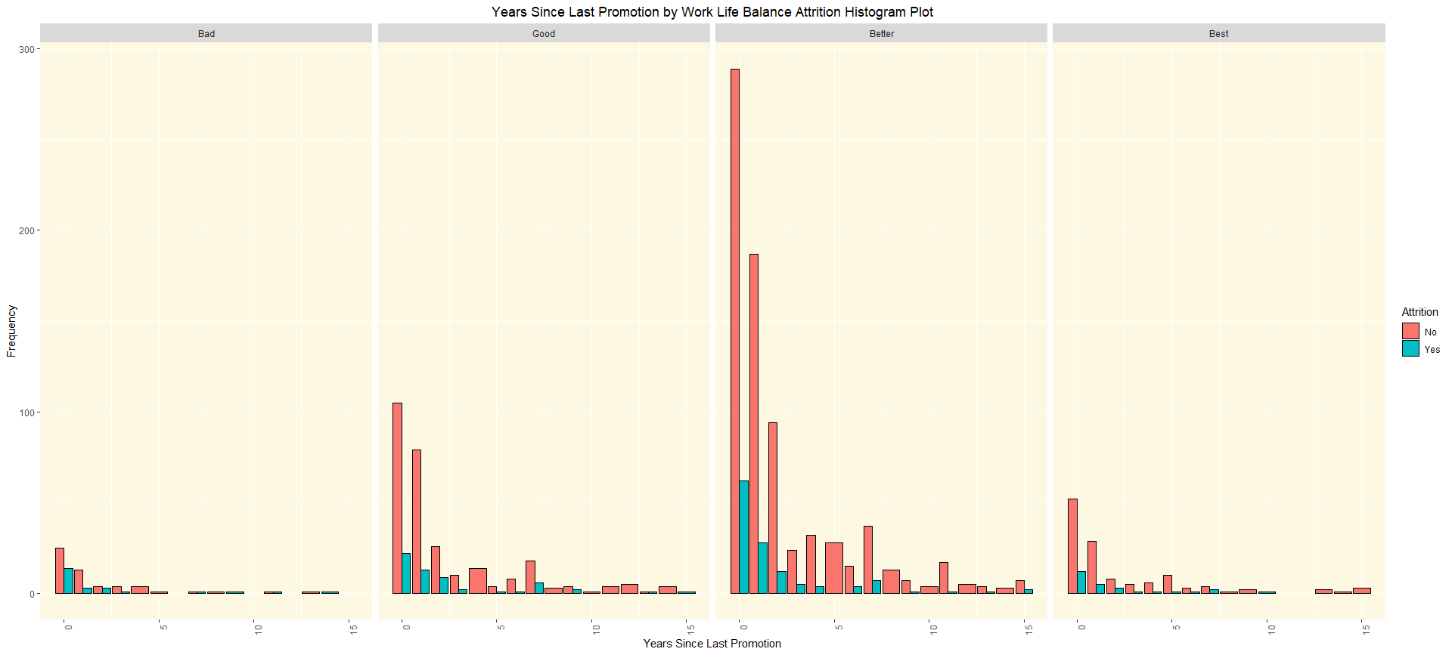

What does income Years Since Last Promotion by Work Life Balance show us?
“Bad” – (31.3% Turnover)
“Good” – (16.9% Turnover)
“Better”-(14.2% Turnover)
“Best” – (17.6% Turnover)

Slide 27
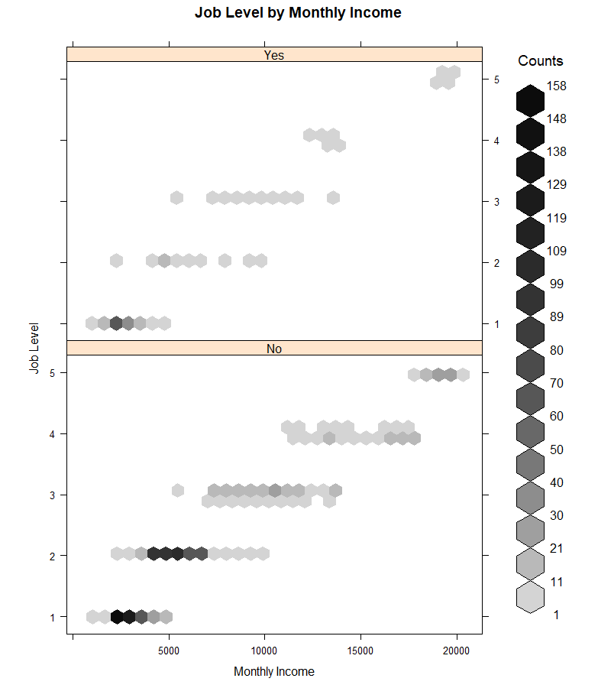
Job Level by Monthly Income Heat Map
Most turnover from level 1s with similar income.

Slide 28
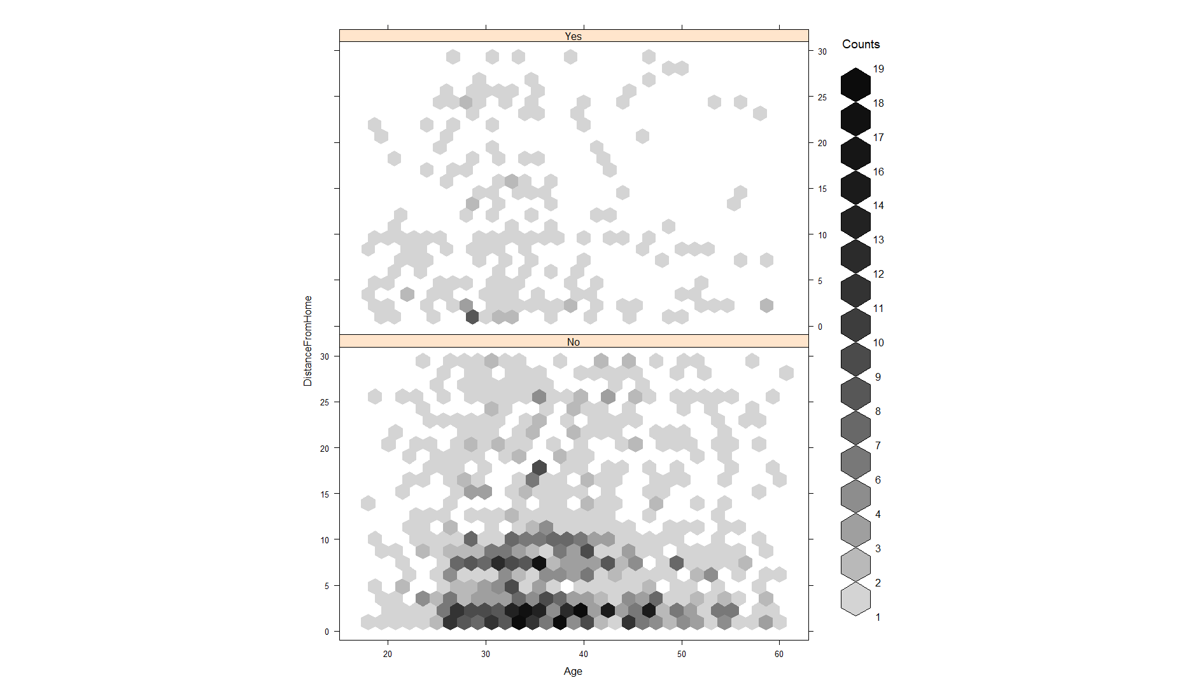
Age by Distance From Home Heat Map
Makes you think what jobs are within 1 mile that people~30 are leaving?

Slide 29
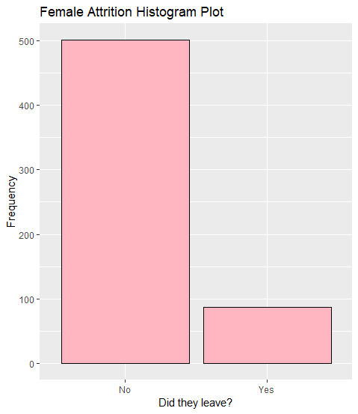
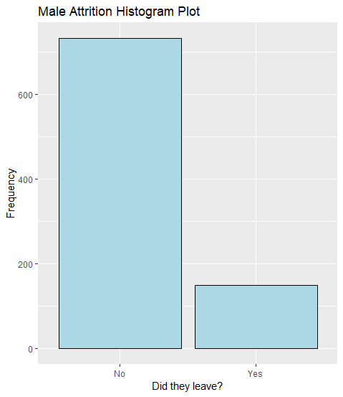
Quick look at Male vs. Female
Highest Attrition Rates – Man or Woman?
* ~ 15% women leaving the company.
* ~ 17% men leaving the company.

Slide 30
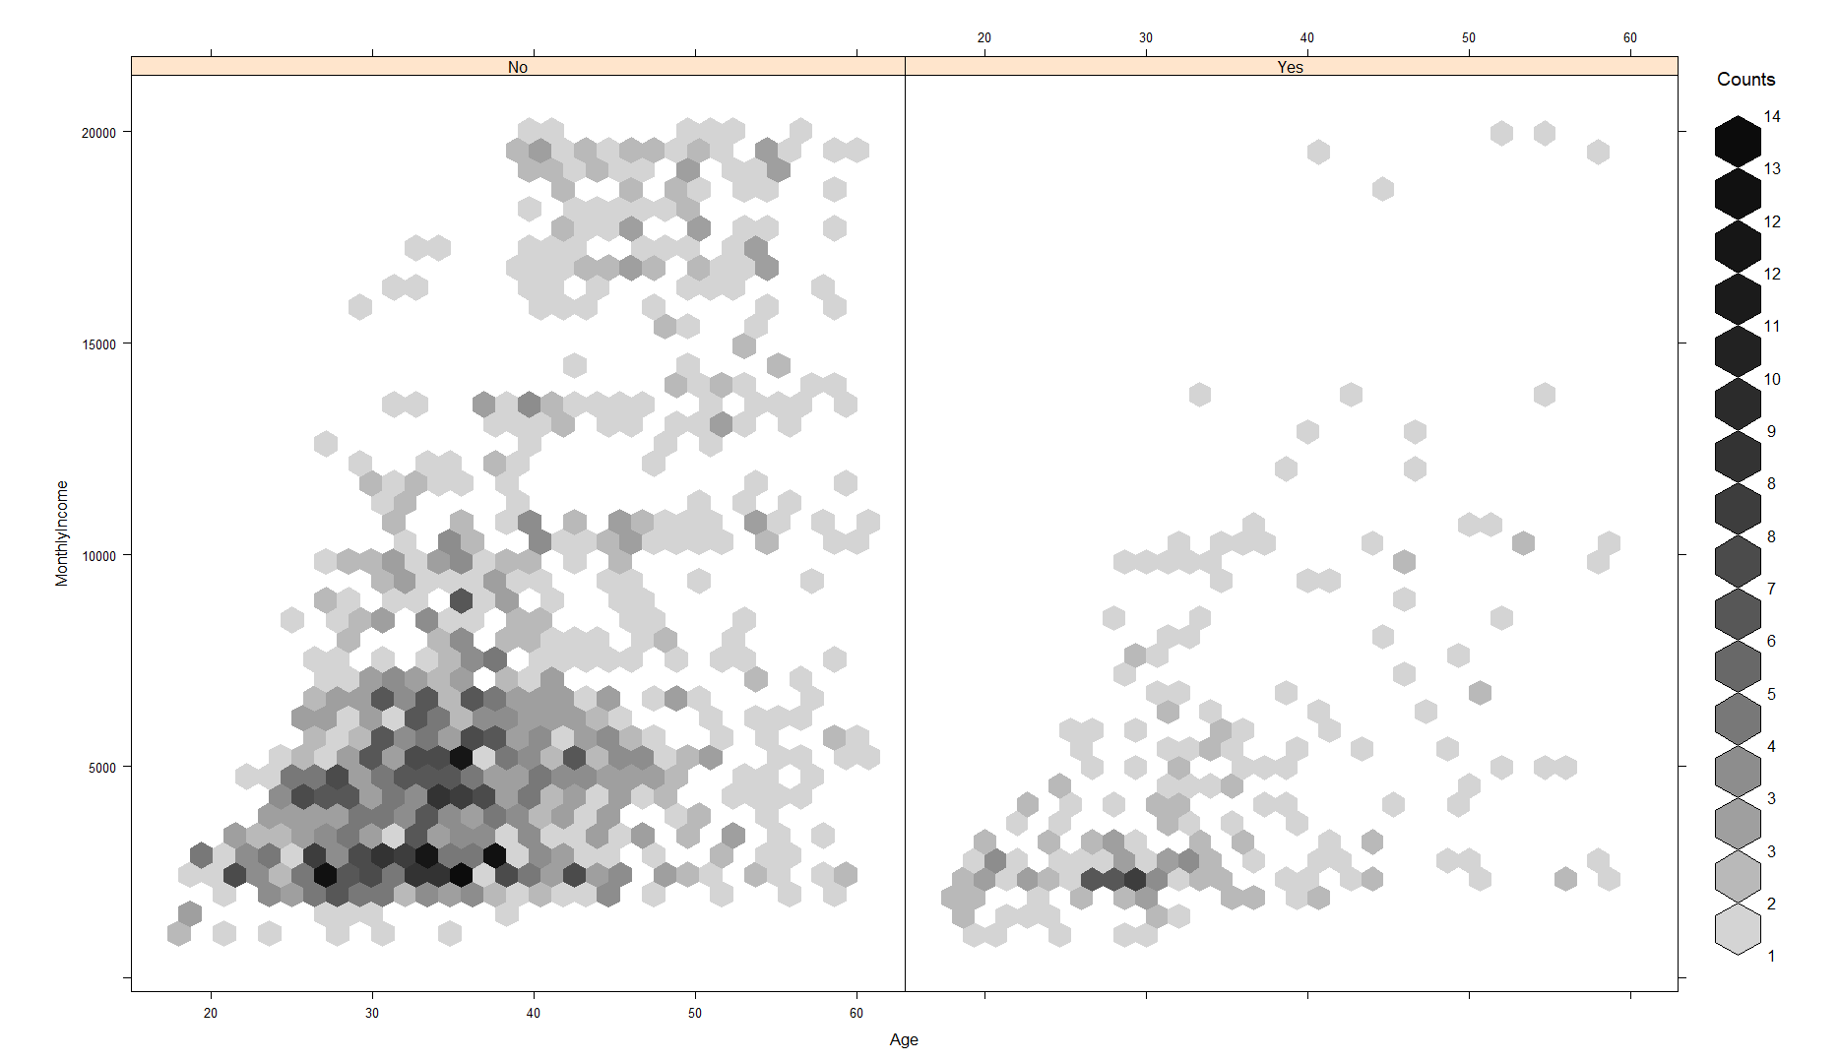
Monthly Income by Age Heat Map
Most people leave ~30 years old making ~2,500/month

Slide 31
Finally- A machine learning approach
The output- Attrition is a great “label” for machine learning
For a more useful measure, probabilities of the labels are output
This model found similar results to the above, with a few changes.
The end (legal) model can predict attrition with ~82% accuracy

Slide 32
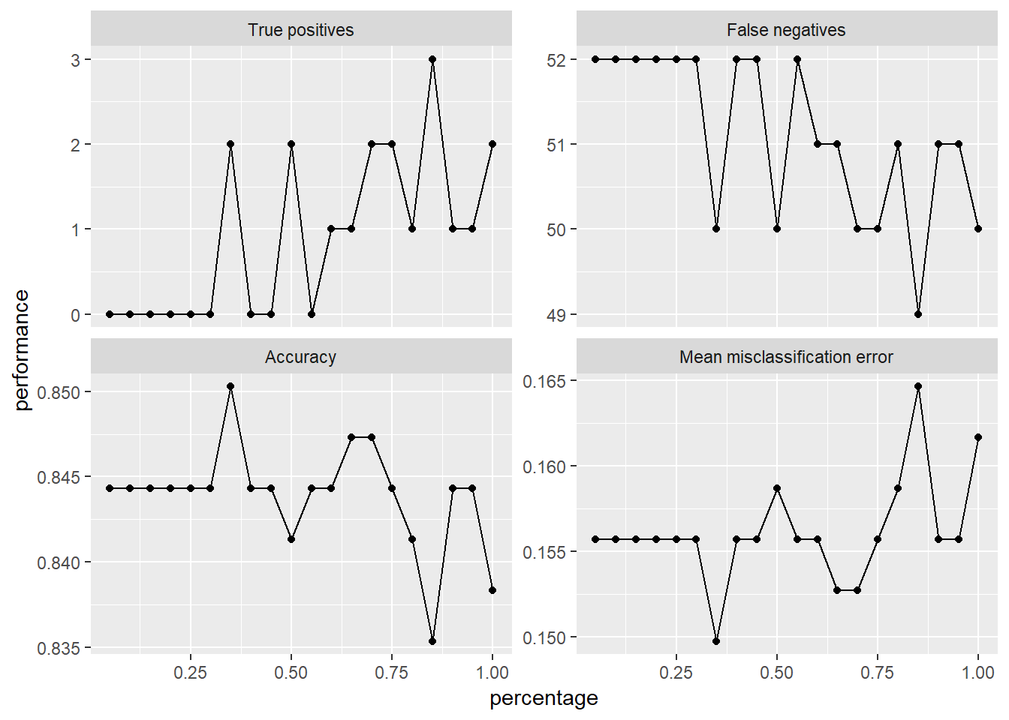
Initial Model
Accuracy hovered around ~84.5%
All factors are considered up front
No significant “learning curve”

Slide 33
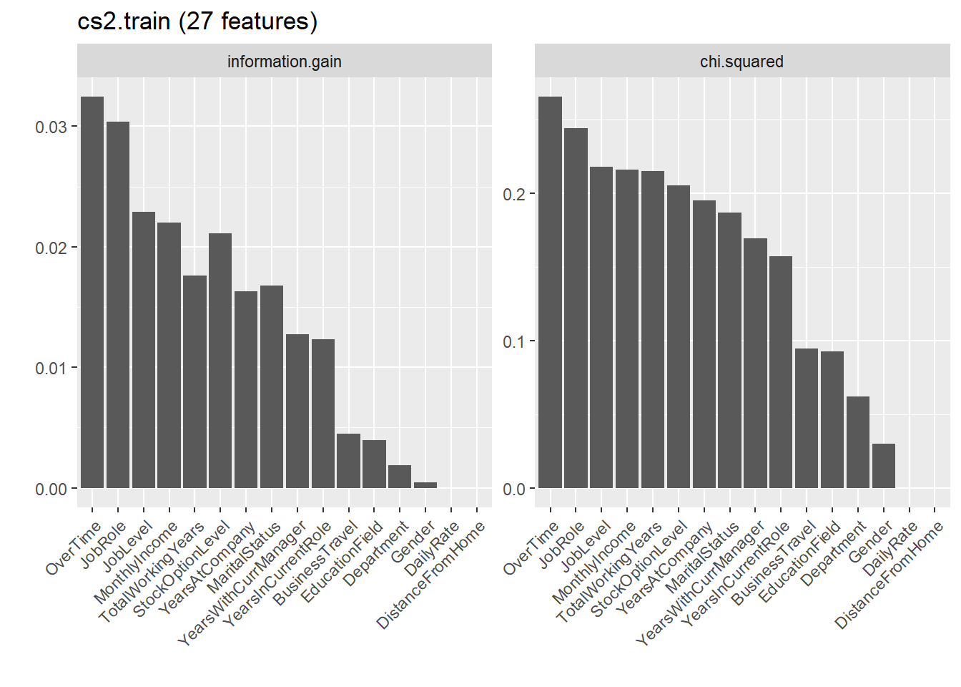
Initial Model – Significant Features
Information.gain measures the ability of a variable to be used to make a decision on data…
Used to build decision trees, but gives us a decent measure of what is important
Overtime, Job Role, Job Level top 3 indicators
Chi-squared reinforces the information.gain measure

Slide 34
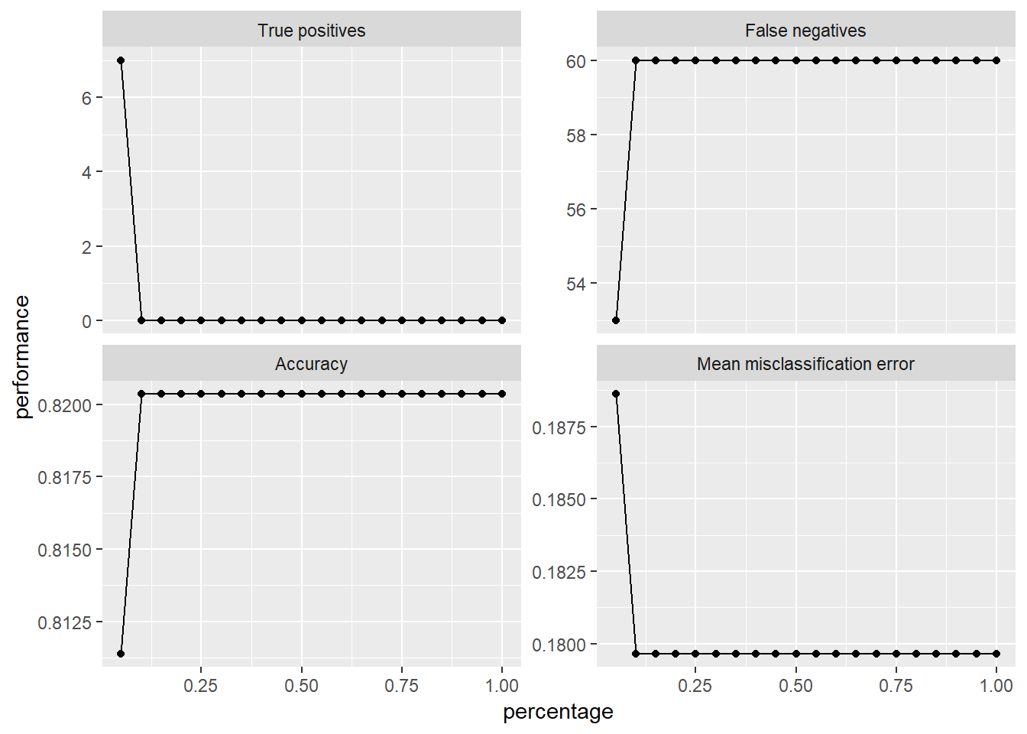
Reduced Model
Illegal discriminators removed
Gender, Age, Marital Status
Accuracy hovered around ~82%
Fewer factors means lower accuracy
However, no lawsuits!

Slide 35
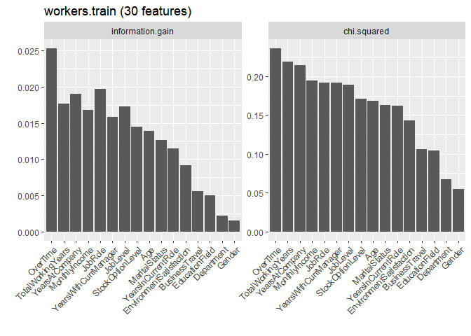
Reduced Model – Significant Features
After removing the features we can’t discriminate by, the top 3 change!
Top three predictors:
Overtime
Total Working Years
Years at Company
Monthly Income is higher than Job Role
Years w/ Manager is higher than Job Level and stock options!

Slide 36
Why does it matter?
Applicants and current employees can be screened before action!
Would you promote an employee you determined is likely to quit?
Would you hire an employee that is not likely to stay?
We can model retention rate, given questions!

Slide 37
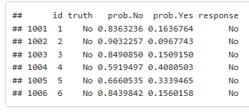
Why does it matter?
The model produces probabilities of retention, given answers:
These questions could be a part of employee feedback, or the job application process, saving money!

Slide 38
Study Process
Three models were compared, with similar findings:
Logistic Regression
Stepwise Selected Multiple Linear Regression
Support Vector Machine

Slide 39
Conclusion
The three largest contributors to Attrition are:
Overtime – 30.5% with vs 10.4% without
Job Role as discussed above
Marital Status – Single people 25.5% likely to leave, 10% and 12.5% for divorced and married
Remember that not all factors can be legally controlled for in the hiring/retention process.

Slide 40
Conclusion
How can we curb the attrition rate? Our top three suggestions:
Hire more people! This reduces overtime, which reduces turnover.
Tackle specific problems within high attrition job categories
Could salespeople distribute travel better?
Overtime again!
Larger stock options?
Raise Environmental Satisfaction (Lighting, ergonomics)
Develop a “Culture of Inclusiveness”, to make single people feel wanted.
Hard to incentivize singleness, but creating friendliness and friendship in the workplace should (anecdotally!) reduce attrition.

