Slide 1


Job Attrition Study
Team “Greco-Roman”
Brady Arendale
John Partee
Steven Vazquez

Slide 2
Study Overview
Why does an employee quit a job?
Do they hate their boss?
Is the work unfulfilling?
We can answer this, with DATA!

Slide 3
Data Analyzed
DDSAnalytics provided 1470 surveys replies, to help predict job attrition.
Responses included 30 meaningful questions, including:
Age
Marital Status
Education Level
Hours Worked
Job level/Role
Compensation
Education Field/level
Gender

Slide 4
What do we want to know?
Who has the highest job attrition rates? What contributes to this?
Who can we hire that is less likely to quit?
How can we retain employees?
How can we use this data to deliver value?

Slide 5
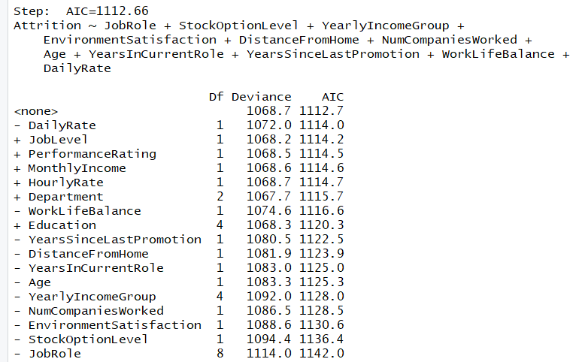
Can a stepwise selection method help us find top attributes?
From stepwise selection method we produce the below model:
Attrition = JobRole + StockOptionLevel + YearlyIncomeGroup + EnvironmentSatisfaction + DistanceFromHome + NumCompaniesWorked + Age + YearsInCurrentRole + YersSinceLastPromotion + WorkLifeBalance + DailyRate

Slide 6

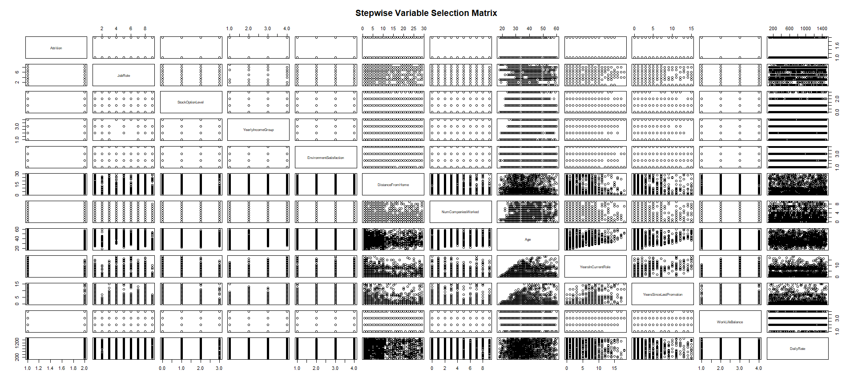



Slide 7
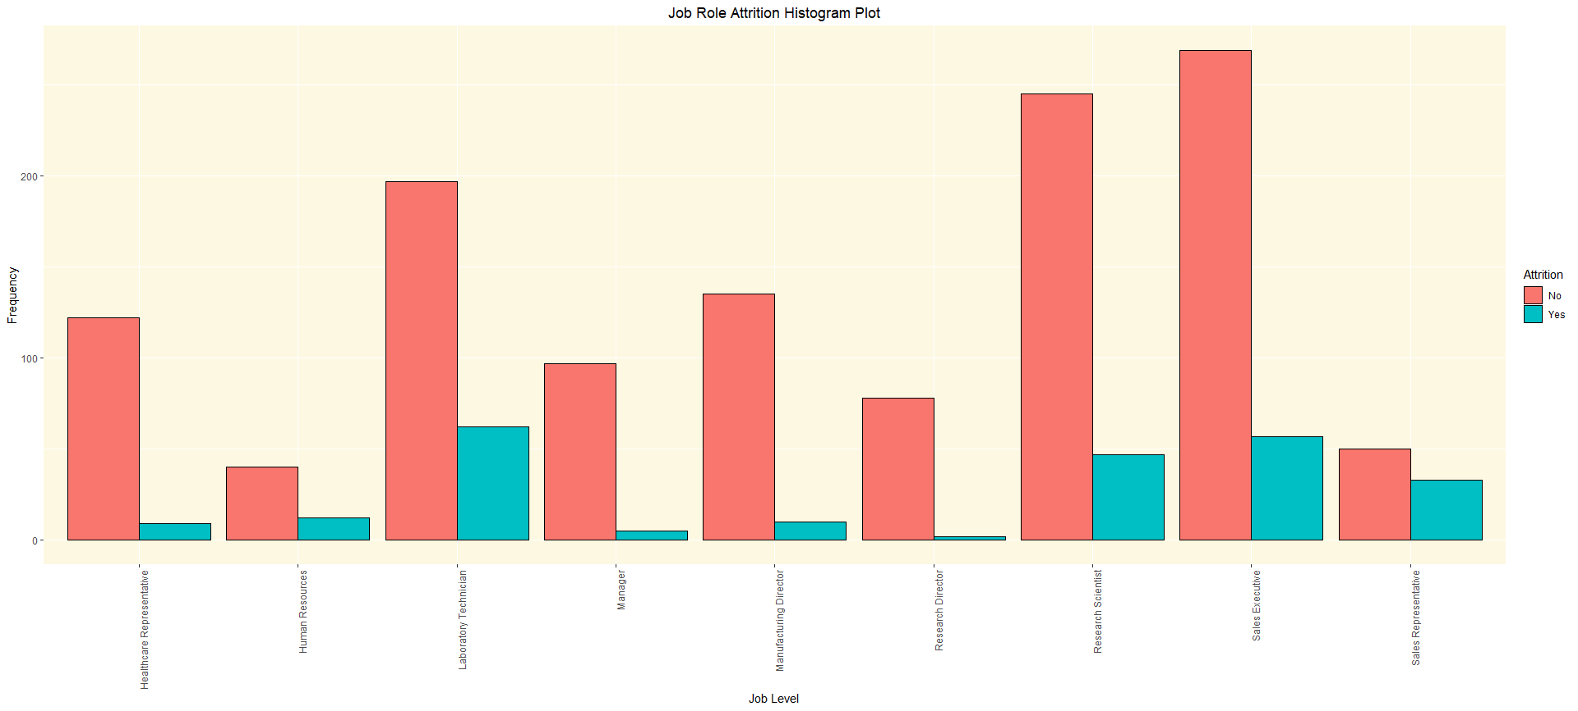
Job Role with Highest Attrition Rate
Job Role with Lowest Attrition Rate
23.9%
17.5%
16.1%
39.8%
6.9%
23.1%
4.9%
6.9%
2.5%
Job Role

Slide 8
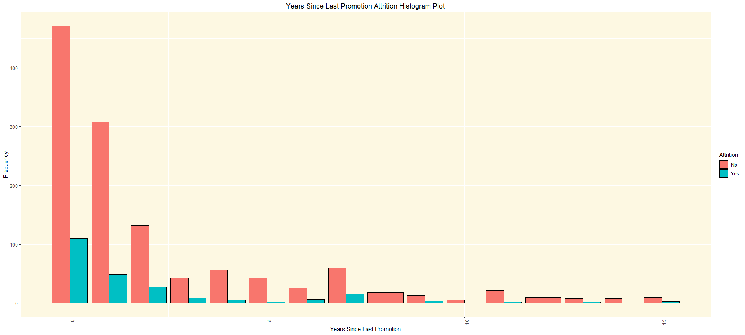

What’s happening between 4-5 years causing people to stay?
18.9%
13.7%
17.0%
21.1%
17.3%
8.2%
4.4%
18.8%
23.5%
20%
8.3%
25%
11.1%
23.1%

Slide 9
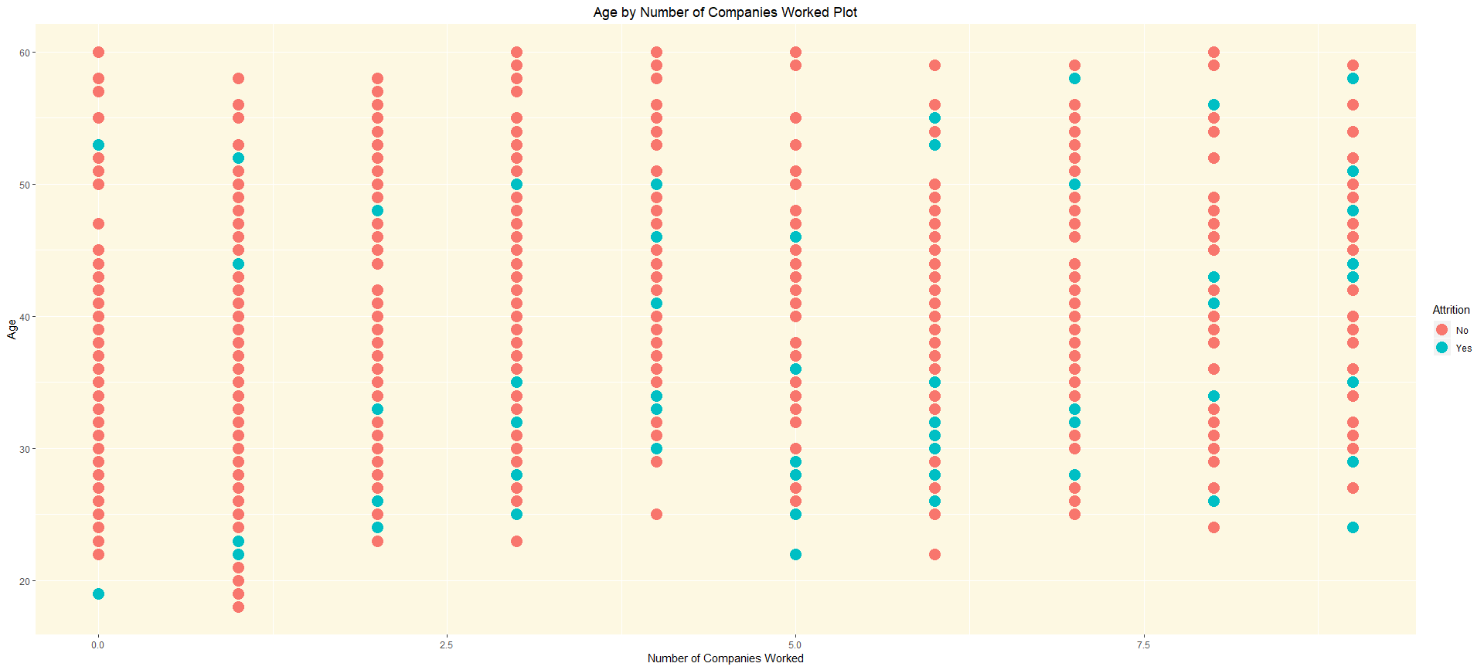
Most attrition cases as expected.

Slide 10
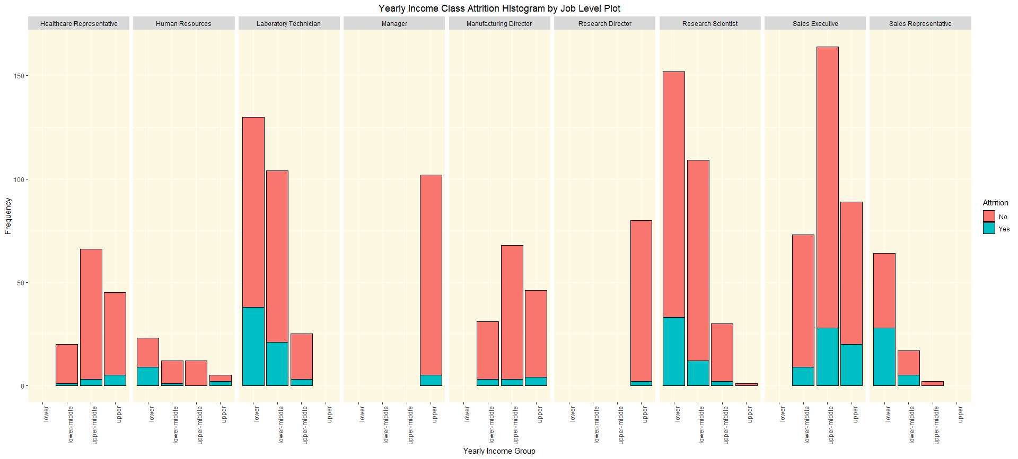
Manager’s and Research Directors only in upper class

Slide 11
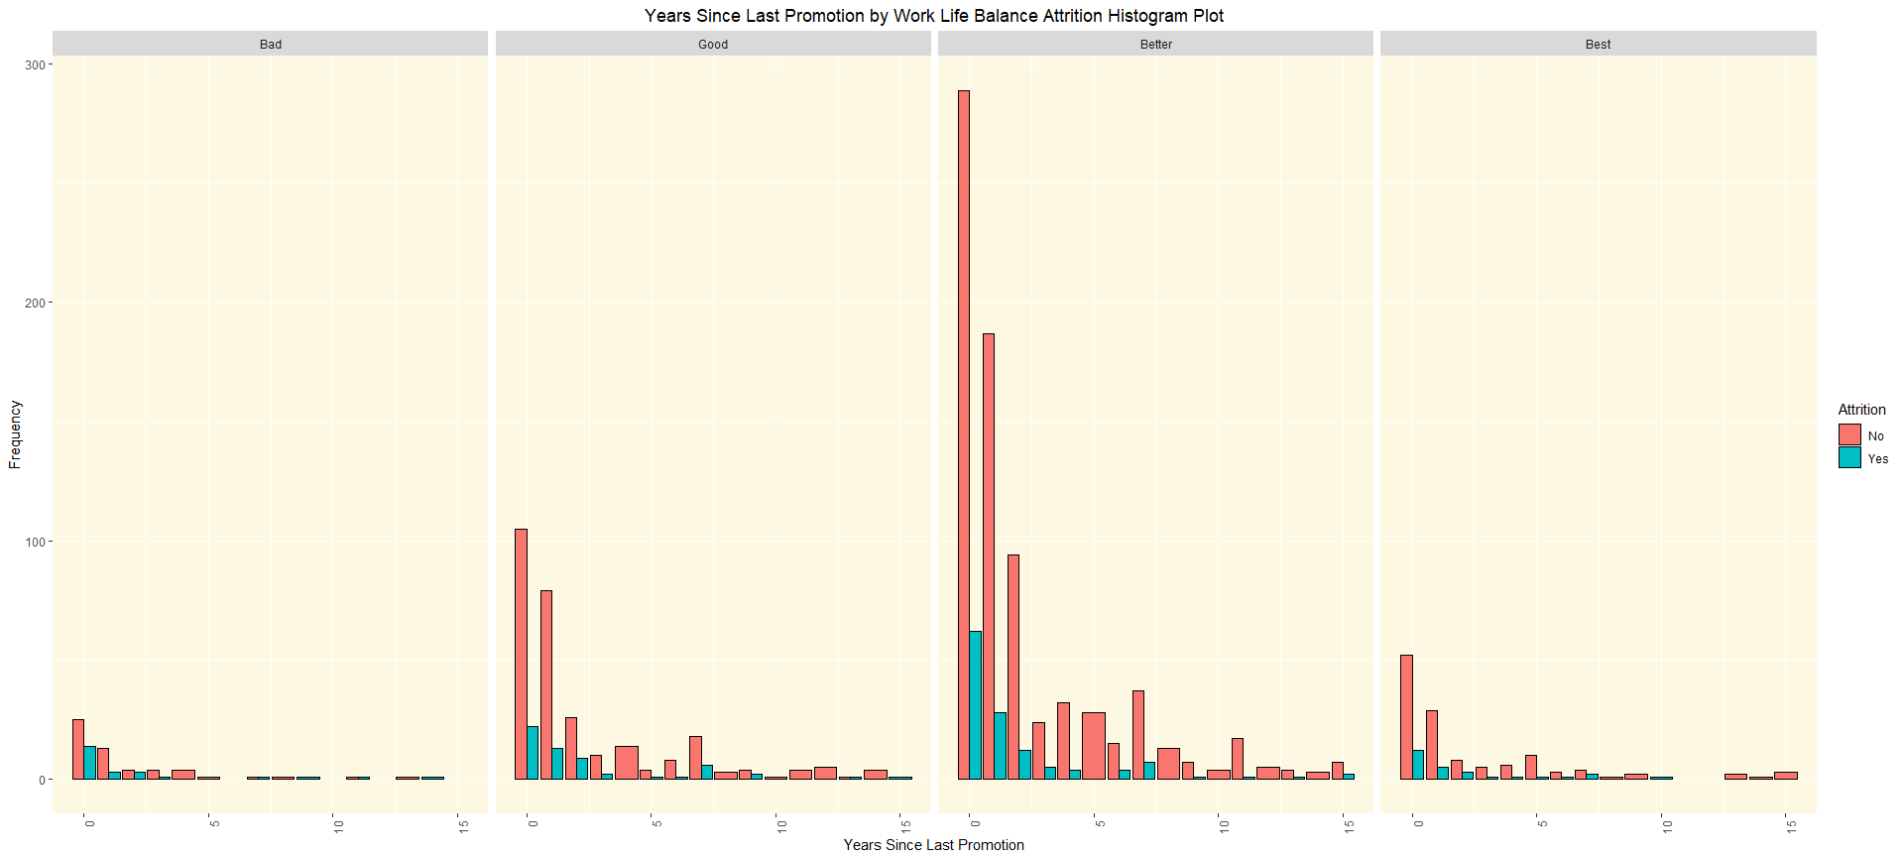
“Bad” – (31.3%)
“Good” – (16.9%)
“Better”-(14.2%)
“Bad” – (17.6%)

Slide 12
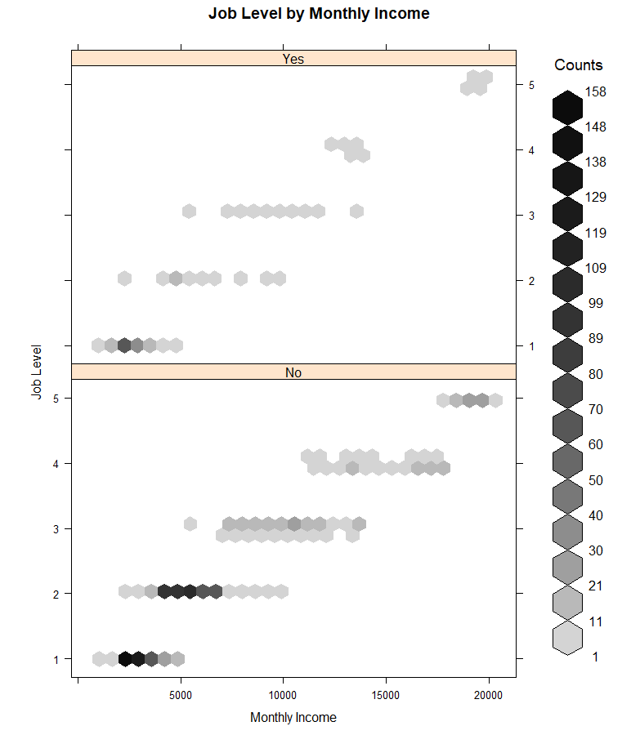
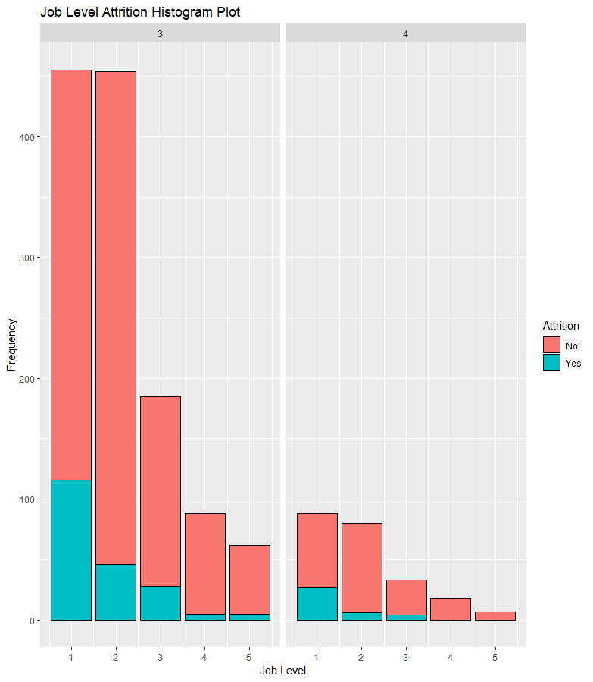

Slide 13
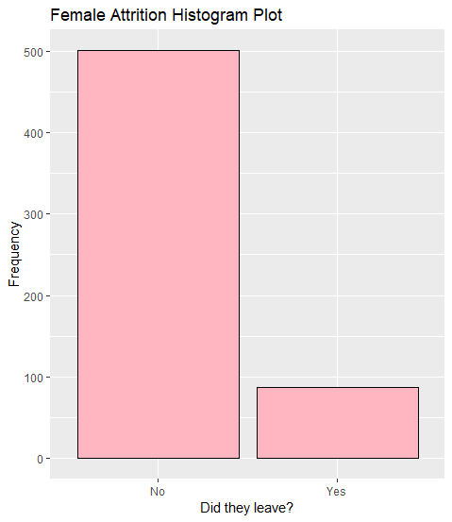
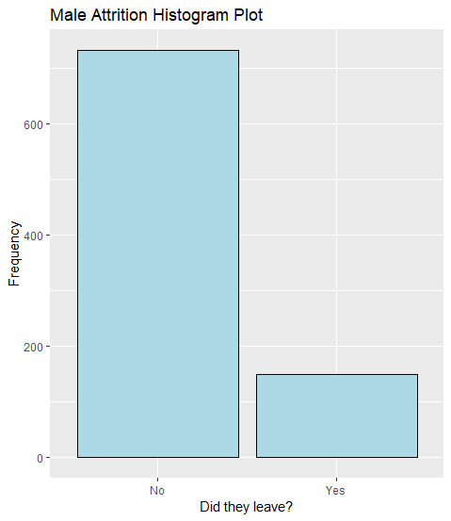
Highest Attrition Rates – Man or Woman?
* ~ 15% women leaving the company.
* ~ 17% men leaving the company.
There were many paths traveled that led us to this conclusion. These are the paths we took…

Slide 14
Conclusion
From graphs, reiterate the variables we’ve chosen and the trends we find most interesting.

Slide 15
Imported data
library(openxlsx)
attritionData <- read.xlsx("CaseStudy2-data.xlsx")

Slide 16
Inspected Data
names(attritionData)
[1] "Age" "Attrition" "BusinessTravel" "DailyRate" "Department"
[6] "DistanceFromHome" "Education" "EducationField" "EmployeeCount" "EmployeeNumber"
[11] "EnvironmentSatisfaction" "Gender" "HourlyRate" "JobInvolvement" "JobLevel"
[16] "JobRole" "JobSatisfaction" "MaritalStatus" "MonthlyIncome" "MonthlyRate"
[21] "NumCompaniesWorked" "Over18" "OverTime" "PercentSalaryHike" "PerformanceRating"
[26] "RelationshipSatisfaction" "StandardHours" "StockOptionLevel" "TotalWorkingYears" "TrainingTimesLastYear"
[31] "WorkLifeBalance" "YearsAtCompany" "YearsInCurrentRole" "YearsSinceLastPromotion" "YearsWithCurrManager"
Potential Trends related to attrition:
Age related to Attrition
People retire, midlife crisis?
WorklifeBalance
People retire, midlife crisis?
JobInvolvment/JobSatisfaction
Are people bored? Are they engaged? Too much work?
Years at company
Do the longer people work at company deter them more from leaving?
Job Role
What jobs have the most people leaving?
Monthly Income
Is there an average wage that causes people to leave?
Gender
Which gender is leaving more?

Slide 17
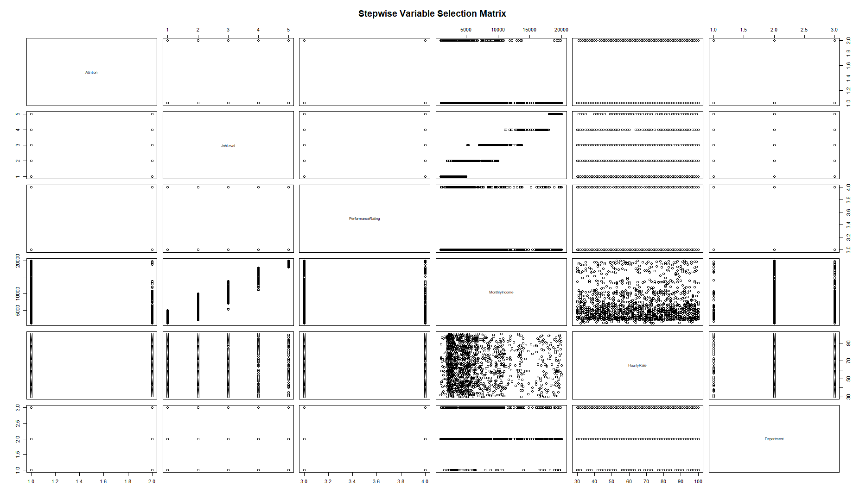

Slide 18
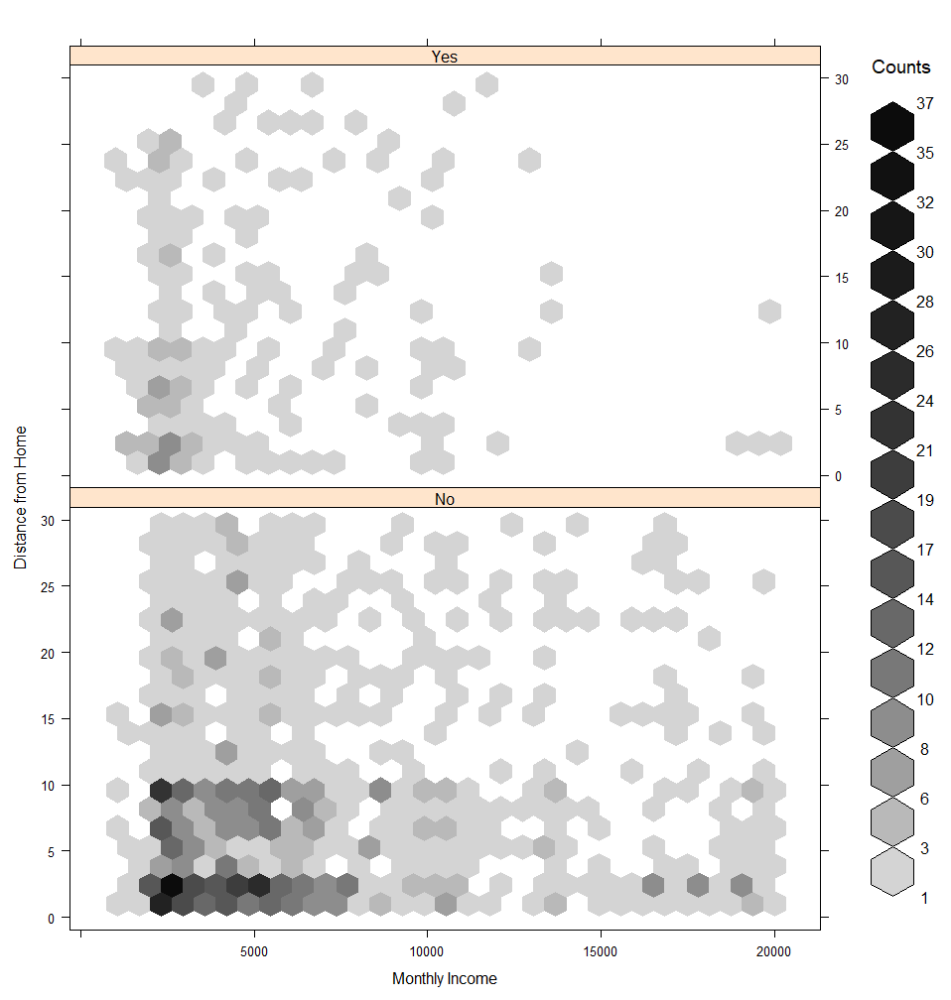
I suspect these are

Slide 19
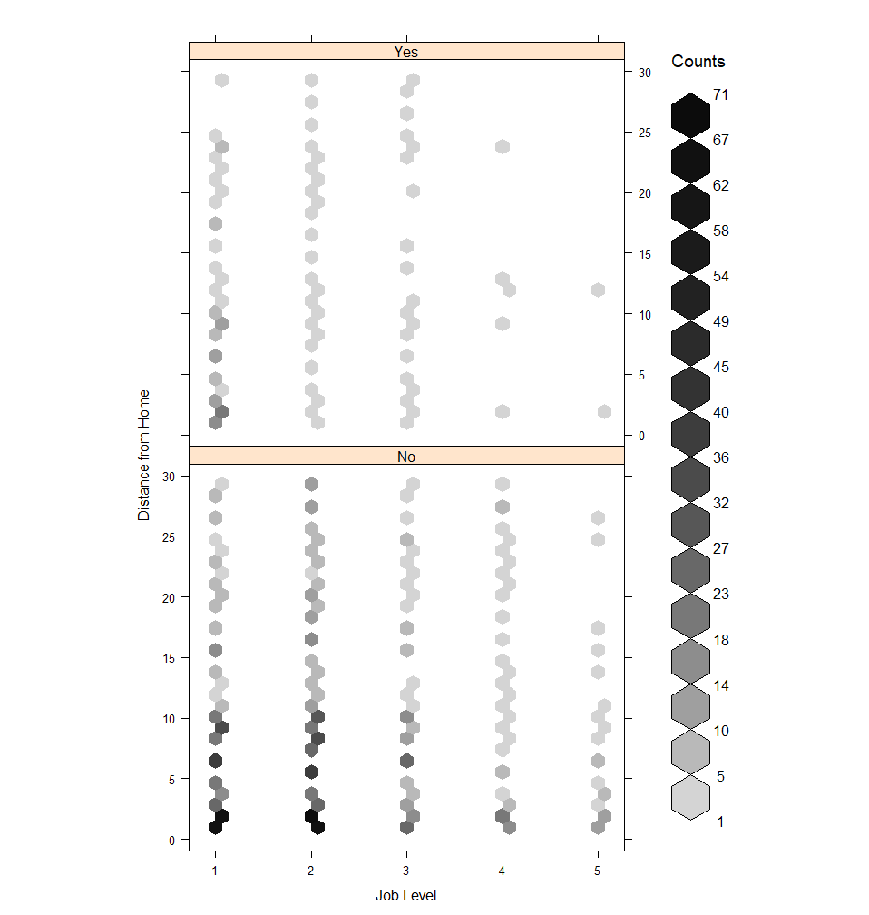

Slide 20
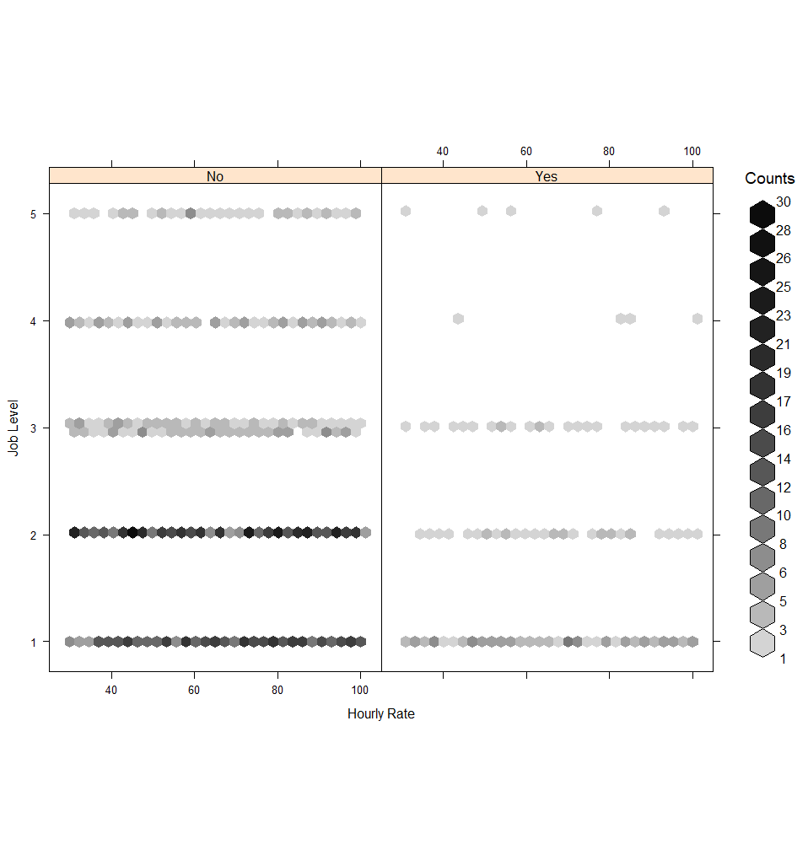

Slide 21
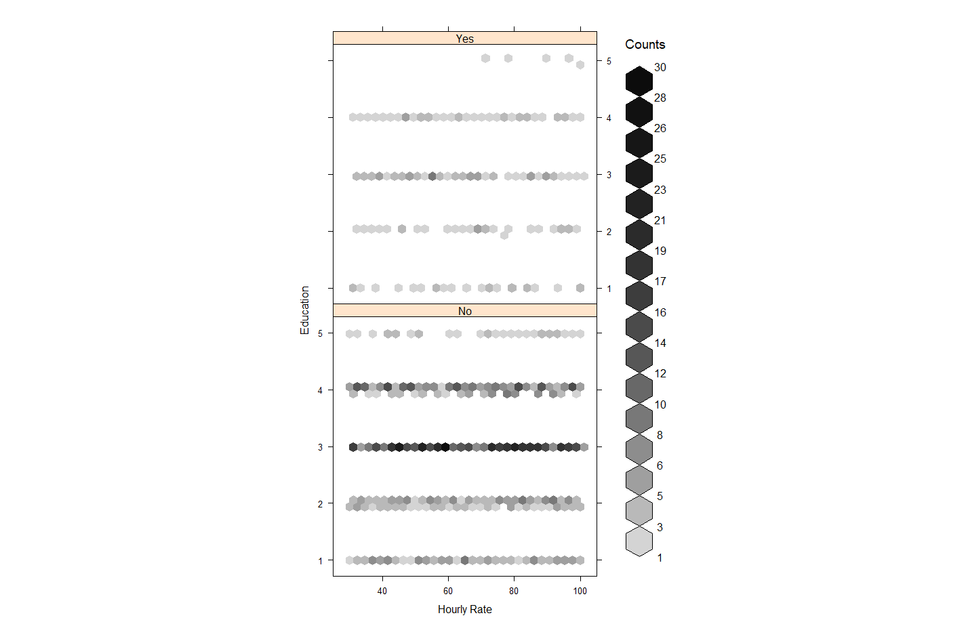

Slide 22
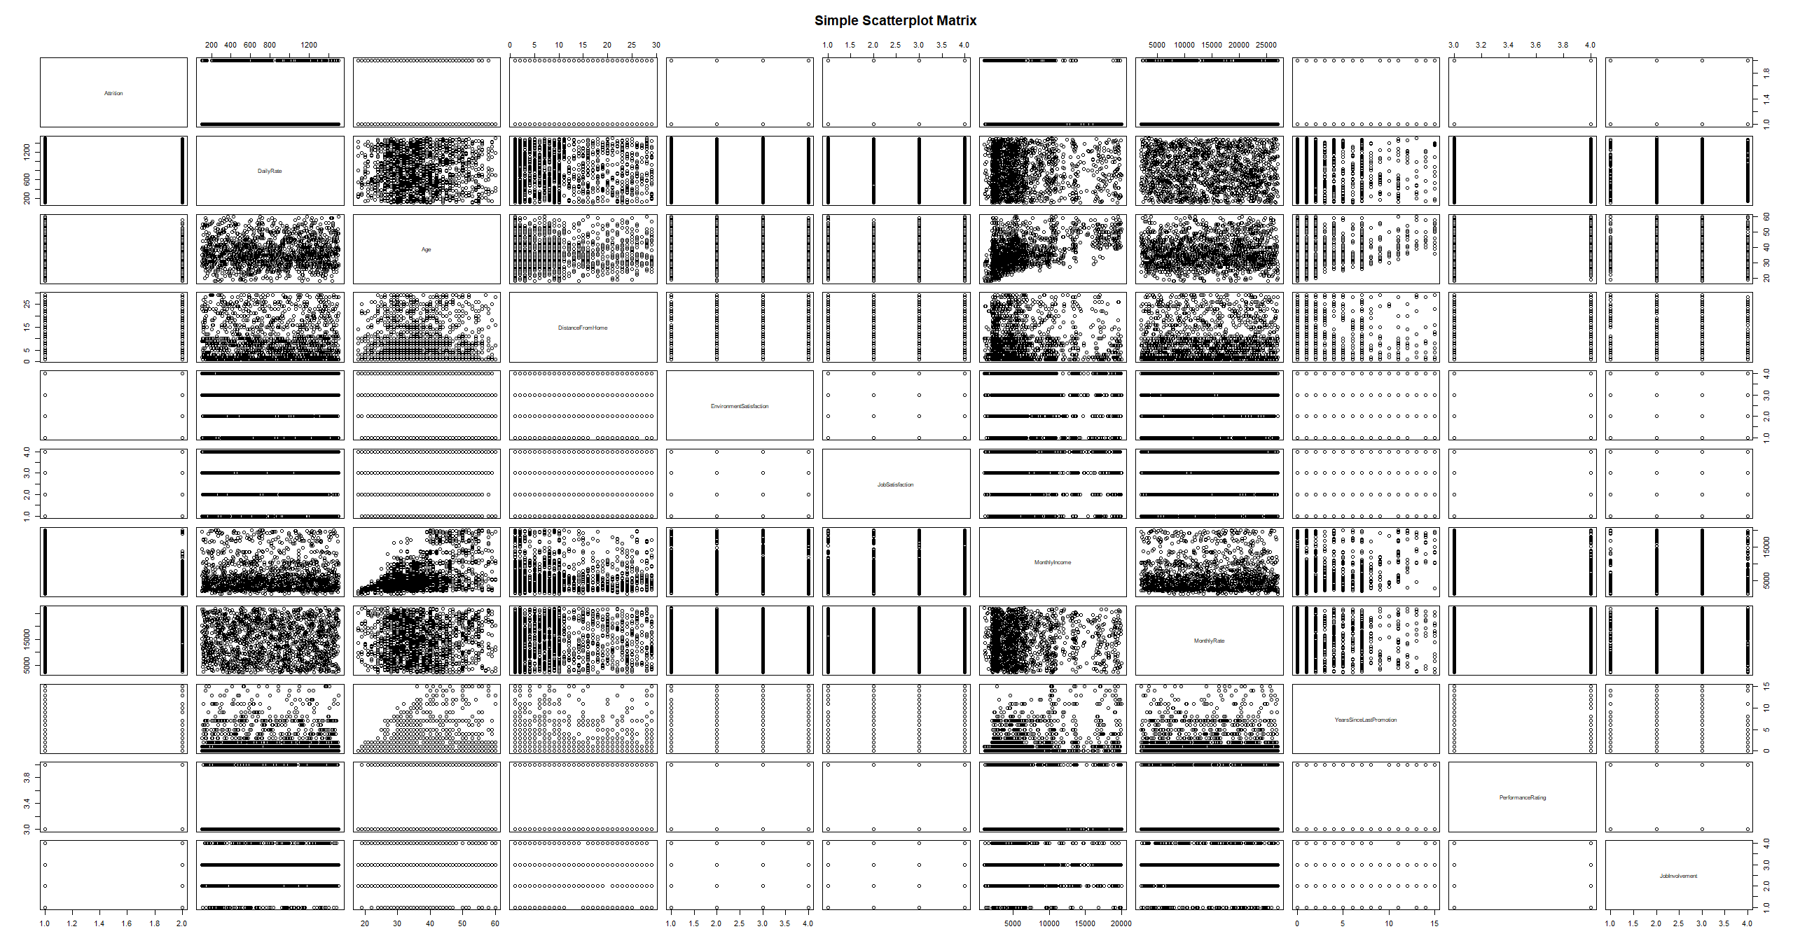

Slide 23
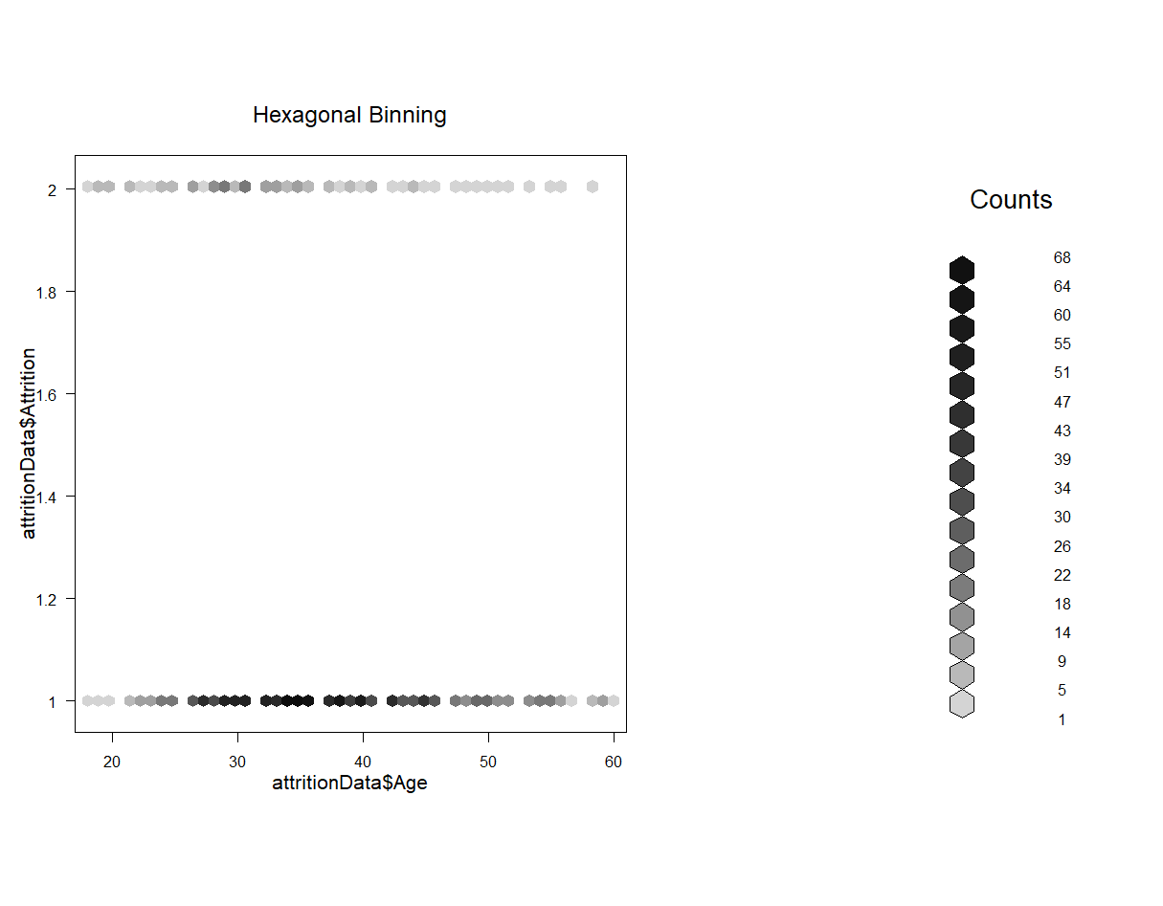

Slide 24
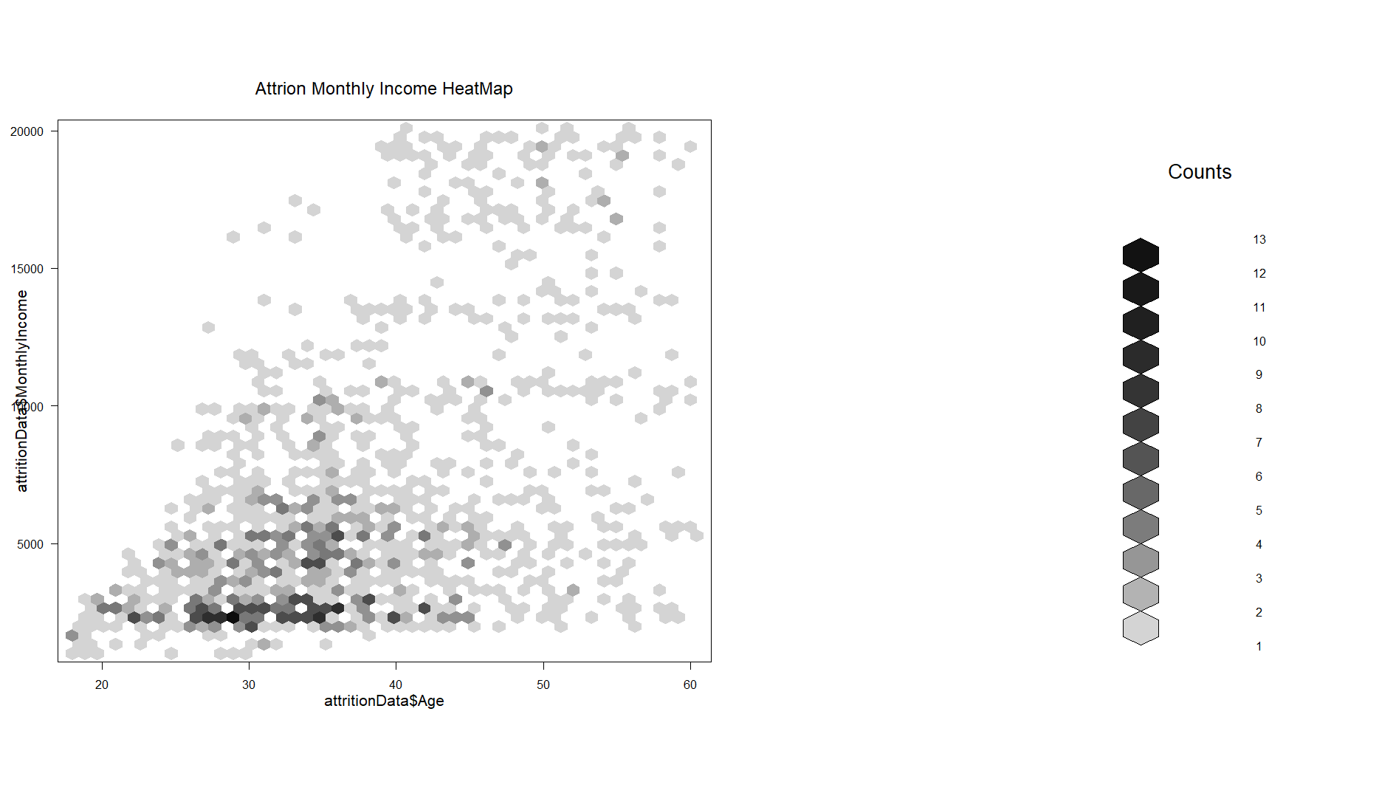

Slide 25
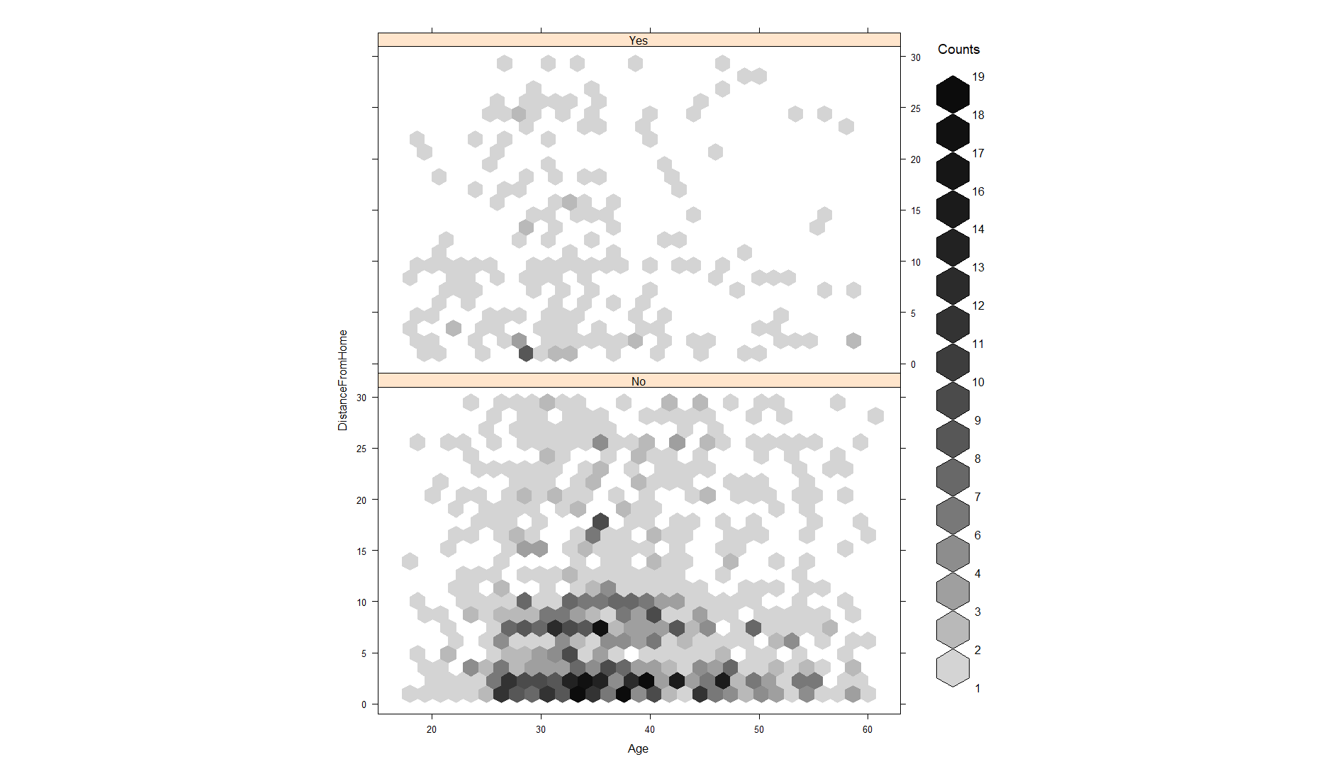
Makes you think what jobs are within 1 mile that people~30 are leaving?

Slide 26
