Slide 1


Job Attrition Study
Team “Greco-Roman”
Brady Arendale
John Partee
Steven Vazquez

Slide 2
Study Overview
Why does an employee quit a job?
Do they hate their boss?
Is the work unfulfilling?
We can answer this, with DATA!

Slide 3
Data Analyzed
DDSAnalytics provided 1470 surveys replies, to help predict job attrition.
Responses included 30 meaningful questions, including:
Age
Marital Status
Education Level
Hours Worked
Job level/Role
Compensation
Education Field/level
Gender

Slide 4
What do we want to know?
Who has the highest job attrition rates? What contributes to this?
Who can we hire that is less likely to quit?
How can we retain employees?
How can we use this data to deliver value?

Slide 5
Background Information
Hiring a new employee can be expensive – as much as 40% of an employee’s salary for entry-level
The national average attrition rate is estimated to be 15-19%
The attrition rate in our data set was 16.1%
Lowering our clients’ attrition rate can save them money and create a more positive work environment
Source: https://business.dailypay.com/blog/employee-retention-rate

Slide 6
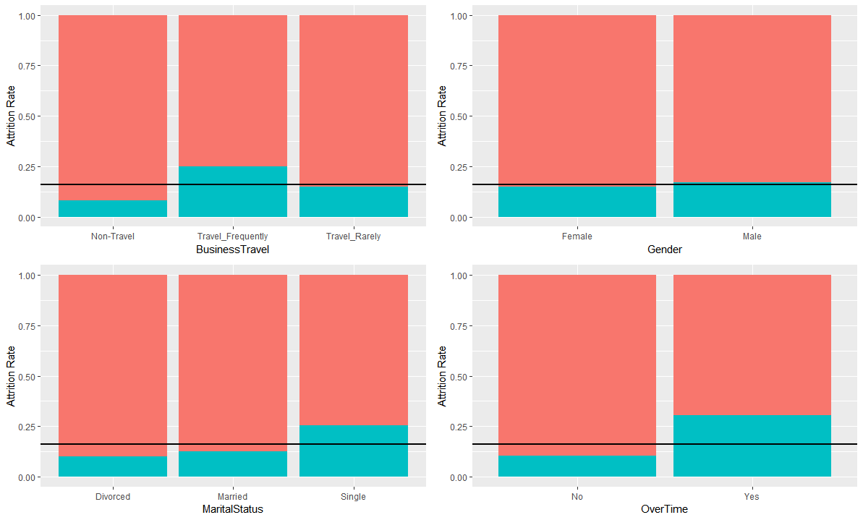

Selected factors vs. attrition

Slide 7
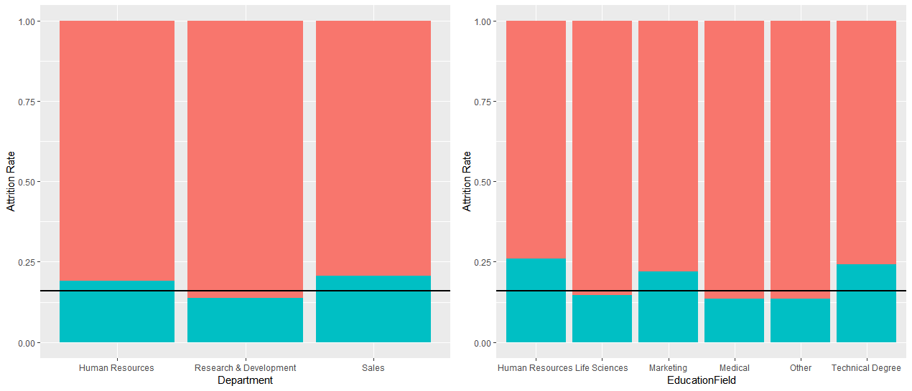
Selected factors vs. attrition

Slide 8
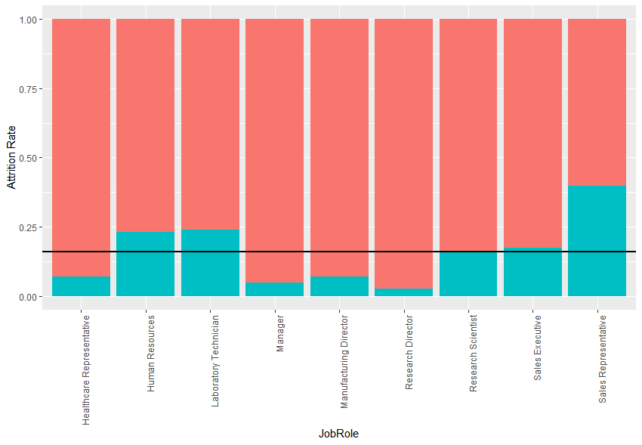
What job roles have high turnover?
High turnover: Laboratory technician, sales representative
Low turnover: Healthcare representative, manager, manufacturing director, research director
Attrition for human resources was not found to be statistically significantly higher than average (may need to collect more data)

Slide 9
What are the top factors contributing to attrition?
Using a forward selection logistic regression model, the top three factors we found to be associated with attrition are:
1) Overtime – Employees who work overtime have a 30.5% attrition rate, compared to 10.4% for those without overtime
2) Job role – as mentioned in the previous slide
3) Marital status – single people are more likely to leave, with a 25.5% attrition rate, compared to 10% for divorced and 12.5% for married

Slide 10
Controlling for discrimination
We can’t discriminate on the basis of age, gender, or marital status, so we ran another model controlling for those variables. The top three factors in this model were:
1) Overtime
2) Job role
3) Environment satisfaction – workers who reported low environment satisfaction had a 25.4% attrition rate, compared to 13-15% for medium to very high

Slide 11
What factors are driving attrition in high turnover roles?
We are interested specifically in controlling attrition rates for our high attrition job roles: sales representatives and laboratory technicians.
Sales representatives had the highest attrition rate, at 39.8%.
Laboratory technicians had an attrition rate of 23.9%.
We again used forward selection logistic regression models to determine the leading factors associated with attrition.

Slide 12
What leads to high turnover for sales representatives?
1) Travel frequency – sales reps who travelled frequently left the company at a 65% rate. No non-travel sales reps have left the company, although we only have a sample size of 5.
2) Overtime – 66.7% attrition rate for sales reps who work overtime, 28.8% for those who do not
3) Years in current role – lower attrition for those who have worked longer
4) Job satisfaction – workers who reported low job satisfaction had a 58.3% attrition rate, 47.6% for medium

Slide 13
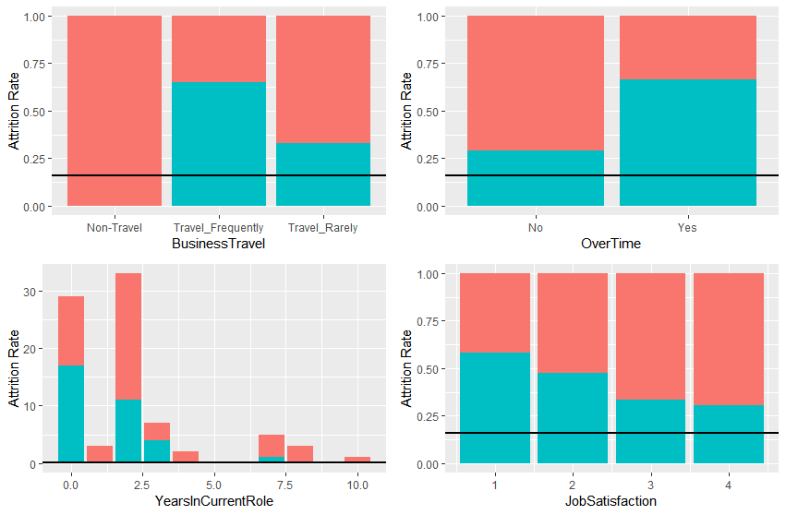
What leads to high turnover for sales representatives?

Slide 14
What leads to high turnover for laboratory technicians?
1) Overtime – lab techs who work overtime have an attrition rate of 50%, compared to 15.7% for no overtime
2) Years at company - lower attrition for those who have worked longer
3) Stock option level – 30.4% attrition rate for the lowest stock option level, compared to 10% for the highest
4) Environment satisfaction – 41.5% attrition rate for lab techs who reported low environment satisfaction

Slide 15
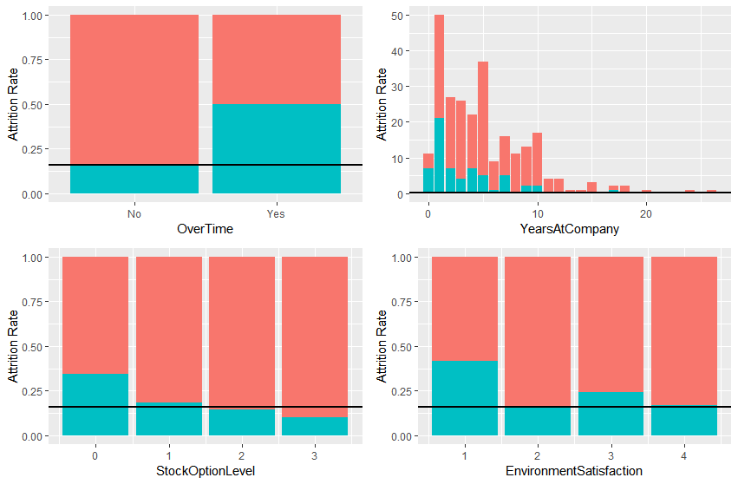
What leads to high turnover for laboratory technicians?

Slide 16
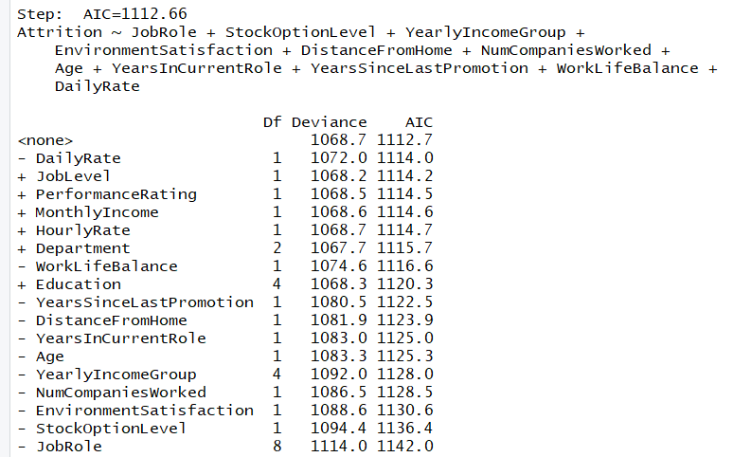
Can a stepwise selection method help us find top attributes?
From stepwise selection method we produce the below model:
Attrition = JobRole + StockOptionLevel + YearlyIncomeGroup + EnvironmentSatisfaction + DistanceFromHome + NumCompaniesWorked + Age + YearsInCurrentRole + YersSinceLastPromotion + WorkLifeBalance + DailyRate

Slide 17

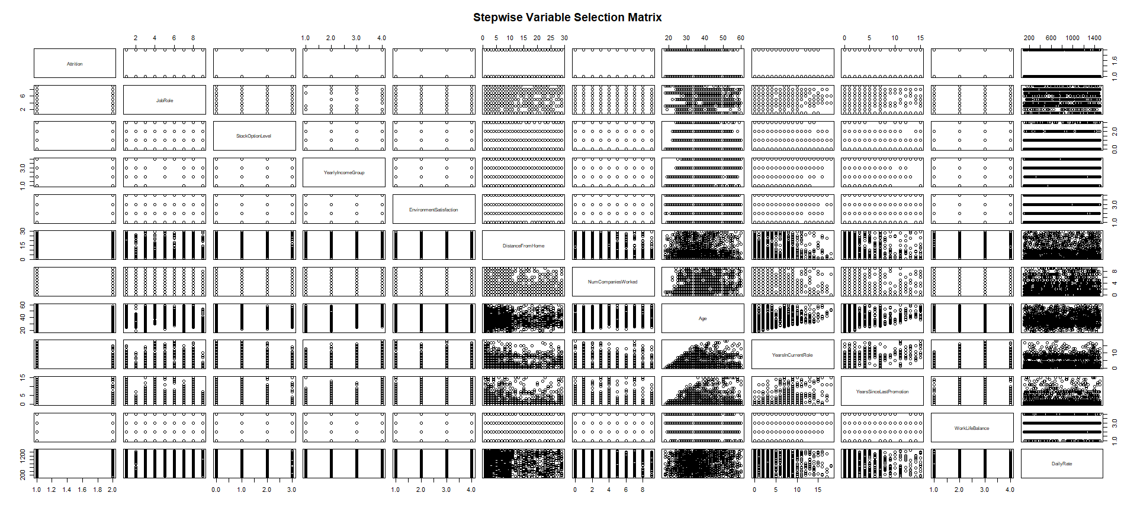



Slide 18
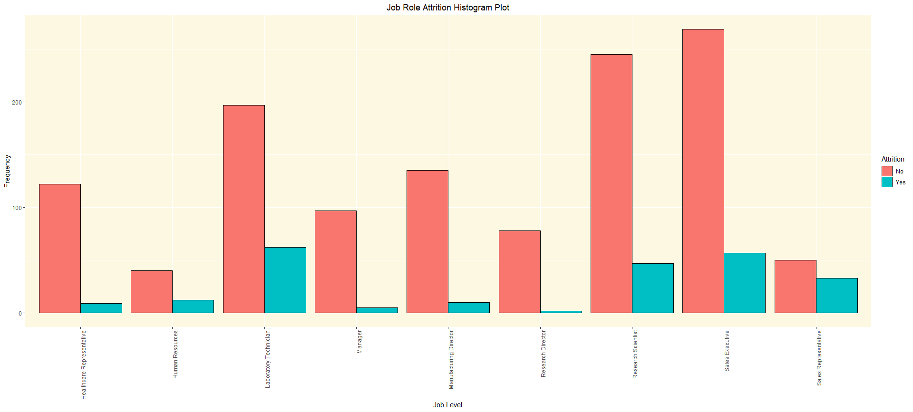
Job Role with Highest Attrition Rate
Job Role with Lowest Attrition Rate
23.9%
17.5%
16.1%
39.8%
6.9%
23.1%
4.9%
6.9%
2.5%
Job Role

Slide 19
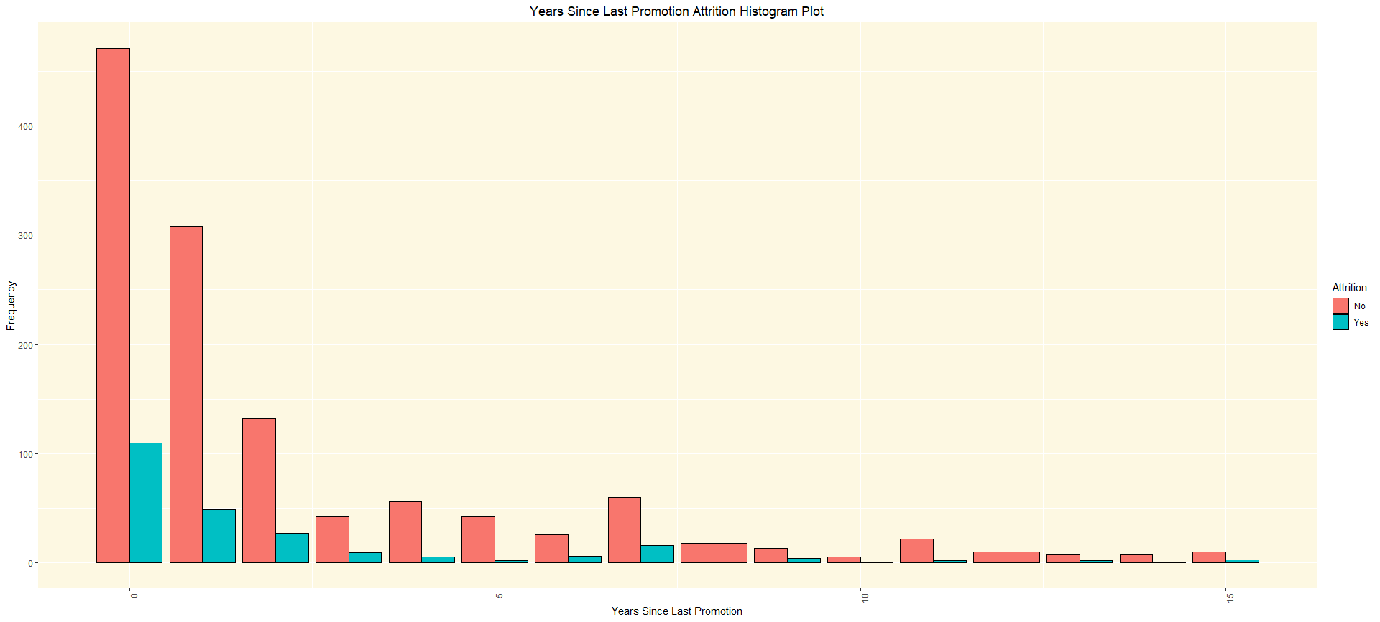

What’s happening between 4-5 years causing people to stay?
18.9%
13.7%
17.0%
21.1%
17.3%
8.2%
4.4%
18.8%
23.5%
20%
8.3%
25%
11.1%
23.1%

Slide 20
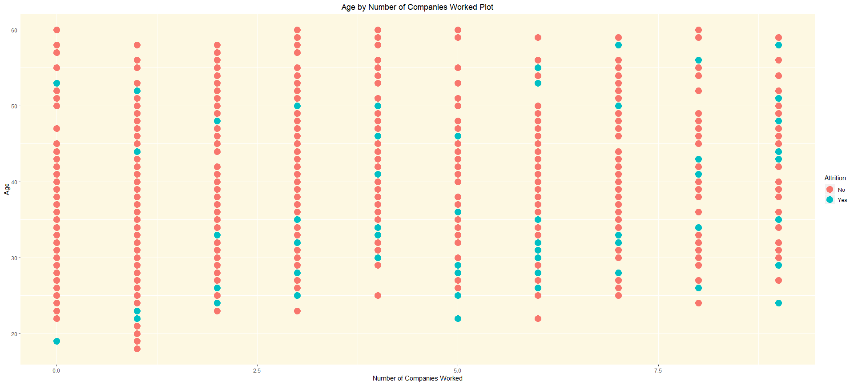
Most attrition cases as expected.

Slide 21
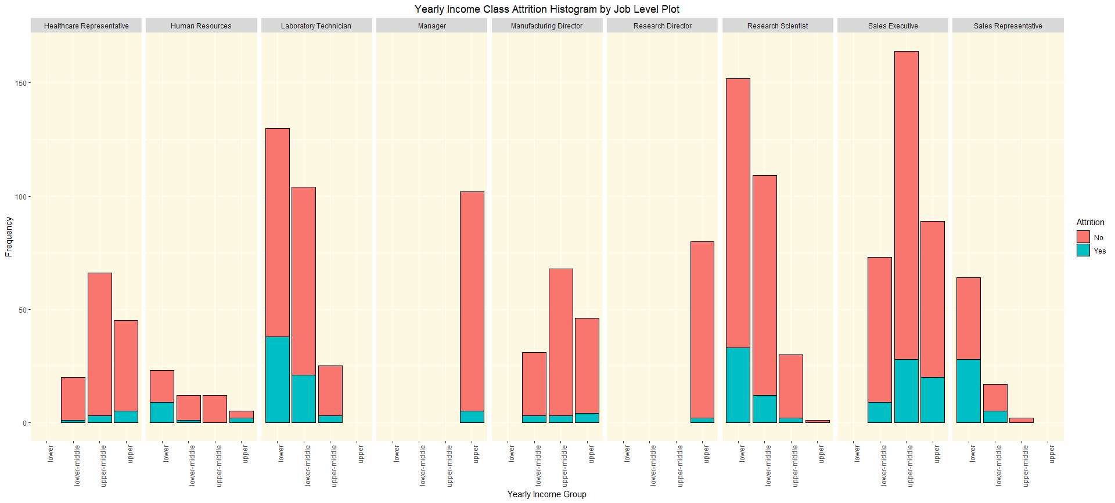
Manager’s and Research Directors only in upper class

Slide 22
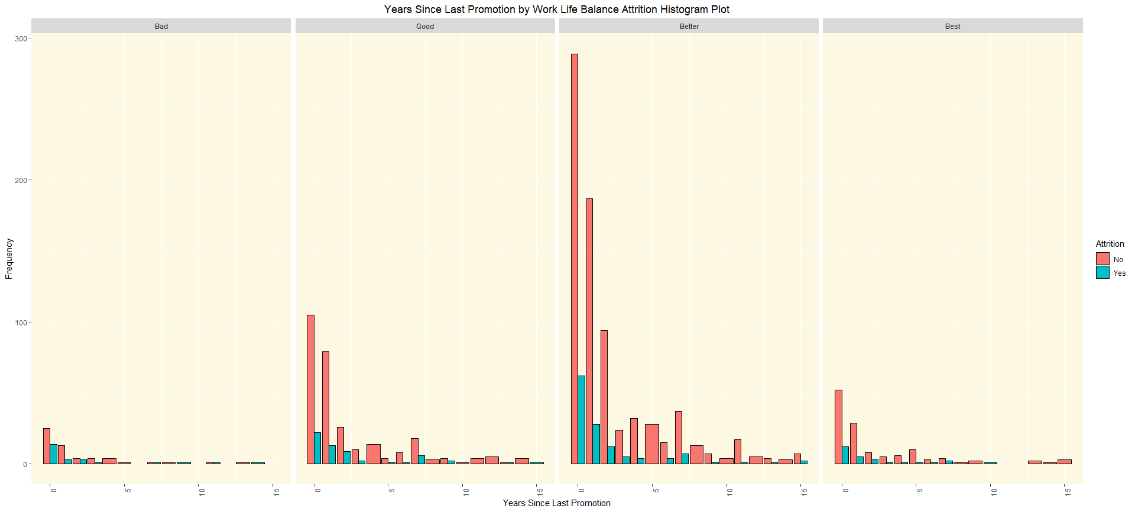
“Bad” – (31.3%)
“Good” – (16.9%)
“Better”-(14.2%)
“Bad” – (17.6%)

Slide 23
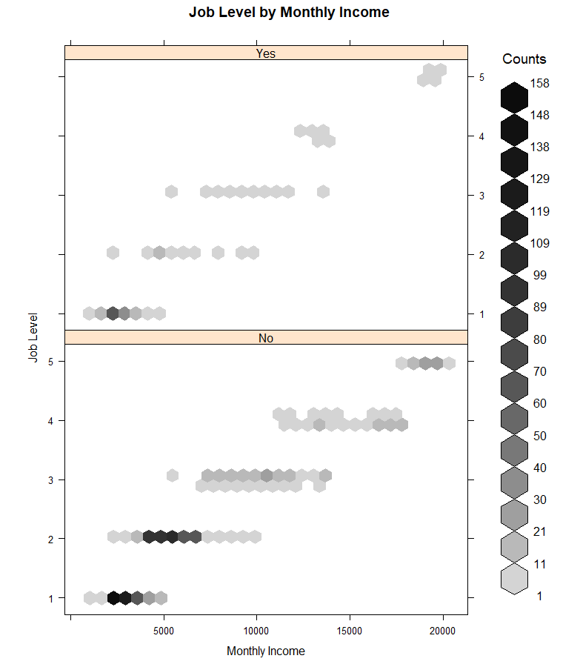
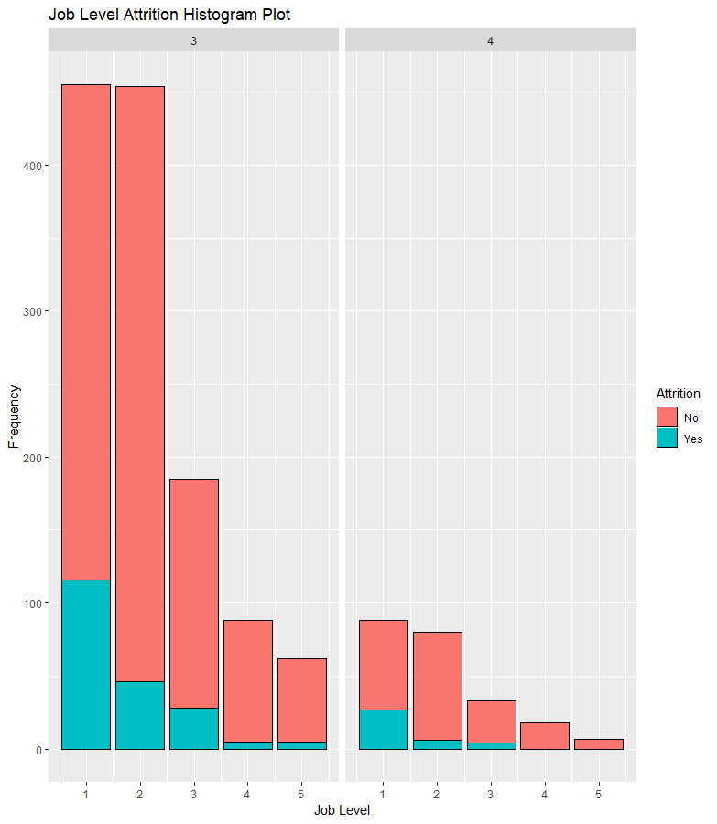

Slide 24
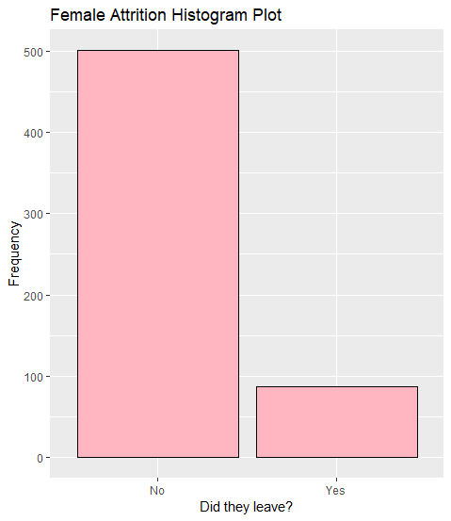
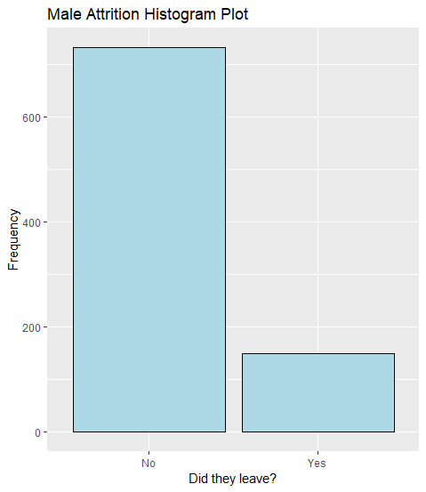
Highest Attrition Rates – Man or Woman?
* ~ 15% women leaving the company.
* ~ 17% men leaving the company.
There were many paths traveled that led us to this conclusion. These are the paths we took…

Slide 25
Conclusion
From graphs, reiterate the variables we’ve chosen and the trends we find most interesting.

Slide 26
Imported data
library(openxlsx)
attritionData <- read.xlsx("CaseStudy2-data.xlsx")

Slide 27
Inspected Data
names(attritionData)
[1] "Age" "Attrition" "BusinessTravel" "DailyRate" "Department"
[6] "DistanceFromHome" "Education" "EducationField" "EmployeeCount" "EmployeeNumber"
[11] "EnvironmentSatisfaction" "Gender" "HourlyRate" "JobInvolvement" "JobLevel"
[16] "JobRole" "JobSatisfaction" "MaritalStatus" "MonthlyIncome" "MonthlyRate"
[21] "NumCompaniesWorked" "Over18" "OverTime" "PercentSalaryHike" "PerformanceRating"
[26] "RelationshipSatisfaction" "StandardHours" "StockOptionLevel" "TotalWorkingYears" "TrainingTimesLastYear"
[31] "WorkLifeBalance" "YearsAtCompany" "YearsInCurrentRole" "YearsSinceLastPromotion" "YearsWithCurrManager"
Potential Trends related to attrition:
Age related to Attrition
People retire, midlife crisis?
WorklifeBalance
People retire, midlife crisis?
JobInvolvment/JobSatisfaction
Are people bored? Are they engaged? Too much work?
Years at company
Do the longer people work at company deter them more from leaving?
Job Role
What jobs have the most people leaving?
Monthly Income
Is there an average wage that causes people to leave?
Gender
Which gender is leaving more?

Slide 28
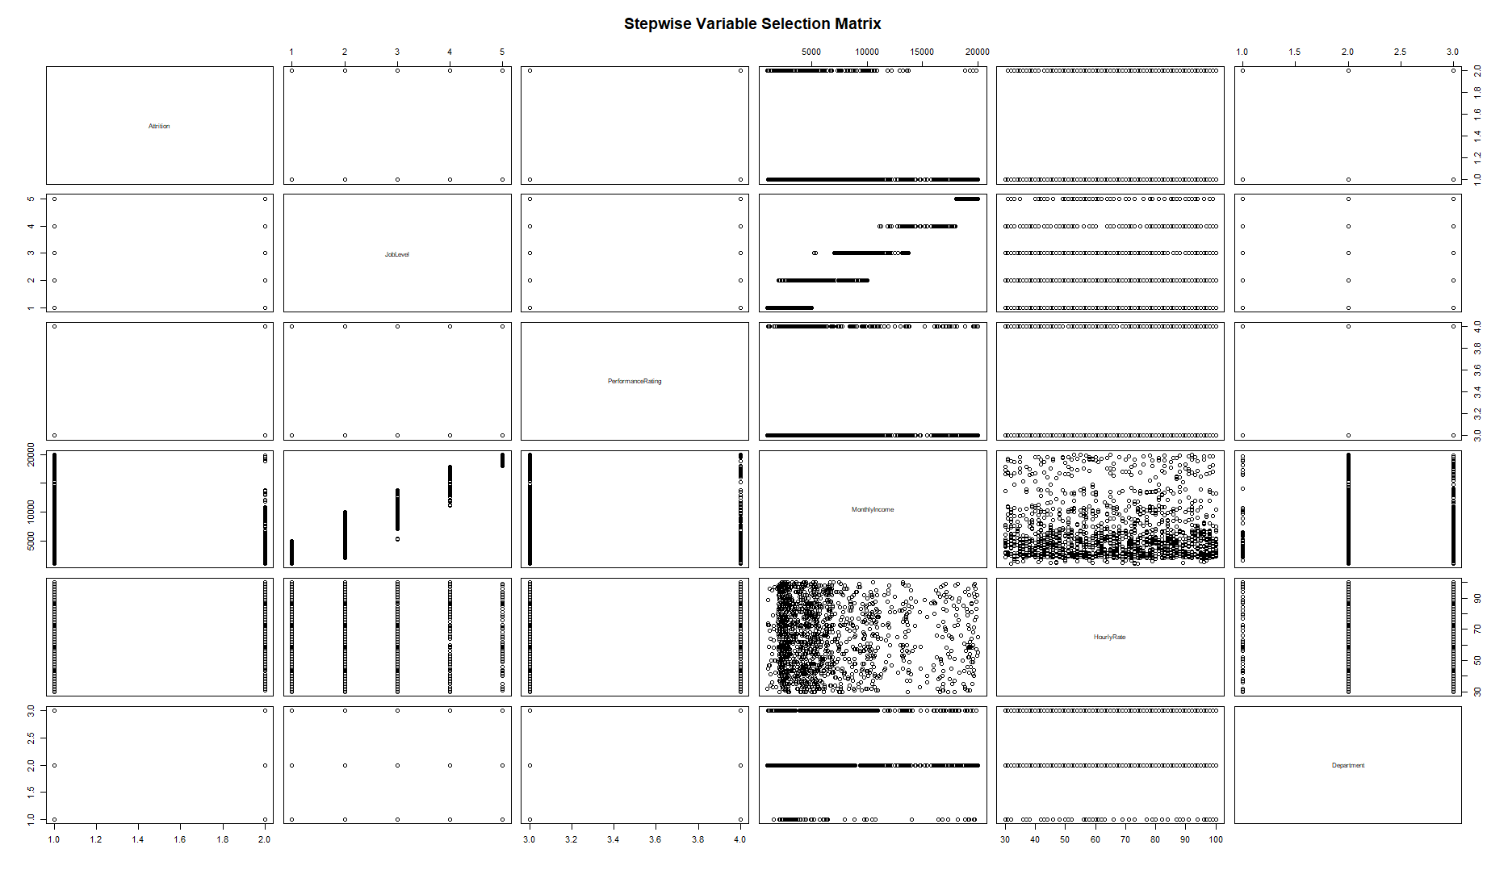

Slide 29
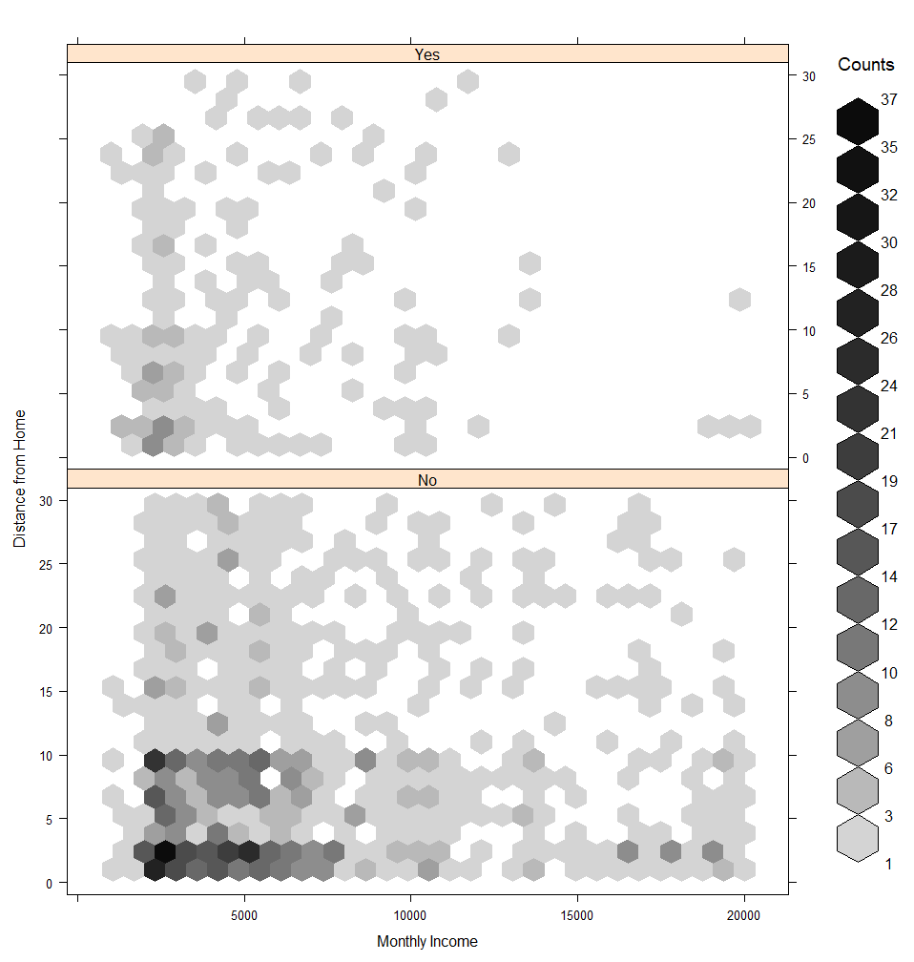
I suspect these are

Slide 30
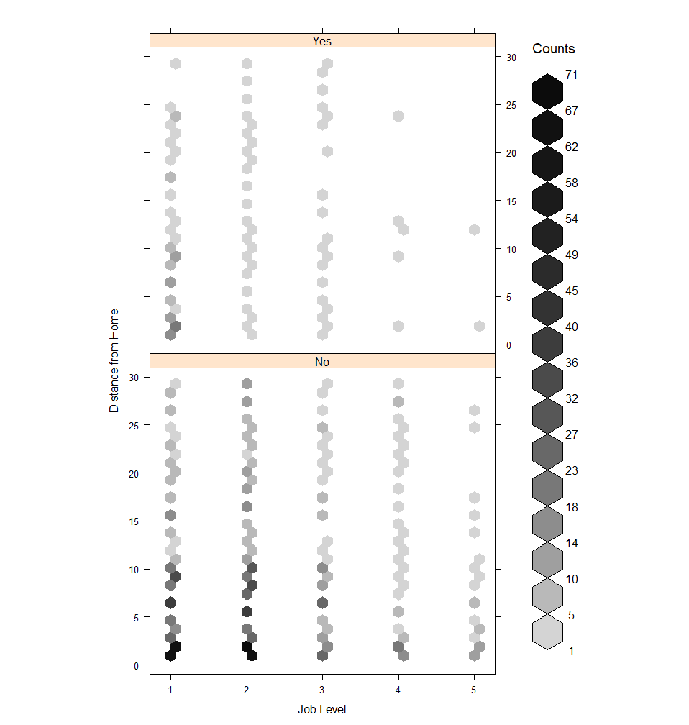

Slide 31
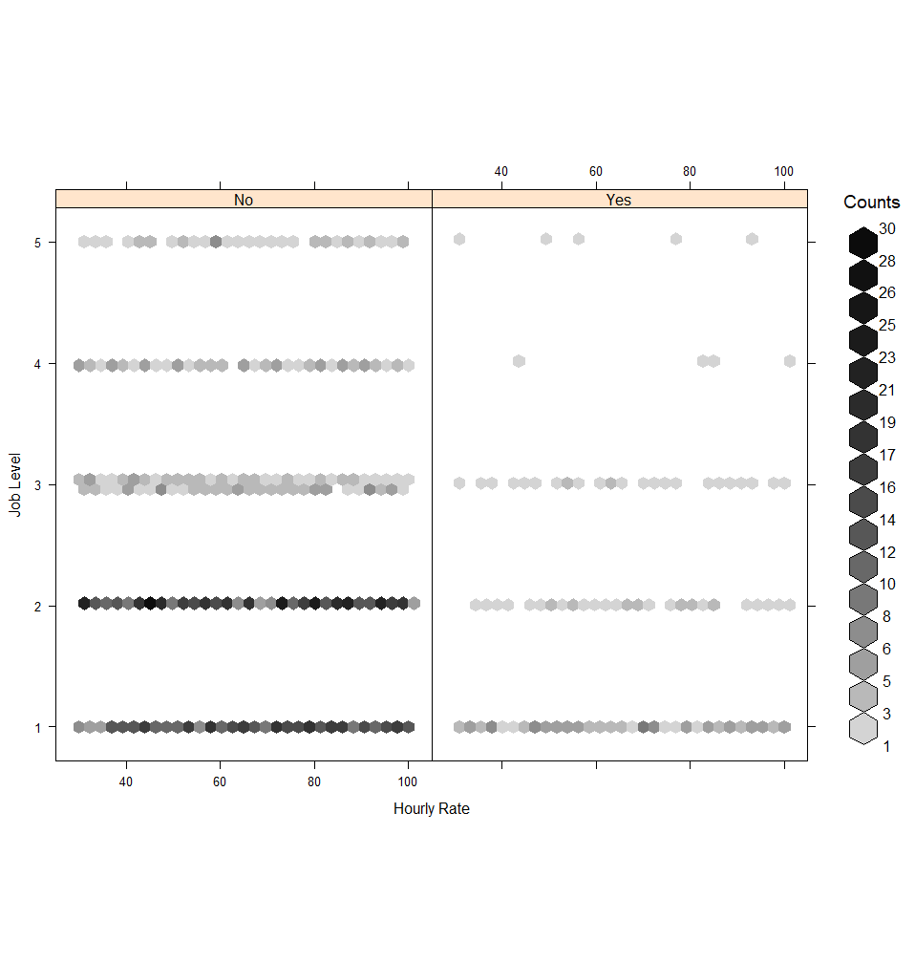

Slide 32
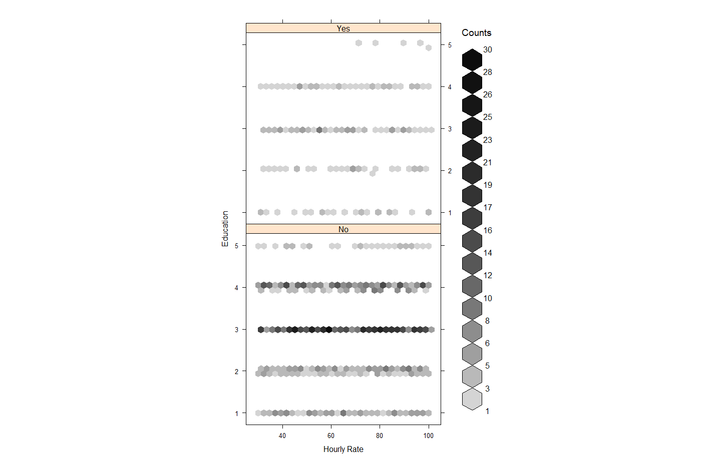

Slide 33
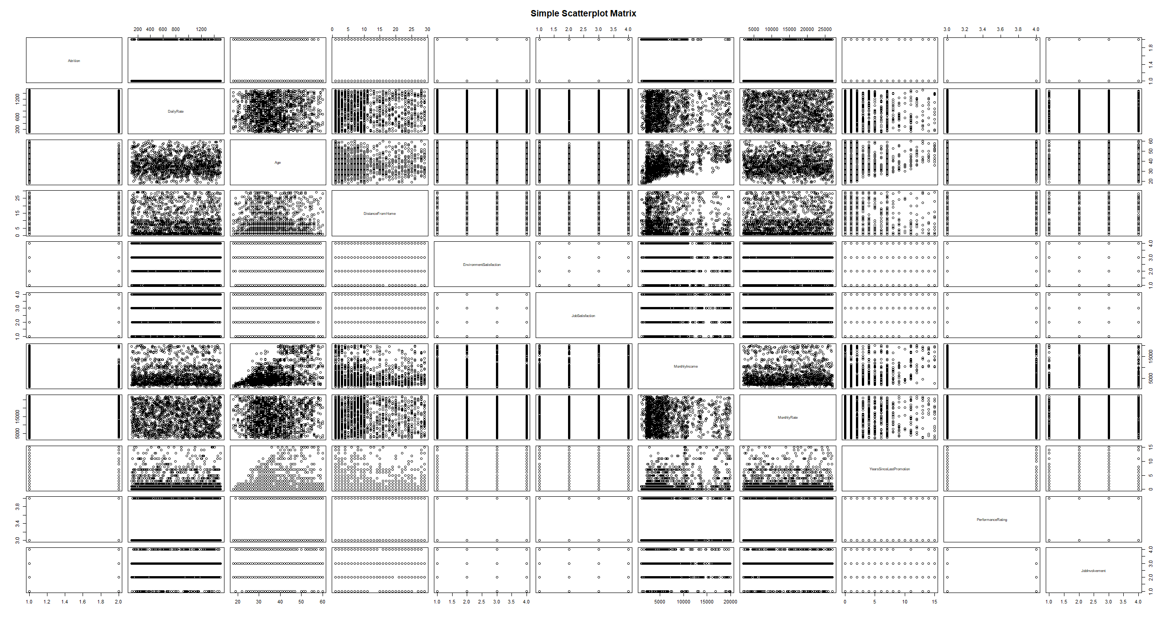

Slide 34
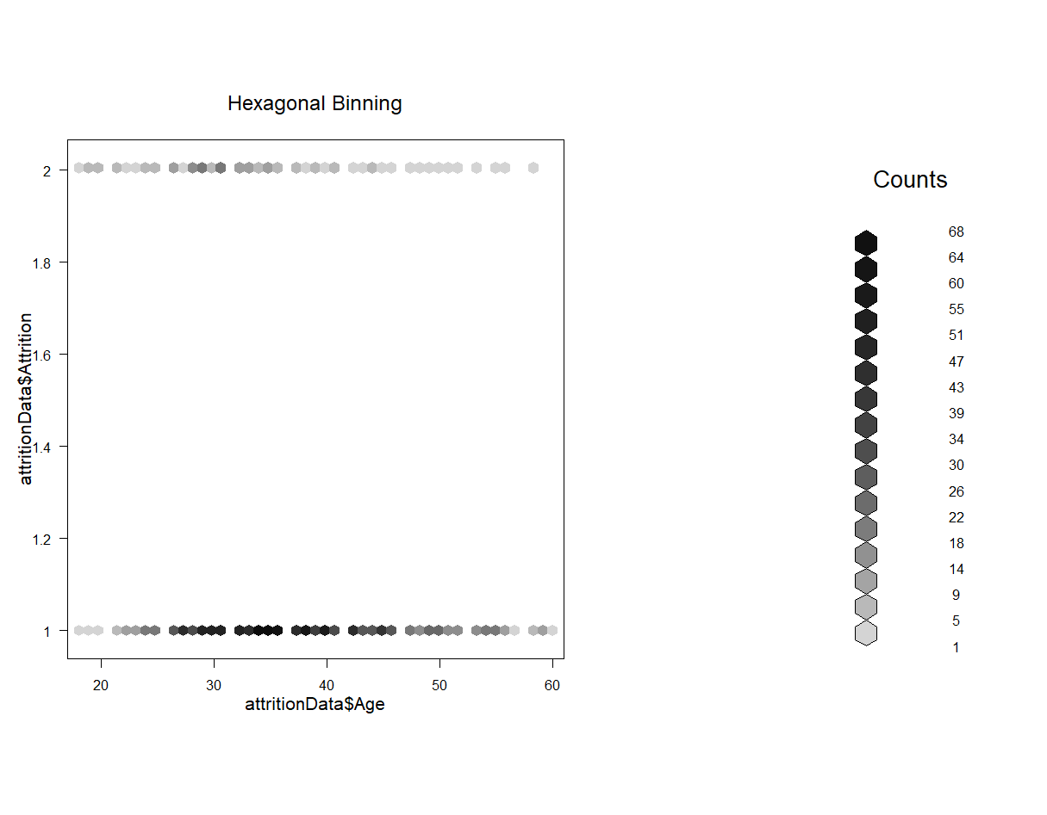

Slide 35
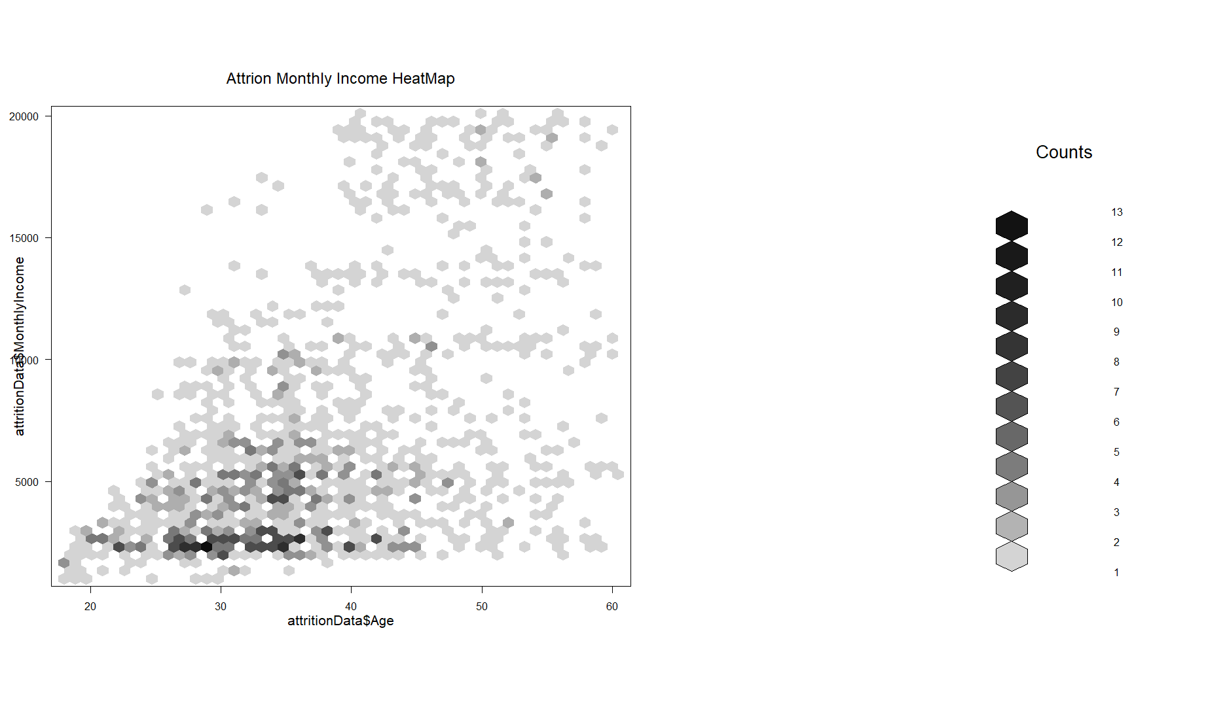

Slide 36
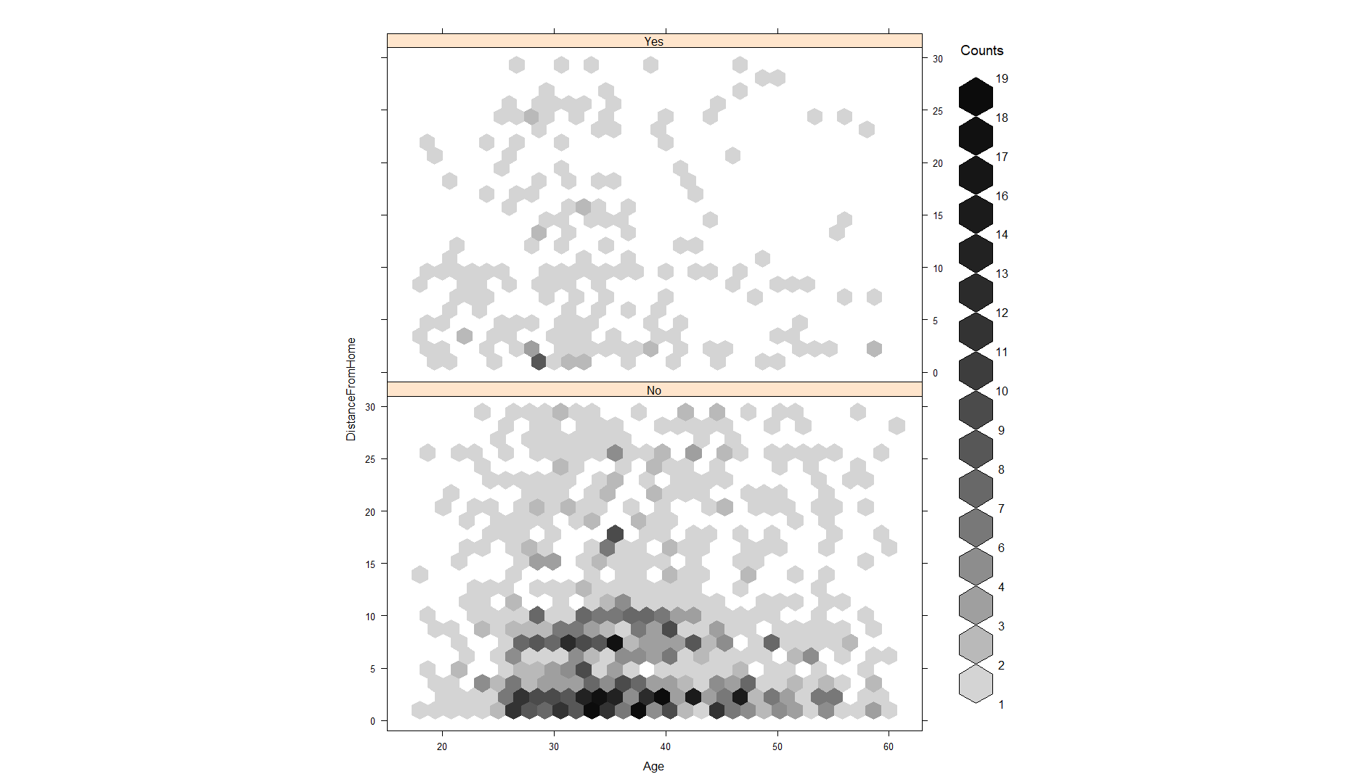
Makes you think what jobs are within 1 mile that people~30 are leaving?

Slide 37
