Slide 1
Imported data
library(openxlsx)
attritionData <- read.xlsx("CaseStudy2-data.xlsx")

Slide 2
Inspected Data
names(attritionData)
[1] "Age" "Attrition" "BusinessTravel" "DailyRate" "Department"
[6] "DistanceFromHome" "Education" "EducationField" "EmployeeCount" "EmployeeNumber"
[11] "EnvironmentSatisfaction" "Gender" "HourlyRate" "JobInvolvement" "JobLevel"
[16] "JobRole" "JobSatisfaction" "MaritalStatus" "MonthlyIncome" "MonthlyRate"
[21] "NumCompaniesWorked" "Over18" "OverTime" "PercentSalaryHike" "PerformanceRating"
[26] "RelationshipSatisfaction" "StandardHours" "StockOptionLevel" "TotalWorkingYears" "TrainingTimesLastYear"
[31] "WorkLifeBalance" "YearsAtCompany" "YearsInCurrentRole" "YearsSinceLastPromotion" "YearsWithCurrManager"
Potential Trends related to attrition:
Age related to Attrition
People retire, midlife crisis?
WorklifeBalance
People retire, midlife crisis?
JobInvolvment/JobSatisfaction
Are people bored? Are they engaged? Too much work?
Years at company
Do the longer people work at company deter them more from leaving?
Job Role
What jobs have the most people leaving?
Monthly Income
Is there an average wage that causes people to leave?
Gender
Which gender is leaving more?

Slide 3
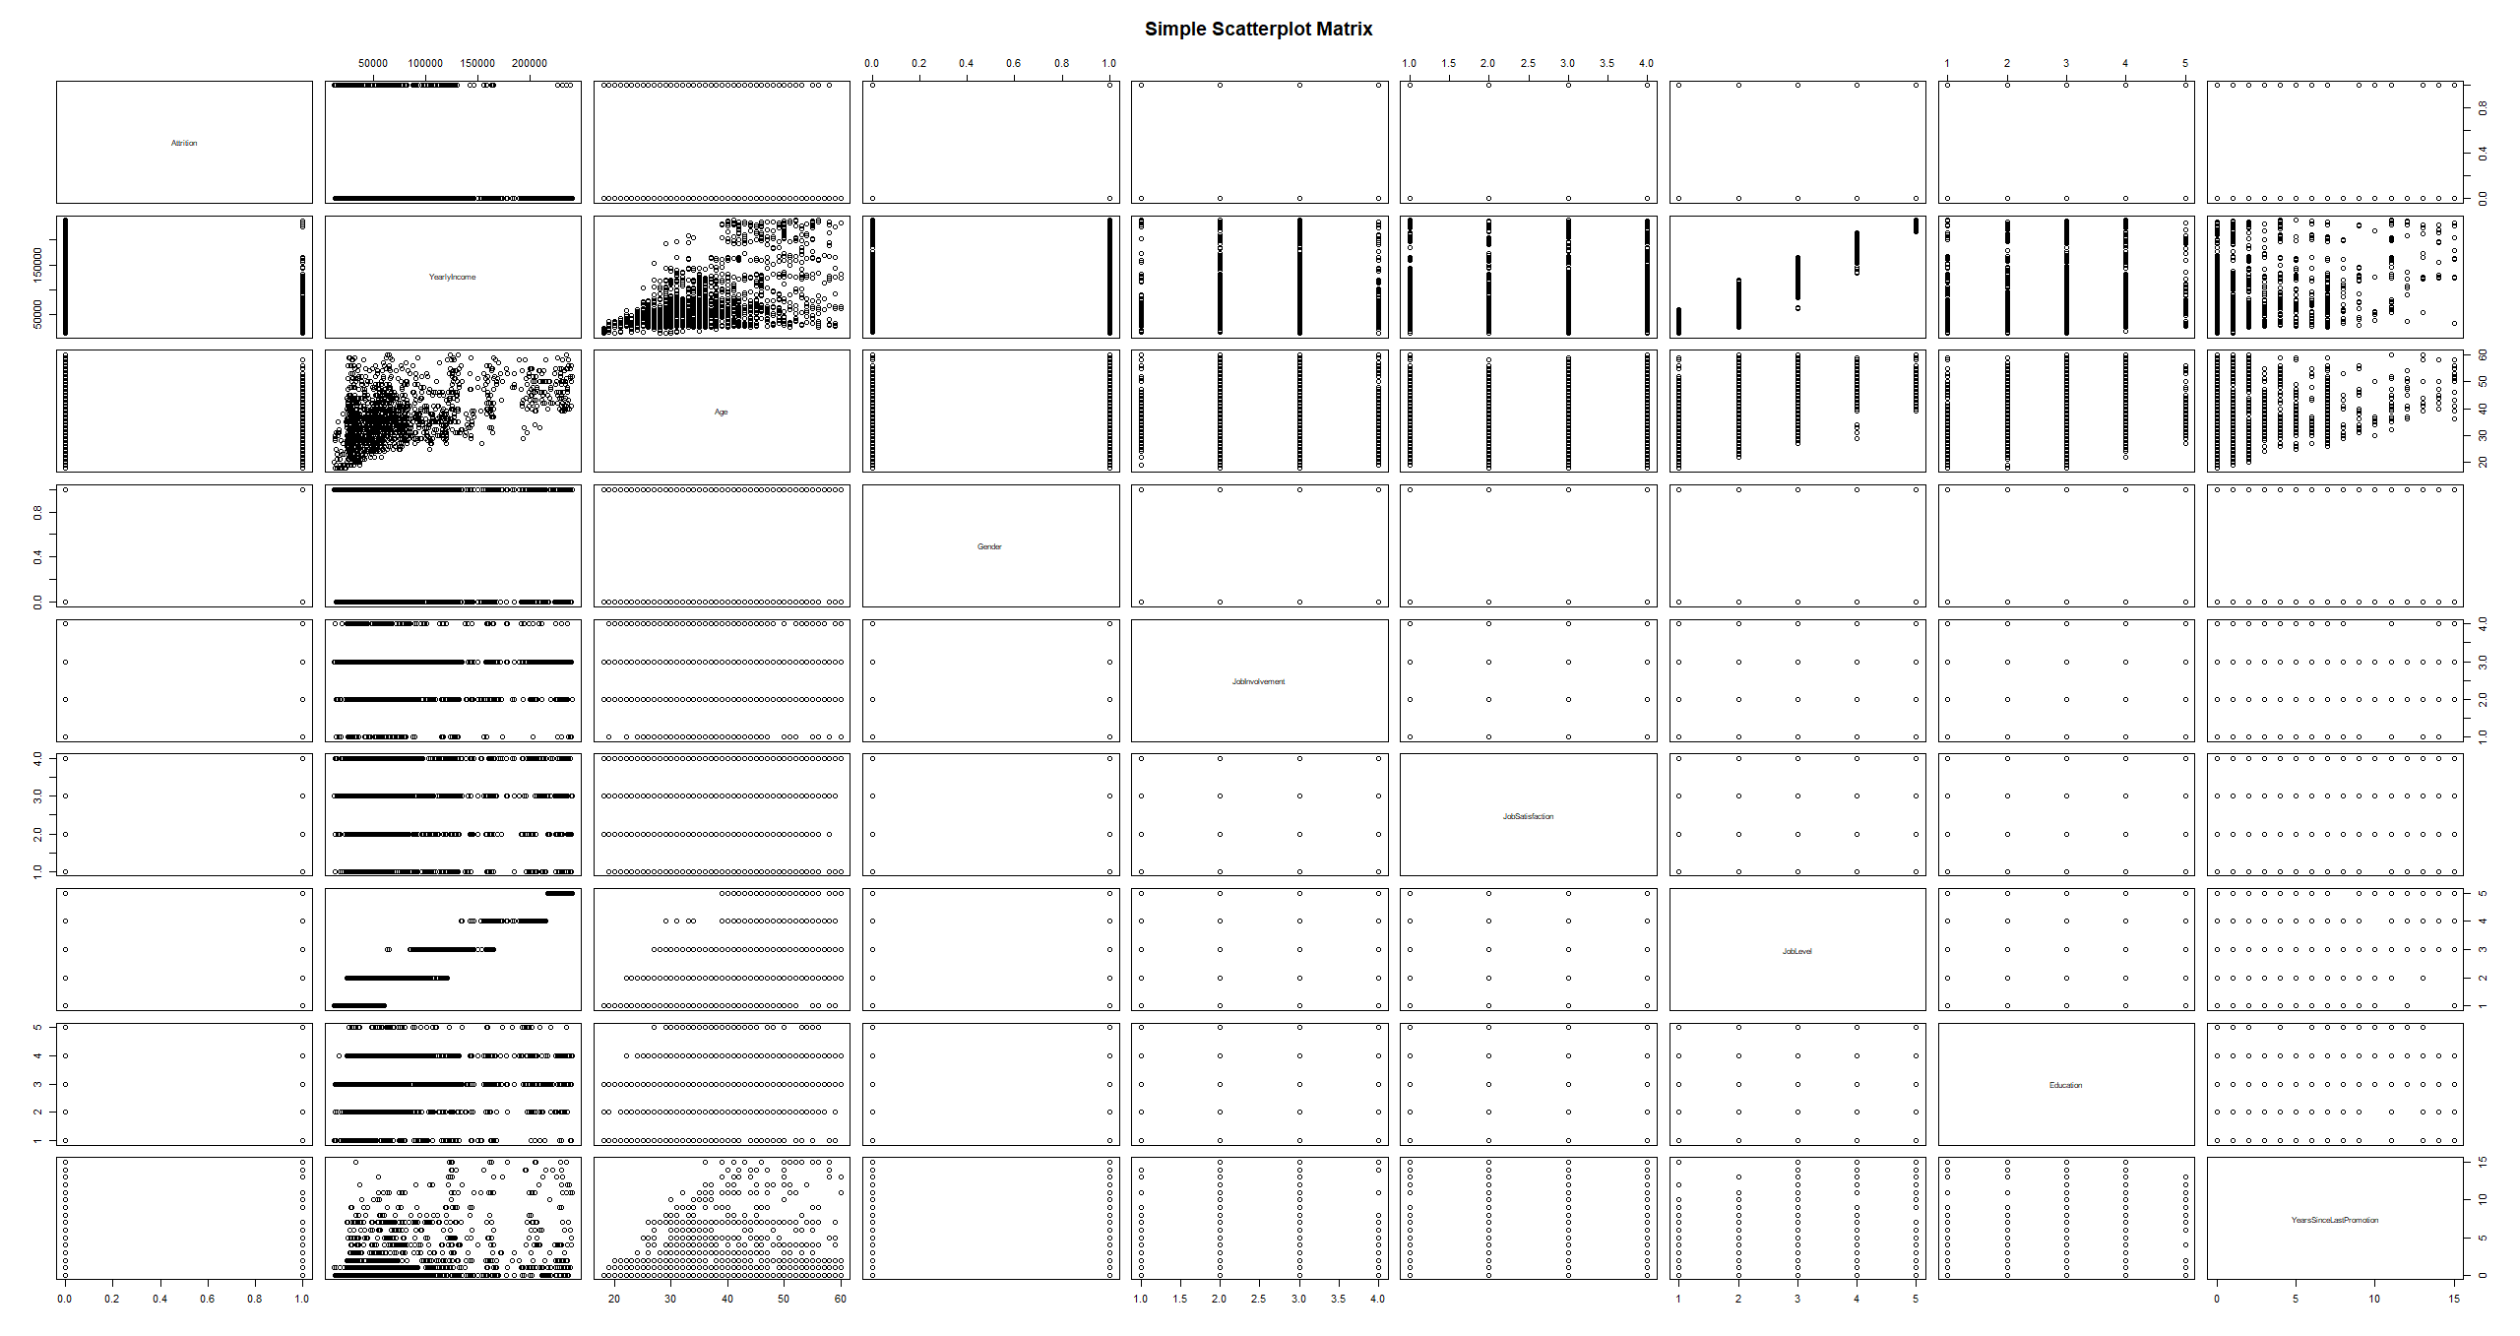
pairs(~Attrition+DailyRate+Age+DistanceFromHome+EnvironmentSatisfaction+JobSatisfaction+MonthlyIncome+MonthlyRate+
YearsSinceLastPromotion+PerformanceRating+JobInvolvement,data=attritionData,
main="Simple Scatterplot Matrix")

Slide 4
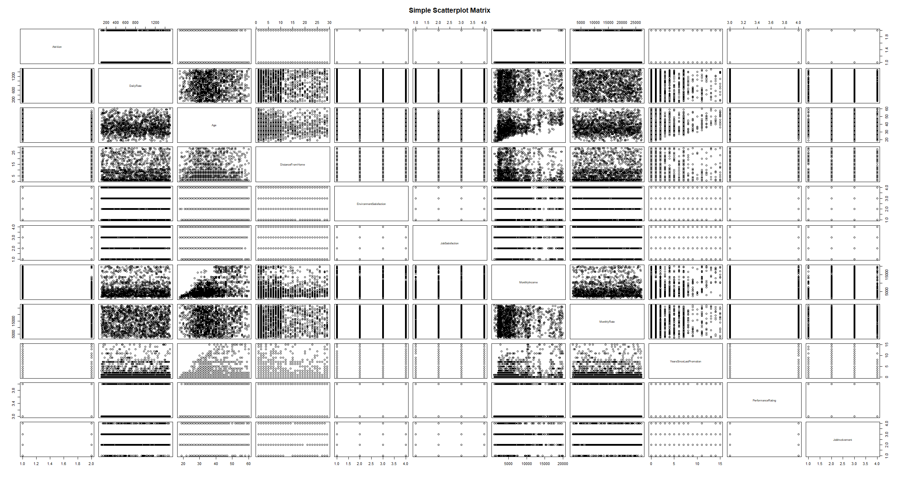

Slide 5
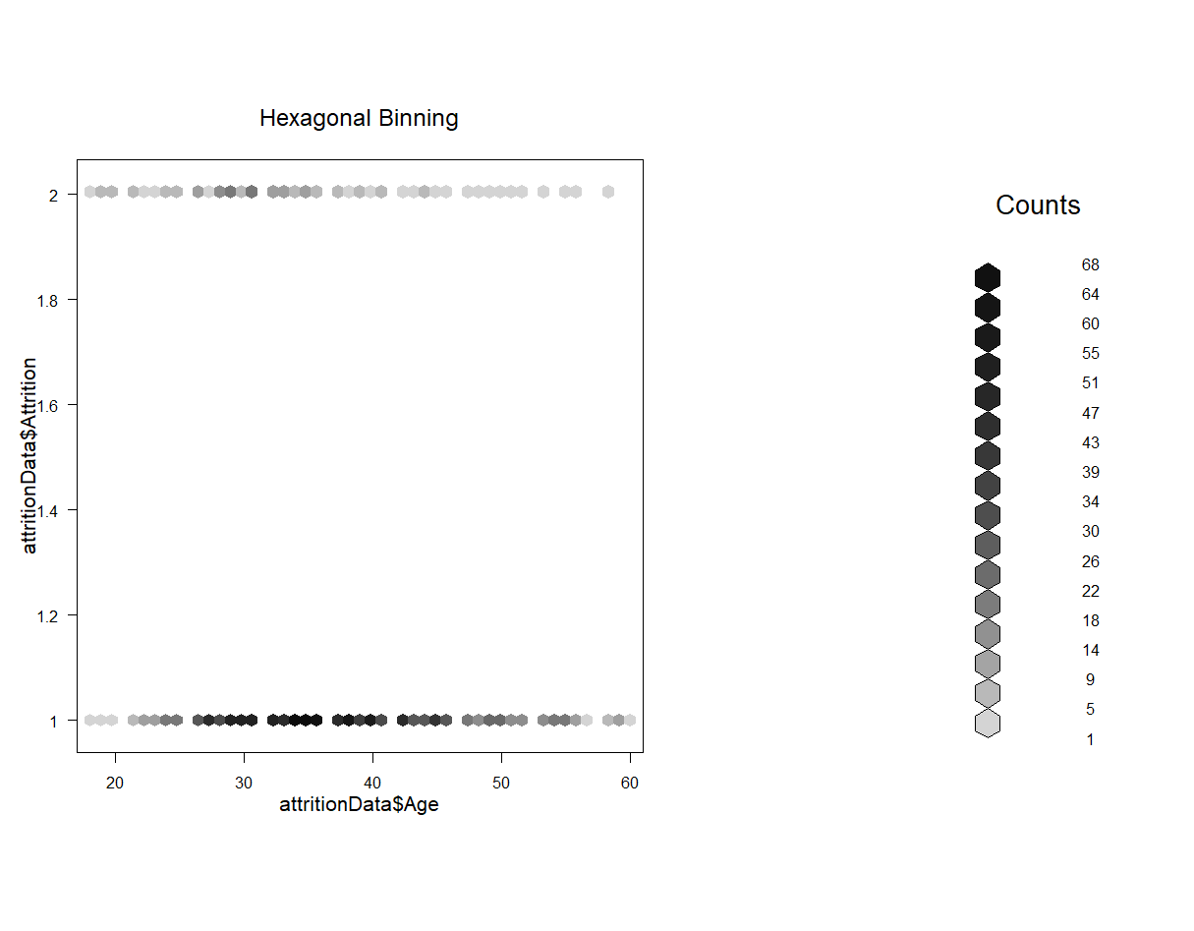

Slide 6
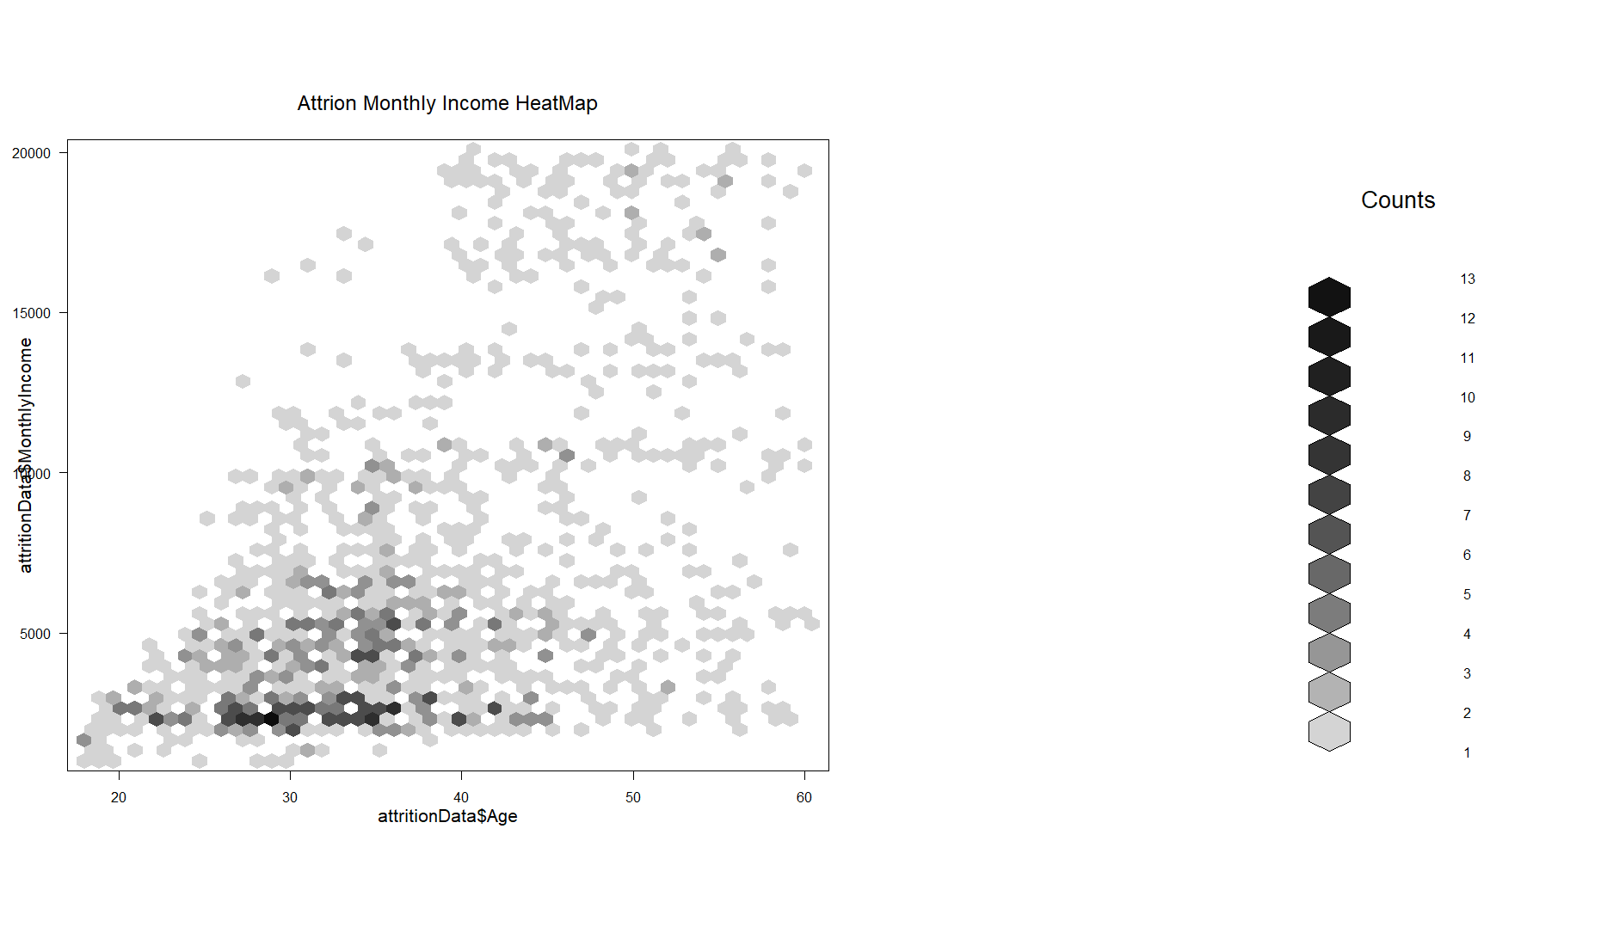

Slide 7
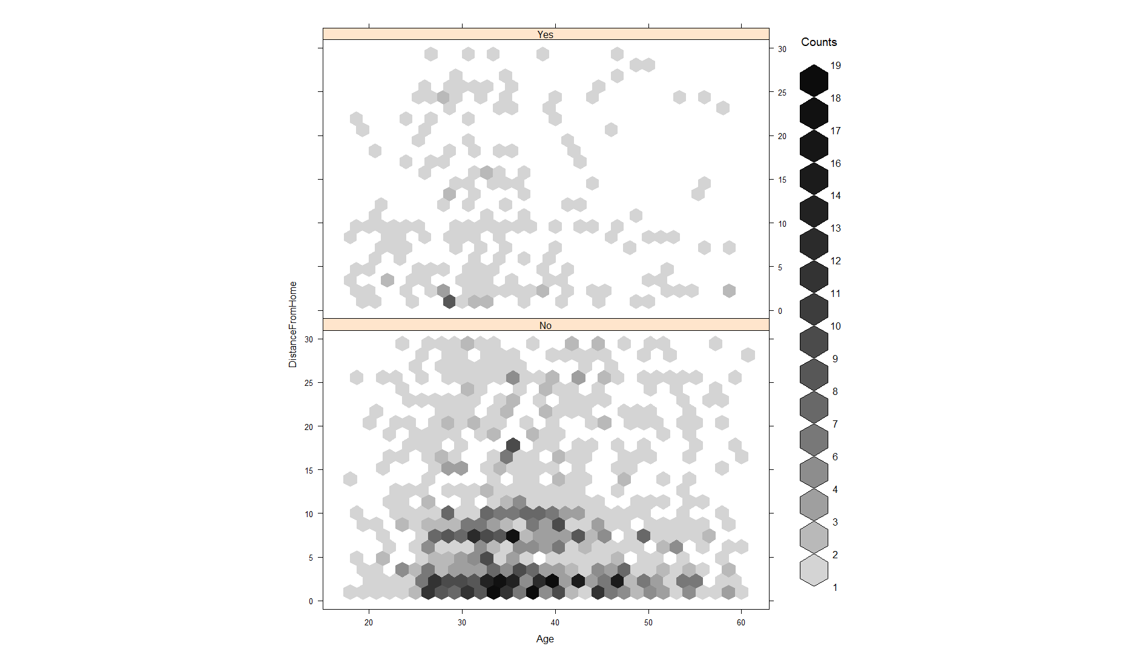
Interesting, what age is this?

Slide 8
