Slide 1


History for the IB MYP 4&5: by Concept
3 Ideology and Intellectual Movements
Outcome: To assess the role of Fascism in the Italian society
©

Slide 2

History for the IB MYP 4&5: by Concept
This symbol was used by Mussolini during his rule over Italy.
What do you think the symbol represents?

Slide 3
History for the IB MYP 4&5: by Concept
Use this extract to answer the question:
What is fascism?
The word Fascism has a dual origin. It comes in part from the word ‘fasces’, a bundle of rods round an axe carried by the magistrates in ancient Rome as a symbol of power and authority. It comes also from the Italian word, fascio, meaning band or group. The basic concept of Fascism, as elaborated by Mussolini, was that the State was absolute before which individuals and groups were all relative.
Politically, to the Fascists, parliamentary democracy could only lead to inefficiency and corrupt government; and so the whole parliamentary system must be discarded. In the words of Mussolini, national strength was conceived qualitatively and not quantitatively. For the strength of the nation, it should be ruled by a well-disciplined party elite, which, under the guidance of an inspired and unquestioned leader, would restore order and stability for the nation and lead it forward to greatness.
Economically, Mussolini preferred state control to laissez faire. Labour and capital must work together under the direction of the state.
Socially, Mussolini condemned Marxism for dividing the nation into classes and causing class war which would sap the strength of a nation. Thus he demanded that the people should subject themselves to the absolute authority of the state. People could find their own worth only when they were serving the state. As a result, freedom of assembly and thinking were wiped out in Italy.
In foreign policy, since Fascism promised national glory, it was natural for Mussolini to adopt an expansionist foreign policy from the beginning of his rule. Mussolini's ultimate goal was to revive the glories of the old Roman Empire.
In short, a Fascist state was a totalitarian state, controlling all the political, economic and social activities of its people. Mussolini always proclaimed, ‘Everything within the state, nothing against the state, nothing outside the state.’ The masses should only ‘believe, obey and fight’.
Extract from www.funfront.net

Slide 4
History for the IB MYP 4&5: by Concept
On the following slides you will see a series of sources related to fascism in Italy under the rule of Benito Mussolini.
For each source consider the following questions:
What is going on in the source?
What does it tell us about
a) Fascism
b) Its impact on Italian society.

Slide 5
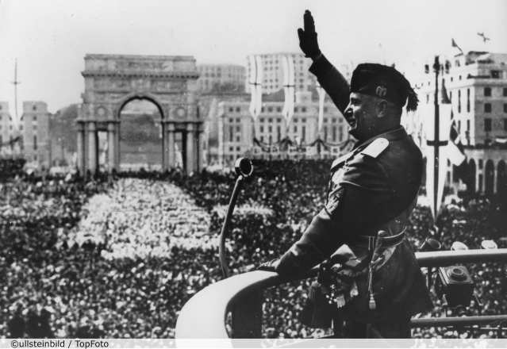
History for the IB MYP 4&5: by Concept

Slide 6
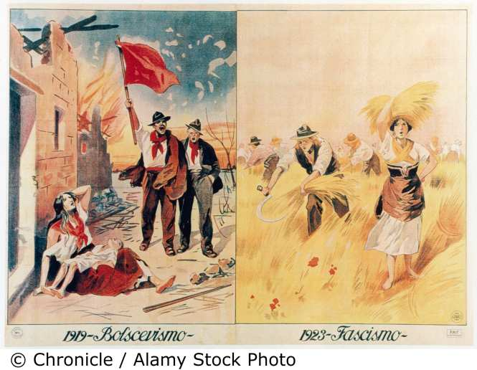
History for the IB MYP 4&5: by Concept

Slide 7
History for the IB MYP 4&5: by Concept
Mussolini’s declaration of war against Britain and France.
Made in Rome, 10 June 1940.
https://www.youtube.com/watch?v=RTEN06p6Rqk

Slide 8
History for the IB MYP 4&5: by Concept
Extract on the relationship with the Roman Catholic Church
Mussolini had to foster good relations with the Roman Catholic Church simply because, regardless of his dictatorship, the Roman Catholic Church was such a powerful institution in Italy. While Mussolini governed the political side of Italy, the Roman Catholic Church governed the spiritual side. In this sense, Mussolini could not afford to anger the Roman Catholic Church.
As a young man, Mussolini had shared his father’s opinion of the Roman Catholic Church. Mussolini senior disliked the power of the Church and the young Mussolini referred to priests as ‘black germs’.
However, once in power after 1922, he had to be more guided. Mussolini had recognised this as early as 1920 when the fledgling future leader of Italy had said that the pope ‘represents 400 million men scattered the world over … (this was) a colossal force.’
Once leader, Mussolini had to decide on whether to take on the power of the Roman Catholic Church in Italy or to work with it. He chose the latter. In this way, Italians did not have to have divided loyalties. Therefore, Mussolini worked to get the Roman Catholic Church to accept a Fascist state while he planned to offer the Roman Catholic Church what it wanted.

Slide 9
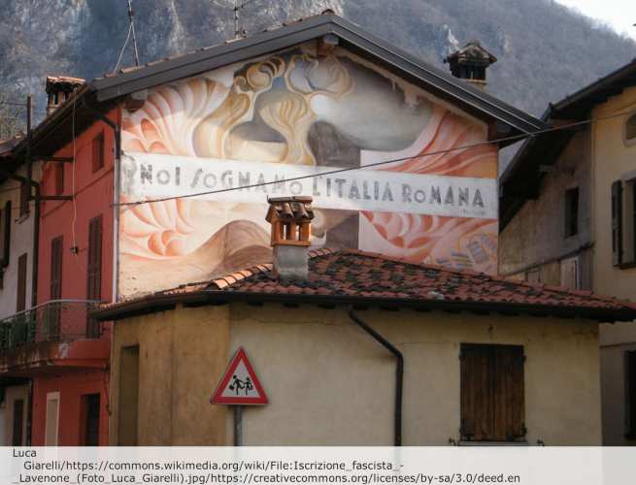
History for the IB MYP 4&5: by Concept
Mural on a house with a fascist slogan:
‘We dream of a Roman Italy’.

Slide 10
History for the IB MYP 4&5: by Concept
The Battle for Births
The ‘Battle for Births’, launched in 1927, was designed to increase the population from 40 million to 60 million by 1950. Mussolini specified 12 children per family as the ideal. To achieve this, a series of ‘carrot and stick’ measures were introduced. Marriage loans were offered to encourage couples to have more children. Part of the loan repayment was cancelled as each new child was born. A further financial inducement was that a married man with at least six children was exempt from all taxation. In addition, health care for mothers and infants was improved. Propaganda suggested that all good Italians had a duty to produce children for the Duce. Indeed, Mussolini gave prizes to the most prolific mothers.
Mark Robson
Access to History: Italy: The Rise of Fascism 1915–1945

Slide 11
History for the IB MYP 4&5: by Concept
Review
What are the key features of fascism?
How did fascism under Benito Mussolini affect ordinary people in Italy?
Extension
You could research this further by examining the political, economic and social policies of Mussolini.

