Slide 1
DATA VISUALIZATION
WHY, WHAT, WHERE and how

Slide 2
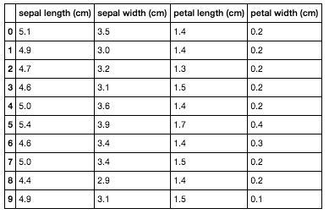

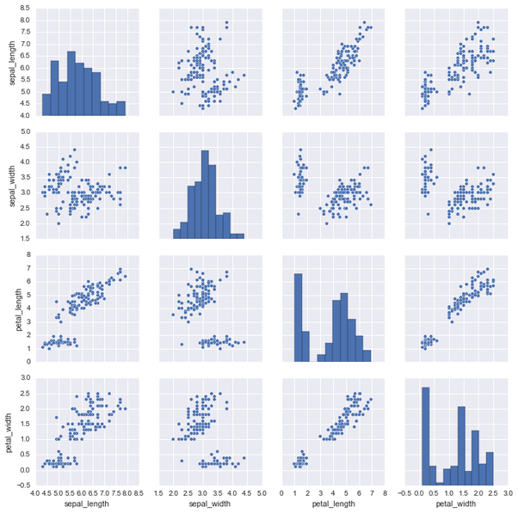
WHY VISUALIZE?
IRIS PAIRPLOT
IRIS DATASET

Slide 3
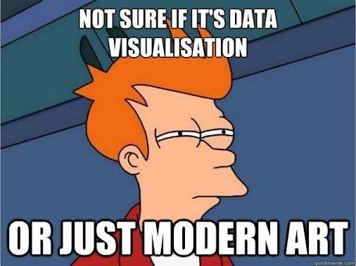
WHAT I WANT TO SEE?
A visual representation of the data
When possible, the representation of an a-priori hypothesis
Information that are relevant to the hypothesis
A visual which goes along well with the nature of the data
Less text but still some text
If it ONLY quacks like a duck doesn’t mean it is a duck

Slide 4
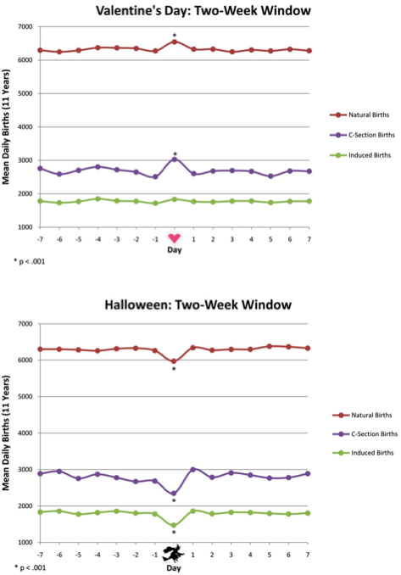
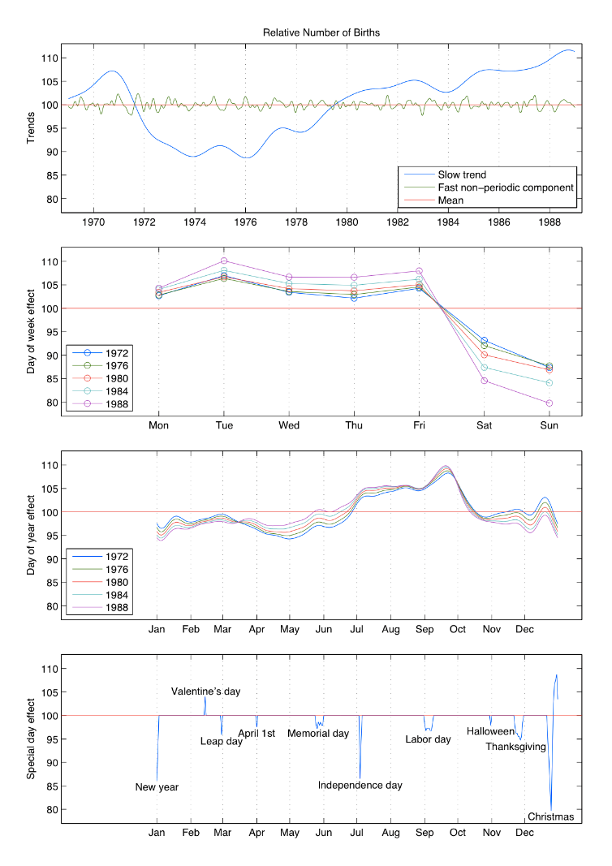
NORMIE
PRO
Levy et al. (2011)
Gelman et al. (2013)

Slide 5





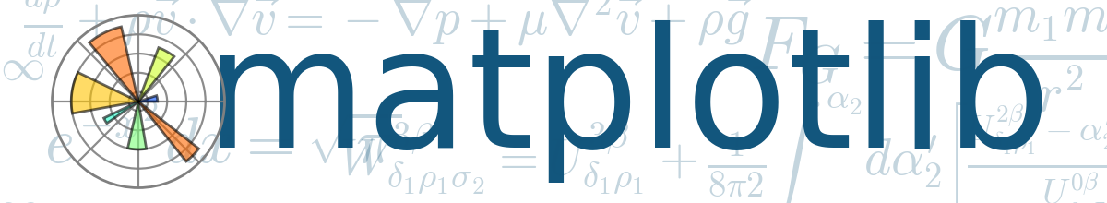



WHERE TO START?

Slide 6
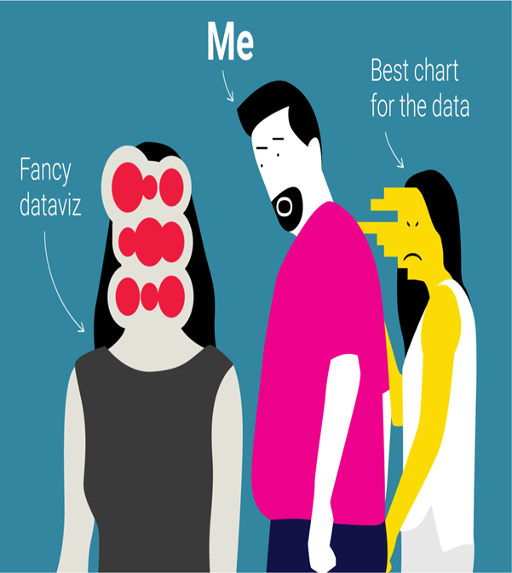
HOW TO DO IT (PROPERLY)?
https://andrewgelman.com/2008/06/06/new_candidate_f/
The complexity of a visualization should match its purpose and audience
A visualization should aim to be as much self-explanatory as possible
Sometimes less is better
Colour codes matter (a lot) as well as dimensionality and motion
Time and space constrains are a real thing
NO PIE CHARTS OR WORDS CLOUD

Slide 7
REFERENCES
Levy, Becca R., Pil H. Chung, and Martin D. Slade. "Influence of Valentine’s Day and Halloween on birth timing." Social Science & Medicine 73, no. 8 (2011): 1246-1248.
Gelman, Andrew, Hal S. Stern, John B. Carlin, David B. Dunson, Aki Vehtari, and Donald B. Rubin. Bayesian data analysis. Chapman and Hall/CRC, 2013.
https://www.youtube.com/watch?v=fc1hkFC2c1E

Slide 8
LET’S GET STARTED!
At least one working environment every 2 people.
If not able to access the environment, read from the html version or follow on the projector.

