Slide 1
Machine Learning

Slide 2
Main branches
Artificial neural networks
Genetic algorithms
Statistic methods
Decision Trees

Slide 3
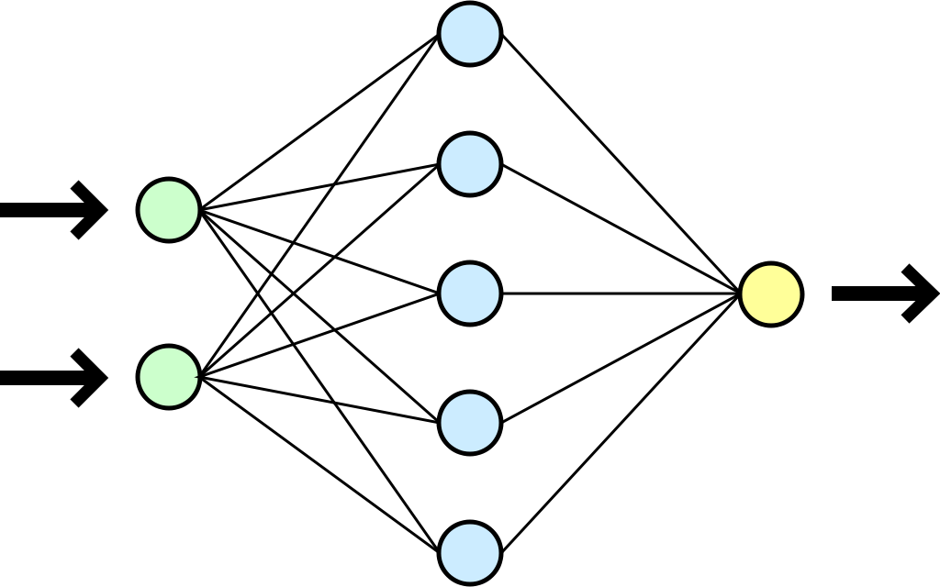
Artificial Neural networks
Inspired by biological neural networks

Slide 4
Artificial Neural networks
Fields of application:
OCR
Speach to text
Shapes recognition

Slide 5
Artificial Neural networks
Ready to use solutions:
F# + R Type provider
Synaptic.js

Slide 6
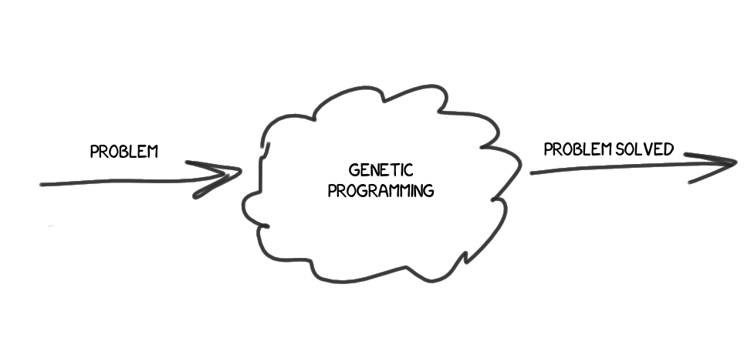
Genetic algorithms
Inspired by natural selection mechanisms

Slide 7
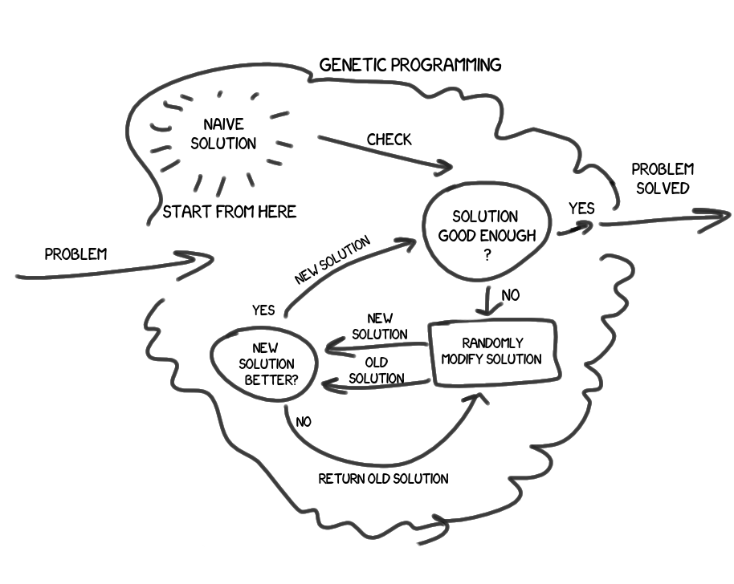
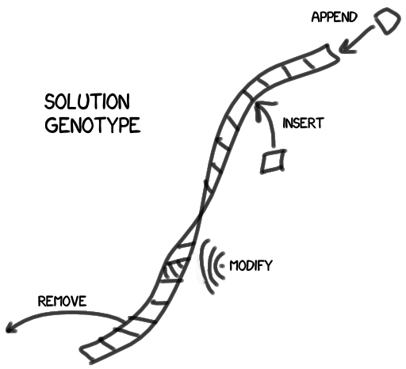
Genetic algorithms

Slide 8
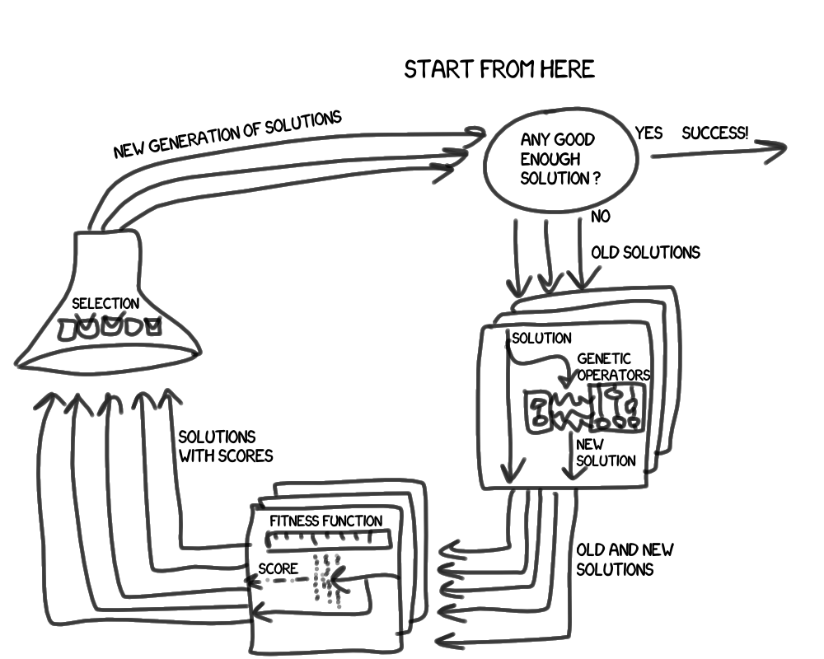
Genetic algorithms
Genetic operations (crossover and mutation)
Fitness function (satisfaction check)
Selection (choice of solution for the next generation)

Slide 9
Genetic algorithms
Fields of application:
Bioinformatics
Climatology
Code-breaking
Game theory

Slide 10
Genetic algorithms
Ready to use solutions:
F# + R Type provider
Vanilla JS implementations

Slide 11
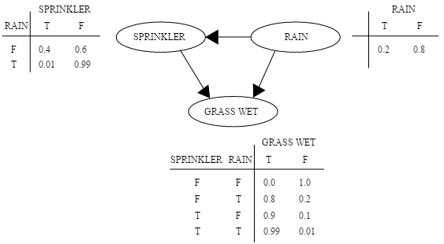
Statistic methods(Bayesian networks)
P(G,S,R) = P(G|S,R)P(S|R)P(R)
P(S,R) = (P(R|S)P(S))/P(R)

Slide 12
Statistic methods(Bayesian networks)
Fields of application:
Anti-SPAM protection
Automated information classification
Risk analysis
Pricing decisions

Slide 13
Statistic methods(Bayesian networks)
Ready to use solutions:
F# + R Type provider
Vanilla JS implementations

Slide 14
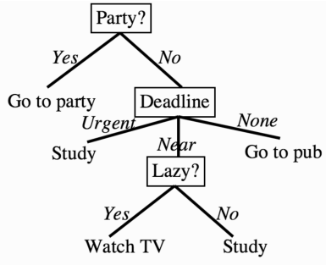
Decision Trees
flowchart-like structure in which each internal node represents a "test" on an attribute

Slide 15
Decision Trees
Let’s try to solve a problem of gender definition
Hair length | Gender
0 | Male
5 | Male
10 | Male
25 | Female
27 | Female
40 | Female

Slide 16
Decision Trees
Solution
Hair length | Gender
0 | Male
5 | Male
10 | Male
25 | Female
27 | Female
40 | Female

Slide 17
Decision Trees
Simpsons task
Name | Hair length | Weight | Age | Gender
Homer | 0 | 250 | 36 | M
Marge | 10 | 150 | 34 | F
Bart | 2 | 90 | 10 | M
Lisa | 6 | 78 | 8 | F
Maggie | 4 | 20 | 1 | F
Abe | 1 | 170 | 70 | M
Selma | 8 | 160 | 41 | F
Otto | 10 | 180 | 38 | M
Krusty | 6 | 200 | 75 | M
Is Comic guy M or F ?
{
person: 'Comic guy',
hairLength: 8,
weight: 290,
age: 38
}

Slide 18
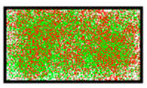
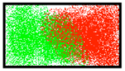
Decision Trees
Entropy
Comes from thermodynamics, more exactly from Second law of thermodynamics:
the total entropy of an isolated system always increases over time, or remains constant in ideal cases where the system is in a steady state or undergoing a reversible process. The increase in entropy accounts for the irreversibility of natural processes, and the asymmetry between future and past.

Slide 19
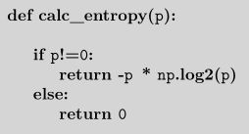

Decision Trees
Entropy in Informaton Theory
Information theory was ‘born’ in 1948 when Claude Shannon published a paper called “A Mathematical Theory of Communication”.
The paper proposes the measure of information entropy, which describes the amount of impurity in a set of features.
$$Entropy\left(p\right)=−\sum_{i}{{p_{i}log}_{2}p_{i}}$$

Slide 20
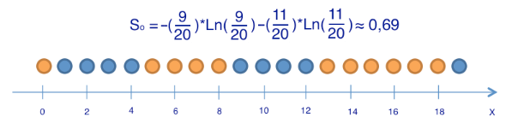
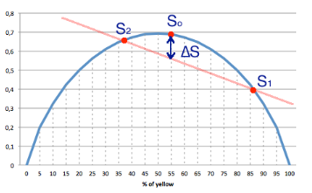
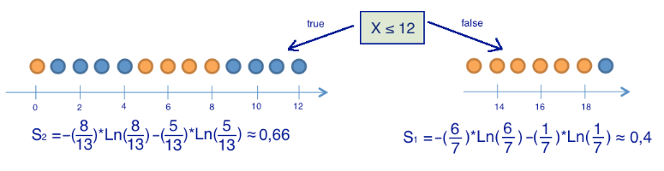
Decision Trees
Shannon entropy example

Slide 21
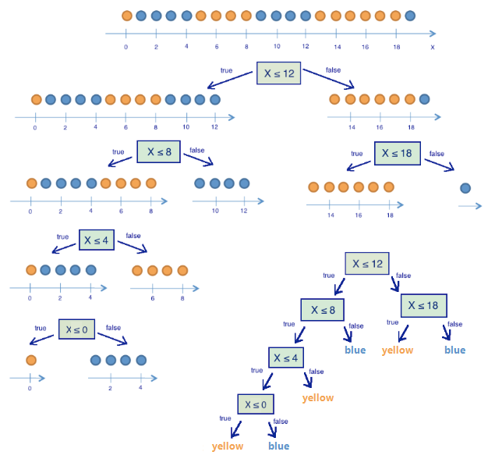
Decision Trees
Shannon entropy example
For the purposes of simplicity
each element has only one
attribute x, but in the reality
we can have as many attributes
as we want.

Slide 22
Decision Trees
Let’s see the demos

Slide 23
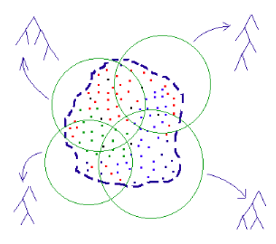
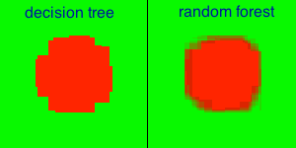
Decision Trees
Random Forest
Stopping criteria is the cornerstone of such algorithms as ID3 and C4.5
To avoid all kind of troubles with stopping criteria (currently entropy = 0) we can split the training set on X equal parts and train one tree per part.
Efficient processing of borderline areas of data

Slide 24
Decision Trees
Let’s see the demos

Slide 25
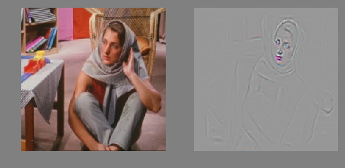
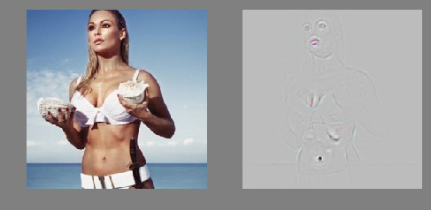
Decision Trees
Useful use case
We can combine artificial neural networks and decision trees to detect suspect images/frames
ANN can adjust the contrast and extract necessary shapes and stripes in efficient manner
Decision trees can classify the extracted set of graphical elements

Slide 26
Decision Trees
Computational Complexity
The computational cost of constructing binary trees is well known for the general case, being O(N logN)
Category search for general case is O(logN) or O(n) for worst case

Slide 27
Decision Trees
Fields of application:
Automated information classification
Automated motions/forms recognition
Financial institutions, Option pricing
Health, BI diagnose or heart attack prediction

Slide 28
Decision Trees
Ready to use solutions:
F# + R Type provider
Vanilla JS implementations

Slide 29
Thanks for your attention
References:
https://habrahabr.ru/post/171759/
http://blog.clarifai.com/what-convolutional-neural-networks-see-at-when-they-see-nudity/
Machine Learning an algorithmic perspective, 2nd edition, Stephen Marsland
Machine Learning Hands-on for developers and technical professionals, Jason Bell

