Slide 1
Programming with F#
Introduction

Slide 2
Ten reasons not to use a statically typed functional programming language
Reason 1: I don’t want to follow the last fad
Like most programmers, I'm naturally conservative and I dislike learning new things. That's why I picked a career in IT
I don’t jump on the latest bandwagon just because all the “cool kids” are doing it
FP just hasn’t been around long enough to convince me that it’s here to stay
And look at the baby of the bunch, F#. It's only seven years old. Sure, that may be a long time to a geologist, but in internet time, seven years is just the blink of an eye

Slide 3
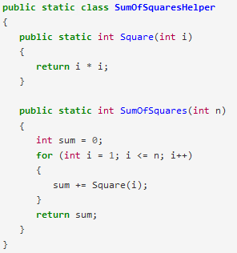

Ten reasons not to use a statically typed functional programming language
Reason 2: I get paid by the line
I don't know about you, but the more lines of code I write, the more productive I feel, my commits are big and my boss can see that I’ve been busy
But when I compare code written in a FL with a good old IL, it scares me
VS

Slide 4
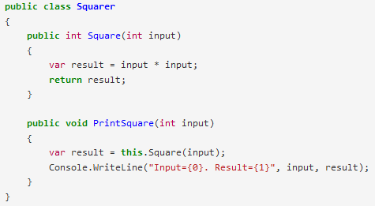
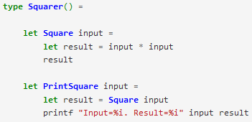
Ten reasons not to use a statically typed functional programming language
Reason 3: I love me some curly braces
And that's another thing. What's up with all these languages that get rid of curly braces. How can they call themselves real programming languages?
VS
Look at the difference! To be honest, I feel a bit lost without the guidance that curly braces give me

Slide 5


Ten reasons not to use a statically typed functional programming language
Reason 4: I like to see explicit types
Well, as it happens, I like to see type declarations. I feel uncomfortable if I don't know the exact type of every parameter. That's why Java is my favorite language.
VS
It's important to me to know that the return is of type IEnumerable <IGrouping <TKey, TSource>> !
Sure, the compiler will type check this for you and warn you if there is a type mismatch. But why let the compiler do the work when your brain can do it instead?

Slide 6
Ten reasons not to use a statically typed functional programming language
Reason 5: I like to fix bugs
To me, there's nothing quite like the thrill of the hunt -- finding and killing a nasty bug. And if the bug is in a production system, even better, because I'll be a hero as well
Reason 6: I live in the debugger
Talking of bug fixing, I spend most of my day in the debugger, stepping through code
Apparently with these statically typed functional languages, if your code compiles, it usually works
Reason 7: I don't want to think about every little detail
In fact, I hear that you are forced to think about all the possible edge cases, and all the possible error conditions, and every other thing that could go wrong. And you have to do this at the beginning - you can't be lazy and postpone it till later
I'd much rather get everything (mostly) working for the happy path, and then fix bugs as they come up

Slide 7
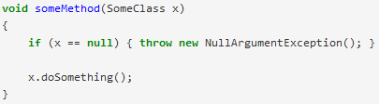
Ten reasons not to use a statically typed functional programming language
Reason 8: I really love to check for null
I'm very conscientious about checking for nulls on every method. It gives me great satisfaction to know that my code is completely bulletproof as a result.
Of course I can't be bothered to put null-checking code everywhere. I'd never get any real work done.
But I've only ever had to deal with one bad crash caused by a NPE. And the business didn't lose too much money during the few weeks I spent looking for the problem. So I'm not sure why this is such a big deal.

Slide 8
Ten reasons not to use a statically typed functional programming language
Reason 9: I like to use design patterns everywhere
I read about design patterns in the Head First DP book and since then I have been diligent in using them at all times for all problems. It certainly makes my code look serious and "enterprise-y", and it impresses my boss.
But I don't see any mention of patterns in functional design. How can you get useful stuff done without Strategy, AbstractFactory, Decorator, Proxy, and so on?
Reason 10: It's too mathematical
Here's some more code for calculating the sum of squares. This is way too hard to understand because of all the weird symbols in it.
But I do hear that functional programs use strange symbols like <*> and >>= and obscure concepts called "monads" and "functors".
I don't know why the functional people couldn't stick with things I already know obvious symbols like ++ and != and easy concepts such as "inheritance" and "polymorphism".

Slide 9
Few words about F#
Open source
Multi-paradigm
Statically typed
Aims cross-platform CLI and also JavaScript and GPU
Appeared in 2005
Originates from MS Research
Influenced by Ocaml, C#, Python, Haskell

Slide 10
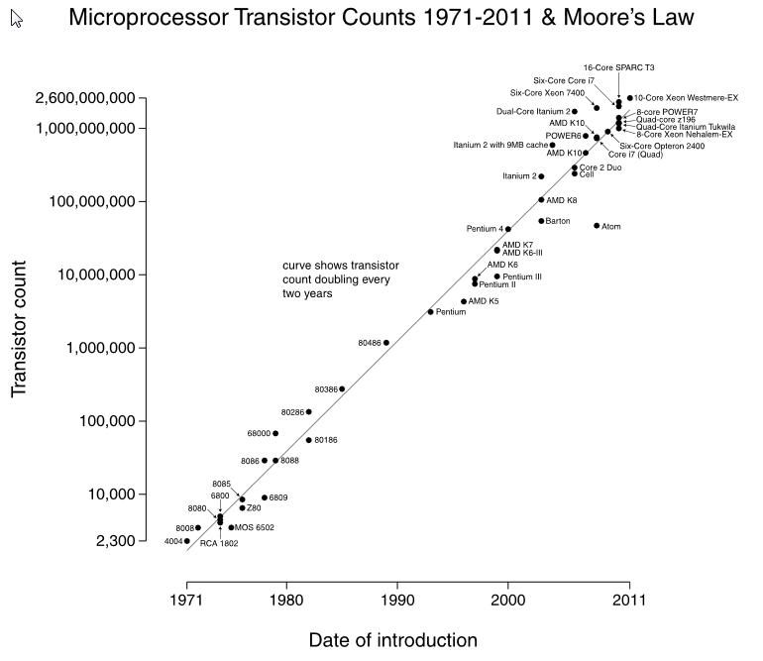
Why an another language
Moore’s law no more working
The number of transistors on integrated circuits doubles approximately every two years
ITRS has growth slowing at the end of 2013, after which time transistor counts and densities are to double only every three years
Notes:
The period often quoted as "18 months" is due to Intel executive David House, who predicted that period for a doubling in chip performance (being a combination of the effect of more transistors and their being faster)
ITRS - International Technology Roadmap for Semiconductors
Landauer's principle
Planes for 500$

Slide 11
Why an another language
Productivity
“What” rather than “how”, in the goal of understanding what a program does
You almost never have to specify the type of an object, thanks to a powerful type inference system
Compared with C# / VB, it generally takes fewer lines of code to solve the same problem
Immutability avoid a lot of misunderstanding
Notes:
Many people find functional programming more elegant or even beautiful, but that's hardly a good reason to use it in a commercial environment
Logical programming, where we don’t need to produce a complete solution to solve a problem
Imperative (OOP) vs Functional
Internal state can be changed by simple method calling on the target object (new Rectangle().Inflate(10))

Slide 12
Why an another language
Correctness
Powerful type system which prevents many common errors such as null reference exceptions
Ability to encode a business logic using the type system itself in such a way that is actually impossible to write incorrect code or mix up units of measure
Some of language mechanisms are able to greatly reduce the need of unit testing

Slide 13
Why an another language
Concurrency
No more need to synchronize an access to data structures, sharing state and avoiding locks is much easier
Easy to use, built-in models and libraries
Asynchronous programming becomes easy, as is parallelism

Slide 14
Why an another language
Completeness
Multi paradigm
Support of other styles which are not 100% pure, ease of interaction with non-pure world of web sites, databases, etc …
Hybrid design permit to do virtually everything that C# can do
Part of the .NET ecosystem
Seamless access to all the third party .NET libraries and tools
Visual studio integration, that produce an IntelliSence, debugger and source control support

Slide 15
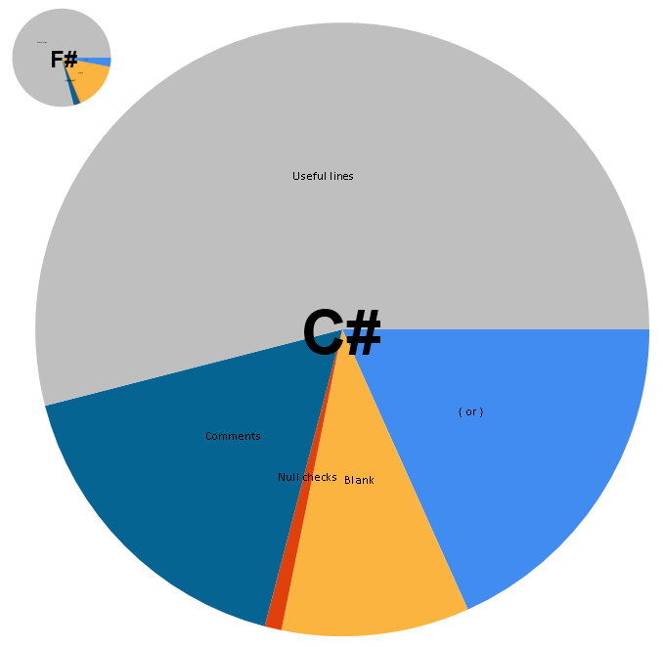
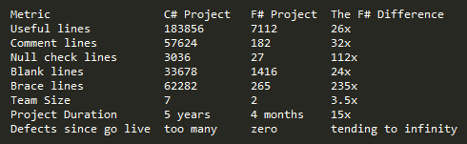
Does the language you choose make a difference?
Notes:
Let's compare the code from two projects using Kit Eason's code analyser on fssnip. One project is written in C# and the other in F#. Both projects consume data feeds, perform some calculations and report the results to the users. The major difference between the projects is that the F# project consumes much more feeds and performs all the calculations in real-time.

Slide 16
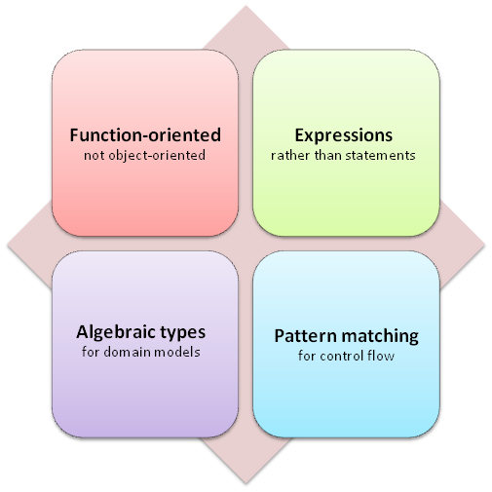
Main concepts

Slide 17
Function-oriented rather than object-oriented
Functions are everywhere and they are first class entities. This nature of F# inflate every part of the language and type system
Binding and composition give us an elegance to build basic function and then function that use those function and so on
Factoring and refactoring, the ability to factor a problem into parts depends how easily the parts can be glued together
Good design, many of the principles such as "separation of concerns", "single responsibility", "program to an interface, not an implementation", arise naturally as a result of a functional approach. And functional code tends to be high level and declarative in general

Slide 18
Expressions rather than statements
Functional languages have not statements, everything is an expression
Every part of the code return a value

Slide 19
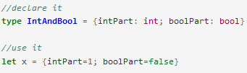
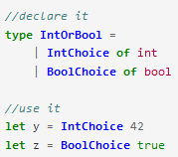
Algebraic types
The type system in F# is based on the concept of algebraic types, new compound types are built by using existing types in two different ways
Combination of values, each picked from a set of types, these are called "product" types
Disjoint union representing a choice between a set of types. These are called "sum" types.
Notes:
By combining "product" and "sum" types in this way, it is easy to create a rich set of types that accurately models any business domain

Slide 20



Pattern matching for flow control
In functional language pattern matching is the purest form of conditional expression
if-then-else replacement
switch replacement
recursive loop representation
All of this conditional expression could be completed with different types of patterns (type test, record, OR, Identifier, etc)
Notes:
Most imperative languages offer a variety of control flow statements for branching and looping:
- if-then-else (and the ternary version bool ? if-true : if-false)
- case or switch statements
- for and foreach loops, with break and continue
- while and until loops
- and even the dreaded goto

Slide 21
Why bugs are afraid of F#
No nulls, there are no nulls so there are no NRE
F# has types that express absence more safely, Options, Choices, etc
Immutable data, no complex state interaction errors
F# is immutable by default
Very strong type system, the compiler works hard to stop me writing nonsense
F# type inference gives immediate feedback on nonsense
Composition of small functions, a small function is easy to reason about, easy to test, and it will continue to work when composed with other small functions, if there is an error it will be in a single small function. Reuse is pervasive.
F# supports first class functions
F# has a syntax friendly to function definition and composition

Slide 22
Why bugs are afraid of F#
Asynchronous programming abstractions, no tedious error prone chaining
F# asynchronous workflows make composing asynchronous computation easy and error free
F# agent abstraction makes dealing with state and concurrency easier to reason about
Higher-order functions over collections, no indexing errors, boundary errors
F# has a rich library of functions over collections
Units of measure, no calculation errors caused by unit misunderstandings
F# supports typing of numeric types
Notes:
- We can find solid actor model implementation for F#
- In 1999 NASA's Climate Orbiter was lost because part of the development team used the metric system and another part used imperial units of measure. This was one of the motivations for a new F# feature called units of measure which allows us to avoid this kind of issue.

Slide 23
λ-calculus
Introduced by Alonzo Church as attempt to formalize every mathematical construct just using the most essential mathematical concept, a function
f(x) = x + 10
becomes (λx.x + 10)
so (λx.x + 10) 32 = 32 + 10 = 42
Another interesting aspect of lambda calculus is that any function is able to take a function as argument
(λop.λx.(op x x)) (+) 21 = (λx.((+) x x)) 21 = (+) 21 21 = 42
Notes:
- In the pure lambda calculus all operators and numerals are also defined using functions

Slide 24
Let’s taste it now
Notes:
- Try all samples one by one

Slide 25
Questions ?
Thanks
Notes:
- Try all samples one by one

