Slide 1
Knockout.js
Join power, pass to future

Slide 2
Era of JQuery
Everyone knows that jquery was born as a pretty nice alternative of the bloated and inconsistent DOM API
In the beginning jQuery was considered such as high level abstraction layer of the DOM API
Time pass, Web advance and application richness grow up
JQuery becomes an excellent low-level way to manipulate elements and events in a web applications
Every time that your applications get more sophisticated, things can get tricky and expensive to maintain if you use JQuery only

Slide 3
Evolution
MVC (Model-View-Controller)
MVP (Model-View-Presenter)
MVVM (Model-View-ViewModel)

Slide 4
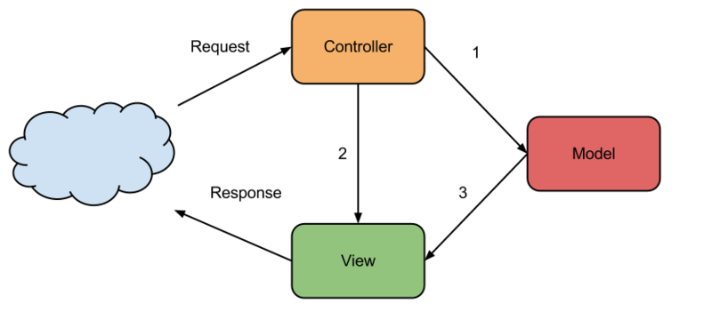
MVC
Lifecycle is well adapted for request/response architecture
After ajax and single-page propagation seems to be limited
Lifecycle increasing means appearance of more and more logic on the controller
No one wants to dispatch a logic between a parts of application

Slide 5

MVP
Presenter means intermediary that represents view state (stateful or stateless)
Presenter could be a javascript object with state fields that interact with view by events (fields are DOM event listeners)
Notes:
Presenter could be a javascript object with state fields that interact with view by events (fields are DOM event listeners)

Slide 6

MVVM
Model-View-View Model is a design pattern for building user interfaces. It describes how you can keep a potentially sophisticated UI simple by splitting it into three parts:
Model – Application stored data (server side via ajax)
ViewModel – Pure representation of the data and operations on a UI
View – Visible, interactive UI representing the state of the view model
All communication between View and ViewModel pass trough data binding events
ViewModel needs alsow PubSub (observable) infrastructure to support this kind of communication

Slide 7
What is Knockout.js
Implements MVVM pattern
Represents easy way to scale up in complexity without fear of introducing inconsistencies
Uses transparent binding mechanism to offer interaction between DOM elements and ViewModels
Uses HTML5 data attributes to realize intereaction View-ViewModel
Helps you to create rich, responsive user interface with a clean underlying data model

Slide 8
What Knockout.js isn’t
It’s not a DOM manipulation library that aims to replace jQuery
It’s not a JQuery extension or dependency

Slide 9
KO’s features
Elegant dependency tracking
Declarative bindings
Trivially extensible
Pure javascript library
Can be added on top of the existing web application
Compact (~13 kb after gzipping)
Works on any mainstream browser (firefox, webkit-based, etc)
Even works with pseudo browsers (msie 6+)
Comprehensive suite of specifications
Notes:
automatically updates the right parts of your UI whenever your data model changes.
a simple and obvious way to connect parts of your UI to your data model. You can construct a complex dynamic UIs easily using arbitrarily nested binding contexts
implement custom behaviors as new declarative bindings for easy reuse in just a few lines of code.
works with any server or client-side technology
without requiring major architectural changes
around 13kb after gzipping
browsers
pseudo browsers
(developed BDD-style) means its correct functioning can easily be verified on new browsers and platforms

Slide 10
How it looks like
View:
<div id=”customerDetails”
data-bind=”visible: currentCustomer() !== null”>
ViewModel:
var vewModel = { currentCustomer: ko.observable(defaultCustomer) }
Customer details will become visible only if current customer value will be assign to the view model field

Slide 11
Let’s try it
Low level manipulation vs KO
List data display
List data manipulation
Extensibility
Testability

Slide 12
KO’s performances
Observable approach can lose a little again Angular.js or some native DOM APIs
Multiple tuning scenarios are possible

Slide 13
Usage recommendation
KO for server-side mixed applications
Angular.js for real single page applications

Slide 14
Many thanks
Flying Spaghetti Monster
Obi-Wan Kenobi

