Slide 1
JavaScript
Build systems

Slide 2
Node.js and NPM
Node.js is a scalable, server-side oriented platform for networking application and more (console and desktop)
Written in C, C++, JavaScript
Supports V8, JavaScript engine
Contains built-in asynchronous I/O lib for file, socket and HTTP
NPM is an official package manager for Node.js and it’s shipped with node since v0.6.3
Notes:
Client languages (or js transliteration) such as: Dart, ClosureScript (Lisp), Coffeescript, Typescript, Fantom, Kotlin, Scala, F#, etc
In 2009 coffee was made on RoR but since 2010 it’s 100% coffee product and Since RoR 3.1 coffee is defacto client-side language

Slide 3

Most popular build systems

Slide 4
Study criterions
Starting, entering threshold
Performance, nobody wants to wait 2 minutes after a banal file modification
Documentation, more simple and comprehensible wins
Extensions and extensibility, nobody wants to piss a code every time when you leak a common library support

Slide 5
Starting, entering threshold

Slide 6
Grunt
Entering threshold for new projects is low
Extensibility seems to be easy to understand
Entering threshold for existent project is a bit tricky
Grunt is easy to write that read, especially when you have nested dependencies and not trivial building logic
Notes:
- Same for extensibility (plugins)
- Few hours can be enough

Slide 7
Gulp
Same threshold that Grunt for new project
Is as easy for writing as for reading
Good extensibility

Slide 8
Gear
No quick start is possible
Example by code and console, probing action
Lack of documentation and mismatching
Notes:
Yahoo
Declared as easy to use
Installation with –g flag
Browser building WAT???

Slide 9
Brunch
Easy to assimilate introduction video
Reference to documentation and best practice
FAQ seems to cover most common cases
Entire system seems to be completely different to 3 previous
Notes:
Introduction about an application creation

Slide 10
Performance

Slide 11
Grunt
Seems to be slow, no multithreading support
Without supplementary plugins cannot work with modifications caching
Expansive dataflow
Notes:
If we change 1 coffee file of 10K, all this files will be reworked
There’s plugins for cover all this glitches, but it becomes a monkey patch instead of normal usage
Each task uses its own stdin/stdout, so for X sequential task grunt abuse with endless file reading/writing

Slide 12
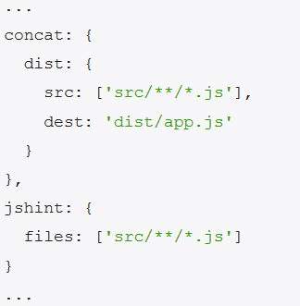
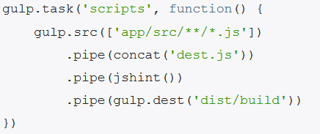
Gulp
Indicates nice performance at all
Mono I/O thread for all nested operations on fs
Grunt Gulp
Notes:
Multithreading out of the box
Can out of the box support different type of tasks in different process

Slide 13
Gear, Brunch
Both work as Gulp thanks to multithreading
Notes:
Strange but the only grunt does not support multithreading

Slide 14
Benchmarks
Standard project of 10 js/css
Gear (300ms)
Gulp (~+30ms)
Brunch (~+80ms)
Grunt (~+30ms)

Slide 15
Documentation

Slide 16
Extensions and extensibility

Slide 17
Allah speaking …
JavaScript had to look like Java only less so, be Java’s dumb kid brother or boy-hostage sidekick.
Plus, I had to be done in ten days or something worse than Javascript would have happened.
I'll do better in the next life.
Brendan Eich (creator of JavaScript)
Notes:
Brendan saved us form vbscript

Slide 18
Coffee in the real life
Open-source, hosted on Github
11th most popular language on Github
How did Coffee get its name?
Coffee was designed to become “Unfancy JavaScript”. Java is a fancy word for coffee, so unfancy JavaScript is CoffeeScript.

Slide 19
Typescript as rival?
Created in October 2012, but still in preview
Open-source, hosted on CodePlex
Not in the top 90 languages on Github
Transcompiles to JavaScript (ES3 and ES6)

Slide 20
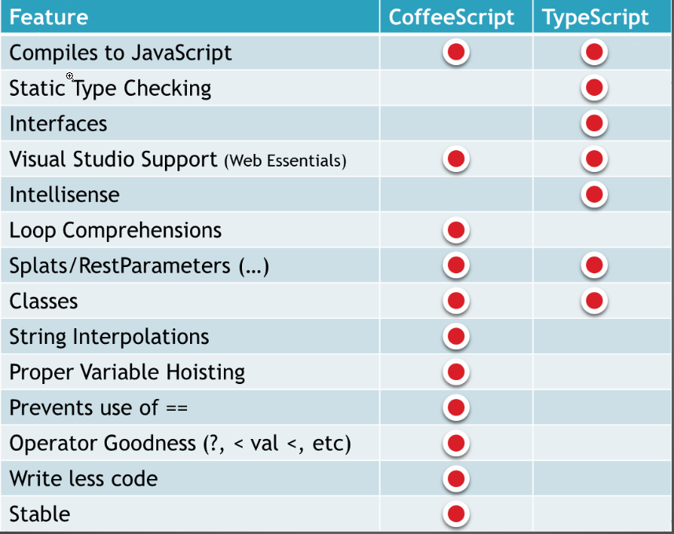

Slide 21
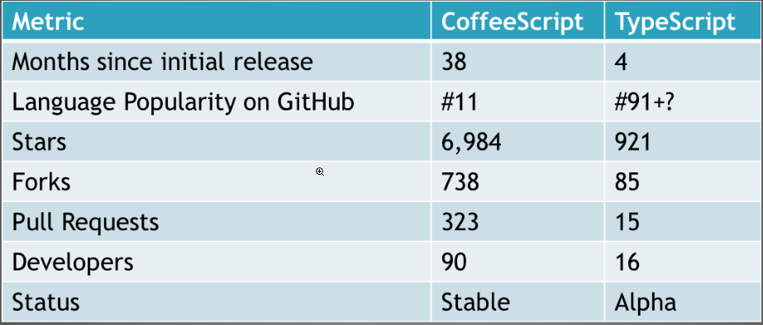

Slide 22
Douglas Crockford
CoffeeScript
One of my favorites along those lines is a new little language called CoffeeScript, which takes the good parts -- not even all of the good parts, but a nice little language -- and comes up with groovy new syntax for it, which is minimal.
It's almost like dandelions: little fluffs of programs that do everything that conventional JavaScript programs do. You can't do anything in that language that you can't do in JavaScript, so it's all cosmetic. I don't know if all or much of that will find its way into JavaScript, because I'm not sure there's enough of a payoff there. But just as an experiment, as a design exercise, I think it's a brilliant piece of work. I'm excited to see stuff like that happening.
TypeScript
Microsoft's TypeScript may be the best of the many JavaScript front ends. It seems to generate the most attractive code. And I think it should take pressure off of the ECMAScript Standard for new features like type declarations and classes. Anders has shown that these can be provided nicely by a preprocessor, so there is no need to change the underlying language. I think that JavaScript's loose typing is one of its best features and that type checking is way overrated. TypeScript adds sweetness, but at a price. It is not a price I am willing to pay.﻿

Slide 23
Brendan Eich
CoffeeScript
It helps to have thinks like CoffeeScript out there it isn’t overriding, it doesn’t tell us what we must to do, but it’s suggestive, and if we want to pave that cow path we can, and I’m in favor.
I advocated strongly for standardising prototypal inheritance à la CoffeeScript’s class, super and @ syntactic sugar.
TypeScript
TypeScript is quite a good piece of work for Visual Studio users, and smartly aligned with ES6.

Slide 24
Questions ?

