Slide 1
JavaScript
Build systems

Slide 2
Node.js and NPM
Node.js is a scalable, server-side oriented platform for networking application and more (console and desktop)
Written in C, C++, JavaScript
Supports V8, JavaScript engine
Contains built-in asynchronous I/O lib for file, socket and HTTP
NPM is an official package manager for Node.js and it’s shipped with node since v0.6.3
Notes:
Client languages (or js transliteration) such as: Dart, ClosureScript (Lisp), Coffeescript, Typescript, Fantom, Kotlin, Scala, F#, etc
In 2009 coffee was made on RoR but since 2010 it’s 100% coffee product and Since RoR 3.1 coffee is defacto client-side language

Slide 3

Most popular build systems

Slide 4
Study criterions
Starting, entering threshold
Performance, nobody wants to wait 2 minutes after a banal file modification
Documentation, more simple and comprehensible wins
Extensions and extensibility, nobody wants to piss a code every time when you leak a common library support

Slide 5
Starting, entering threshold

Slide 6
Grunt
Entering threshold for new projects is low
Extensibility seems to be easy to understand
Entering threshold for existent project is a bit tricky
Grunt is easy to write that read, especially when you have nested dependencies and not trivial building logic
Notes:
- Same for extensibility (plugins)
- Few hours can be enough

Slide 7
Gulp
Same threshold that Grunt for new project
Is as easy for writing as for reading
Good extensibility

Slide 8
Gear
No quick start is possible
Example by code and console, probing action
Lack of documentation and mismatching
Notes:
Yahoo
Declared as easy to use
Installation with –g flag
Browser building WAT???

Slide 9
Brunch
Easy to assimilate introduction video
Reference to documentation and best practice
FAQ seems to cover most common cases
Entire system seems to be completely different to 3 previous
Notes:
Introduction about an application creation

Slide 10
Performance

Slide 11
Grunt
Seems to be slow, no multithreading support
Without supplementary plugins cannot work with modifications caching
Expansive dataflow
Notes:
If we change 1 coffee file of 10K, all this files will be reworked
There’s plugins for cover all this glitches, but it becomes a monkey patch instead of normal usage
Each task uses its own stdin/stdout, so for X sequential task grunt abuse with endless file reading/writing

Slide 12
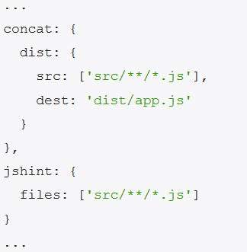
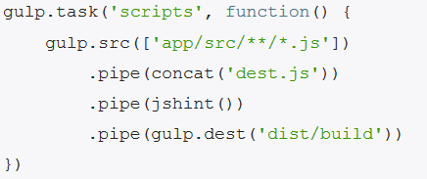
Gulp
Indicates nice performance at all
Mono I/O thread for all nested operations on fs
Grunt Gulp
Notes:
Multithreading out of the box
Can out of the box support different type of tasks in different process

Slide 13
Gear, Brunch
Both work as Gulp thanks to multithreading
Notes:
Strange but the only grunt does not support multithreading

Slide 14
Benchmarks
Standard project of 10 js/css
Gear (300ms)
Gulp (~+30ms)
Brunch (~+80ms)
Grunt (~+30ms)

Slide 15
Documentation

Slide 16
Grunt
Documentation seems to be complete
All you need can be found on the project site
Excellent documentation state (simply and explicitly)
No screencasts

Slide 17
Gulp
Almost the same level that Grunt
Documentation can be found on github
Lack of ready samples to get starting
No straight guidelines to get starting
Can be tricky for build-system beginners

Slide 18
Gear
Not for humans
Just an API collection, you need, you do
Hard to find any information on internet (sharepoint spirit)

Slide 19
Brunch
5 files in git repository with detailed description
1 FAQ
Simple and explicit information
Not a lot of information on external sites

Slide 20
Extensions and extensibility

Slide 21
Plugins
Grunt: 2000+, but a lot of this plugins were never updated after first release
Gulp: 200+, but this amount increase like a shot
Gear: WAT?! What you talking about, dude?
Brunch: 50+, amount increase but a bit slowly

Slide 22
Conclusions

Slide 23
Grunt
No clean idea about project future
Maintainers seem to stop gaps of different nature, instead of fix performance problems
More and more users turn to another build systems
Project starts to wither

Slide 24
Gulp
Like fresh air sip after Grunt
Project goes forward at a steady gait
Project is growing fast

Slide 25
Gear
Seems to be an internal project pulled to the public just because it’s a company spirit
No activity during last 8 months

Slide 26
Brunch
Good and quality project
But it takes its time to grow, strange for this sort of potential
It leaks only the rate of growth

Slide 27

Gulp wins!

Slide 28


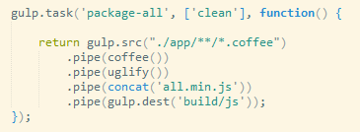
Usage
Top plugins
coffee
less
watch
concat
changed
jasmine
cached

Slide 29
Questions ?

