Slide 1
Coffeescript
A little language

Slide 2
What coffee is
Last 4 years of impetuous web/mobile development were marked by appearance of miscellaneous client-side languages
Initially coffee was made on RoR, but now it’s a pure coffee
Coffee is an attempt to expose the good parts of JS in a simple way
Coffee is just a JavaScript
Notes:
Client languages (or js transliteration) such as: Dart, ClosureScript (Lisp), Coffeescript, Typescript, Fantom, Kotlin, Scala, F#, etc
In 2009 coffee was made on RoR but since 2010 it’s 100% coffee product and Since RoR 3.1 coffee is defacto client-side language

Slide 3
What coffee aims
Simplicity
Compactness
Rapidity
Correctness
Compatibility
Notes:
Programs in coffee are much more simpler that in JS
For the same functionalities coffee code can be 3 times more compact that an equivalent on JS
All coffee programs are as rapid as classic js programs
Coffee hide or smooth over some of sharp corner of javascript
Coffee does not deprecate your old JS code. It works with every JS version

Slide 4
What about JavaScript
Amount of code to solve a given problem
Readability, comprehension and maintainability
Some of WAT and side-effects
High level of misunderstanding of the language

Slide 5
Allah speaking …
JavaScript had to look like Java only less so, be Java’s dumb kid brother or boy-hostage sidekick.
Plus, I had to be done in ten days or something worse than Javascript would have happened.
I'll do better in the next life.
Brendan Eich (creator of JavaScript)
Notes:
Brendan saved us form vbscript

Slide 6
Coffee in the real life
Open-source, hosted on Github
11th most popular language on Github
How did Coffee get its name?
Coffee was designed to become “Unfancy JavaScript”. Java is a fancy word for coffee, so unfancy JavaScript is CoffeeScript.

Slide 7
Typescript as rival?
Created in October 2012, but still in preview
Open-source, hosted on CodePlex
Not in the top 90 languages on Github
Transcompiles to JavaScript (ES3 and ES6)

Slide 8
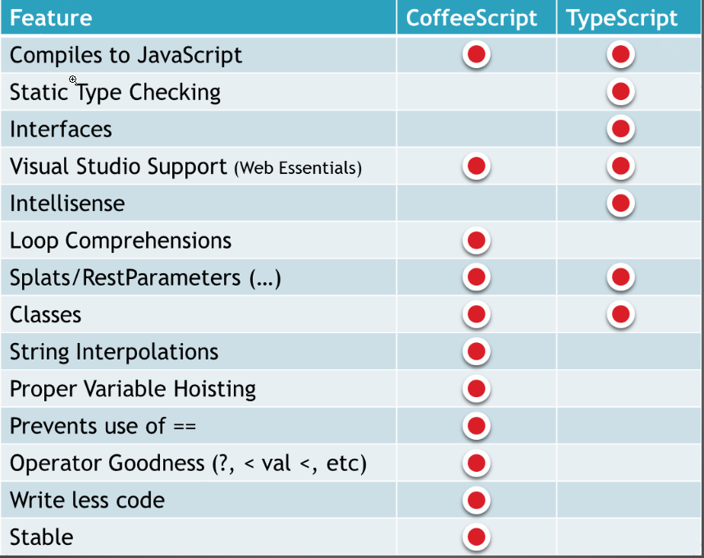

Slide 9
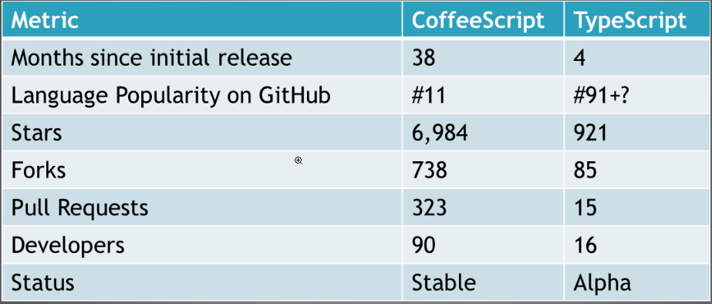

Slide 10
Douglas Crockford
CoffeeScript
One of my favorites along those lines is a new little language called CoffeeScript, which takes the good parts -- not even all of the good parts, but a nice little language -- and comes up with groovy new syntax for it, which is minimal.
It's almost like dandelions: little fluffs of programs that do everything that conventional JavaScript programs do. You can't do anything in that language that you can't do in JavaScript, so it's all cosmetic. I don't know if all or much of that will find its way into JavaScript, because I'm not sure there's enough of a payoff there. But just as an experiment, as a design exercise, I think it's a brilliant piece of work. I'm excited to see stuff like that happening.
TypeScript
Microsoft's TypeScript may be the best of the many JavaScript front ends. It seems to generate the most attractive code. And I think it should take pressure off of the ECMAScript Standard for new features like type declarations and classes. Anders has shown that these can be provided nicely by a preprocessor, so there is no need to change the underlying language. I think that JavaScript's loose typing is one of its best features and that type checking is way overrated. TypeScript adds sweetness, but at a price. It is not a price I am willing to pay.﻿

Slide 11
Brendan Eich
CoffeeScript
It helps to have thinks like CoffeeScript out there it isn’t overriding, it doesn’t tell us what we must to do, but it’s suggestive, and if we want to pave that cow path we can, and I’m in favor.
I advocated strongly for standardising prototypal inheritance à la CoffeeScript’s class, super and @ syntactic sugar.
TypeScript
TypeScript is quite a good piece of work for Visual Studio users, and smartly aligned with ES6.

Slide 12
Questions ?

