Slide 1
Knockout.js
Join power, pass to future

Slide 2
Evolution
MVC (Model-View-Controller)
MVP (Model-View-Presenter)
MVVM (Model-View-ViewModel)

Slide 3
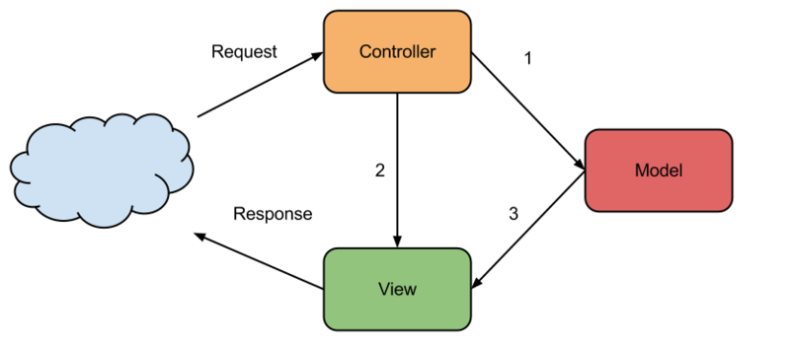
MVC
Lifecycle is well adapted for request/response architecture
After ajax and single-page propagation seems to be limited
Lifecycle increasing means appearance of more and more logic on the controller
No one wants to dispatch a logic between a parts of application

Slide 4

MVP
Presenter means intermediary that represents view state (stateful or stateless)
Presenter could be a javascript object with state fields that interact with view by events (fields are DOM event listeners)
Notes:
Presenter could be a javascript object with state fields that interact with view by events (fields are DOM event listeners)

Slide 5

MVVM
ViewModel represents view state
All communication between View and ViewModel pass by data binding events
ViewModel needs alsow PubSub (observable) infrastructure to support this kind of communication
Notes:
Presenter could be a javascript object with state fields that interact with view by events (fields are DOM event listeners)

Slide 6
What is Knockout.js
Implements MVVM pattern
Uses transparent binding mechanism to offer interaction between DOM elements and ViewModels
Uses HTML5 data attributes to realize intereaction View-ViewModel
Notes:
Presenter could be a javascript object with state fields that interact with view by events (fields are DOM event listeners)

Slide 7
Main concepts
View:
<div id=”customerDetails”
data-bind=”visible: currentCustomer() !== null”>
ViewModel:
var vewModel = { currentCustomer: ko.observable(defaultCustomer) }
Customer details will become visible only if current customer value will be assign to the view model field
Notes:
Presenter could be a javascript object with state fields that interact with view by events (fields are DOM event listeners)

