Slide 1
Programming with F#
First steps

Slide 2
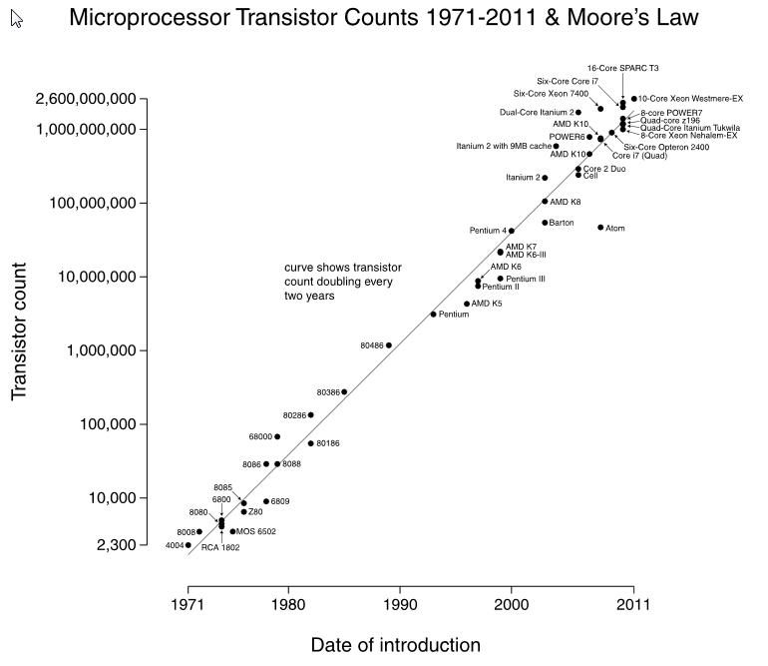
Why an another language
Moore’s law no more working
The number of transistors on integrated circuits doubles approximately every two years
ITRS has growth slowing at the end of 2013, after which time transistor counts and densities are to double only every three years
Notes:
The period often quoted as "18 months" is due to Intel executive David House, who predicted that period for a doubling in chip performance (being a combination of the effect of more transistors and their being faster)
ITRS - International Technology Roadmap for Semiconductors
Landauer's principle

Slide 3
Why an another language
Productivity
“What” rather than “how”, in the goal of understanding what a program does
You almost never have to specify the type of an object, thanks to a powerful type inference system
Compared with C# / VB, it generally takes fewer lines of code to solve the same problem
Immutability avoid a lot of misunderstanding
Notes:
Many people find functional programming more elegant or even beautiful, but that's hardly a good reason to use it in a commercial environment
Logical programming, where we don’t need to produce a complete solution to solve a problem
Imperative (OOP) vs Functional
Internal state can be changed by simple method calling on the target object (new Rectangle().Inflate(10))

Slide 4
Why an another language
Convenience

Slide 5
Why an another language
WTF?

Slide 6
Why an another language
WTF?

