Slide 1
Interpretable Machine Learning Approach to Human Emotion Recognition and Visualization
Presenters: Vahan Babushkin, Binfang Ye

Slide 2
Why do it and Where to use?
basic human experience
decision making
human interaction
performance and

Slide 3
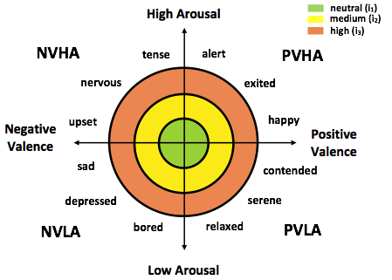
Circumplex model
Valence – estimates the extent of the pleasantness of perceiving the stimulus i.e. positive or negative affectivity.
Arousal – estimates the degree of awakeness induced by the stimulus, i.e. measures how calming or exciting the information is.
Most of the affective computing studies the valence and arousal are assigned high/low levels:
PVHA – positive valence high arousal,
PVLA – positive valence low arousal, NVLA – negative valence low arousal,
NVHA – negative valence high arousal

Slide 4
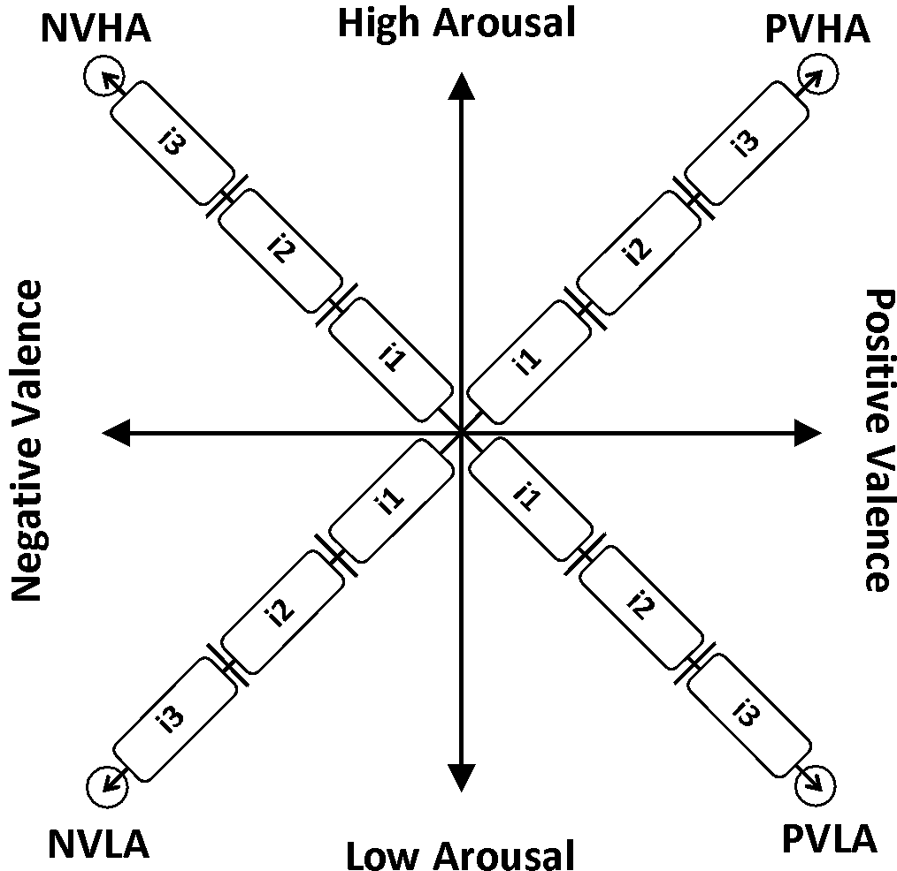
Circumplex model revisited
PVHA – Positive Valence High Arousal,
NVHA – Negative Valence High Arousal,
NVLA – Negative Valence Low Arousal
PVLA – Positive Valence Low Arousal
Emotion Intensity levels:
i1 – low,
i2 – medium,
i3 – high intensity

Slide 5
Data
2671 trials
160 timepoints
59 sensors
80 frequency bins
Labels
4 classes: PVLA, PVHA, NVLA,NVHA,
12 classes: PVHA_0, PVHA_1, PVHA_2, PVLA_0, PVLA_1, PVLA_2, NVHA_0, NVHA_1, NVHA_2, NVLA_0, NVLA_1, NVLA_2

Slide 6
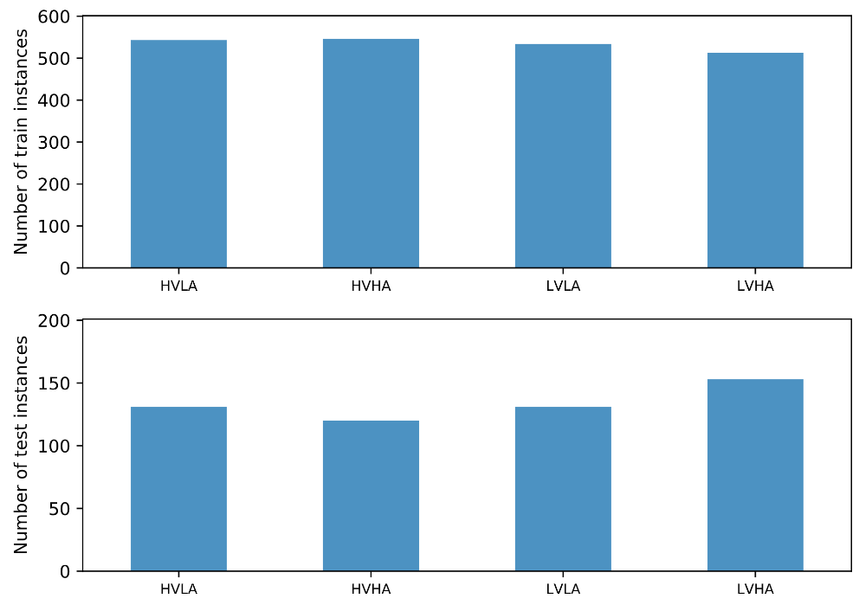
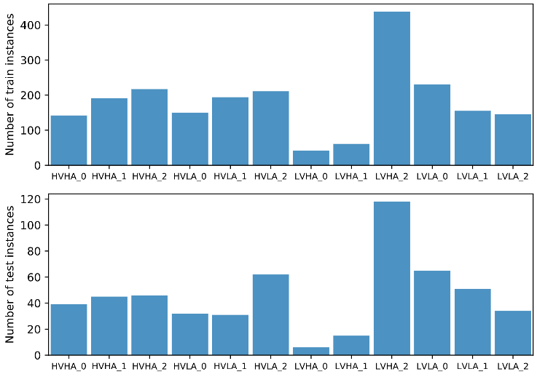
Samples Distribution Across Classes
4 classes
12 classes

Slide 7
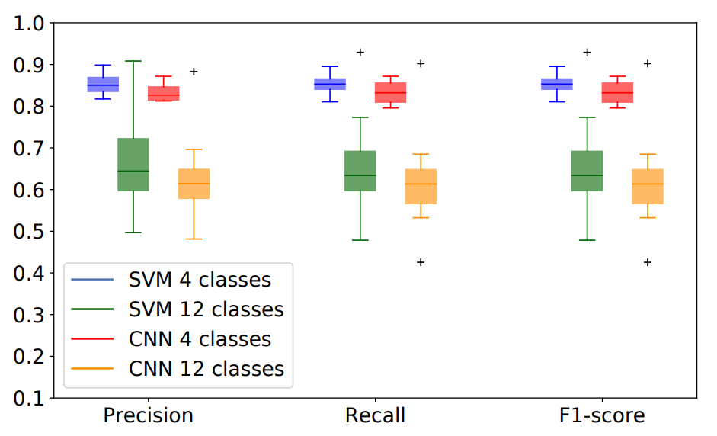
Previous Results

Slide 8
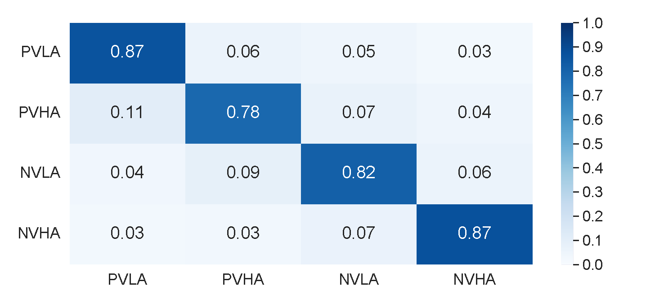

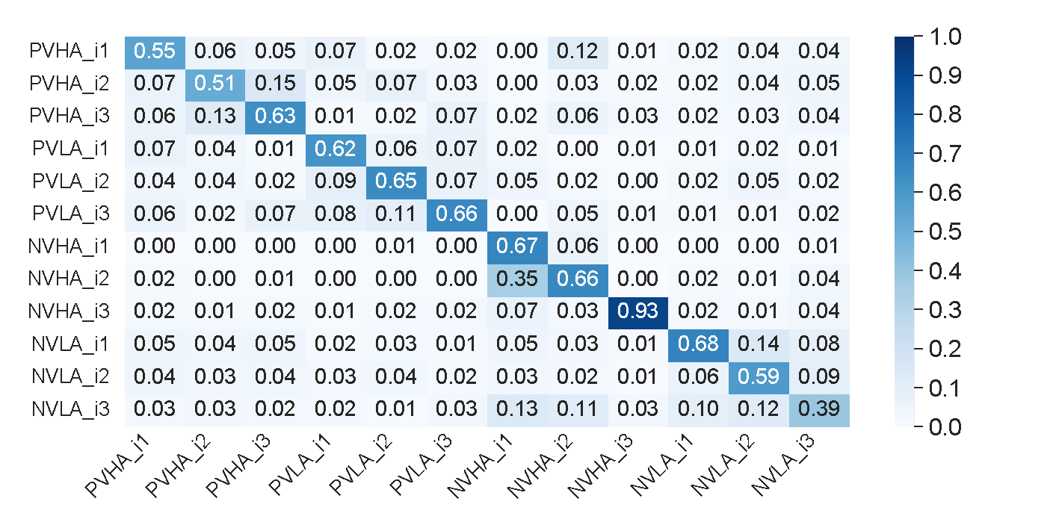
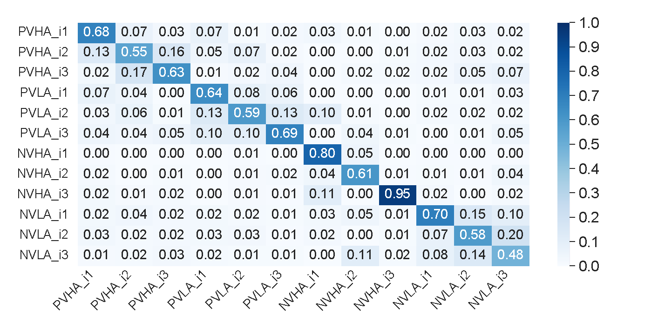
Previous Results
CNN
SVM
4 classes
12 classes

Slide 9
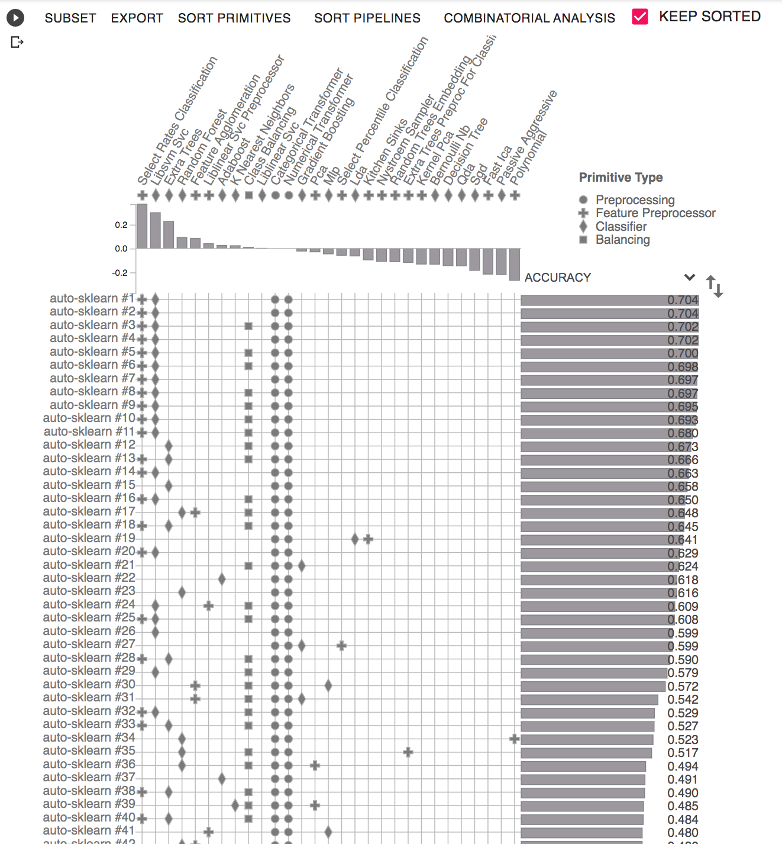
Preliminary results – automl
Python Automl does not allow to process the data with dimensionality > 2
We have averaged the 80×160×59×2671 tensor across the time and three frequency bins, corresponding to beta, lower gamma, and higher gamma bands.
Then the newly-obtained 3×59×2671 trials matrix was flattened to get a vector of length 177 for each trial.
The AutoMl has been performed on the flattened vector.

Slide 10
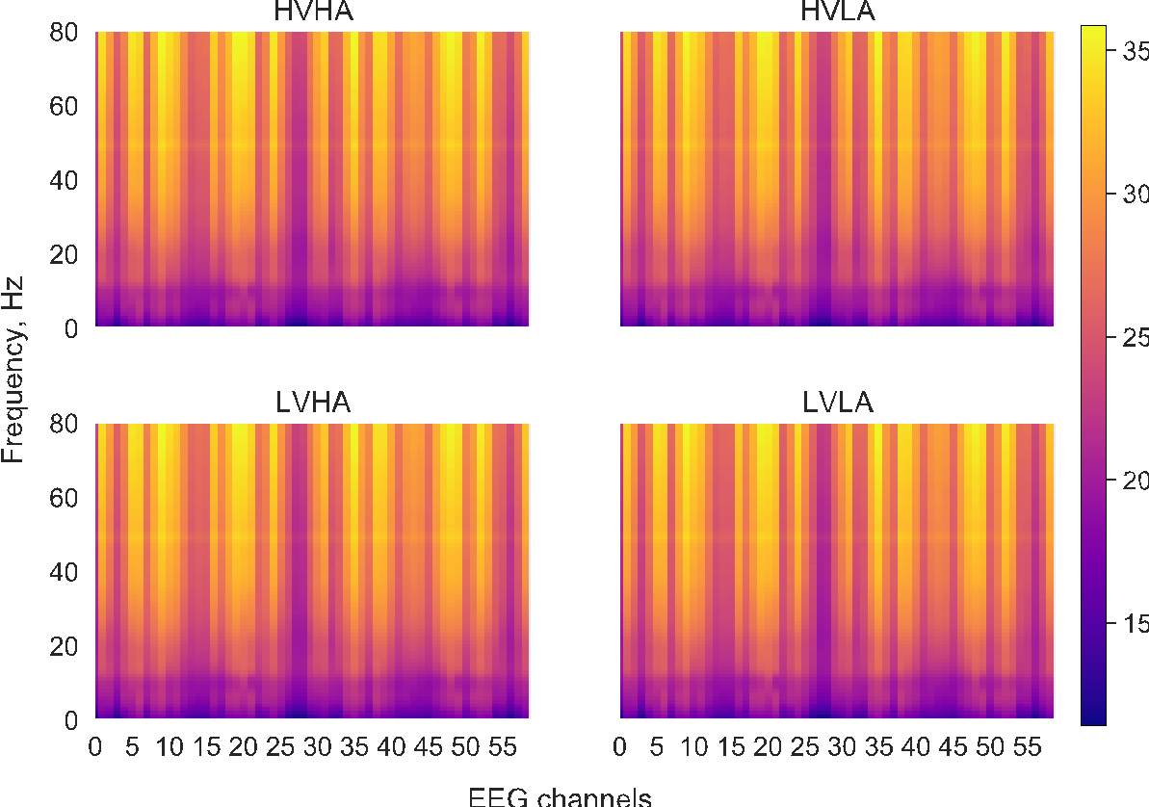
What to visualize?
The data. For example, on the left panel – spectrogram of EEG recordings, averaged over all trials and all timepoints for each of the four classes

Slide 11
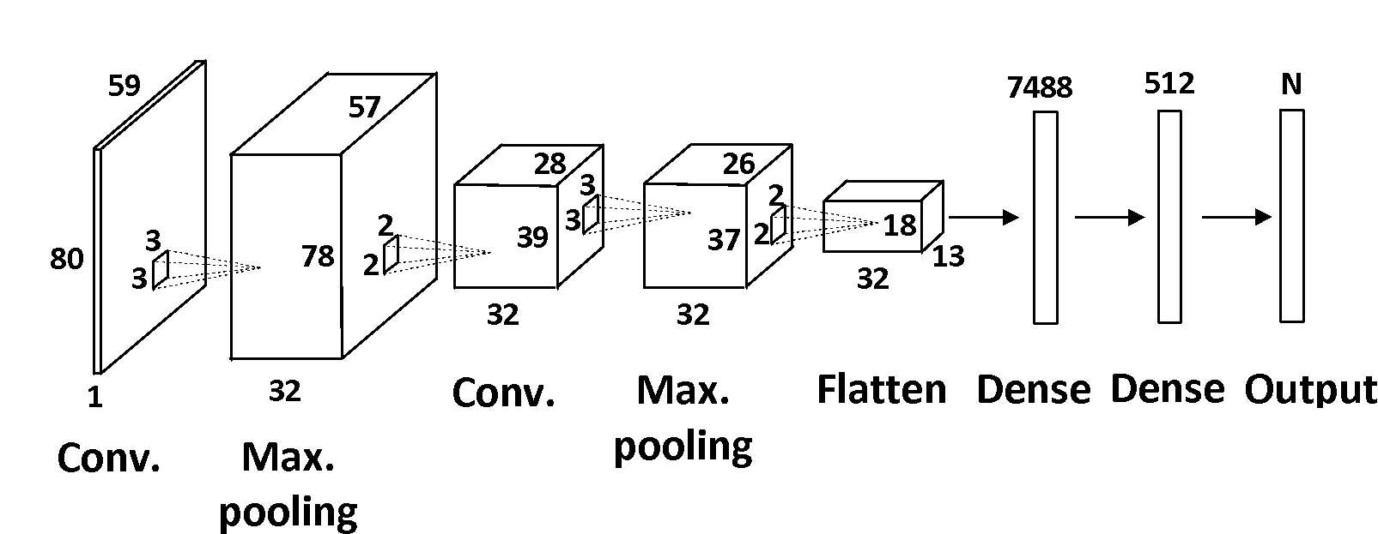
What to visualize?
CNN layers
Feature visualization: saliency map — a simple heatmap that highlights pixels of the input image that most caused the output classification. In or case — which channel-frequency pair caused the output classification.

Slide 12
What to visualize?
Temporal Dynamics in CNN layers
Visualize saliency or feature map for some period of time, e.g. each 10 timepoints
Which time interval is most important for prediction
(our hypothesis – the time-points at the end of the trial when the max. activation is achieved)

Slide 13
One way to visualize the CNN layers
Method: Deconvolutional Network
Idea: Map the feature activities back to the input pixel space
Steps:
Got the trained models
Select one CNN layer and attach the Deconvnet layer
Select one convnet activation and pass the feature maps as input to the attached deconvnet layer.
Unpool
Rectify
Filter

Slide 14
What to visualize?
Data-level visualization:
Visualizing high dimensionality EEG data (t-SNE) to figure out which emotional classes are close together
Visualizing EEG spectrograms (time-frequency, channel-frequency)
Visualizing dependencies/correlations in EEG data (e.g. correlations between 2 channels)
Feature Selection (e.g. Principal Components, Mutual Info, etc.)
Model level visualization:
SVM decision boundaries
CNN Hidden Layers (feature/salience maps)
LSTM activations (if LSTM works for these data)
Visual analysis of parameter space
Visualizing model performance

Slide 15
Which model to use
CNN (for visualization)
SVM (for visualization)
1D – CNN (similar to Human Activity Recognition problem)
RNN/LSTM

Slide 16
Reference
Matthew D. Zeiler and Rob Fergus.Visualizing and Understanding
Convolutional network. In ECCV, 2013.

Slide 17
Thank you

