Slide 1
GEOMETRIC TRANSFORMATIONS
COMPUTER GRAPHICS PROJECT
Vaibhav Bajpai
Computer Science – 5th Semester

Slide 2
Overview
Introduction
Project Description
  Objective
Technologies Used
Screenshots

Slide 3
Introduction
  A transformation in elementary terms is any of a variety of different functions from geometry, such as rotations, reflections and translations. These can be carried out in Euclidean space, particularly in dimensions 2 and 3.
  Transformations:
      Geometric Transformations
      Coordinate Transformations

Slide 4
Introduction
  Geometric Transformations:
    Translation
    Rotation
    Scaling
    Reflection
    Shear

Slide 5
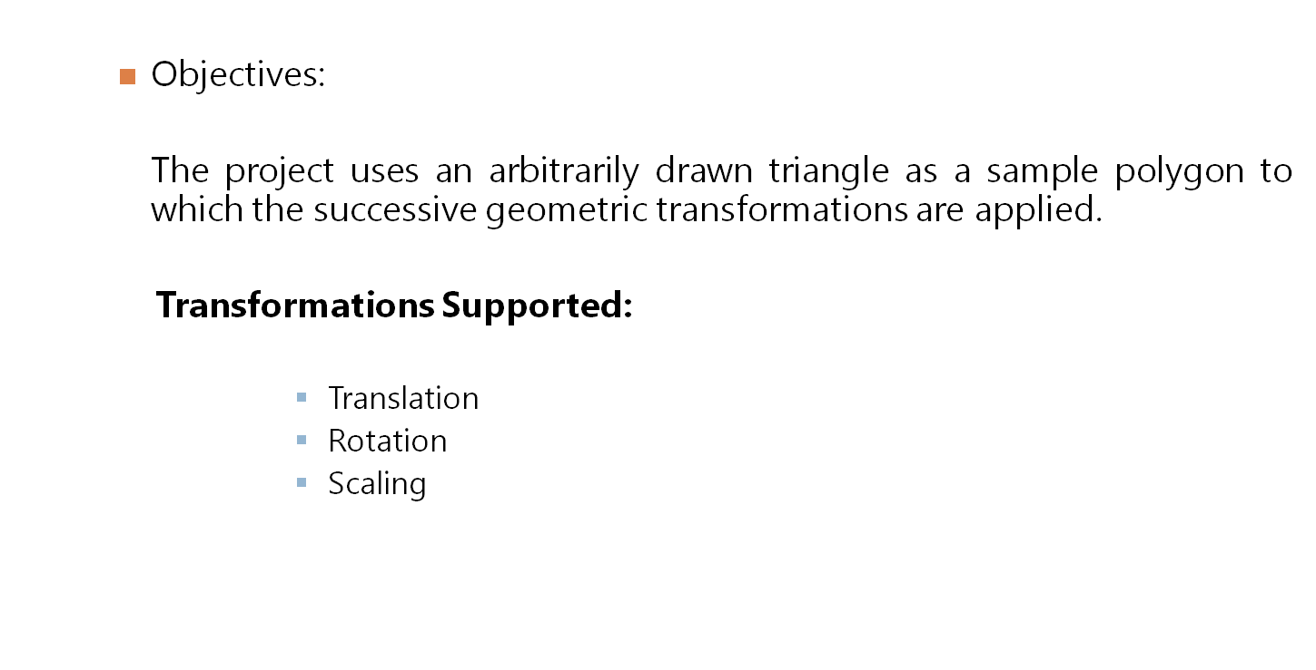
Project Description

Slide 6
Project Description
    Key Features:
      32-bit C++ Compiler
        The project uses GCC instead of 16-bit Turbo C++ compiler extending the address space of the project beyond 16KiB to support high resolution as 800x600 to display polygons and preventing stack overflows in case of flood-fill subroutines that extensively use recursion to fill the areas.
      Cross-Platform Graphic Library
      The project uses SDL(Simple Direct Media Layer) instead of graphic.h to implement low level pixel operations to allow the project to be easily ported across different platforms

Slide 7
Technologies Used
Language: C++
        Compiler: GCC(g++)
Graphic Library: SDL(Simple Direct Media Layer)
Supported O/S: Linux, Windows, OSX

Slide 8
Simple Direct Media Layer
Simple DirectMedia Layer is a cross-platform multimedia library designed to provide low level access to audio, keyboard, mouse, joystick, 3D hardware via OpenGL, and 2D video frame buffer.
SDL supports Linux, Windows, Windows CE, BeOS, MacOS, Mac OS X, FreeBSD, NetBSD, OpenBSD, BSD/OS, Solaris, IRIX, and QNX.
SDL is written in C, but works with C++ natively . SDL is distributed under GNU LGPL version 2.

Slide 9
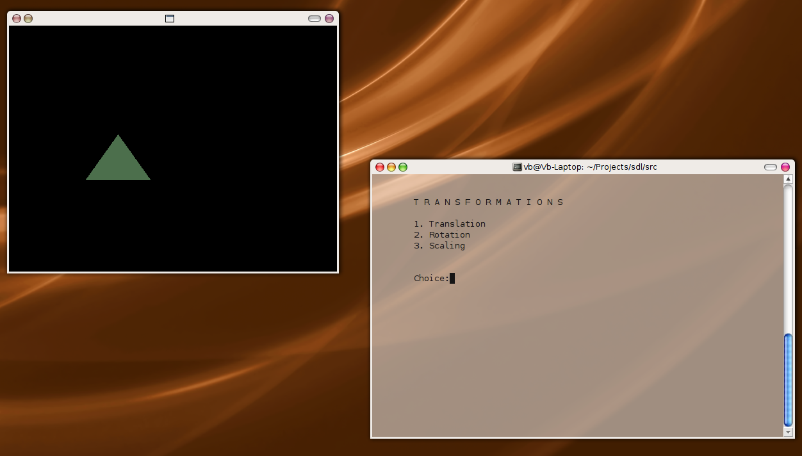
Screenshots

Slide 10
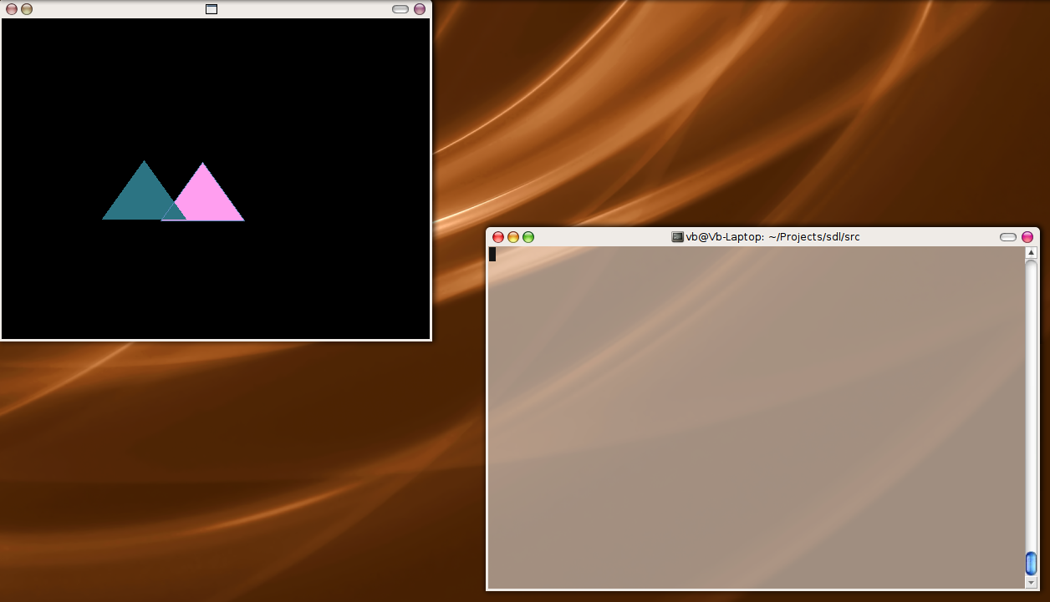
Screenshots

Slide 11
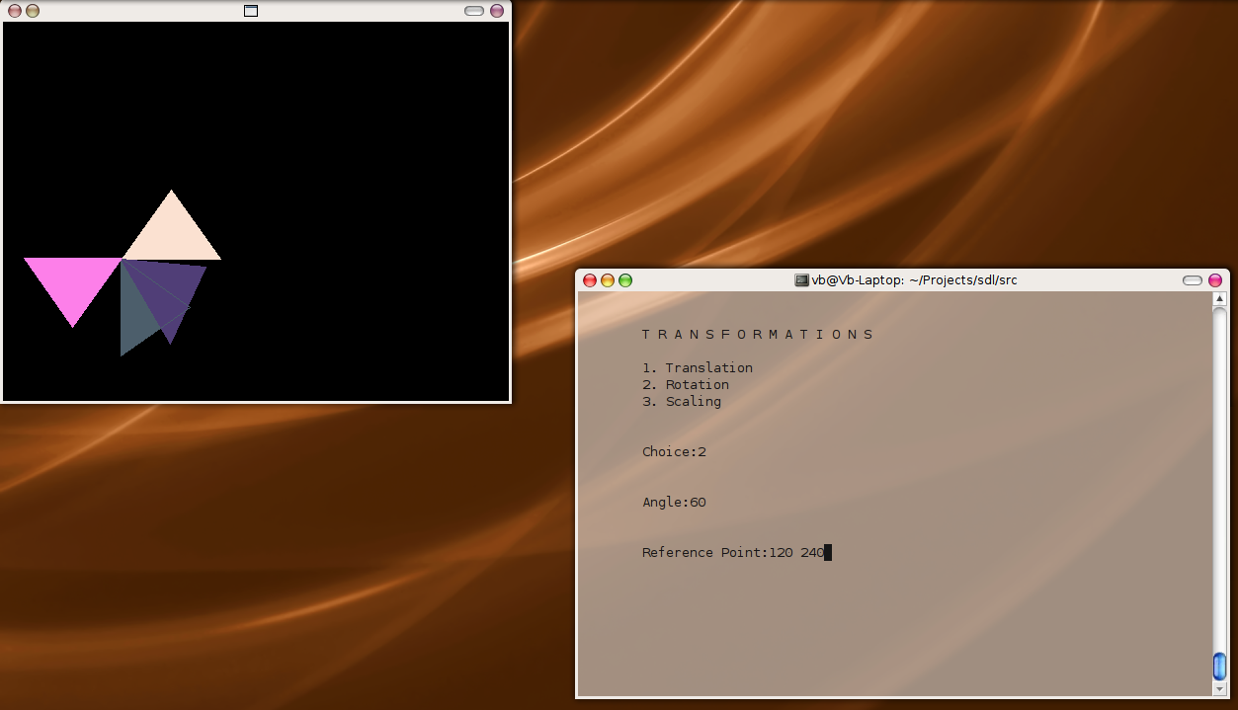
Screenshots

