Slide 1
DEXTER
making search Web 2.0 ready!

Slide 2
OBJECTIVE
To blend social networking into the Google search engine & encapsulate it into a Web2.0 browsing environment.

Slide 3
GOALS
The search results should be ordered in a way that they give preference to readers opinion .
The user should be able to separately 'submit' a url to the Dexter database.
Any url ever 'voted up' or submitted should be logged in for future reference by the user.
User should be able to choose one of the two interfaces as default home ('Surf' /'Search').
The privacy of the user proﬁle should be maintained.
Mechanism should exist to weed out 'spam' and 'inappropriate' url and comment.
The search interface should be as simplistic as the google search engine homepage.

Slide 4
BENEFITS
Dexter implements the social search paradigm where relevance of search results is determined by considering the interactions or contributions of users.
Dexter would enable users to vote the search results and comment on them.
Dexter would also include another interface “Dexter Surf”.
Reduces impact of link spam .
Increased relevance because each result has been selected by users
It would display results that are more current or in context with changing information
Dexter would allow bookmarking of url.
Dexter would allow social networking and increase collabaration

Slide 5
FUNCTIONS
The user should be able to search without being logged in, though should not be allowed to vote or comment.
The user should be able to separately submit a url to the Dexter database.
The user should be able to bookmark the voted results, and be able to tag them.
User should be able to choose one of the two interfaces as default home ('Surf' / 'Classic‘).
User should be able to add dexter friends from google contacts.

Slide 6
OPERATING ENVIRONMENT
Client-Side Requirements
    Hardware Platform – capability of a machine being able to connect to the internet or the LAN in which the web application is deployed to.
    Operating System –all Operating Systems that have an inbuilt network stack incorporated into the kernel.
    Software Platform –
Browser – IE 6+, Firefox 2+, Safari, Opera, Chrome

Slide 7
Server-Side Requirements
  Hardware Platform-
    Atleast 256 MB RAM
    10 GB HDD space
  Operating System –
    32-bit Linux/Windows Operating System
    2 GB Page File/Swap
  Software Platforms –
    Java SE 6
    Java EE 5 compatible Application Server (Glass ﬁsh)‏
    Apache Web Server
    Struts and Hibernate libraries

Slide 8
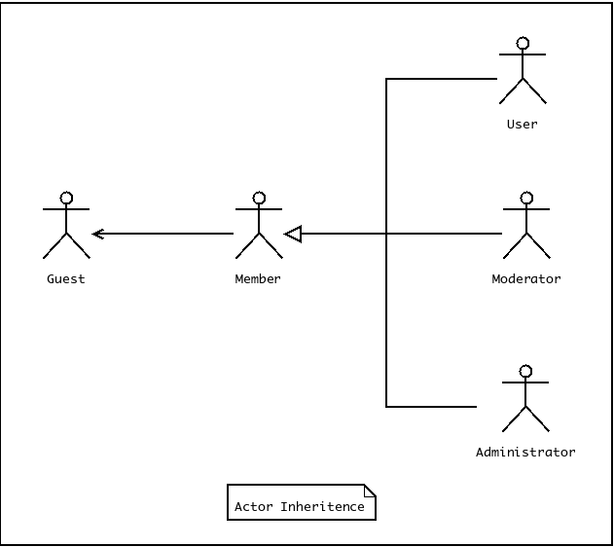
SYSTEM FEATURES

Slide 9
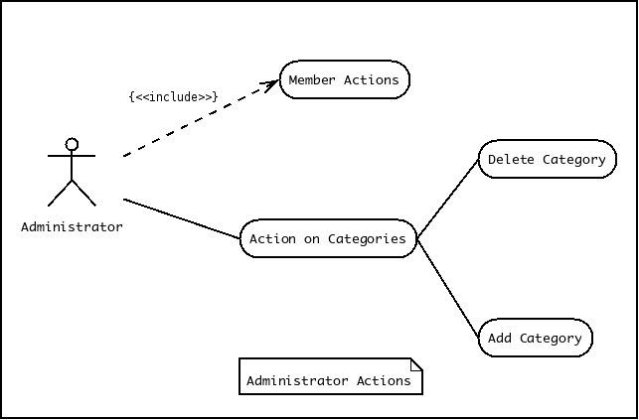
ADMINISTRATOR ACTIONS

Slide 10
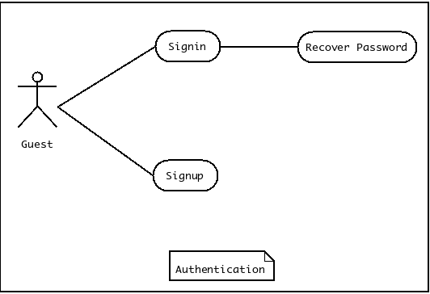
AUTHENTICATION

Slide 11
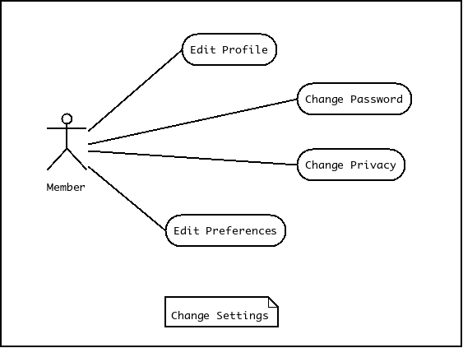
CHANGE SETTINGS

Slide 12
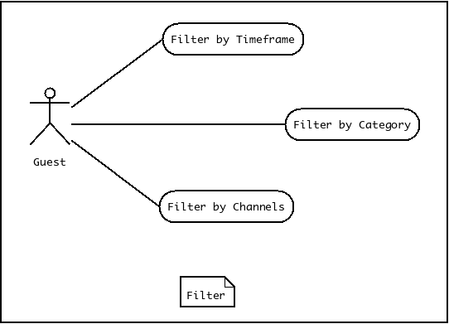
FILTER

Slide 13
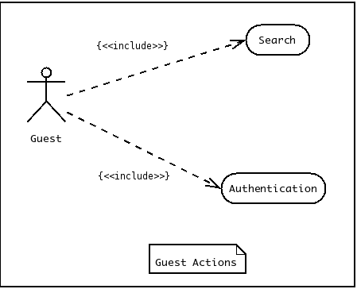
GUEST ACTIONS

Slide 14
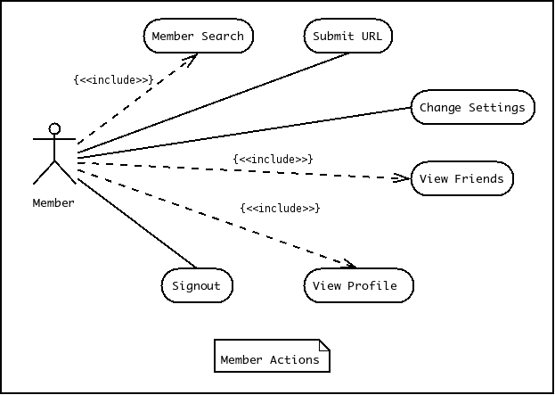
MEMBER ACTIONS

Slide 15
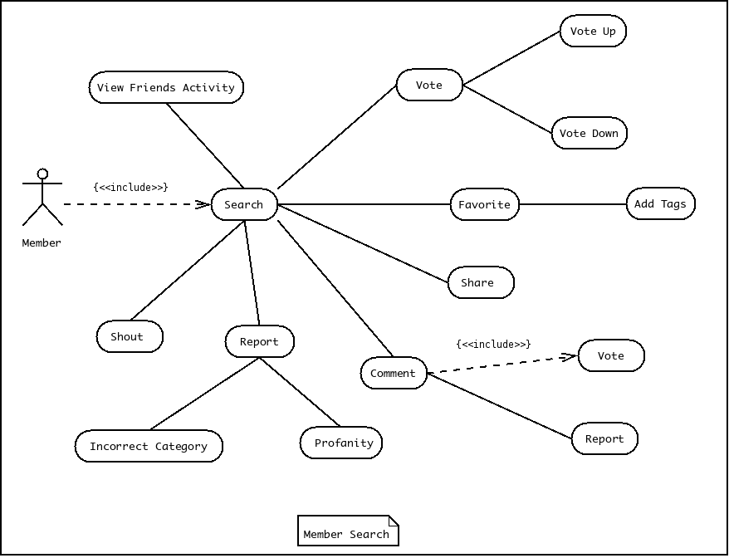
MEMBER SEARCH

Slide 16
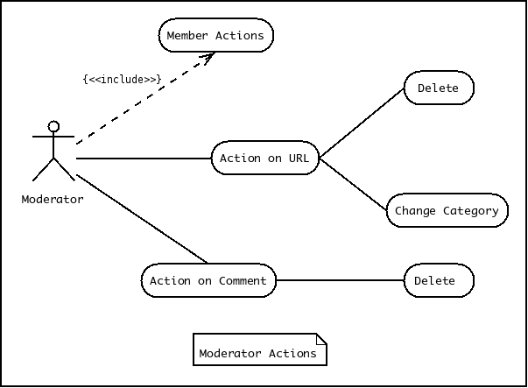
MODERATOR ACTIONS

Slide 17
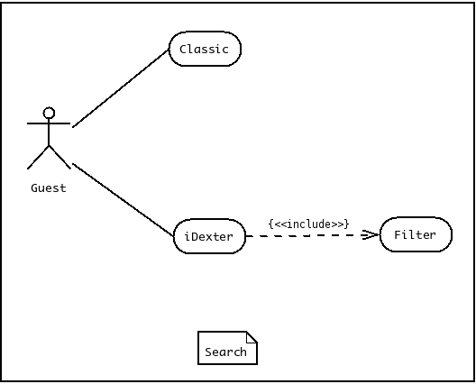
SEARCH

Slide 18
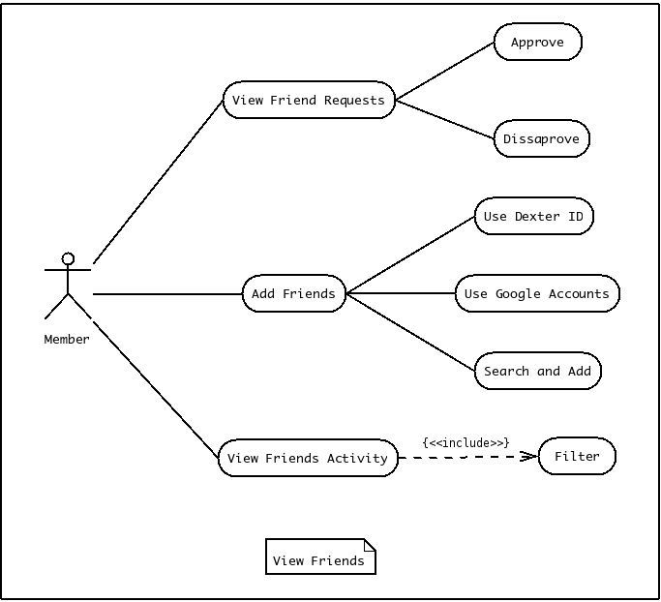
VIEW FRIENDS

Slide 19
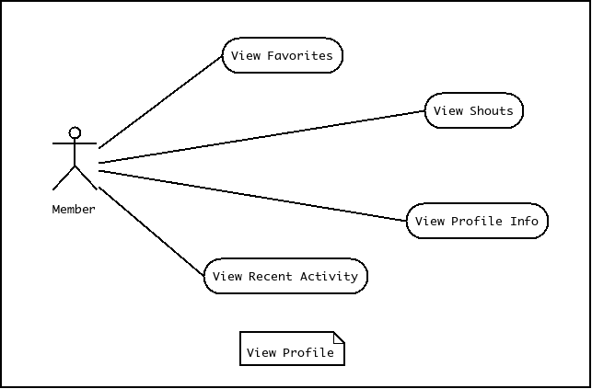
VIEW PROFILE

Slide 20
SOFTWARE QUALITY ATTRIBUTES
ADAPTABILITY
It would automatically adapt to the changing order of search results which have not yet been submitted.
FLEXIBILITY
The search results are ﬂexible as they are user ordered.
MAINTAINABILITY
Moderators/Administrators have the work to maintain the content in the Dexter database.
REUSABILITY
Dexter being open-source could be used by other projects who would wish to add to its functionality.
USABILITY
Its even usable in cases when user does not know what to search for and can use the iDexter interface to get started.

